Slide 1
Academic Communication Spring Semester 2023
Each person: Please take
two handouts from the front desk
(Syllabus, “Typical Conference”)
plus one small card.
Do not write on these yet.
Website: http://staff.ustc.edu.cn/~acadcom

Slide 2
Course Website
http://staff.ustc.edu.cn/~acadcom
USTC says, “This website will soon stop working”
But it is so convenient, I’ll keep using it as long as we can!
If/when it disappears, I’ll set up a substitute information source.

Slide 3
Purpose
This course is designed to help students develop the oral English skills necessary to present research papers using English at an international conference.

Slide 4
Teacher
Murray Sherk
Use msherk@ustc.edu.cn for questions.
Office hours by appointment – arrange a time by email or after any class.

Slide 5
Textbook
No textbook. We will use handouts.
Note: Each handout is yours to keep, but you should save all handouts since some are used more than once.
A handout you get one week may be used again weeks later.
Lose one? Get electronic copy from the course website.

Slide 6
Teaching Methods
Course focus = Presentation Skills
organization
delivery
visual aids
...
so students learn how to present a scientific paper in English using a typical international style

Slide 7
Class Policies
6 sections (=groups of students) of this course:
Attend the one you are registered for! (except to make up for a missed class)
Attendance is required.
Students who miss more than two lessons (4 classroom hours) will not be allowed to take the final exam.
Being late 1-10 minutes counts as missing half a lesson
Being late >10 minutes counts as an absence

Slide 8
Attendance Card
Each student needs an attendance card.
Bring a picture to glue onto the card.
Have a photo now? Glue it on.
No photo today? Bring one next week.
Hand in the card before you leave today (even if you do not have a photo on it yet)

Slide 9
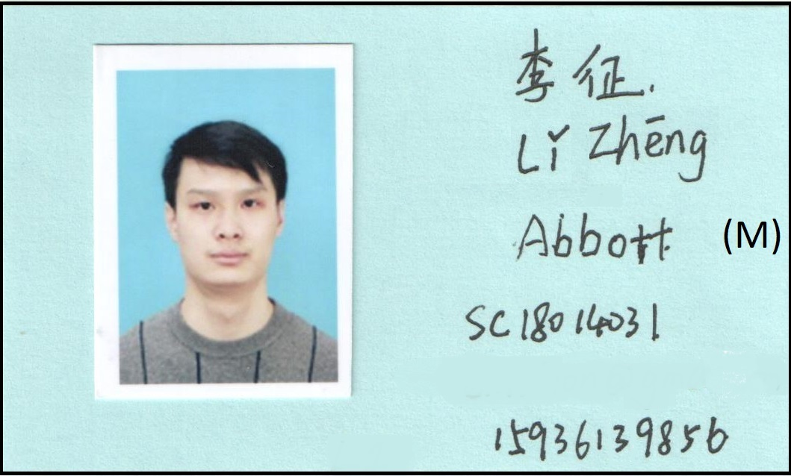
Front
Name in Hanzi.
Pinyin with tone marks.
English name: (leave blank for me to choose a name).
(M)ale or (F)emale.
USTC Student number.
Phone# for vital newsflash.
Your major (what you’re studying): Your hometown (where you grew up): Fill in the blank with a few words about yourself: “A very interesting thing about me is __________________________ ___________________________.”
Back

Slide 10
Attendance Card
Each student needs an attendance card.
Bring a picture to glue onto the card.
Have a photo now? Glue it on.
No photo today? Bring one next week.
Hand in the card before you leave today (even if you do not have a photo on it yet)

Slide 11
Class Policies (continued)
International conference standards of behavior will be expected in class.
In particular,
students should be on time for classes
(just as they should be for international conference sessions)
phones should be silent during class time (You are welcome to use them as dictionaries, but do not text/phone during class)

Slide 12
Class Policies (continued)
Students are expected to cooperate willingly
Your learning experience will be more productive if you use only English while in the classroom

Slide 13
Evaluation
End of the term: simulated conference
Each student will present a paper in their research area (9 minutes) and then answer questions from the audience (2-3 minutes).
Your presentation counts for 100% of your term grade.
90% for your actual presentation that day
10% for preparing a transcript properly

Slide 14
Course Schedule
9 Classroom Lessons:
Start: Week of March 6, 2023.
See http://staff.ustc.edu.cn/~acadcom
Simulated Conference (Oral Exams)
the 6-week period after classroom lessons end
6 students per session
You’ll be a speaker in ONE exam session
You are an audience member for the other talks in your session (e.g., ask questions)
Most sessions at same time/place as your class lessons, but some may be at other times.

Slide 15
Which paper will you present?
See back of Syllabus handout.
Bring to the third class of this semester a photocopy or print-out of the paper you want to present for your final exam.
Yours or somebody else’s: both OK.
Published or unpublished: both OK.
In Chinese or English: both OK but I need to see an English abstract.
Choose wisely!

Slide 16
Which paper? Rules
The result/paper should be new in 2017 or more recently. Aim for 2020 or newer.
The paper must be about a specific research result that…
is in your research area
was never published before this paper
It must not be a general summary/overview of progress in an area.
It must not be a simple introduction to an area or previously-known technique.

Slide 17
Which paper? Rules
Since you have only 9 minutes to present the result, do not choose a result that is extremely complicated or long.
You may choose to present only one result of a paper that has several.
Note: You may change your mind later!
(But good choice ➔ your class work applies directly to your final exam presentation.)

Slide 18
Danger Signs
If the title of the paper contains any words like the following, then it is a BAD paper and you should choose a different one!
“Summary of…”,
“Recent Progress in…”
“Overview of…”
“Introduction to…”
“Review of…”
If every scientific result in the paper has already been published somewhere else, then it is a BAD paper for this course.

Slide 19
Something that is NOT on our syllabus sheet…
People who are taking the USTC “Daily Communication” (DC) course or who have taken AC or DC course might tell you about something called “EPC”.

Slide 20
NOTE: No EPC!!!!!!!!!
Our AC course does NOT include EPC sessions.
Some students in the DC course still do EPC, but AC has changed.
If a friend says that you need to do EPC, ignore that out-of-date info.
AC students do NOT
do EPC classes.

Slide 21
20 + 20(?) = 40
This course is scheduled to have 40 classroom hours.
Part 1:
We have 9 two-hour classroom lessons.
You will have 1 two-hour exam session.
(9 * 2) + 2 = 20
The other hours?
“Part 2: Self-paced Work”

Slide 22
20 + 20(?) = 40
Part 1: 20 hours in the classroom
“Part 2: Self-paced Work”
Ms. 陈澄 will email information to the student address you put in the teaching platform (研究生信息平台).
Check the website and look for information that should arrive between March 6 and March 13.
Contact Ms. Chen at echocc@ustc.edu.cn if you do not receive text messages or email.

Slide 23
Goals of This Course
Good speakers will get better
Everybody can learn a bit more
Bad speakers will get “good enough” (for a conference)
Pay attention to the techniques taught
They do work!!!

Slide 24
Goals of This Course
You will know what to aim for
What are you trying to do?
Clear goals
Professional attitude
You will know what mistakes to avoid
Common mistakes ruin good talks

Slide 25
Types of Scientific Presentations
We’ll consider four:
Conference Presentation
Colloquium
Seminar
Your Exam

Slide 26
 | Seminar | Colloquium | Conference Presentation | Your Exam!
Length | 60 minutes | 60 minutes
Audience
Purpose

Slide 27
 | Seminar | Colloquium | Conference Presentation | Your Exam!
Length | 60 minutes | 60 minutes
Audience | 10-20 Experts in your area | 50-150 Experts in your field; most not in your area
Purpose

Slide 28
 | Seminar | Colloquium | Conference Presentation | Your Exam!
Length | 60 minutes | 60 minutes
Audience | 10-20 Experts in your area | 50-150 Experts in your field; most not in your area
Purpose | Explain details of your result

Slide 29
 | Seminar | Colloquium | Conference Presentation | Your Exam!
Length | 60 minutes | 60 minutes
Audience | 10-20 Experts in your area | 50-150 Experts in your field; most not in your area
Purpose | Explain details of your result | Explain recent progress in your area

Slide 30
Conference Presentation
20 minutes
Audience:
100-600
(A) experts in some area “close” to your area (how close depends on how narrow the conference is)
(B) some experts in your particular area (perhaps world-famous experts!)

Slide 31
Conference Presentation
20 minutes
Audience: 100-600 experts in some area (A) “close” to yours or (B) exactly yours.
Purposes:
For (A): Give enough information so experts in other areas know basically what the result is and why they might want to read the paper.
For (B): Summarize key points of your new result so experts in your area understand it. “Give away the good stuff.”

Slide 32
 | Seminar | Colloquium | Conference Presentation | Your Exam!
Length | 60 minutes | 60 minutes | 20 minutes
Audience | 10-20 Experts in your area | 50-150 Experts in your field; most not in your area | 100-600 Experts in an area (A) close to yours, or (B) exactly yours
Purpose | Explain details of your result | Explain recent progress in your area | (A) Basic info: WHAT [the result is] and WHY [it is worthwhile] (B): Summarize key points so experts can fill in the blanks

Slide 33
Your Final Exam
Length:
9 minutes [+3 for question & answer]
Audience:
5-6 grad students + teacher
experts in some research area but probably not yours
Purpose:
Convince your teacher that you can present a research result well in English at an international conference

Slide 34
 | Seminar | Colloquium | Conference Presentation | Your Exam!
Length | 60 minutes | 60 minutes | 20 minutes | 9 minutes
Audience | 10-20 Experts in your area | 50-150 Experts in your field; most not in your area | 100-600 Experts in an area (A) close to yours, or (B) exactly yours | 5 + 1 Treat like conference audience
Purpose | Explain details of your result | Explain recent progress in your area | (A) Basic info: WHAT [the result is] and WHY [it is worthwhile] (B): Summarize key points so experts can fill in the blanks | Convince teacher that you can present research well in English (=PASS!)
Do this to do this

Slide 35
Preparation for a Conference
One student looks at Version A;
the other at Version B (other side of sheet)
Do not look at your partner’s side of the sheet!
By reading out loud and/or asking questions, fill in the blanks on your sheet.
Best way: Ask intelligent questions like
“The call for papers goes out how many months before the conference?”

Slide 36
Homework
Think about what makes a presentation good, and what makes one bad.
If you did not have a photo of yourself today, bring a small picture of yourself to next class for your attendance card.
A printed-out selfie is fine.
GIVE YOUR CARD BACK TO ME NOW
even if it does not have a photo yet.

