Slide 1
Eight Great Ideas in Computer Architecture
These are eight great ideas that computer architects have invented in the last 60 years of computer design. They are so powerful they have lasted long after the first computer that used them, with newer architects demonstrating their admiration by imitating their predecessors -- Patterson
https://www.elsevier.com/connect/8-great-ideas-in-computer-architecture

Slide 2
Eight Great ideas in Computer Architecture
Design for Moore’s Law
Abstraction to Simplify Design
Make the Common Case Fast
Dependability via Redundancy
Memory Hierarchy
Performance via Parallelism
Performance via Pipelining
Performance via Prediction

Slide 3
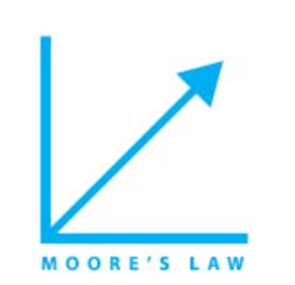
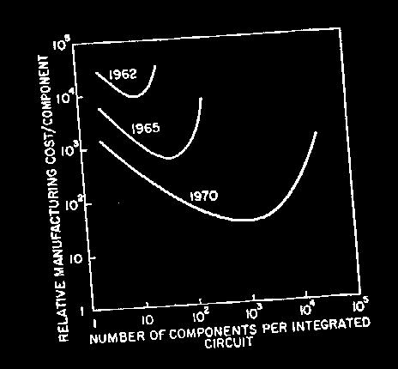
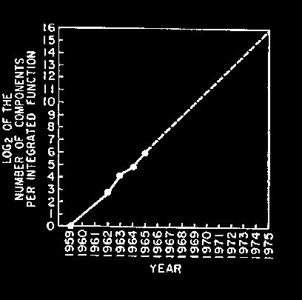
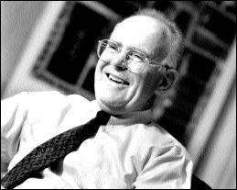
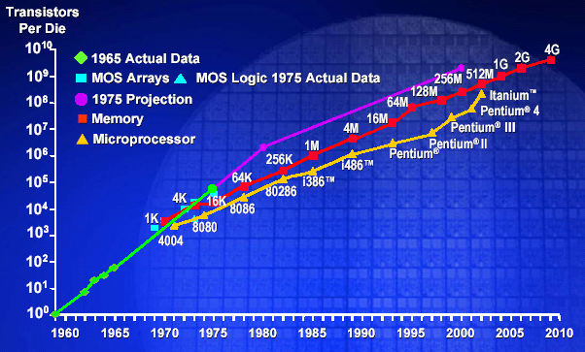
1. Moore’s Law（摩尔定律）
Who is Moore?
1．集成电路芯片上所集成的电路的数目，每隔18个月就翻一番。
2．微处理器的性能每隔18个月提高一倍，或价格下降一半。
3．用一个美元所能买到的电脑性能，每隔18个月翻两番。
“Cramming More Components onto Integrated Circuits”
  Gordon Moore, Electronics, 1965
# on transistors on cost-effective integrated circuit double every 18 months
3
Notes:
http://baike.baidu.com/view/17904.htm?fromId=968563
1．集成电路芯片上所集成的电路的数目，每隔18个月就翻一番。
2．微处理器的性能每隔18个月提高一倍，或价格下降一半。
3．用一个美元所能买到的电脑性能，每隔18个月翻两番。
Co-founder of Intel

Slide 4
1. Design for Moore’s Law
The one constant for computer designers is rapid change, which is driven largely by Moore's Law. It states that integrated circuit resources double every 18–24 months. Moore's Law resulted from a 1965 prediction of such growth in IC capacity made by Gordon Moore, one of the founders of Intel. As computer designs can take years, the resources available per chip can easily double or quadruple between the start and finish of the project. Like a skeet shooter, computer architects must anticipate where the technology will be when the design finishes rather than design for where it starts.
Notes:
03/04-Lecture 1

Slide 5

2. Abstraction via Layers of Representation
temp = v[k];
v[k] = v[k+1];
v[k+1] = temp;
High Level Language
Program (e.g., C)
Compiler
lw $t0, 0($2)
lw $t1, 4($2)
sw $t1, 0($2)
sw $t0, 4($2)
Assembly Language Program (e.g., MIPS)
Assembler
0000 1001 1100 0110 1010 1111 0101 1000
1010 1111 0101 1000 0000 1001 1100 0110
1100 0110 1010 1111 0101 1000 0000 1001
0101 1000 0000 1001 1100 0110 1010 1111
Machine Language Program (MIPS)
Machine Interpretation
Abstraction uses multiple levels with each level hiding the details of levels below it. For example:
The instruction set of a processor hides the details of the activities involved in executing an instruction.
High-level languages hide the details of the sequence of instructions needed to accomplish a task.
Operating systems hide the details involved in handling input and output devices.
Hardware Architecture Description
(e.g., block diagrams)
Architecture Implementation
Logic Circuit Description
(Circuit Schematic Diagrams)

Slide 6
2. Use Abstraction to Simplify Design
Both computer architects and programmers had to invent techniques to make themselves more productive, for otherwise design time would lengthen as dramatically as resources grew by Moore's Law. A major productivity technique for hardware and software is to use abstractions to represent the design at different levels of representation; lower-level details are hidden to offer a simpler model at higher levels. We'll use the abstract painting icon to represent this second great idea.
GIVE ME AN EXAMPLE?
Notes:
03/04-Lecture 1

Slide 7

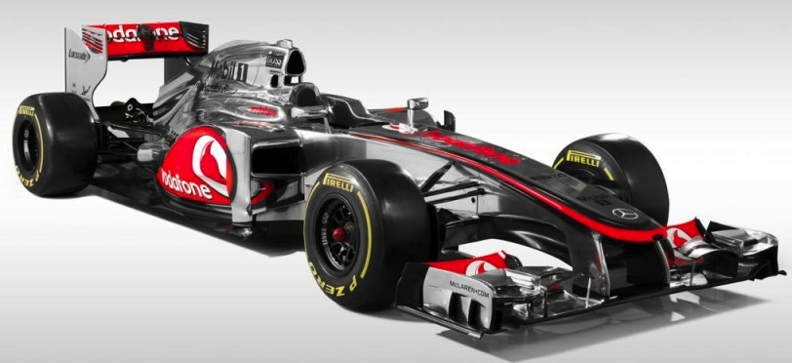
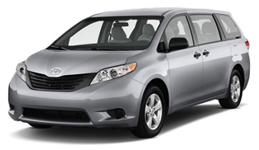
3. Make the Common Case Fast
在进行设计选择时，注重优化经常发生的事件
优化不经常执行的代码意义不大
选择一种（性能）度量方式来确定经常性事件（Common case)
你的任务是把人以最快速度从A点送到B点，绝大多数情况下只有一个人。你选哪辆车？
在设计ISA时该如何利用这个idea?
如何知道哪个指令最常运行？
Notes:
Capability computing vs. capacity computing

Slide 8

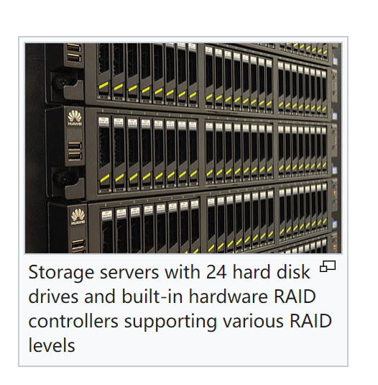
4. Dependability via Redundancy
通过冗余使得部分部件失效不影响整个系统的运行
假设你的预算为T， 是买一台单价为T的大容量磁盘，还是买100台单价为T/100的廉价磁盘？
One of the most important ideas in data storage is the Redundant Array of Inexpensive Disks (RAID) concept. In most versions of RAID, data is stored redundantly on multiple disks. The redundancy insures that if one disk fails the data can be recovered from other disks.

Slide 9

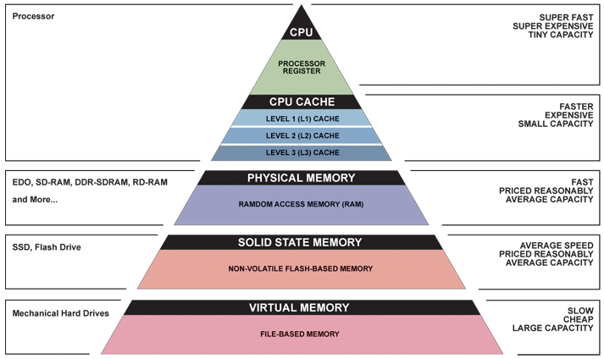
5. Memory Hierarchy
Fast, Expensive,
but Small
Why Does Cache Work?
Cheap,
Large,
but Slow

Slide 10

6. Performance Through Parallelism
Doing different parts of a task in parallel accomplishes the task in less time than doing them sequentially. A processor engages in several activities in the execution of an instruction. It runs faster if it can do these activities in parallel.
Parallel Requests
  Assigned to computer, e.g., Search “Katz”
Parallel Threads,
  Assigned to core, e.g., Lookup, Ads
Parallel Instructions
  >1 instruction @ one time e.g., 5 pipelined instructions
Parallel Data
  >1 data item @ one time, GPU is SIMD (Single Instruction Multiple Word)
Hardware Descriptions
  All gates functioning in parallel at same time
Notes:
03/04-Lecture 1

Slide 11

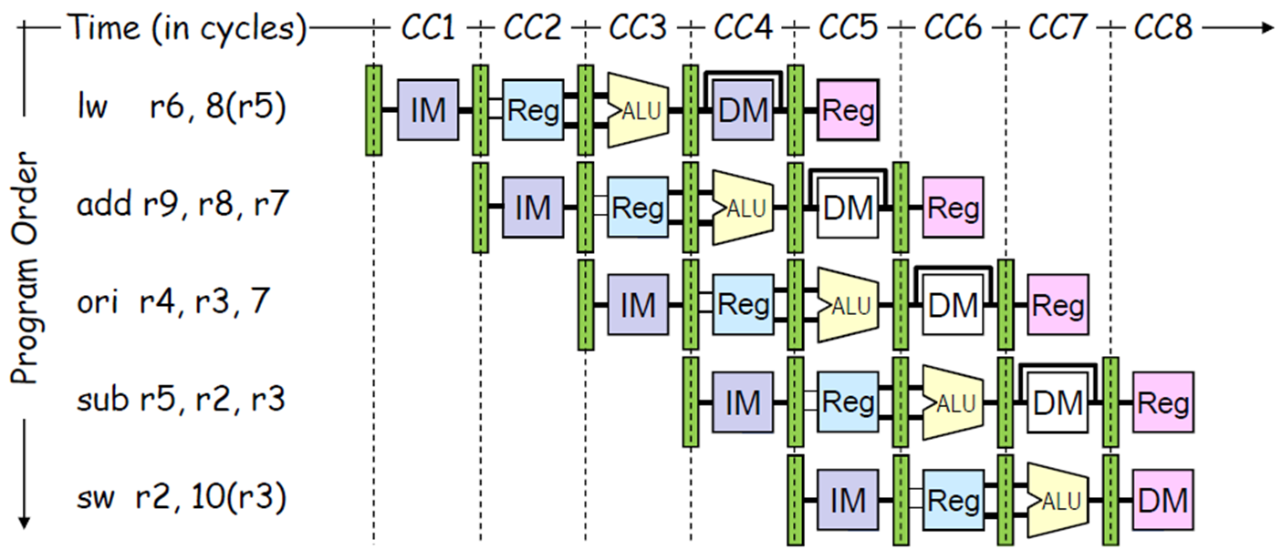
Performance Through Pipelining
This idea is an extension of the idea of parallelism. It is essentially handling the activities involved in instruction execution as an assembly line. As soon as the first activity of an instruction is done you move it to the second activity and start the first activity of a new instruction. This results in executing more instructions per unit time compared to waiting for all activities of the first instruction to complete before starting the second instruction.
Notes:
03/04-Lecture 1

Slide 12

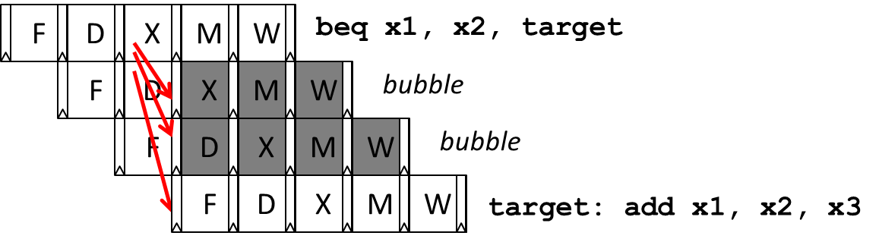
8. Performance Through Prediction
A conditional branch is a type of instruction that determines the next instruction to be executed based on a condition test. Conditional branches are essential for implementing high-level language if statements and loops.
Unfortunately, conditional branches interfere with the smooth operation of a pipeline — the processor does not know where to fetch the next instruction until after the condition has been tested.
Many modern processors reduce the impact of branches with speculative execution: make an informed guess about the outcome of the condition test and start executing the indicated instruction. Performance is improved if the guesses are reasonably accurate and the penalty of wrong guesses is not too severe.
Notes:
03/04-Lecture 1

Slide 13
Classes of Computers

Slide 14
计算机的分类
个人移动设备 (PMD)
  智能手机、平板电脑
  ARM-ISA兼容的通用处理器芯片（SoC）在市场上处于统治地位
  SoC中包含大量的专用加速器 (radio, image, video, graphics, audio, motion, location, security, etc.)
  强调能效和实时性(energy efficiency and real-time)
桌面计算（Desktop Computing）
  强调性价比(price-performance)
服务器（Servers）
  强调可用性、可缩放性、吞吐率(availability, scalability, throughput)

Slide 15
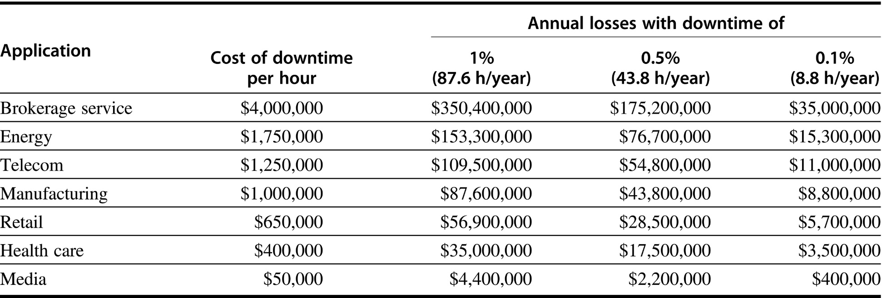
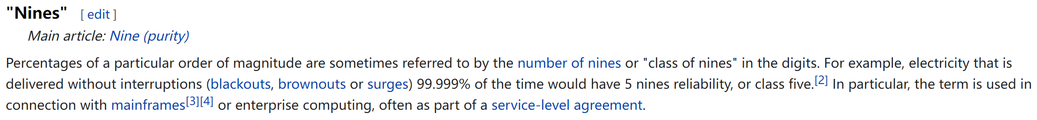
Cost of downtime
Figure 1.3 Costs rounded to nearest $100,000 of an unavailable system are shown by analyzing the cost of downtime (in terms of immediately lost revenue), assuming three different levels of availability, and that downtime is distributed uniformly. These data are from Landstrom (2014) and were collected and analyzed by Contingency Planning Research.
availability

Slide 16
计算机的分类（续）
集群/仓储级计算机（Clusters / Warehouse Scale Computers）
  每个数据中心包含10+万个处理器核
  X86-ISA兼容的服务器芯片在市场上占统治地位
  专门的应用程序，加上虚拟机的云托管
  现在越来越多地使用gpu、fpga和定制硬件来加速工作负载
  其分支: Supercomputers：强调浮点运算性能和高速内部互联
  强调可用性和性价比(availability、price-performance、energy)

Slide 17
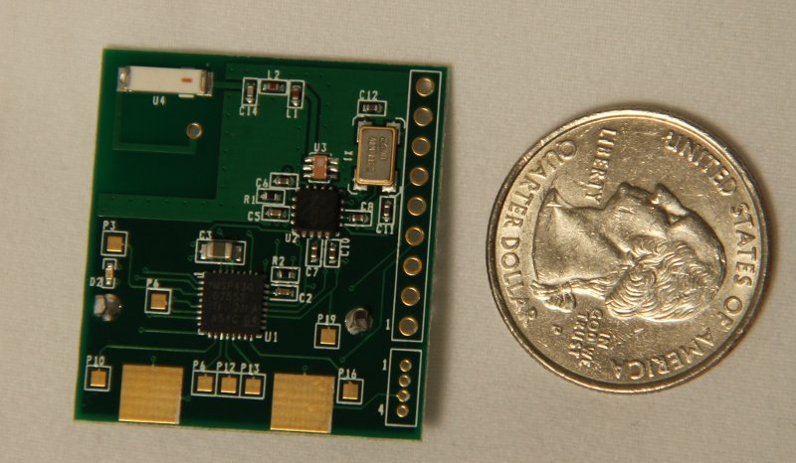
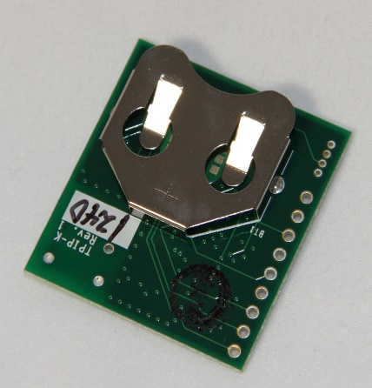
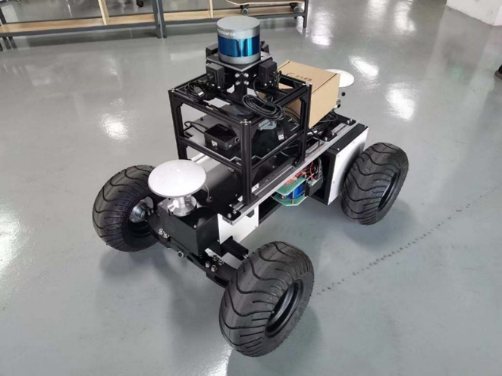
计算机的分类（续）
嵌入式计算机/物联网（Embedded Computers / Internet of Things）
  有线/无线网络基础设施，打印机
  消费类产品( TV/Music/Games/Automotive/Camera/MP3)
  物联网（Internet of Things!)
  强调价格、能耗及面向特定应用的性能(Emphasis: price、energy、application-specific performance)

Slide 18
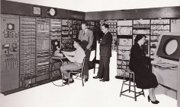
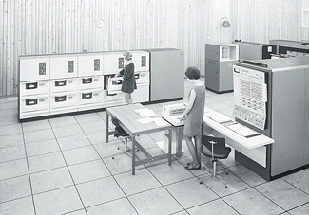
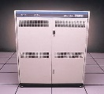
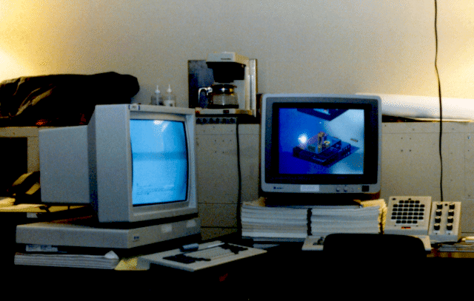





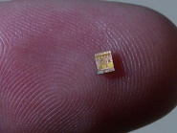
The Opportunity
Bell’s Law: a new computer class emerges every 10 years
Computers
Per Person
1:10⁶
Mainframe
Mini
1:10³
Workstation
PC
1:1
Laptop
PDA
Cell
Tag
10³:1
years
Notes:
A new class of computers emerges every 10 years. In current years, embedded IoT devices are increasingly deployed.

Slide 19
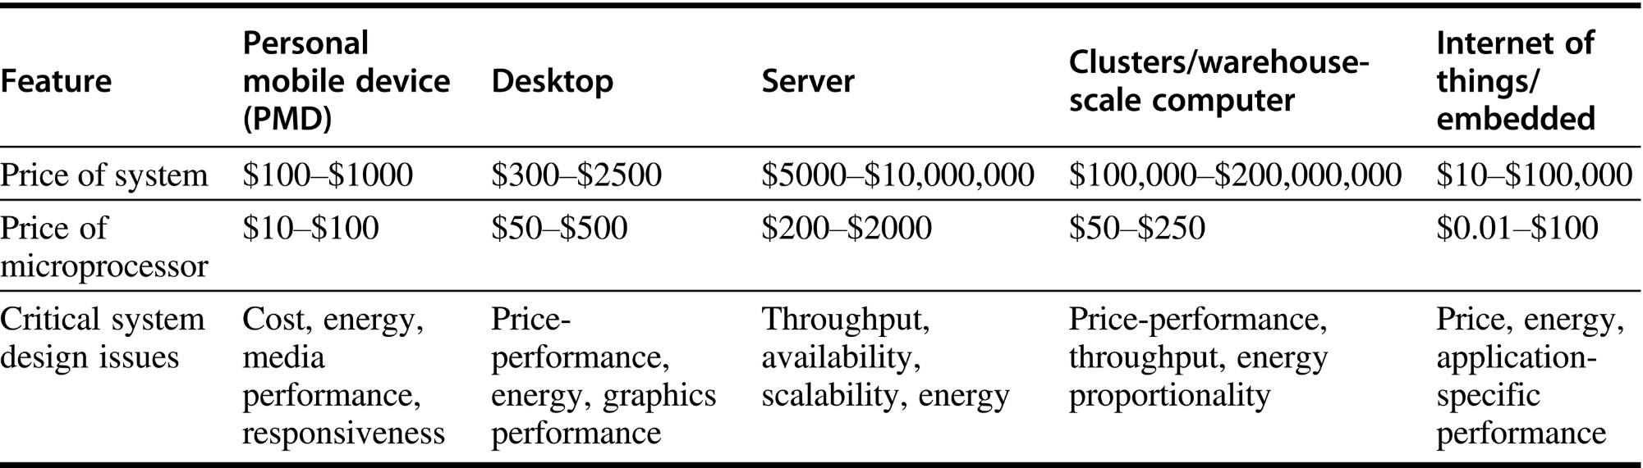
五类主流计算系统特点
Figure 1.2 A summary of the five mainstream computing classes and their system characteristics. Sales in 2015 included about 1.6 billion PMDs (90% cell phones), 275 million desktop PCs, and 15 million servers. The total number of embedded processors sold was nearly 19 billion. In total, 14.8 billion ARM-technology-based chips were shipped in 2015. Note the wide range in system price for servers and embedded systems, which go from USB keys to network routers. For servers, this range arises from the need for very large-scale multiprocessor systems for high-end transaction processing.

Slide 20
Closer Look at Processor Technology

Slide 21

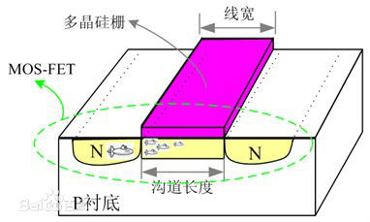
Closer Look at Processor Technology
特征尺寸不断减小（feature size ），芯片集成度不断提高
  电路的速度在不断提高
  芯片的面积在不断增加 （10%-20% ）
  主频在提高 ( 功耗成为问题)
  单位面积的晶体管数量在增加
性能每10年提高100倍
  时钟频率提高了10倍
  DRAM 的密度每3年提高4倍
如何使用这些晶体管?
  Parallelism in processing: 有更多的功能部件
    每个时钟周期并行多个操作降低了CPI
  Locality in data access: 更大的Cache
    降低了访存的延时从而降低了CPI，提高了处理器的利用率
什么是特征尺寸？(x, y) 维度上最小的尺寸
金属氧化物半导体场效应晶体管

Slide 22
Architecture: Increase in Parallelism
1985年以前位级(4-8-16位)并行（Bit level parallelism）
  32-bit 处理器后性能提升变慢
  90年代采用64-bit 、128-bit 及更高位 通过向量处理提高性能
  重大的拐点：32位处理器和缓存适合(fit)一个芯片
80年代中到90年代后期主要发展指令级并行（Instruction Level Parallelism）
  流水线、RISC、编译技术的进步→ 挖掘指令级并行
  片上cache及功能部件的增加-> 超标量执行(superscalar)
  更精巧的技术: 乱序执行(out of order execution)和硬件投机执行 (speculative execution)
现状：线程级并行和片上多处理器（thread level parallelism and chip multiprocessors）
  线程级并行超越了指令集并行
  在单个芯片中部署多个处理器及互联结构
  在处理器芯片内多个线程并行执行
硬件线程+ 软件线程

Slide 23
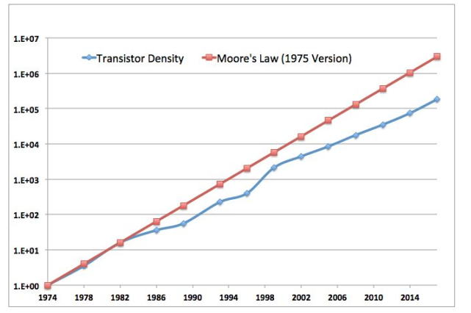
Moore’s Law Slowdown in Intel Processors
增长变缓

Slide 24
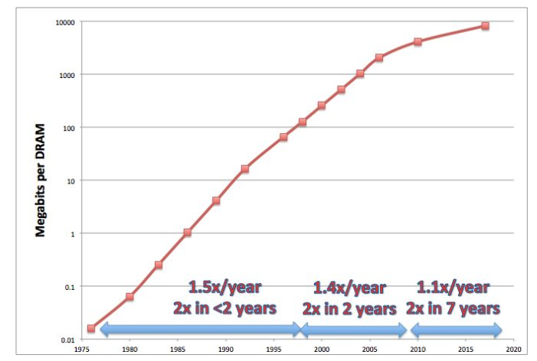
Moore’s Law in DRAMs

Slide 25
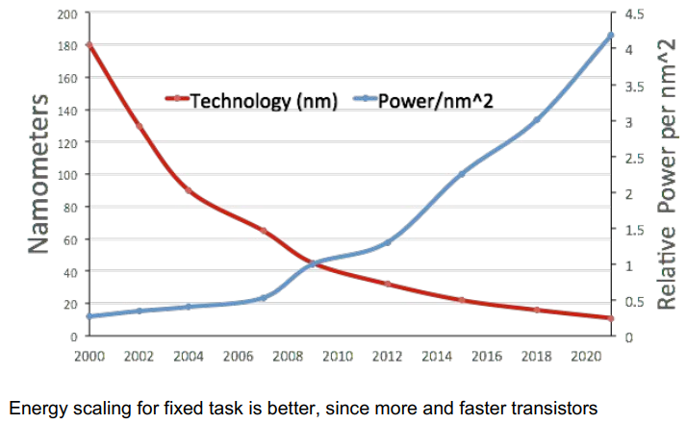
Technology & Power: Dennard Scaling
Dennard scaling(登纳德缩放比例定律)：晶体管尺寸变小，功耗会同比变小（相同面积下功耗不变）

Slide 26
Why is low-power Important?
Power must be brought in and distributed around the chip
Power is dissipated as heat and must be removed
Three things to consider
  Peak power （电源能够提供的功率 < 处理器需要的最大功率 => 电压下降 => 无法正常工作）
  Thermal design power (TDP)热设计功耗， 决定了电路的冷却需求 （often peak power >TDP> 平均功率 ）
  Energy能耗 or power功耗? Which one is a better metric?
能耗！和完成一件任务的时间有关 E = pt

Slide 27
Power in Integrated Circuits
功耗问题是当今计算机设计面临的最大挑战之一
  芯片内部和外围电路都存在功耗问题
  功耗会产生热，须解决散热问题
热设计功率（Thermal Design Power (TDP)）
  Intel：热设计功率，一种基于最坏情况应用的功率耗散目标
  表达了设备的功耗特征
  主要用于电源和冷却系统的设计
  通常它低于峰值功耗，但高于平均功耗
TDP和功耗的关系？
  答案是没有关系。很多测试表明，CPU的最大真实功耗小于TDP值，但是在加压超频后峰值功耗有可能超过TDP。
降低频率可导致功耗下降

Slide 28
Power versus Energy
功耗(Power) 指单位时间的能耗：1 Watt = 1 Joule / Second
一个任务执行的能耗 (energy) = Average Power × Execution Time
Power or Energy? 哪个指标更合适？
  针对给定的任务，能耗是一种更合适的度量指标（joules)
  针对电池供电的设备，我们需要关注能效
Example: which processor is more energy efficient?
  Processor A consumes 20% more power than B on a given task
  However, A requires only 70% of the execution time needed by B
Answer: Energy consumption of A = 1.2 × 0.7 = 0.84 of B
  Processor A consumes less energy than B (more energy-efficient)

Slide 29
Power & Energy
Dynamic Energy动态能耗 ∝
Capacitive Load（电容负载） × Voltage²
  从0-1-0 或 1-0-1逻辑跃迁的脉冲能量
  Capacitive Load =输出晶体管和导线的电容负载
  20年来晶体管供电电压已经从5V降到1V
Dynamic Power ∝
Capacitive Load × Voltage²× Frequency Switched
时钟周期

Slide 30
动态能耗和功耗
针对CMOS技术, 动态的能量消耗是由于晶体管的on和off状态的切换引起的
Dynamic Energy ∝ Capacitive Load × Voltage²
  the energy of pulse of the logic transition of 0-1-0 or 1-0-1
  Capacitive Load = Capacitance of output transistors & wires
  Voltage has dropped from 5V to below 1V in 20 years
Dynamic Power ∝
Capacitive Load × Voltage²× Frequency Switched
降低频率可以降低功耗
降低频率导致执行时间增加 ->不能降低能耗
降低电压可有效降低功耗和能耗

Slide 31
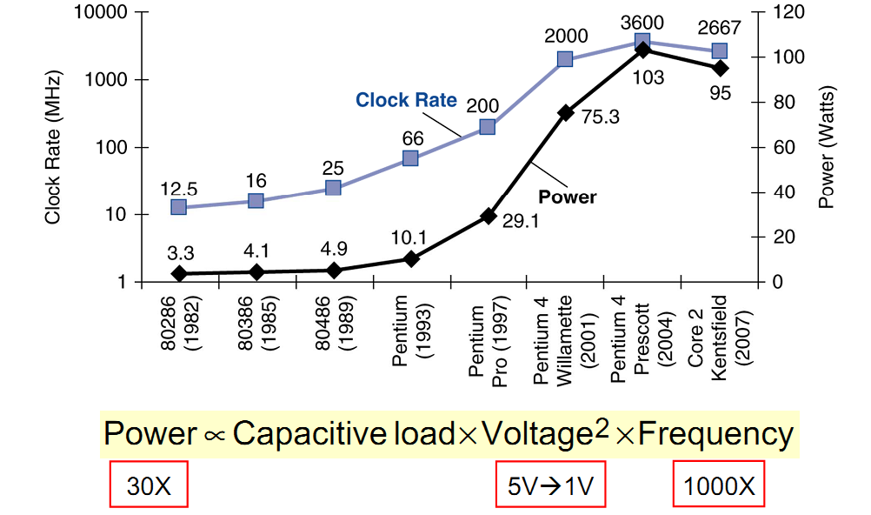
Trends in Power & Clock Frequency

Slide 32
减少动态功耗的技术
关闭不活动模块或处理器核的时钟(Do nothing well)
  Such as a floating-point unit when there are no FP instructions
Dynamic Voltage-Frequency Scaling (DVFS)
  在有些场景不需要CPU全力运行
  降低电压和频率可降低功耗
针对典型场景特殊设计 (Design for the typical case)
  电池供电的设备(手机、笔记本等)常处于idle状态，DRAM和外部存储采用低功耗模式工作以降低能耗
Overclocking (Turbo Mode)
  当在较高频率运行时，先以较高频率在少量核上运行一段时间，直到温度开始上升至不安全区域。一个core以较高频率运行，同时关闭其他核

Slide 33
Dynamic Voltage Scaling (DVS)
DVS scales the operating voltage of the processor along with the frequency.
Since energy is proportional to v² , (v∝f) DVS can potentially provide significant energy savings through frequency and voltage scaling => DVFS
^{can reduce} voltage and frequency by (say) 10%; can slow a program by (say) 8%, but reduce dynamic power by 27%, reduce total power by (say) 23%, reduce total energy by 17%
有一次注意到当服务器的工作数量增加时，完成同一个工作需要的时间却变短了。能解释下这可能是为什么吗？

Slide 34
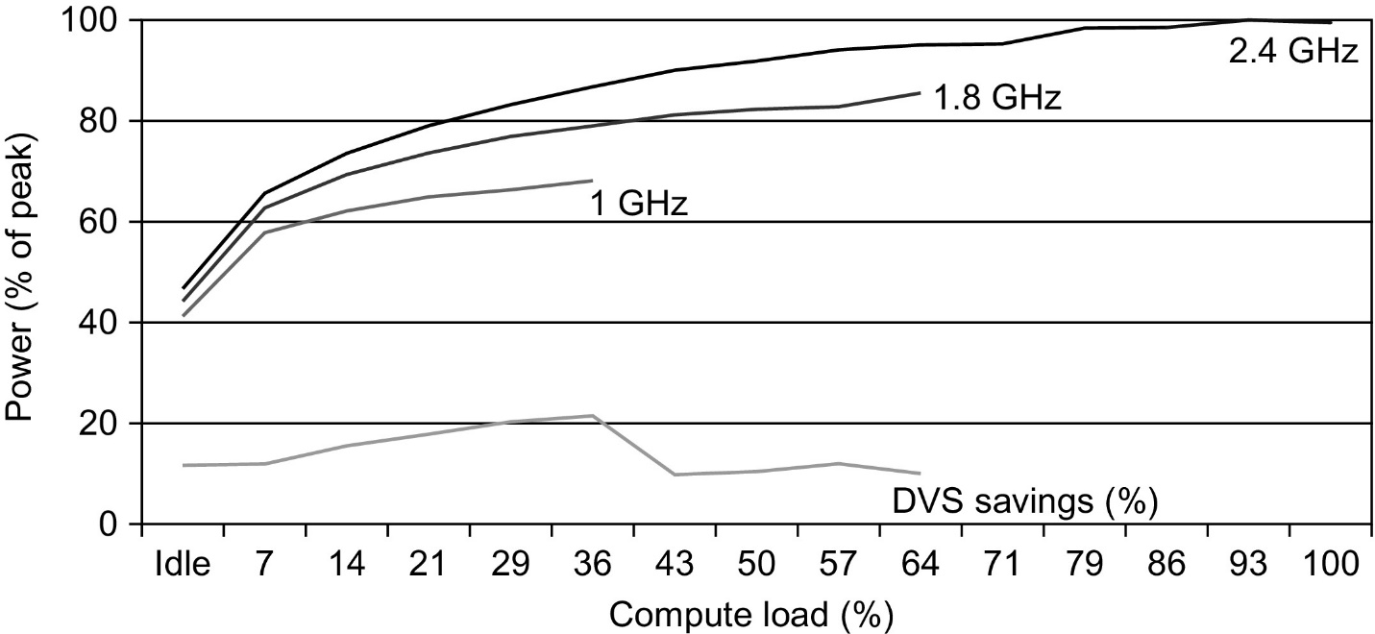
低功耗技术-DVFS
Figure 1.12 Energy savings for a server using an AMD Opteron microprocessor, 8 GB of DRAM, and one ATA disk. At 1.8 GHz, the server can handle at most up to two-thirds of the workload without causing service-level violations, and at 1 GHz, it can safely handle only one-third of the workload (Figure 5.11 in Barroso and Hölzle, 2009).

Slide 35
静态功耗（Static Power）
当晶体管处于off状态时,漏电流产生的功耗称为静态功耗
随着晶体管尺寸的减少漏电流的大小在增加
Static Power = Static Current × Voltage
  Static power increases with the number of transistors
静态功耗有时会占到全部功耗的50%
  Large SRAM caches need static power to maintain their values
Power Gating: 通过切断供电减少漏电流
  To inactive modules to control the loss of leakage current

Slide 36
有关功耗和能耗小结
给定负载情况下能耗越少，能效越高, 特别是对电池供电的移动设备。
功耗应该被看作一个约束条件
  A chip might be limited to 120 watts (cooling + power supply)
Power Consumed = Dynamic Power + Static Power
  晶体管开和关的切换导致的功耗为动态功耗
  由于晶体管静态漏电流导致的功耗称为静态功耗
通过降低频率可节省功耗
降低电压可降低功耗和能耗

Slide 37
与能效相关的其他指标
EDP (Energy Delay Product)
  EDP = Energy ∗ Delay = Power ∗ Delay2
Performance per Power
  FLOPS per watt ( Scientific computing)
SWaP (space, wattage and performance)
  Sun Microsystems metric for data centers, incorporating energy and space.
  SWaP = Performance / (Space ∗ Power)

Slide 38
Current and Future Trends

Slide 39
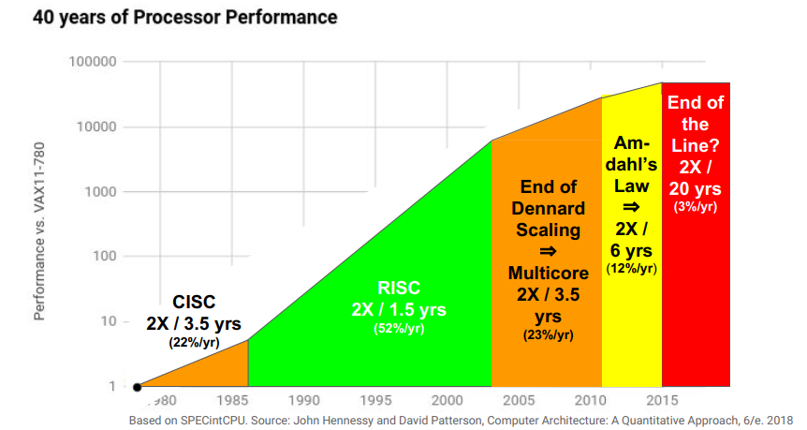
End of Growth of Single Program Speed?
So, What is next?

Slide 40
How far will Instruction Level
Parallelism (ILP) go?
理想超标量模型执行下有限的ILP：无限的资源和存取带宽、完善的预取和重命名机制，但是使用现实的Cache。结果：4条指令并行取得了最大的ILP benefit； 5以后则收获甚微
平均来讲，每五条指令有一条control transfer instruction
Why do we have very limited ILP?

Slide 41
有关体系结构的新旧观念
Old Conventional Wisdom: Power is free, Transistors expensive
New CW: “Power wall” Power expensive, Transistors free
Old CW: 通过编译、体系结构创新来增加指令级并行 (Out-of-order, speculation, VLIW, …)
New CW: “ILP wall” 挖掘指令级并行的收益越来越小
Old CW: 乘法器速度较慢，访存速度比较快
New CW: “Memory wall” 乘法器速度提升了，访存成为瓶颈
(200 clock cycles to DRAM memory, 4 clocks for multiply)
Old CW: 单处理器性能2X / 1.5 yrs
New CW: Power Wall + ILP Wall + Memory Wall = Brick Wall
  单处理器性能 2X / 5(?) yrs
⇒ 芯片设计的巨大变化: multiple “cores”
(2X processors per chip / ~ 2 years)
    越简单的处理器越节能

Slide 42
计算机安全现状及挑战
虽然目前有一些保护措施，但没有很好使用
  域、环等机制
  似乎作用不大，并且开销较高
过去希望：软件能够消除攻击路径
  程序验证
  内核态、用户态
Spectre & meltdown漏洞: 利用推断执行机制=>时序攻击
许多微体系架构存在这类漏洞，这些漏洞是体系结构定义的bug
需要CA2.0来避免利用这类漏洞的攻击
硬件必须有助于安全系统的建立

Slide 43
小结：计算机系统设计方面的巨大变化
在过去的50年，Moore’s law和Dennard scaling(登纳德缩放比例定律)主宰着芯片产业的发展
  Moore 1965年预测：晶体管数量随着尺寸缩小按接近平方关系增长（每18个月2X）
  Dennard 1974年预测：晶体管尺寸变小，功耗会同比变小（相同面积下功耗不变）
  工艺技术的进步可在不改变软件模型的情况下，持续地提高系统性能/能耗比
最近10年间，工艺技术的发展受到了很大制约
  Dennard scaling over (supply voltage ~fixed)
  Moore’s Law (cost/transistor) over?
  Energy efficiency constrains everything
  ……
功耗问题成为系统结构设计必须考虑的问题
软件设计者必须考虑:
  Parallel systems
  Heterogeneous systems

Slide 44
小结：体系结构挑战性问题
性能提升处于停滞状态
  Moore定律正在减速
  邓纳德缩放定律正在失效
    微体系架构技术：指令集并行、多核等技术的低效会消耗能量

Slide 45
现代体系结构发展趋势
性能提升的基本手段：并行
应用需求
  计算的需求不断增长，如Scientific computing, video, graphics, databases, deep learning…
工艺发展的趋势
  芯片的集成度不断提高，但提升的速度在放缓
  时钟频率的提高在放缓，并有降低的趋势
体系结构的发展及机遇
  指令集并行受到制约
  线程级并行和数据级并行是发展的方向
  提高单处理器性能花费的代价呈现上升趋势
  面向特定领域的体系结构正蓬勃发展

