Slide 1
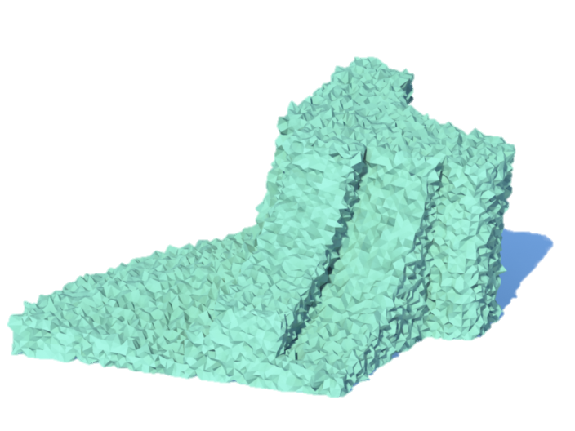
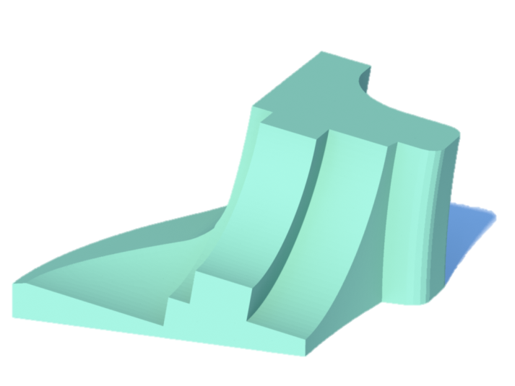
Denoising while preserving sharp feature
A Challenging Problem
?
Input
Output
Notes:
(5”) Mesh denoising while preserving sharp features is a challenging problem.

Slide 2
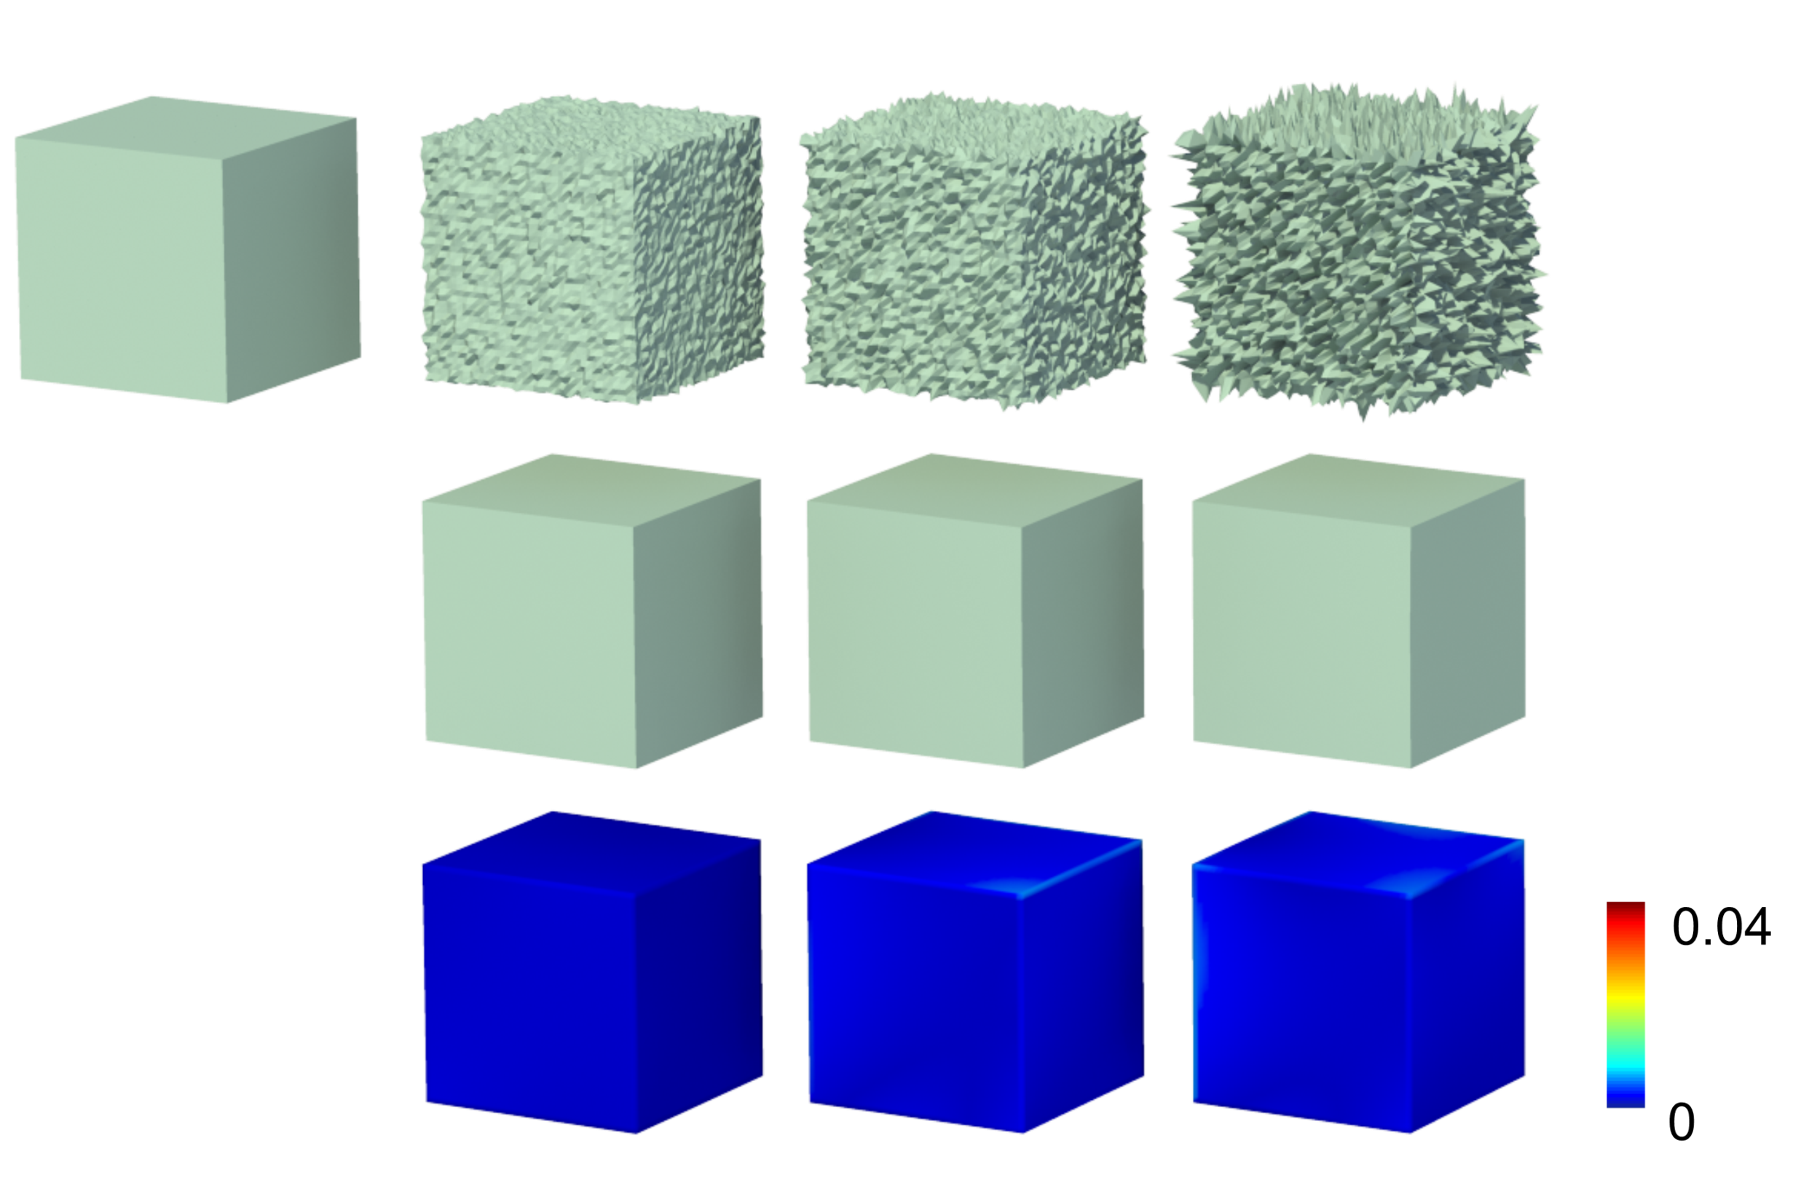

Denoising while preserving sharp feature
A Challenging Problem
Small feature?
Large noise?
Ambiguous
Notes:
(6”) It is very hard to distinguish sharp features from noisy data as shown here.

Slide 3
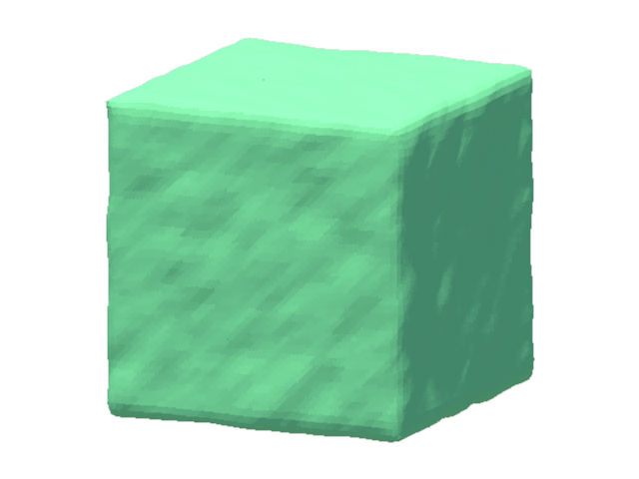
Denoising while preserving sharp feature
A Chicken-and-egg Problem
Feature detection
  unreliable
Local denoising operations
  blur feature
Notes:
(6”) Actually, it is a chicken-and-egg problem.
//
On one hand, Feature detection is unreliable in the presence of noise
On the other hand, Local denoising operations would blur sharp features

Slide 4

Compressed sensing
Decouple
Feature
noise
Simultaneously
Notes:
(8”) Unlike existing approaches, we introduce a big hammer, called compressed sensing, to decouple sharp features and noise simultaneously.

Slide 5
Compressed sensing
?
2:00p.m. Thursday, August 14
Notes:
(5”) Do you want to know how we make it? Please come to our talk on Thursday afternoon.

