Slide 1
Advanced 3D Motion Prediction for Video Based
Dynamic Point Cloud Compression
Li Li, Zhu Li, Vladyslav Zakharchenko, Jianle Chen, Houqiang Li
University of Missouri, Kansas City
Futurewei Technologies American Media Lab
University of Science and Technology of China
Email: lizhu@umkc.edu

Slide 2
Outline
Introduction
Related works
Proposed algorithms
  Motivation
  Geometry-based motion prediction
  Auxiliary-information-based motion prediction
Experimental results
Conclusion and future work

Slide 3
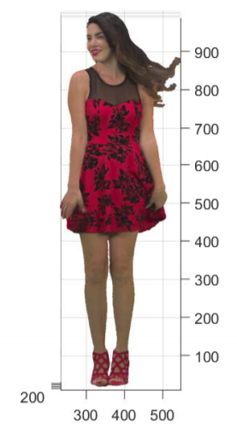
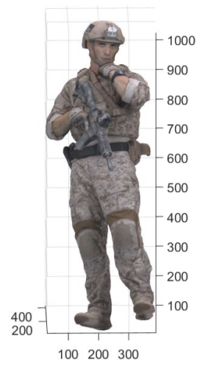
Introduction
Point cloud media format is becoming more and more popular due to its potential to be widely used
  6-DOF virtual reality: point cloud object
  Auto driving: point cloud scene
The point cloud is with both geometry information and attribute information
  Geometry information is (x, y, z) to
  indicate the position of the point
  Attribute information can be (r, g, b)
  or reflectance

Slide 4
Introduction
The point cloud can be divided into static point cloud and dynamic point cloud
  The dynamic point cloud is basically composed of several frames of the static point cloud
The size of the dynamic point cloud can be very large
  30 static point cloud per second
  One million points per static point cloud
  30 and 24 points for the (x, y, z) and (r, g, b)
  Overall, the size can be as large as 180Mbytes/s
Therefore, there is an urgent need to compress the point cloud especially the dynamic point cloud efficiently

Slide 5
Related works
The current methods to compress the DPC can be roughly divided into two groups:
  the 3-D based method
  the 2-D video based method
The 3-D based method
  Perform motion estimation and motion compensation in 3-D space
  3-D motion estimation and motion compensation are very challenging
    The DPC may have various points in different frames
    These points do not have explicit correspondence
  Feature matching problem/ICP-based motion compensation
    The compression efficiency of the 3-D based method is still limited due to the fixed cube size and the limitation of ICP
Notes:
Bi-prediction and weighted prediction can also be used to better improve the coding efficiency.

Slide 6
Related works
The 2-D based method
  Project the point cloud into 2-D videos and then compress using the mature video compression standard such as HEVC
  A simple solution is to project the point cloud to the six faces of a cubic
    It may lead to the lose of a number of points due to occlusion
    It may also cause the quite serious un-smoothness of the geometry
The state-of-the-art 2-D based method
  Project the point cloud to a cube patch by patch and all the patches are organized into a video to compress
  The winner of the MPEG call for proposal for the dynamic point cloud compression
  Video-based point cloud compression (V-PCC)
Notes:
One summary report on ICME challenge on LF image compression reveals that the pseudo sequence based methods show better …

Slide 7

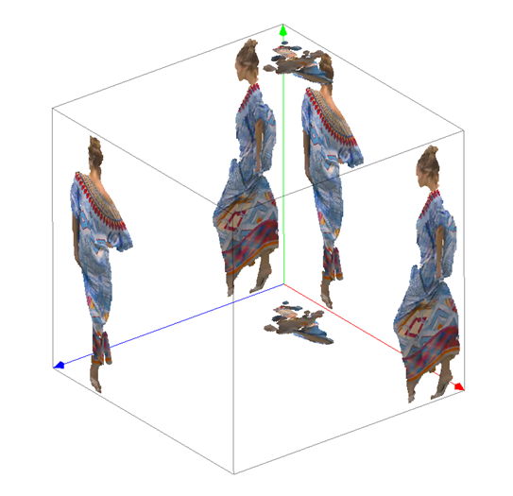
Video-based point cloud compression
Patch generation: a point cloud is divided into multiple patches by projecting to its bounding box
  An initial clustering of the point cloud is
  first obtained by associating each point with
  the face having the most similar normal
  The cluster is then refined by updating the
  index of each point based on its normal and
  the normal of the nearest neighbors
  Finally, the patches are extracted by
  applying a connected component extraction
  procedure

Slide 8
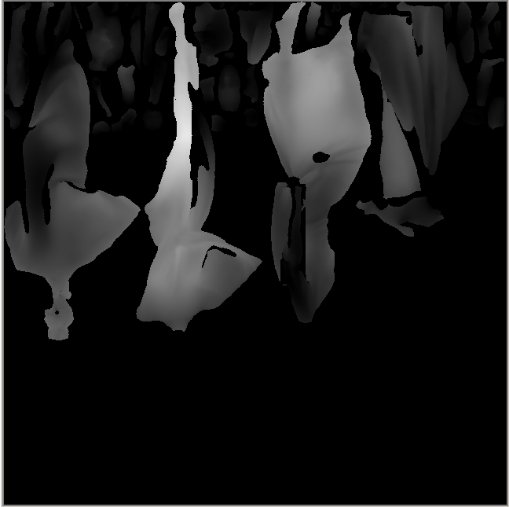
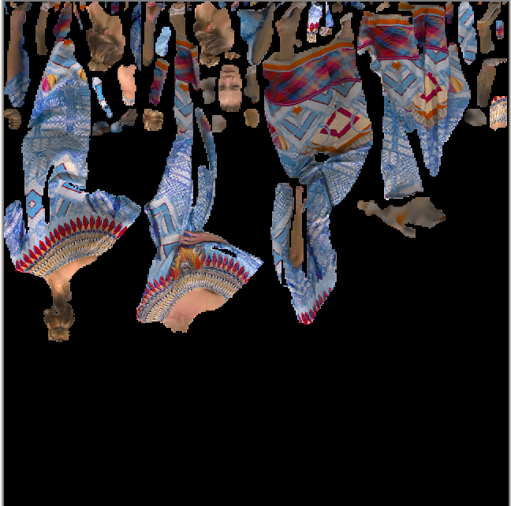
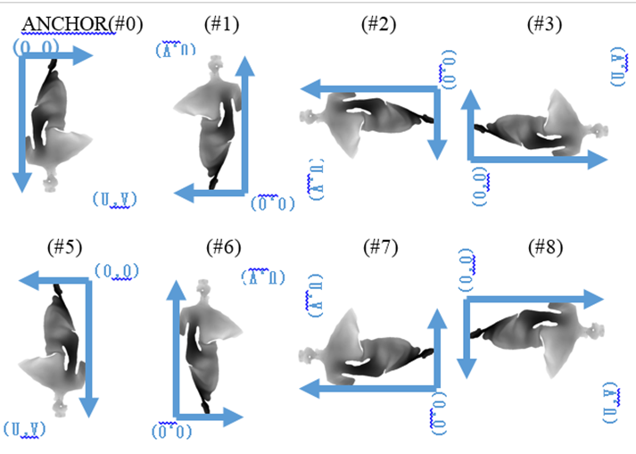

Video-based point cloud compression
Patch packing
Patch padding
  Push-pull background filling
  Global method

Slide 9
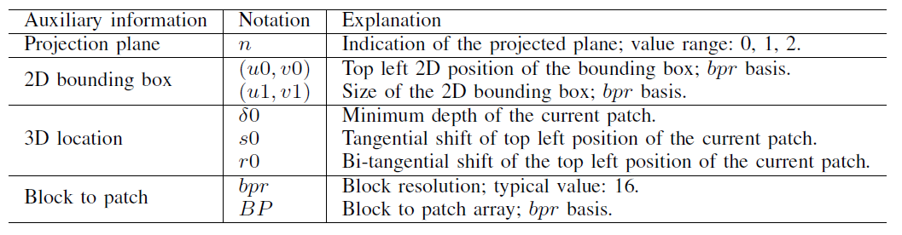
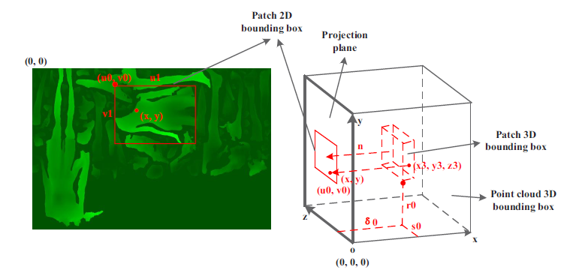
Video-based point cloud compression
Auxiliary information: indicate the occupancy

Slide 10
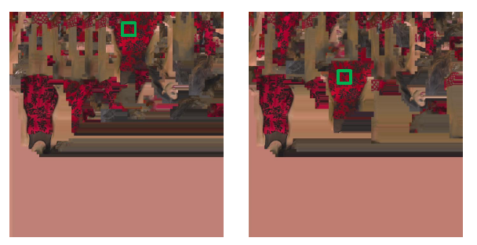
Motivation
The patches may be put in totally different positions in various frames (Green squares)
  The current video codec may be unable to find a good motion vector for each block in this case
  The geometry is encoded before the attribute, we can use the geometry to derive a better motion vector for attribute

Slide 11
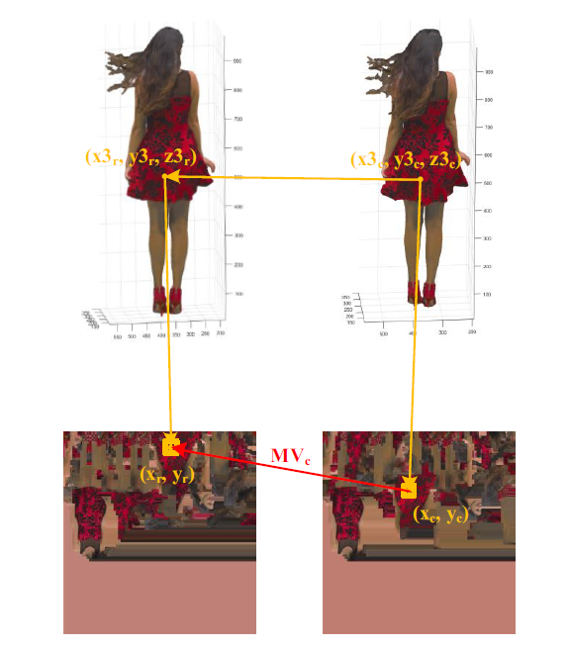
General 3D to 2D motion model
Given the 3D motion and the 3D to 2D correspondence, we can derive the 2D motion

Slide 12
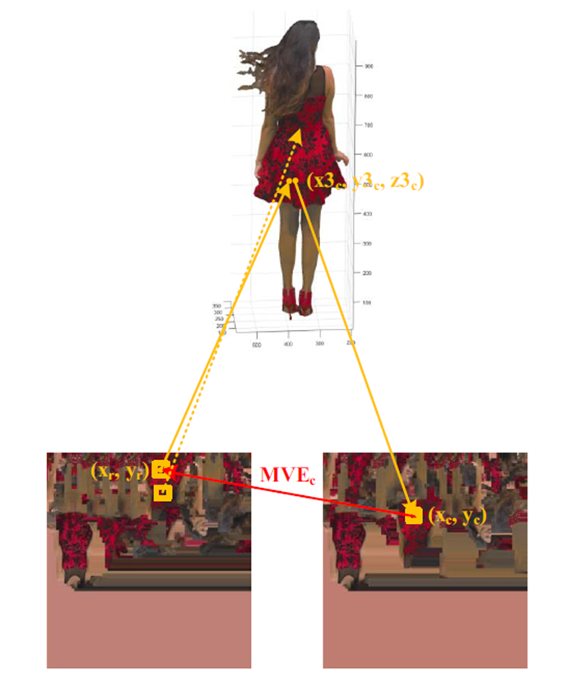
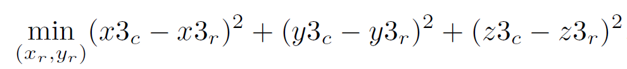
Geometry-based motion prediction
In the V-PCC, we know the 3D-to-2D correspondence but do not know the 3D motion
We assume the current frame and the reference frame will not change seriously
The problem is that (x3c,y3c,z3c) may not
have a corresponding 2D point, we perform
motion estimation which will increase the
encoder and decoder complexity

Slide 13
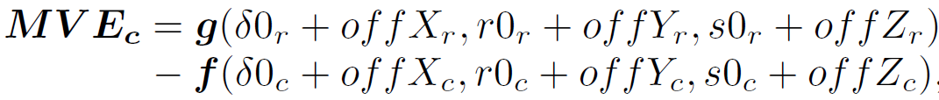
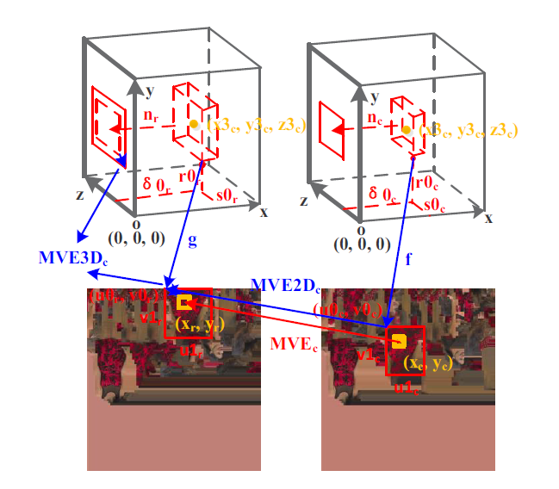
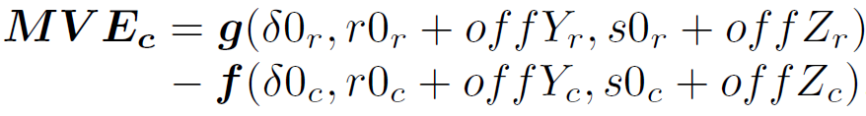


Auxiliary information based motion prediction
The previous method has the following two disadvantages
  The high encoder and decoder complexity
  It can only apply to the attribute
The auxiliary information based motion prediction
  The auxiliary information basically provides the coarse geometry

Slide 14
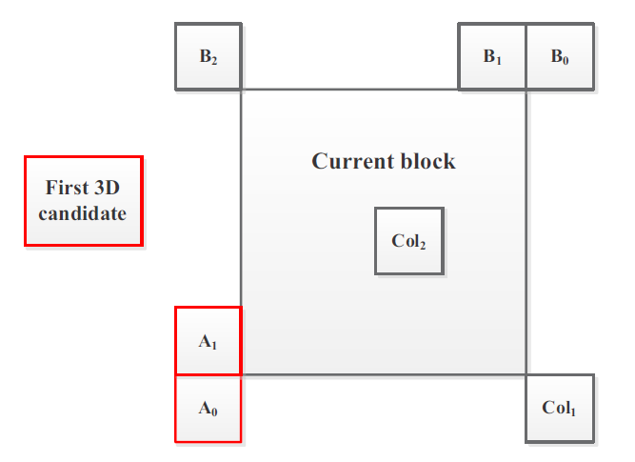
Normative or Non-normative
Normative
  Add the derived MV as a MVP candidate
Non-normative
  Add the derived MV as the MV start candidate

Slide 15
Experiments setup
The proposed algorithm is implemented in the V-PCC reference software and the corresponding HEVC reference software
We test the all the dynamic point clouds defined in the common test condition including loot, redandblack, soldier, queen, longdress
For the geometry, both point-to-point is point-to-plane are used
For the attribute, the qualities of the luma, Cb, and Cr are considered

Slide 16
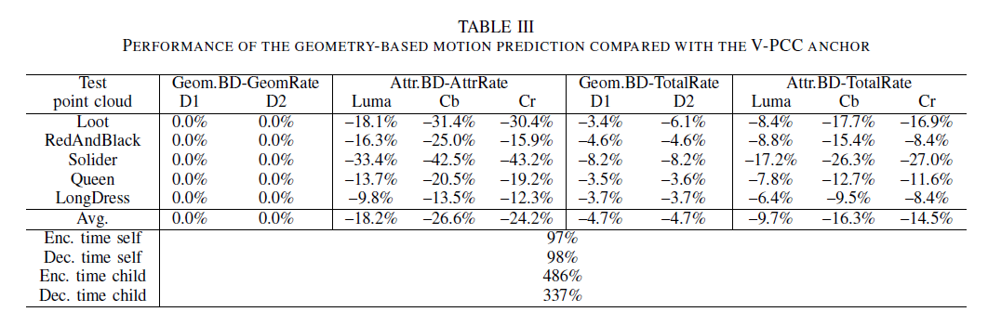
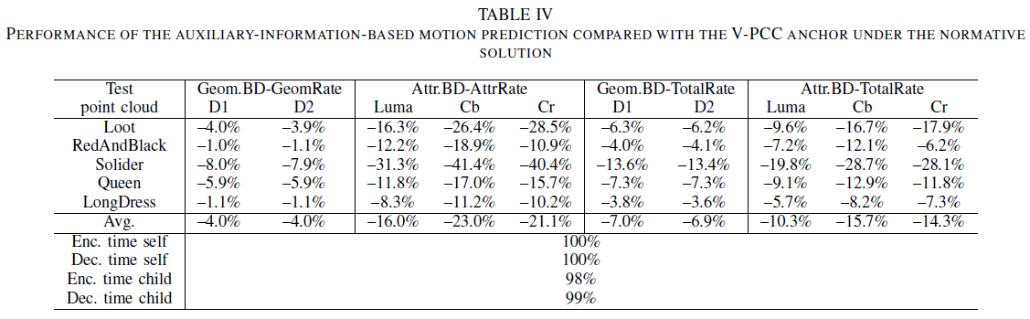
Experimental results on the overall scheme
Overall scheme results

Slide 17
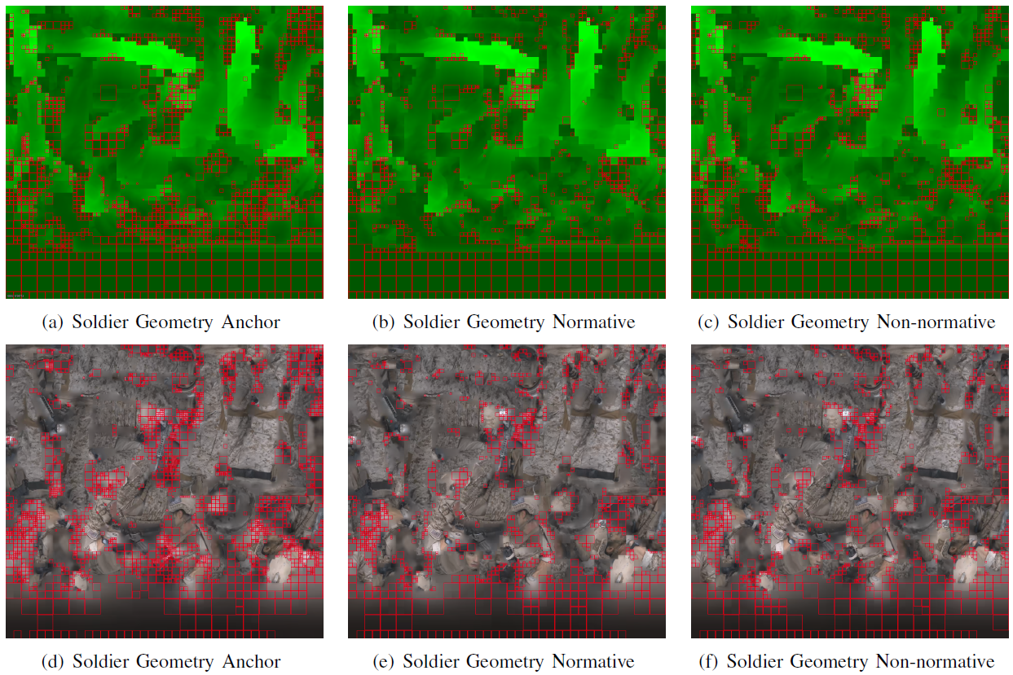
Performance Analysis
Intra blocks reduce significantly

Slide 18
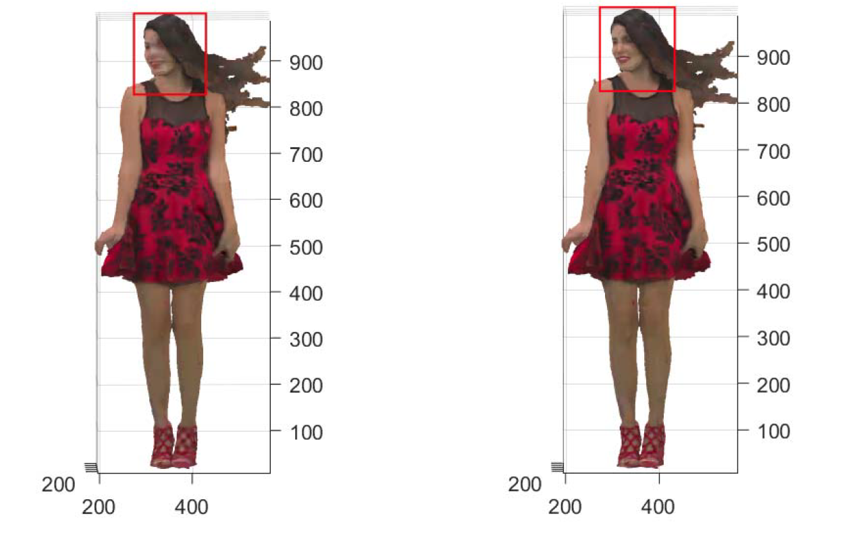
Subjective quality

Slide 19
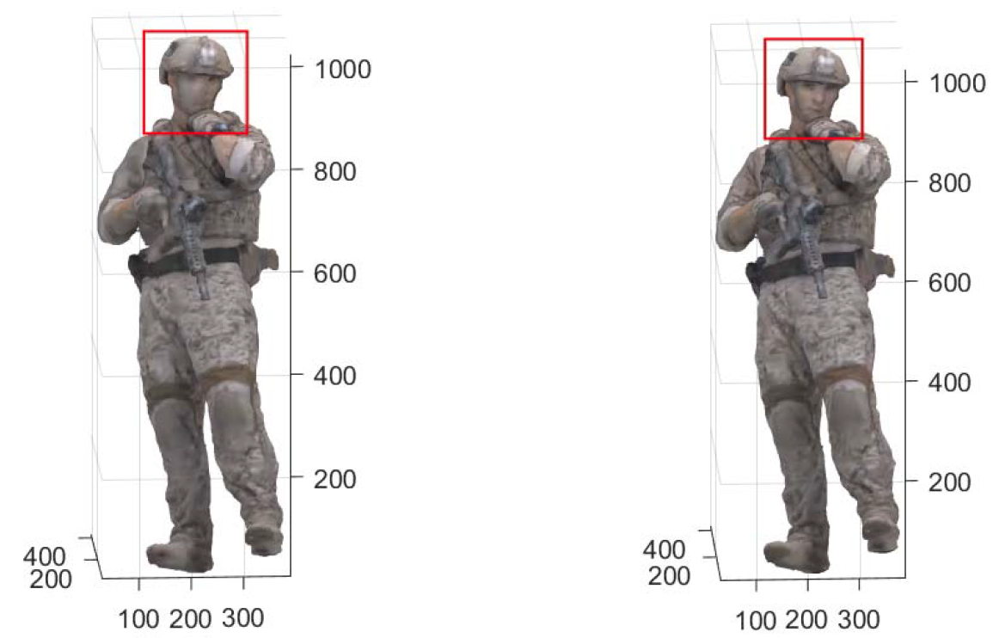
Subjective quality

Slide 20
Conclusion
We propose using the geometry or auxiliary information to derive a better motion vector predictor to deal with the patch inconsistency problem in V-PCC
  We propose a general 3D to 2D motion model
  We propose a geometry based method
    High complexity
    Apply only to the attribute
  We propose an auxiliary information based method
    Low complexity
    Apply to both the geometry and attribute
Significant bitrate savings are achieved using the proposed methods

Slide 21
Thank you!

