Slide 1
Theory and Practice of Modern Cryptography
Chapter 14
Lattice Cryptography
苗付友
mfy@ustc.edu.cn
Dec. 2022

Slide 2
Outline
1.Congruential Public Key System
2. Subset-sum problems and knapsack cryptosystems
3.Vector Space
4.Lattice：Definition and Property
5. Short vectors in lattices
6.Babai’s Algorithm
7. Cryptosystems based on hard lattice problems
8. The GGH public key cryptosystem
9. Lattice Reduction Algorithm
10. Application of LLL Algorithm in cryptanalysis

Slide 3
What can lattice do?
Lattice:
set of vectors, which are linear combinations of independent vectors with integer coefficients
Functions
Cryptoanalysis
Constructing Cryptosystem

Slide 4
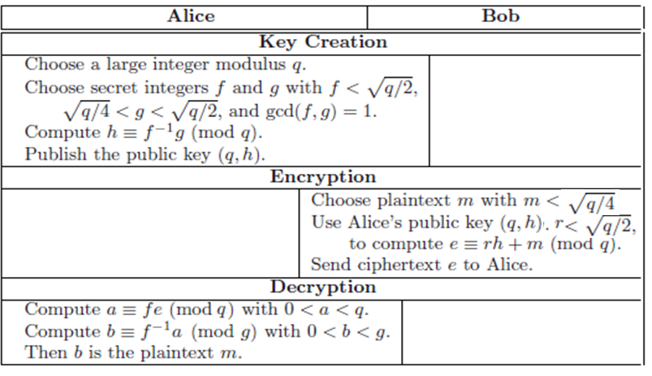
1. A congruential public key cryptosystem
Bob sends message m to Alice secretly
A congruential public key cryptosystem

Slide 5
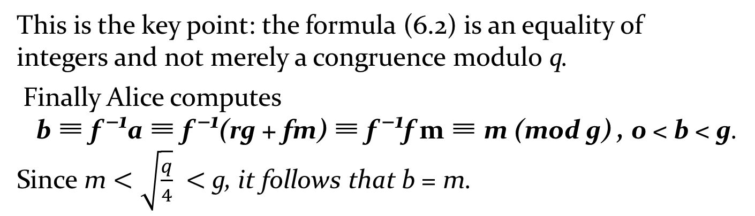
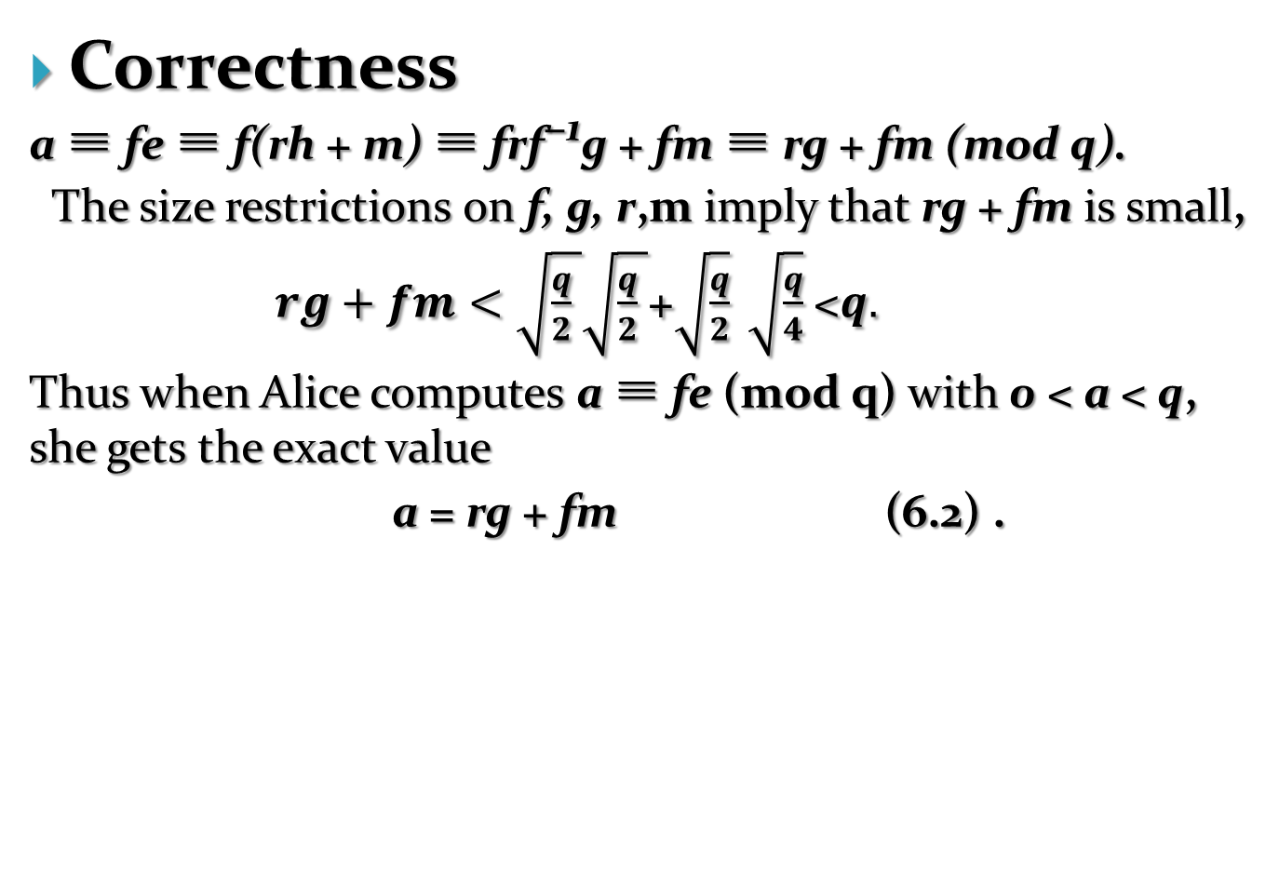
Correctness
a ≡ fe ≡ f(rh + m) ≡ frf⁻¹g + fm ≡ rg + fm (mod q).
The size restrictions on f, g, r,m imply that rg + fm is small,
$rg+fm<\sqrt{\frac{q}{2} }\sqrt{\frac{q}{2} }$+$\sqrt{\frac{q}{2}} \sqrt{\frac{q}{4}}$<$q.$
Thus when Alice computes a ≡ fe (mod q) with 0 < a < q, she gets the exact value
a = rg + fm (6.2) .
This is the key point: the formula (6.2) is an equality of integers and not merely a congruence modulo q.
Finally Alice computes
b ≡ f ⁻¹a ≡ f ⁻¹(rg + fm) ≡ f ⁻¹f m ≡ m (mod g) , 0 < b < g.
Since m $<\sqrt{\frac{q}{4}} <$g, it follows that b = m.

Slide 6
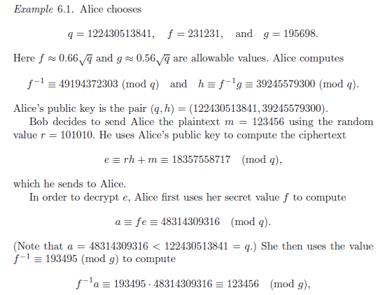
Example

Slide 7
How to crack?
To find the private key (f, g) from the known public key (q, h).
However, if one find any pair of positive integers F and G satisfying
Fh ≡ G (mod q) and F=O(q^{1/2}) , G= O(q^{1/2}). (6.3)
(F,G) is likely to serve as a decryption key.
(6.3): Fh = G + qR, F=F +0R i.e.,
F(1,h)-R(0,q)=(F,G)
  Known vectors: (1,h)=v₁, | v₁ |=q; (0,q)=v₂, | v₂ |=q;
  Unknown vector: (F,G)=w, |w|=q^{1/2}
Problem: to find a short nonzero vector in:
L = {a₁v₁ + a₂v₂ : a₁, a₂ ∈ Z}.

Slide 8
2.Subset-sum problems and knapsack cryptosystems
The Subset-Sum Problem
  Suppose that you are given a list of positive integers
  (M1,M2, . . . , Mn) and another integer S. Find a subset of the elements in the list whose sum is S.
(You may assume that there is at least one such subset.)
Example
  Let M = (2, 3, 4, 9, 14, 23) and S = 27. Then a bit of trial and error yields the subset {4, 9, 14} whose sum is 27, and it is not hard to check that this is the only subset that sums to 27. Similarly, for S = 29, {2, 4, 23 } and {2, 4, 9, 14} both have the sum of 29.

Slide 9
2.Subset-sum problems and knapsack cryptosystems
Equivalent Description of Subset-sum Problem
  The list M = (M₁,M₂, . . . , M_{n}) of positive integers is public knowledge. Bob chooses a secret binary vector x = (x₁, x₂, . . . , x_{n}), i.e., each x_{i} may be either 0 or 1. Bob computes the sum
  and sends S to Alice. The subset-sum problem asks Alice to find either the original vector x or another binary vector giving the same sum.
  find x by checking all 2^{n} binary vectors of length n. A simple collision algorithm allows Alice to cut the exponent in half.

Slide 10
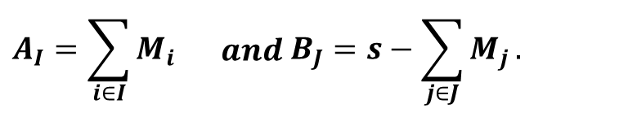
Collision Algorithm
  Let M = (M1,M2, . . . , Mn) and let (M, S) be a subset-sum problem. For all sets of integers I and J satisfying
  I = {i : 1 ≤ i ≤n/2} and J ⊂ {j : n/2 < j ≤ n},
  compute and make a list of the values
  Then these lists include a pair of sets I’ and J’ satisfying A_{I’}= B_{J’} and the sets I’ and J’ give a solution to the subset-sum problem,
  The number of entries in each list is at most 2^{n/2}, so the running time of the algorithm is O(2^{n/2+𝜀}), where 𝜀 is some small value that accounts for sorting and comparing the lists.
$$A_{I}=\sum_{i∈I}{M_{i}}\begin{matrix} & and\end{matrix} B_{J}=s−\sum_{j∈J}{M_{j}}.$$

Slide 11
2.Subset-sum problems
Superincreasing Sequence
  A superincreasing sequence of integers is a list of positive integers r = (r₁, r₂, . . . , r_{n}) with the property that
  r_{i+1} ≥ 2r_{i} for all 1 ≤ i ≤ n − 1.
Lemma 6.4
  Let r = (r₁, r₂, . . . , r_{n}) be a superincreasing sequence. Then r_{k} > r_{k−1} + · · · + r₂ + r₁ for all 2 ≤ k ≤ n.
  Proof: r_{k+1} ≥ 2r_{k} = r_{k} + r_{k} > r_{k} + ( r_{k−1} + · · · + r₂ + r₁ ).

Slide 12
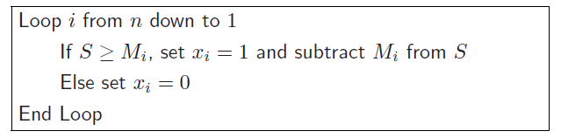
2.Subset-sum problems
Proposition 6.5.
  Let (M, S) be a subset-sum problem in which the integers in M form a superincreasing sequence. Assuming that a solution x exists, it is unique and may be computed by the following fast algorithm:

Slide 13
2.Subset-sum problems
Example
  The set M = (3, 11, 24, 50, 115) is superincreasing. We write
  S = 142 as a sum of elements in M by following the algorithm. 1) S ≥ 115, so x₅ = 1 ,S = S − 115 = 27.
  2) S=27 < 50, so x₄ = 0.
  3) S=27 ≥ 24, so x₃ = 1 , S = 27 − 24 = 3.
  4) S=3 < 11, so x2 = 0,
  5) S=3 ≥ 3, so x₁ = 1. s= 3−3 = 0
  Thus, x = (1, 0, 1, 0, 1) is a solution. We check our answer, 1 · 3 + 0 · 11 + 1 · 24 + 0 · 50 + 1 · 115 = 142.

Slide 14
2.1 Merkle and Hellman’s public key cryptosystem
Merkle and Hellman’s public key cryptosystem based on a superincreasing subset-sum problem that is disguised using congruences.
public/private key pair Creation
  Secret Key: Alice chooses a secret superincreasing sequence r = (r₁, . . . , r_{n}) and two large secret integers A and B satisfying B > 2r_{n} and gcd(A,B) = 1.
  Public Key：Alice creates a new public sequence M that is not superincreasing by setting
  M_{i}≡ Ar_{i} (mod B) with 0 ≤ M_{i} < B.

Slide 15
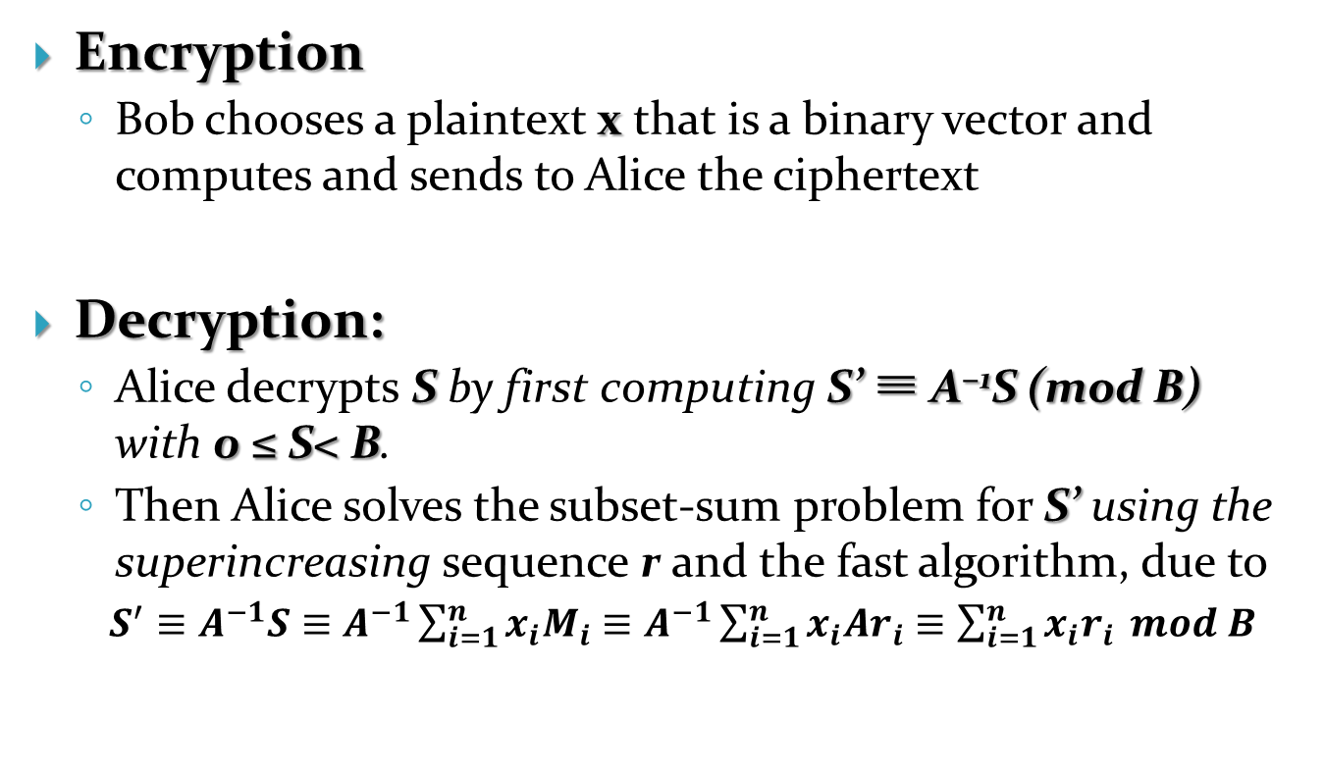
2.1 Merkle and Hellman’s public key cryptosystem
Encryption
  Bob chooses a plaintext x that is a binary vector and computes and sends to Alice the ciphertext
Decryption:
  Alice decrypts S by first computing S’ ≡ A⁻¹S (mod B) with 0 ≤ S< B.
  Then Alice solves the subset-sum problem for S’ using the superincreasing sequence r and the fast algorithm, due to
  $S^{′}≡A^{−1}S≡A^{−1}\sum_{i=1}^{n}{x_{i}M_{i}≡A^{−1}}\sum_{i=1}^{n}{x_{i}Ar_{i}≡\sum_{i=1}^{n}{x_{i}r_{i}}} mod B$

Slide 16
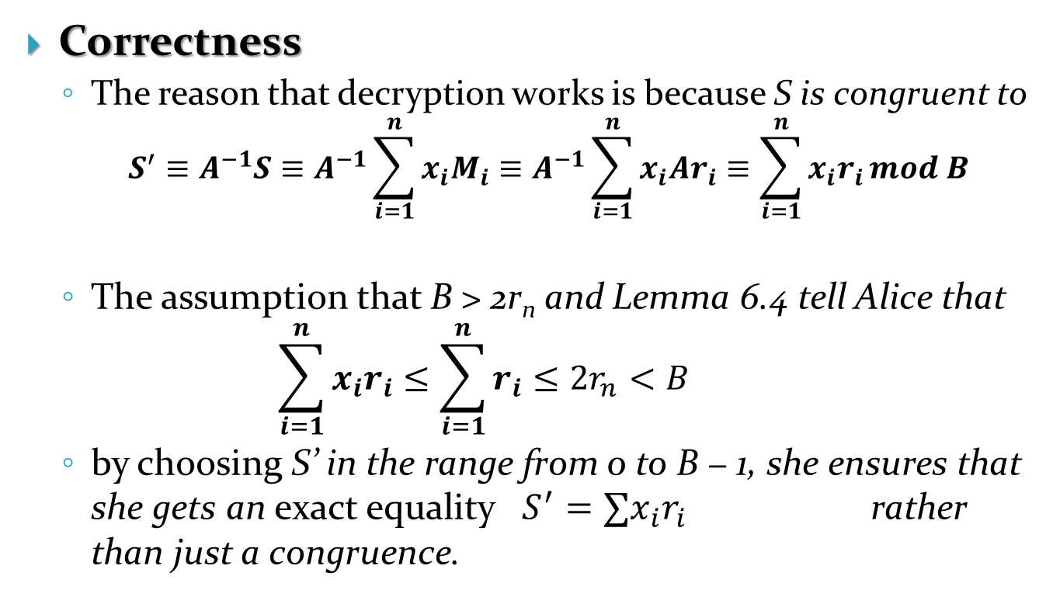
2.1 Merkle and Hellman’s public key cryptosystem
Correctness
  The reason that decryption works is because S is congruent to
      $$S^{′}≡A^{−1}S≡A^{−1}\sum_{i=1}^{n}{x_{i}M_{i}≡A^{−1}}\sum_{i=1}^{n}{x_{i}Ar_{i}≡\sum_{i=1}^{n}{x_{i}r_{i}}}mod B$$
  The assumption that B > 2r_{n} and Lemma 6.4 tell Alice that
    $$\sum_{i=1}^{n}{x_{i}r_{i}≤\sum_{i=1}^{n}{r_{i}≤2r_{n}<B}}$$
  by choosing S’ in the range from 0 to B − 1, she ensures that she gets an exact equality $S^{′}=∑x_{i}r_{i}$ rather than just a congruence.

Slide 17
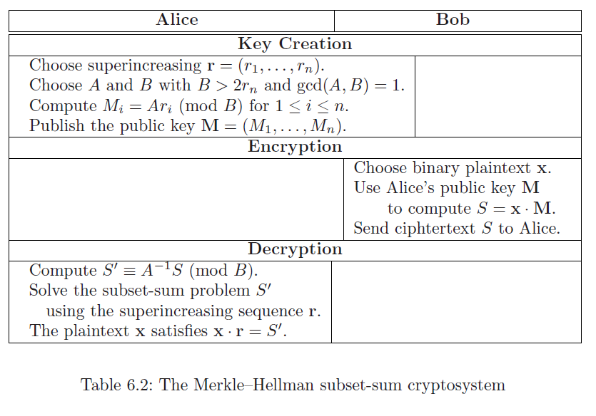
2.1 Merkle and Hellman’s public key cryptosystem

Slide 18
2.1 Merkle and Hellman’s public key cryptosystem
Example
  1) Alice’s secret superincreasing sequence:
  r = (3, 11, 24, 50, 115) , A = 113 , B = 250.
  The disguised sequence
  M ≡ (113 · 3, 113 · 11, 113 · 24, 113 · 50, 113 · 115) (mod 250)
  = (89, 243, 212, 150, 245).
  2) Bob wants to send Alice x = (1, 0, 1, 0, 1):
    encrypts x by computing
    S = x ·M = 1· 89 + 0 · 243 + 1 · 212 + 0 · 150 + 1 · 245 = 546.
  3) Alice multiplies S by 177, 113⁻¹ modulo 250, to obtain
    S’ ≡ 177 · 546 = 142 (mod 250)
    solve S’ = x · r for the superincreasing sequence r

Slide 19
2.3 Size of Parameters
Subset-sum/Knapsack Cryptosystem
  2^{n} binary vectors x = (x₁, . . . , x_{n}),
  O(2^{n/2}) operations required to break by a collision algorithm
  n>2k to obtain security on the order of 2^{k}
  r₁ should be larger than 2^{n} and thus
  r_{n} > 2r_{n−1} > 4r_{n−2} > · · · > 2^{n}r₁ > 2^{2n}.
  B > 2 r_{n} = 2^{2n+1}, M_{i} = O(2^{2n})
  The public key: M = (M₁,M₂, . . . , M_{n}),|M|=n*2n=2n² bits
  Ciphertext: S = O(2^{2n}), |S|=2n bits
  Plaintext: |x|=n bits.
  Message expansion ratio: 2:1

Slide 20
2.3 Size of Parameters
Example
  If n = 160 bits, then public key size: 2n²=51200 bits
  RSA or Diffie-Hellman of the same order of security 2⁸⁰
  requires 1000 bits, much shorter than 2n²=51200 bits
  but knapsack system has tremendous speed
  Knapsack based cryptosystems have a fundamental weakness due to LLL lattice reduction paper:
  n<300 is not secure,
  the private/public key length: 2n²=180000 bits =176Kb.
  (Too large to be impractical.)

Slide 21
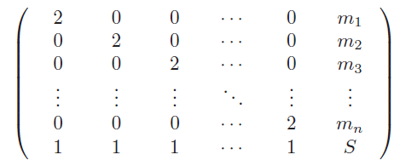
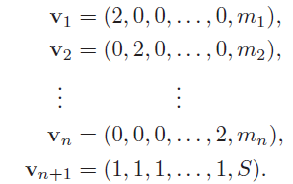
2.4 Reformulate subset-sum using vectors
to write S as a subset-sum from the set M = (m₁, . . . , m_{n})
1) form the matrix
2) label vectors as

Slide 22
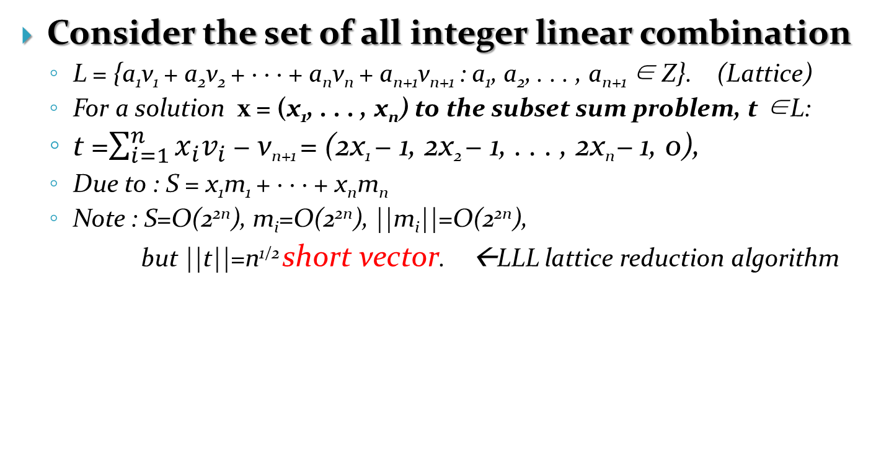
2.4 Reformulate subset sum
–short vector
Consider the set of all integer linear combination
  L = {a₁v₁ + a₂v₂ + · · · + a_{n}v_{n} + a_{n+1}v_{n+1} : a₁, a₂, . . . , a_{n+1} ∈ Z}. (Lattice)
  For a solution x = (x₁, . . . , x_{n}) to the subset sum problem, t ∈L:
  t =$\sum_{i=1}^{n}{x_{i}v_{i}}$ − v_{n+1} = (2x₁ − 1, 2x₂ − 1, . . . , 2x_{n} − 1, 0),
  Due to : S = x₁m₁ + · · · + x_{n}m_{n}
  Note : S=O(2^{2n}), m_{i}=O(2^{2n}), ||m_{i}||=O(2^{2n}),
  but ||t||=n^{1/2} short vector. ←LLL lattice reduction algorithm

Slide 23
3. A brief review of vector spaces
Vector Space in R^{m}
  A vector space V is a subset of R^{m} with the property that
  α₁v₁ + α₂v₂ ∈ V for all v₁, v₂ ∈ V and all α₁, α₂ ∈ R.
  Equivalently, a vector space is a subset of R^{m} that is closed under addition and under scalar multiplication by elements of R.
Linear Combinations
  Let v₁, v₂, . . . , v_{k} ∈ V. A linear combination of v₁, v₂, . . . , v_{k} ∈ V is any vector of the form
  w = α₁v₁ + α₂v₂ + · · · + α_{k}v_{k} with α₁, . . . , α_{k} ∈ R.
  The collection of all such linear combinations,
  {α₁v₁ + α₂v₂ + · · · + α_{k}v_{k} : α₁, . . . , α_{k} ∈ R},
  is called the span of {v₁, v₂, . . . , v_{k} }.

Slide 24
3. A brief review of vector spaces
Independence.
  A set of vectors v₁, v₂, . . . , v_{k} ∈ V is (linearly) independent
  if the only way to get
  α₁v₁ + α₂v₂ + · · · + α_{k}v_{k} = 0 (6.5)
  is to have α₁ = α₂ = · · · = α_{k} = 0. The set is (linearly) dependent if we can make (6.5) true with at least one α_{i} nonzero.
Bases.
  A basis for V is a set of linearly independent vectors v₁, v₂, . . . , v_{n} that span V . This is equivalent to saying that every vector w ∈ V can be written in the form
  w = α₁v₁ + α₂v₂ + · · · + α_{n}v_{n}
  for a unique choice of α₁, . . . , α_{n} ∈ R.

Slide 25
3. A brief review of vector spaces
Proposition 6.11. Let V ⊂ R^{m} be a vector space.
  (a) There exists a basis for V .
  (b) Any two bases for V have the same number of elements. The number of elements in a basis for V is called the dimension of V .

Slide 26
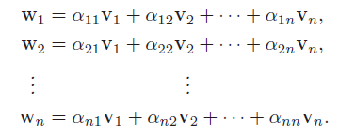
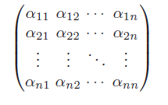
3. A brief review of vector spaces
  (c) Let v₁, v₂, . . . , v_{n} be a basis for V and let w₁, w₂, . . . , w_{n} be another set of n vectors in V . Write each w_{j} as a linear combination of the v_{i} ,
Then w₁, w₂, . . . , w_{n} is also a basis for V if and only if the determinant of the matrix is not equal to zero.

Slide 27
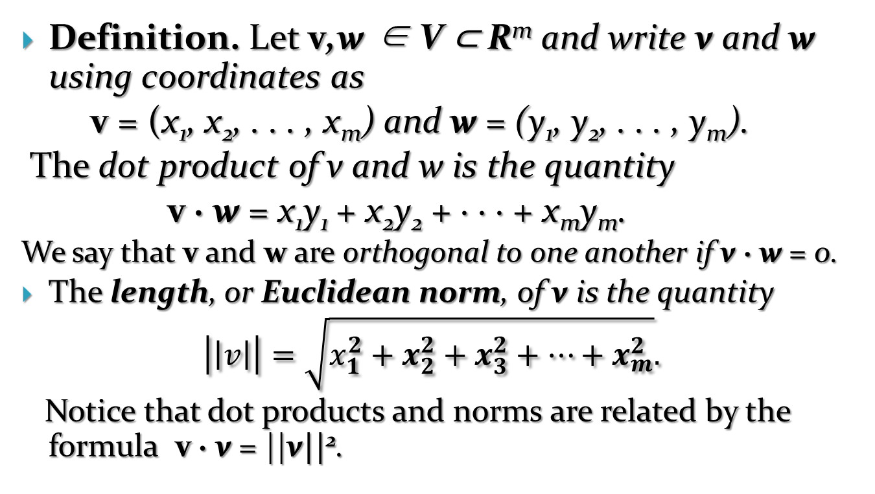
3. A brief review of vector spaces
Definition. Let v,w ∈ V ⊂ R^{m} and write v and w using coordinates as
v = (x₁, x₂, . . . , x_{m}) and w = (y₁, y₂, . . . , y_{m}).
The dot product of v and w is the quantity
v · w = x₁y₁ + x₂y₂ + · · · + x_{m}y_{m}.
We say that v and w are orthogonal to one another if v · w = 0.
The length, or Euclidean norm, of v is the quantity
$$\left|\left|v\right|\right|=\sqrt{x_{1}^{2}+x_{2}^{2}+x_{3}^{2}+…+x_{m}^{2}}.$$
Notice that dot products and norms are related by the formula v · v = ||v||².

Slide 28
3. A brief review of vector spaces
Proposition 6.12. Let v,w ∈ V ⊂ R^{m}.
(a) Let θ be the angle between the vectors v and w, where we place the starting points of v and w at the origin 0. Then
v · w = ||v|| ||w|| cos(θ), (6.6)
(b) (Cauchy–Schwarz inequality)
|v · w| ≤ ||v|| ||w|| . (6.7)

Slide 29
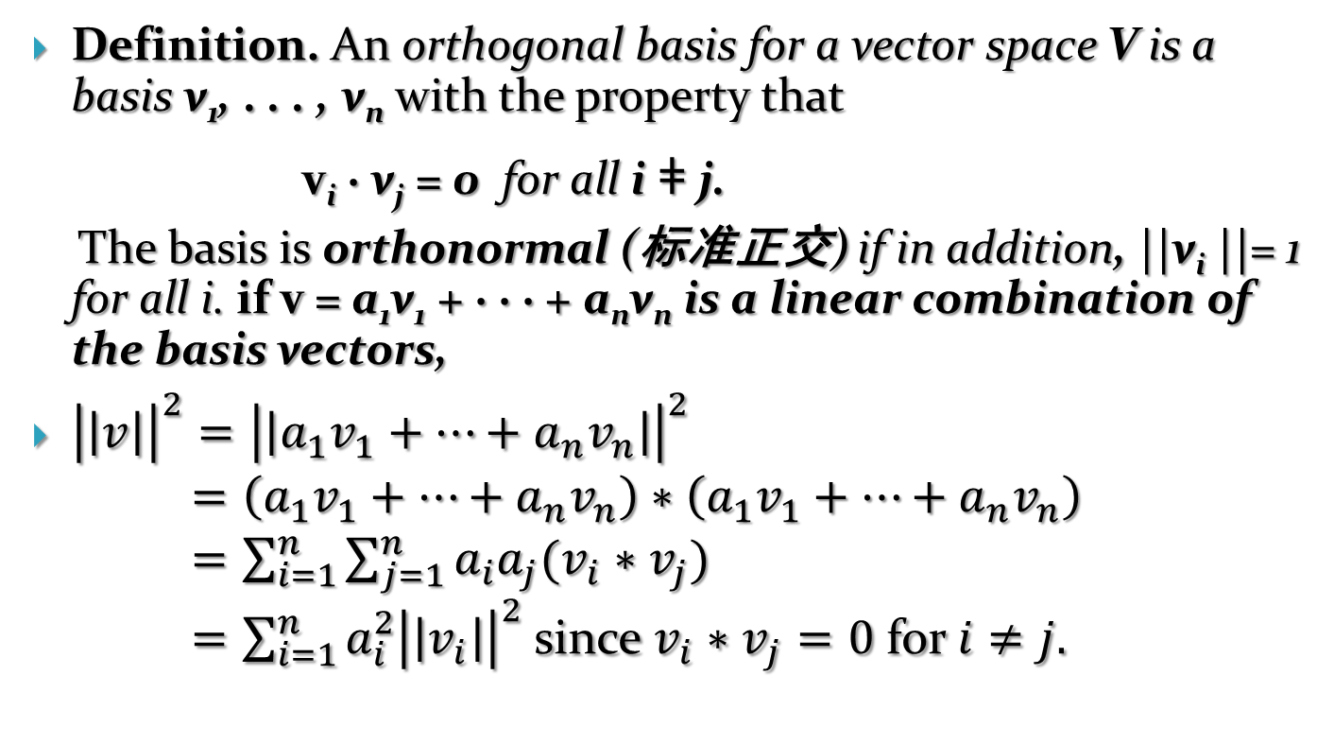
3. A brief review of vector spaces
Definition. An orthogonal basis for a vector space V is a basis v₁, . . . , v_{n} with the property that
v_{i} · v_{j} = 0 for all i ǂ j.
The basis is orthonormal (标准正交) if in addition, ||v_{i} ||= 1 for all i. if v = a₁v₁ + · · · + a_{n}v_{n} is a linear combination of the basis vectors,
${\left|\left|v\right|\right|}^{2}={\left|\left|a_{1}v_{1}+…+a_{n}v_{n}\right|\right|}^{2}$
$=\left(a_{1}v_{1}+…+a_{n}v_{n}\right)∗\left(a_{1}v_{1}+…+a_{n}v_{n}\right)$
$=\sum_{i=1}^{n}{\sum_{j=1}^{n}{a_{i}a_{j}(v_{i}∗v_{j})}}$
$=\sum_{i=1}^{n}{a_{i}^{2}{\left|\left|v_{i}\right|\right|}^{2}}$since $v_{i}∗v_{j}=0$ for $i≠j.$

Slide 30
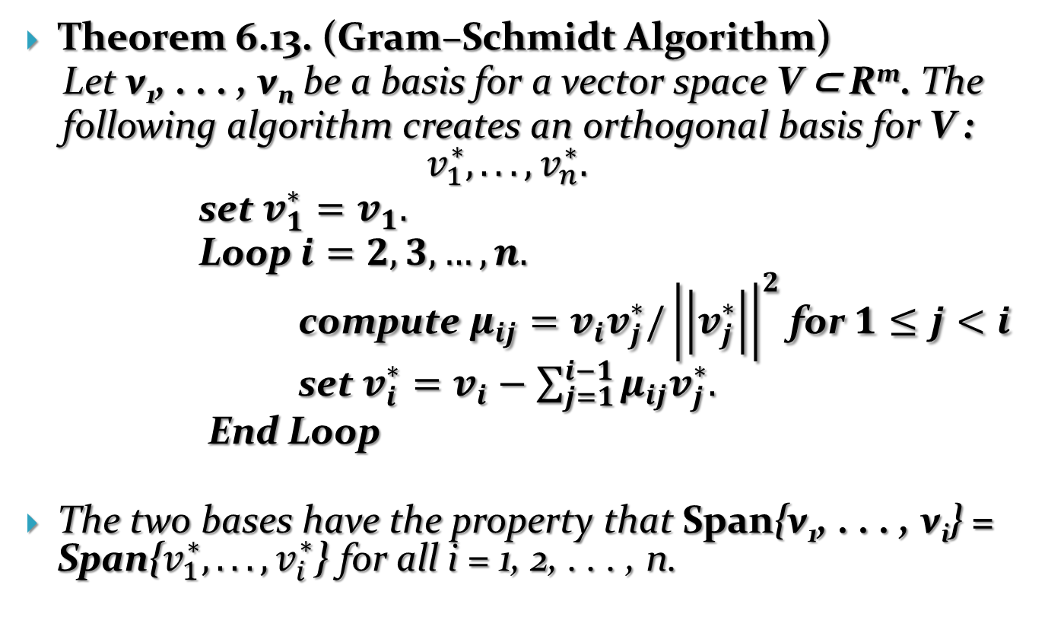
3. A brief review of vector spaces
Theorem 6.13. (Gram–Schmidt Algorithm)
Let v₁, . . . , v_{n} be a basis for a vector space V ⊂ R^{m}. The
following algorithm creates an orthogonal basis for V :
$$v_{1}^{∗},...,v_{n}^{∗}.$$
set $v_{1}^{∗}=v_{1}.$
Loop $i=2,3,…,n.$
compute $μ_{ij}=v_{i}v_{j}^{∗}/{\left|\left|v_{j}^{∗}\right|\right|}^{2}$ for $1≤j<i$
set $v_{i}^{∗}=v_{i}−\sum_{j=1}^{i−1}{μ_{ij}v_{j}^{∗}.}$
End Loop
The two bases have the property that Span{v₁, . . . , v_{i}} = Span{$v_{1}^{∗},...,v_{i}^{∗}$} for all i = 1, 2, . . . , n.

Slide 31



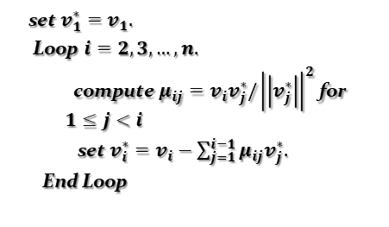

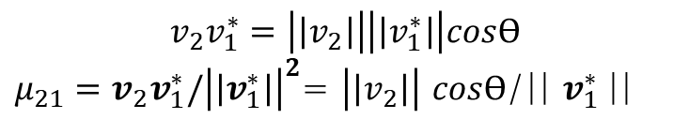




set $v_{1}^{∗}=v_{1}.$
Loop $i=2,3,…,n.$
compute $μ_{ij}=v_{i}v_{j}^{∗}/{\left|\left|v_{j}^{∗}\right|\right|}^{2}$ for $1≤j<i$
set $v_{i}^{∗}=v_{i}−\sum_{j=1}^{i−1}{μ_{ij}v_{j}^{∗}.}$
End Loop
$$−μ_{21}v_{1}^{∗}$$
$$v_{2}$$
$$ϴ$$
$$v_{1}^{∗}$$
$$−μ_{21}v_{1}^{∗}$$
$$v_{2}$$
$$ϴ$$
$$v_{1}^{∗}$$
$$μ_{21}v_{1}^{∗}$$
$$v_{2}v_{1}^{∗}=\left|\left|v_{2}\right|\right|\left|\left|v_{1}^{∗}\right|\right|cosϴ$$
${μ_{21}=v}_{2}v_{1}^{∗}/{\left|\left|v_{1}^{∗}\right|\right|}^{2}$= $\left|\left|v_{2}\right|\right|$ $cosϴ$/|| $v_{1}^{∗}$||

Slide 32
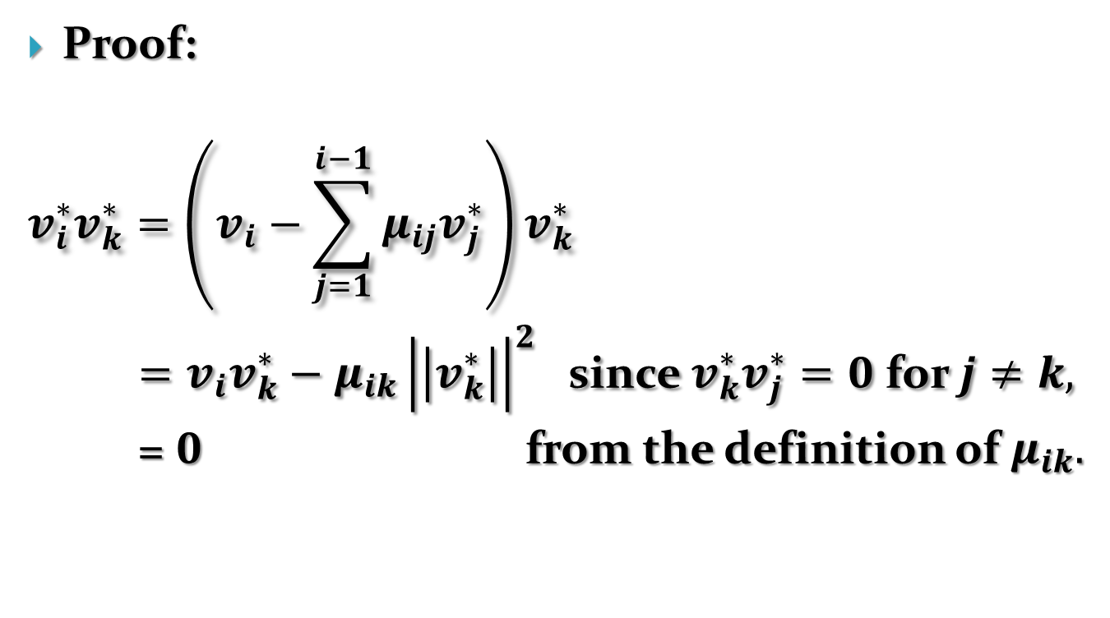
3. A brief review of vector spaces
Proof:
$$v_{i}^{∗}v_{k}^{∗}=\left(v_{i}−\sum_{j=1}^{i−1}{μ_{ij}v_{j}^{∗}}\right)v_{k}^{∗}$$
$=v_{i}v_{k}^{∗}−μ_{ik}{\left|\left|v_{k}^{∗}\right|\right|}^{2}$ since $v_{k}^{∗}v_{j}^{∗}=0$ for $j≠k,$
= $0$ from the definition of $μ_{ik}.$

Slide 33
4. Lattices: Basic definitions and properties
Definition. Let v₁, . . . , v_{n} ∈ R^{m} be a set of linearly independent vectors. The lattice L generated by v₁, . . . , v_{n} is the set of linear combinations of v₁, . . . , v_{n} , with coefficients in Z,
L = {a₁v₁ + a₂v₂ + · · · + a_{n}v_{n} : a₁, a₂, . . . , a_{n} ∈ Z}.
A basis for L is any set of independent vectors that generates L. Any two such sets have the same number of elements. The dimension of L is the number of vectors in a basis for L.

Slide 34
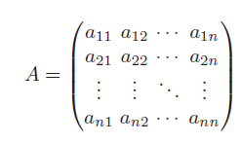
4. Lattices: Basic definitions and properties
A basis for a lattice L: v₁, . . . , v_{n}
Collection of vectors: w₁, . . . ,w_{n} ∈ L
  w₁ = a₁₁v₁ + a₁₂v₂ + · · · + a_{1n}v_{n},
  w₂= a₂₁v₁ + a₂₂v₂ + · · · + a_{2n}v_{n},
  ...
  ...
  w_{n}= a_{n1}v₁ + a_{n2}v₂ + · · · + a_{nn}v_{n},
  a_{ij} are all integers.
  W={w₁,…, w_{n}}, V={v₁,…, v_{n}}^{T},
  A⁻¹ A=I
  W=AV, V=A⁻¹W
  1=det(I)=det(A A⁻¹)=det(A)det(A⁻¹)
  det(A)=det(A⁻¹) = ± 1

Slide 35
4. Lattices: Basic definitions and properties
Proposition 6.14. Any two bases for a lattice L are related by a matrix having integer coefficients and determinant equal to ±1.
Definition. An integral (or integer) lattice is a lattice all of whose vectors have integer coordinates. Equivalently, an integral lattice is an additive subgroup of Z^{m} for some m ≥ 1.

Slide 36
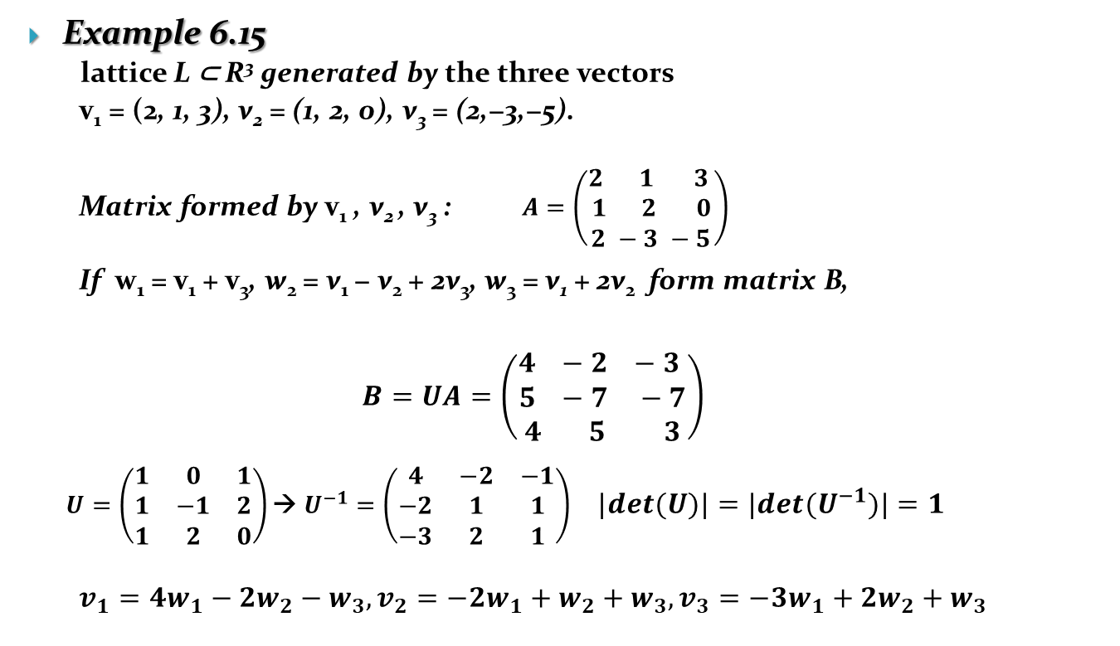
4. Lattices: Basic definitions and properties
Example 6.15
  lattice L ⊂ R³ generated by the three vectors
  v₁ = (2, 1, 3), v₂ = (1, 2, 0), v₃ = (2,−3,−5).
  Matrix formed by v₁ , v₂ , v₃ : $A=\left(\begin{aligned}2 1 3 \\ 1 2 0 \\ 2 −3 −5\end{aligned}\right)$
  If w₁ = v₁ + v₃, w₂ = v₁ − v₂ + 2v₃, w₃ = v₁ + 2v₂ form matrix B,
  $$B=UA=\left(\begin{aligned}4 −2 −3 \\ 5 −7 −7 \\ 4 5 3\end{aligned}\right)$$
  $U=\left(\begin{matrix}1 & 0 & 1 \\ 1 & −1 & 2 \\ 1 & 2 & 0\end{matrix}\right)\text{→} U^{−1}=\left(\begin{matrix}4 & −2 & −1 \\ −2 & 1 & 1 \\ −3 & 2 & 1\end{matrix}\right)$ $|det⁡(U)|=|det⁡(U^{−1})|=1$
  $$v_{1}=4w_{1}−2w_{2}−w_{3}, v_{2}=−2w_{1}+w_{2}+w_{3}, v_{3}=−3w_{1}+2w_{2}+w_{3}$$

Slide 37
4. Lattices: Basic definitions and properties
Definition. A subset L of R^{m} is an additive subgroup if it is closed under addition and subtraction. It is called a discrete additive subgroup if there is a positive constant 𝜀> 0 with the following property: for every v ∈ L,
L ∩ {w ∈ R^{m} : ||v − w|| <𝜀 } = {v}. (6.8)
In other words, if you take any vector v in L and draw a solid ball of radius 𝜀 around v, then there are no other points of L inside the ball.

Slide 38
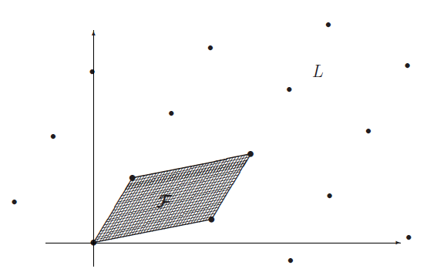
4. Lattices: Basic definitions and properties
Theorem 6.17. A subset of R^{m} is a lattice if and only if it is a discrete additive subgroup.
a lattice viewed as an orderly arrangement of points in R^{m}
A lattice L and a fundamental domain F

Slide 39
4. Lattices: Basic definitions and properties
Definition. Let L be a lattice of dimension n and let v₁, v₂, . . . , v_{n} be a basis for L. The fundamental domain (or fundamental parallelepiped) for L corresponding to this basis is the set
F(v₁, . . . , v_{n}) = {t₁v₁ + t₂v₂ + · · · + t_{n}v_{n} : 0 ≤ t_{i} < 1}

Slide 40
4. Lattices: Basic definitions and properties
Proposition 6.18. Let L ⊂ R^{n} be a lattice of dimension n and let F be a fundamental domain for L. Then every vector w ∈ R^{n} can be written in the form
w = t + v for a unique t ∈ F and a unique v ∈ L.
Equivalently, the union of the translated fundamental domains
F + v ={ t + v : t ∈ F}
as v ranges over the vectors in the lattice L exactly covers R^{n}

Slide 41
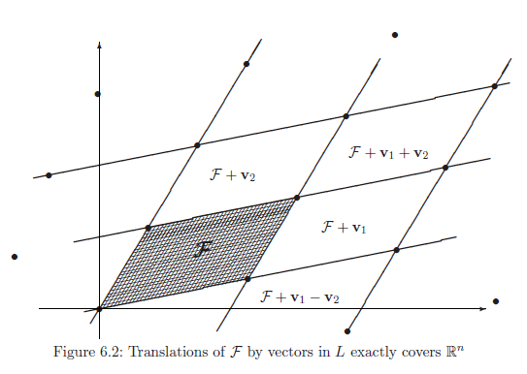
4. Lattices: Basic definitions and properties

Slide 42
4. Lattices: Basic definitions and properties
Definition. Let L be a lattice of dimension n and let F be a fundamental domain for L. Then the n-dimensional volume of F is called the determinant of L (or sometimes the covolume of L). It is denoted by det(L).
view the basis vectors v₁, . . . , v_{n} as being vectors of a given length that describe the sides of the parallelepiped F, the largest volume is obtained when the vectors are pairwise orthogonal to one another

Slide 43
4. Lattices: Basic definitions and properties
Proposition 6.19 (Hadamard’s Inequality). Let L be a lattice, take any basis v₁, . . . , v_{n} for L, and let F be a fundamental domain for L. Then
detL = Vol(F) ≤ ||v₁ || || v₂ || · · · || v_{n} ||. (6.10)
The closer that the basis is to being orthogonal, the closer that Hadamard’s inequality (6.10) comes to being an equality.

Slide 44
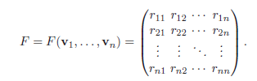
4. Lattices: Basic definitions and properties
Proposition 6.20. Let L ⊂ R^{n} be a lattice of dimension n, let v₁, v₂, . . . , v_{n} be a basis for L, and let F = F(v₁, v₂, . . . , v_{n} ) be the associated fundamental domain. Write the coordinates of the ith basis vector as
v_{i} = (r_{i1}, r_{i2}, . . . , r_{in})
and use the coordinates of the v_{i} as the rows of a matrix,
Then the volume of F is given by the formula
VolF(v₁, . . . , v_{n}) =|detF(v₁, . . . , v_{n})|.

Slide 45
4. Lattices: Basic definitions and properties
  Corollary 6.22. Let L ⊂ R^{n} be a lattice of dimension n. Then every fundamental domain for L has the same volume. Hence det(L) is an invariant of the lattice L, independent of the particular fundamental domain used to compute it.

Slide 46
5. Short vectors in lattices
The Shortest Vector Problem (SVP): Find a shortest nonzero vector in a lattice L, i.e., find a nonzero vector v ∈ L that minimizes the Euclidean norm v.
The Closest Vector Problem (CVP): Given a vector w ∈ R^{m} that is not in L, find a vector v ∈ L that is closest to w, i.e., find a vector v ∈ L that minimizes the Euclidean norm ||w − v||.
there may be more than one shortest /closest nonzero vector in a lattice.

Slide 47
5. Short vectors in lattices
There may be more than one shortest nonzero vector in a lattice.
Both SVP and CVP are profound problems, and both become computationally difficult as the dimension n of the lattice grows.
CVP is known to be NP-hard and SVP is NP-hard under a certain “randomized reduction hypothesis.”

Slide 48
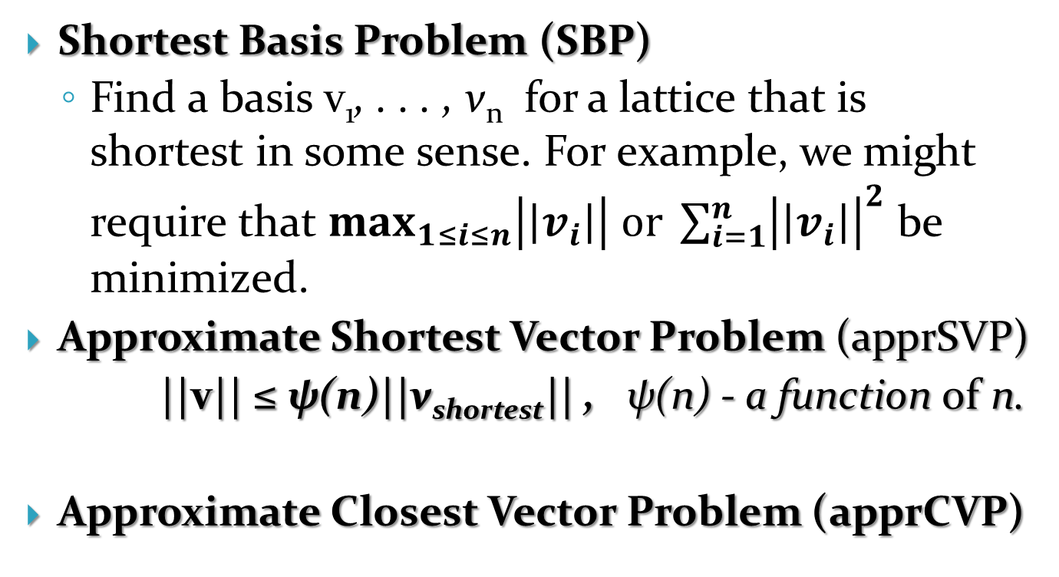
Variants of SVP and CVP
Shortest Basis Problem (SBP)
  Find a basis v₁, . . . , v_{n} for a lattice that is shortest in some sense. For example, we might require that $\max_{1≤i≤n}\left|\left|v_{i}\right|\right| or \sum_{i=1}^{n}{{\left|\left|v_{i}\right|\right|}^{2}}$ be minimized.
Approximate Shortest Vector Problem (apprSVP)
||v|| ≤ ψ(n)||v_{shortest}|| , ψ(n) - a function of n.
Approximate Closest Vector Problem (apprCVP)

Slide 49
Hadamard ratio
an n-dimensional lattice L always has a basis v₁, . . . , v_{n} satisfying
||v₁||||v₂|| · · · ||v_{n}|| ≤ n^{n/2}(detL).
Hadamard’s inequality
||v₁||||v₂|| · · · ||v_{n}|| ≥ det L.
Hadamard ratio of the basis B = {v₁, . . . , v_{n} }
Thus 0 < H(B) ≤ 1, and the closer that the value is to 1, the more orthogonal are the vectors in the basis.

Slide 50
6. Babai’s algorithm and using a “good” basis to solve apprCVP
If a lattice L ⊂ R^{n} has a basis v₁, . . . , v_{n} consisting of vectors that are pairwise orthogonal, i.e., such that v_{i} · v_{j} = 0 for all i = j, it is easy to solve both SVP and CVP.
solve SVP: the length of any vector in L
  the shortest nonzero vector(s) in L are simply the shortest vector(s) in the set {±v₁, . . . ,±v_{n}}.

Slide 51
to solve CVP
to find the vector in L that is closest to a given vector w ∈ R^{n}
w = t₁v₁ + t₂v₂ + · · · + t_{n}v_{n} ; t₁, . . . , t_{n} ∈ R. for v = a₁v₁ + · · · + a_{n}v_{n} ∈ L,
||v−w||² = (a₁ −t₁)²v₁² +(a₂ −t₂)²v₂² +· · ·+(a_{n} −t_{n})²v_{n}². (6.23)
The a_{i} are required to be integers, so (6.23) is minimized if we take each a_{i} to be the integer closest to the corresponding t_{i}.

Slide 52
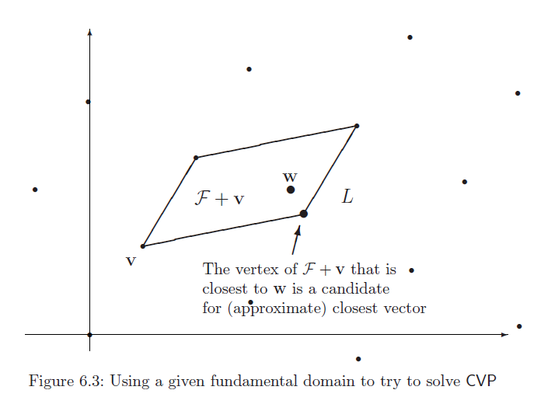

Slide 53
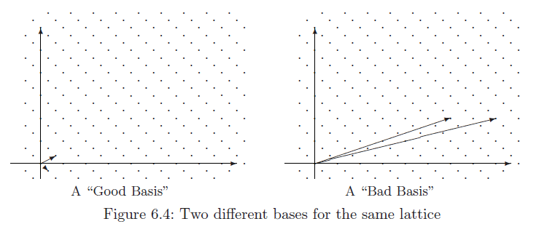
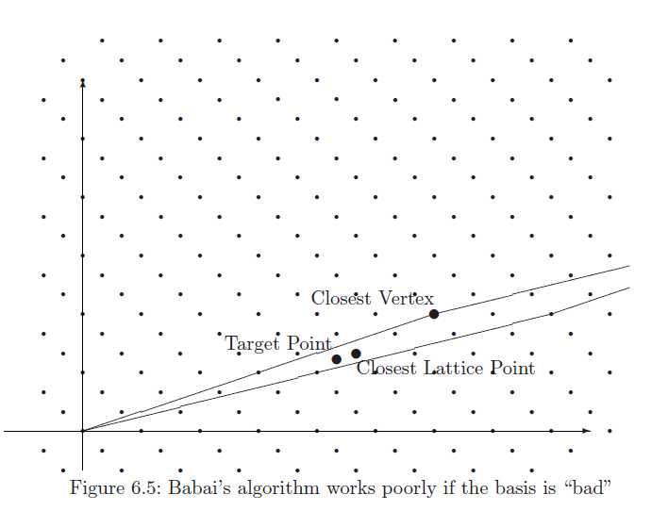

Slide 54
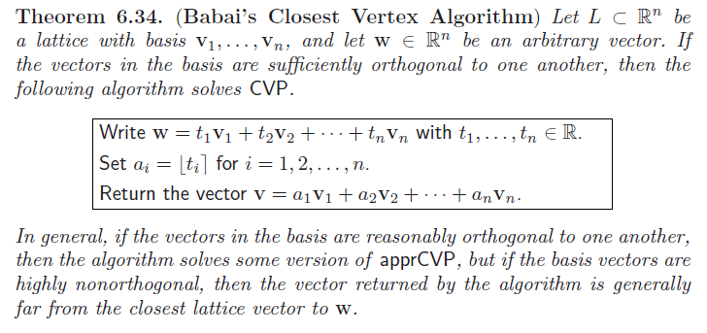

Slide 55
Example 6.35. Let L ⊂ R² be the lattice given by the basis v₁ = (137, 312) and v₂ = (215,−187). To find a vector in L that is close to the vector w = (53172, 81743).
1). to express w as a linear combination of v₁ and v₂ using real coordinates: w = t₁v₁ + t₂v₂. i.e.,
  53172 = 137t₁+ 215t₂ and 81743 = 312t₁ − 187t₂, (6.24)
  t1 ≈ 296.85 and t2 ≈ 58.15
2). v =⎿t₁⏋ v₁ + ⎿ t₂⏋v₂ = 297(137, 312) + 58(215,−187) = (53159, 81818).
Then v is in L and v should be close to w, and ||v − w|| ≈ 76.12

Slide 56


Hadamard ratio of v₁,v₂
To solve the same closest vector problem in the same lattice, but using the new (bad) basis:
  v₁’= (1975, 438) = 5v₁ + 6v₂ and v₂’ = (7548, 1627) = 19v₁ + 23v₂.
  the solution (t1, t2) ≈ (5722.66,−1490.34),
v' = 5723v₁’− 1490v₂’= (56405, 82444).
Hadamard ratio of v₁’,v₂’:

Slide 57
7. Cryptosystems based on hard lattice problems
Based on SVP and/or CVP in a lattice L of large dimension n.
  the GGH cryptosystem of Goldreich, Goldwasser, and Halevi
  the NTRU cryptosystem proposed by Hoffstein, Pipher,and Silverman
Motivation:
  1) to have cryptosystems based on a variety of hard mathematical problems;
  2) lattice-based cryptosystems are frequently much faster than factorization or discrete logarithm-based systems such as ElGamal, RSA, and ECC;
  3) based on simple linear algebra operations , easy to implement in hardware and software .
But the security analysis of lattice-based cryptosystems is not nearly well understood yet.

Slide 58
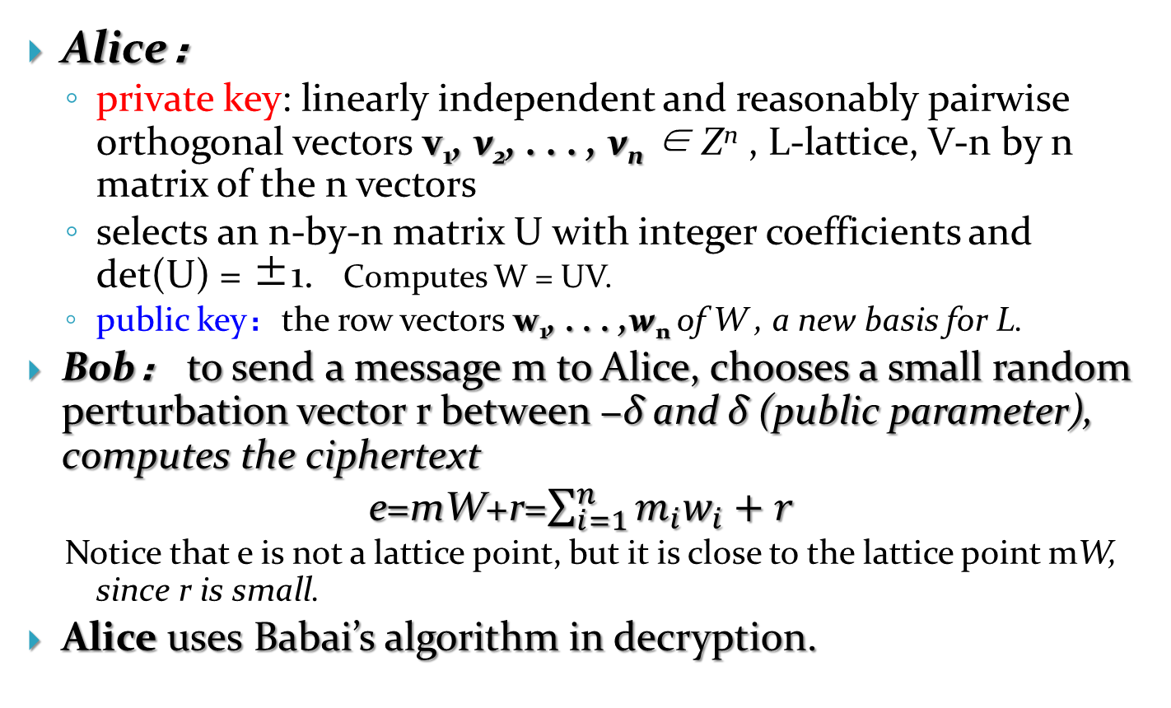
8. The GGH public key cryptosystem
Alice：
  private key: linearly independent and reasonably pairwise orthogonal vectors v₁, v₂, . . . , v_{n} ∈ Z^{n} , L-lattice, V-n by n matrix of the n vectors
  selects an n-by-n matrix U with integer coefficients and det(U) = ±1. Computes W = UV.
  public key：the row vectors w₁, . . . ,w_{n} of W , a new basis for L.
Bob： to send a message m to Alice, chooses a small random perturbation vector r between −δ and δ (public parameter), computes the ciphertext
e=mW+r=$\sum_{i=1}^{n}{m_{i}w_{i}+r}$
  Notice that e is not a lattice point, but it is close to the lattice point mW, since r is small.
Alice uses Babai’s algorithm in decryption.

Slide 59
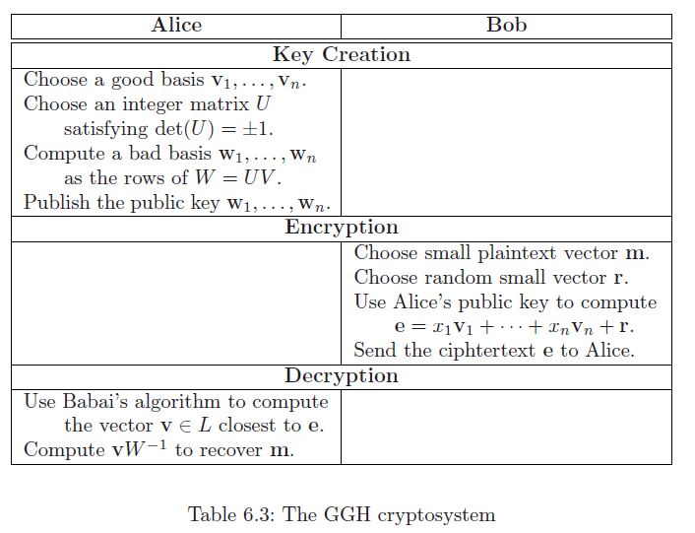
e = m₁w₁ + · · · + m_{n}w_{n} + r.
← Use good basis to remove r

Slide 61
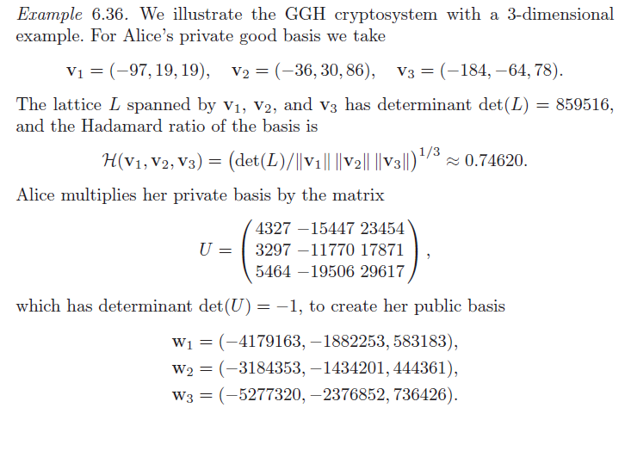
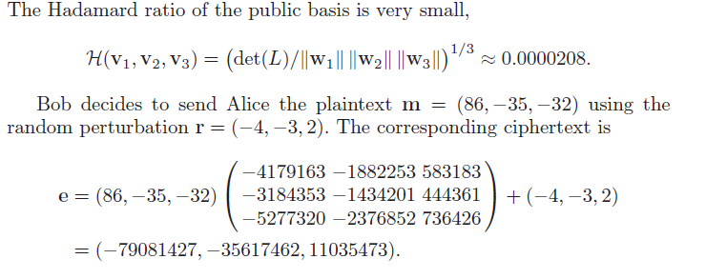

Slide 62
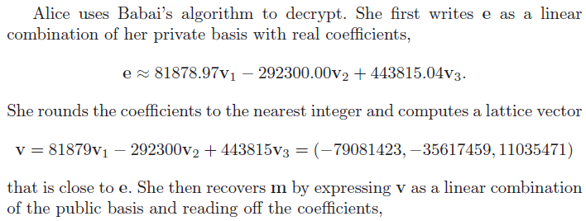
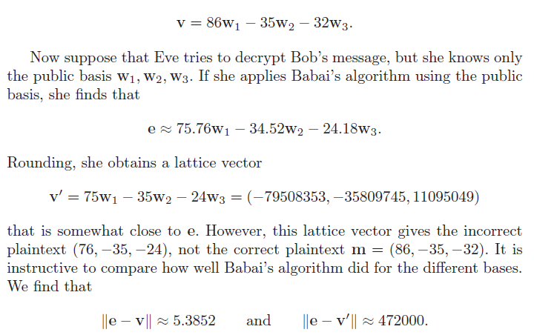

Slide 63
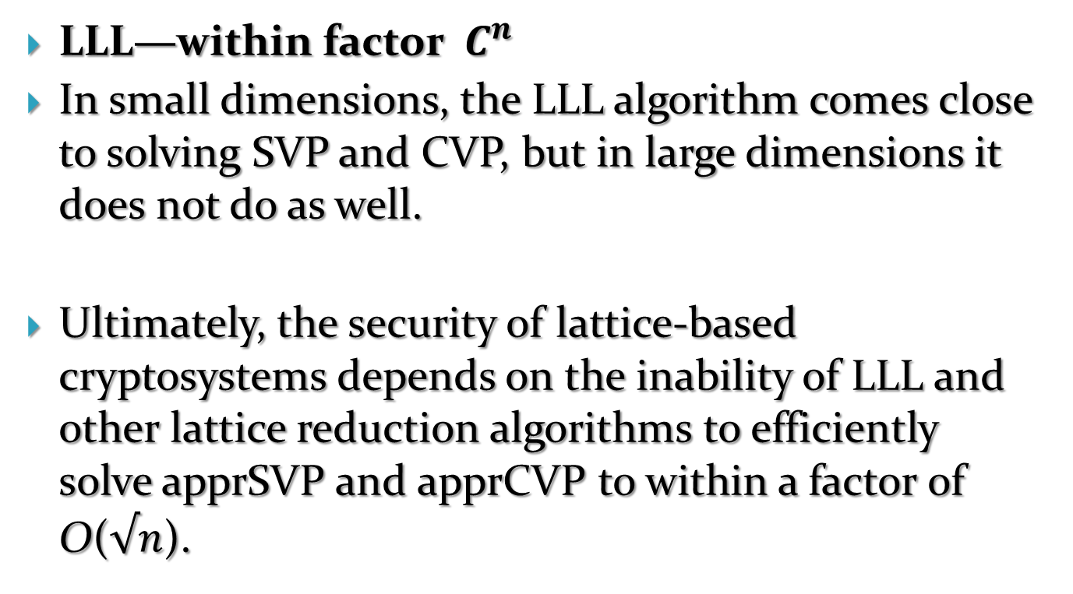
Lattice Reduction Algorithm
LLL—within factor $C^{n}$
In small dimensions, the LLL algorithm comes close to solving SVP and CVP, but in large dimensions it does not do as well.
Ultimately, the security of lattice-based cryptosystems depends on the inability of LLL and other lattice reduction algorithms to efficiently solve apprSVP and apprCVP to within a factor of O($√n$).

Slide 64
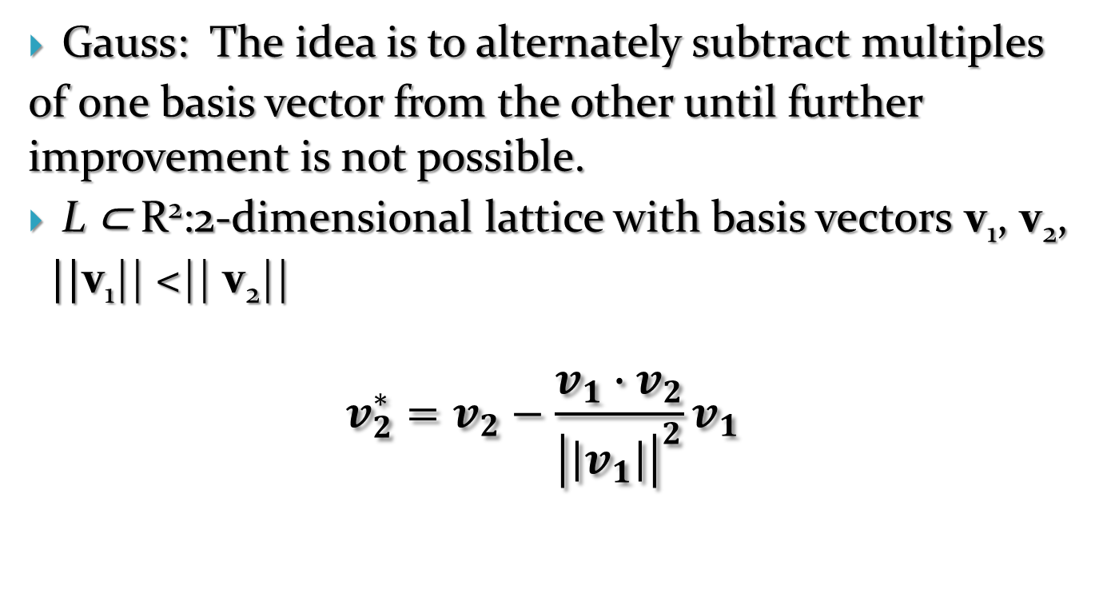
Gaussian lattice reduction in dimension 2
Gauss: The idea is to alternately subtract multiples
of one basis vector from the other until further improvement is not possible.
L ⊂ R²:2-dimensional lattice with basis vectors v₁, v₂,
||v₁|| <|| v₂||
$$v_{2}^{∗}=v_{2}−\frac{v_{1}∙v_{2}}{{\left|\left|v_{1}\right|\right|}^{2}}v_{1}$$

Slide 65
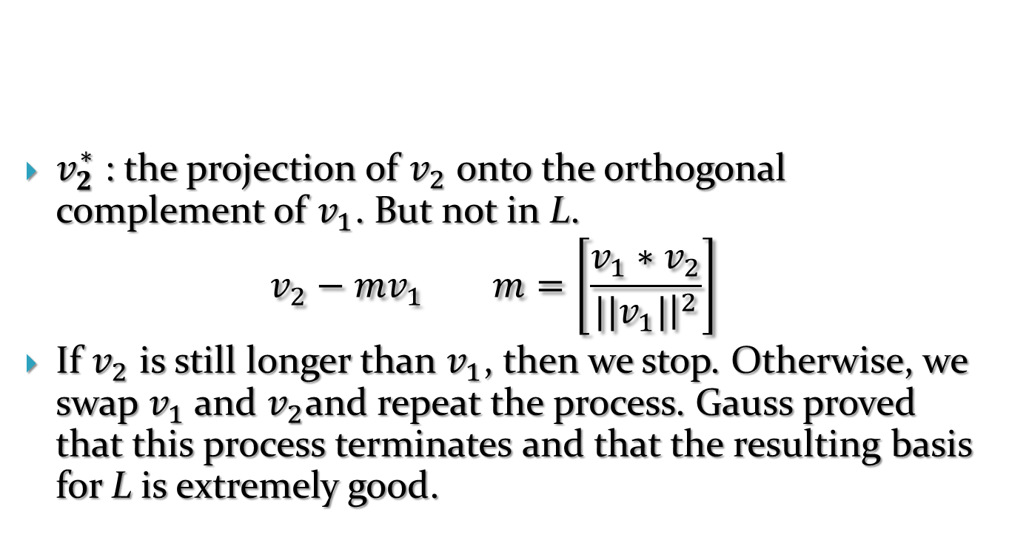
$v_{2}^{∗}$ : the projection of $v_{2}$ onto the orthogonal complement of $v_{1}$. But not in L.
$$v_{2}−mv_{1} m=\left[\frac{v_{1}∗v_{2}}{{||v}_{1}|{\left.​\right|}^{2}}\right]$$
If $v_{2}$ is still longer than $v_{1}$, then we stop. Otherwise, we swap $v_{1}$ and $v_{2}$and repeat the process. Gauss proved that this process terminates and that the resulting basis for L is extremely good.

Slide 66
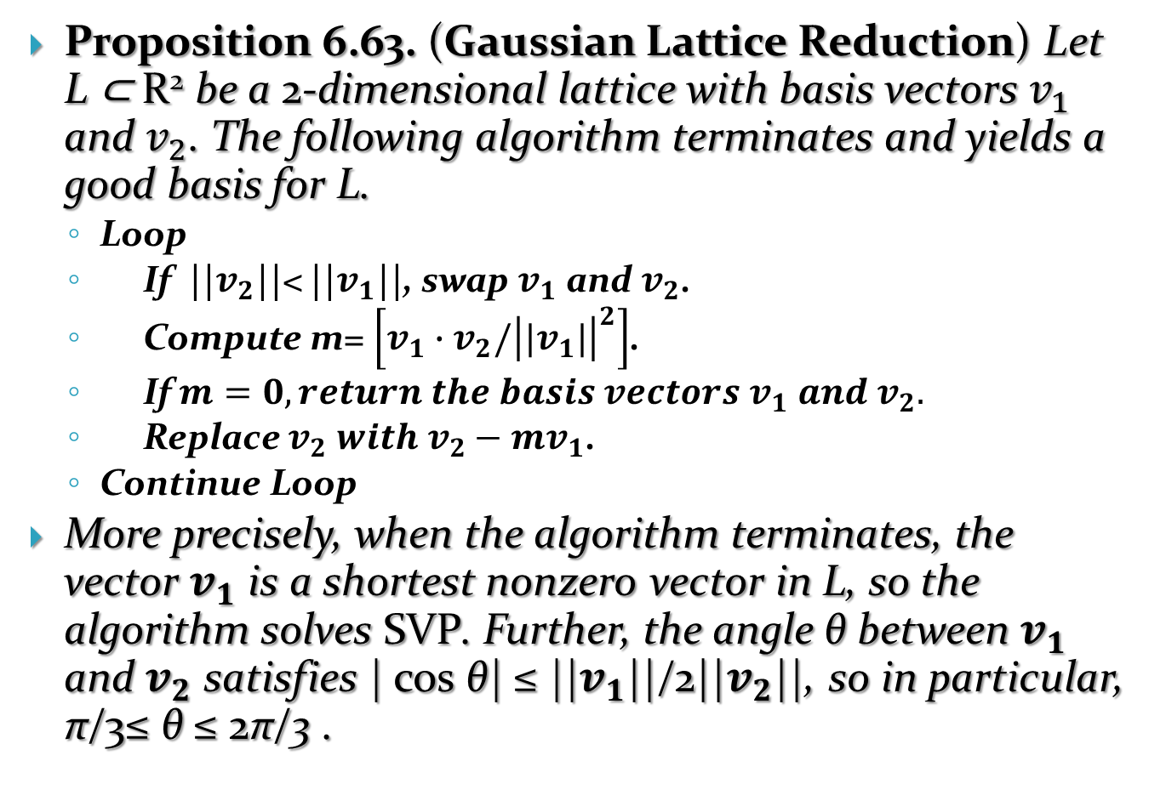
Proposition 6.63. (Gaussian Lattice Reduction) Let L ⊂ R² be a 2-dimensional lattice with basis vectors $v_{1}$ and $v_{2}$. The following algorithm terminates and yields a good basis for L.
  Loop
  If ||$v_{2}$||< ||$v_{1}$||, swap $v_{1}$ and $v_{2}$.
  Compute m= $\left[v_{1}{∙v}_{2}/{\left|{|v}_{1}|\right|}^{2}\right]$.
  If $m=0, return the basis vectors v_{1} and v_{2}.$
  Replace $v_{2} with v_{2}−mv_{1}$.
  Continue Loop
More precisely, when the algorithm terminates, the vector $v_{1}$ is a shortest nonzero vector in L, so the algorithm solves SVP. Further, the angle θ between $v_{1}$ and $v_{2}$ satisfies | cos θ| ≤ ||$v_{1}$||/2||$v_{2}$||, so in particular, π/3≤ θ ≤ 2π/3 .

Slide 67

$v_{1}$ = (66586820, 65354729) and $v_{2}$ = (6513996, 6393464).

Slide 68
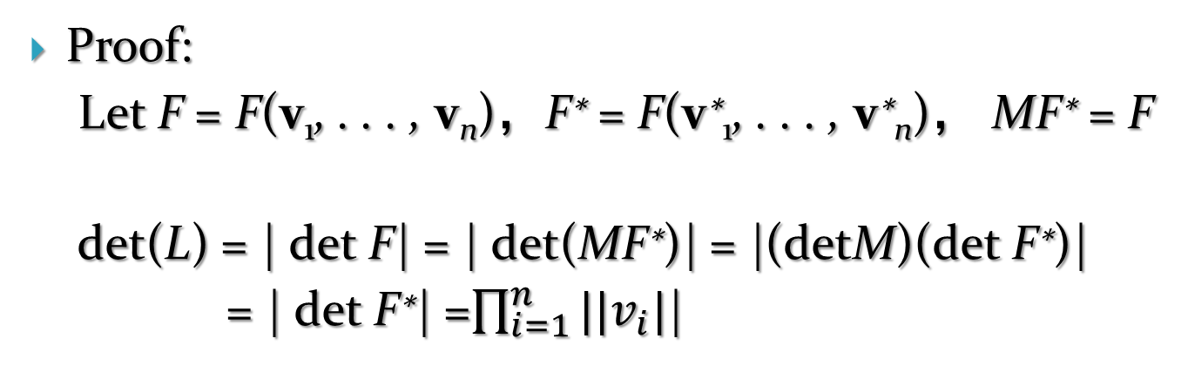
The LLL lattice reduction algorithm
Proof:
Let F = F(v₁, . . . , v_{n})，F∗ = F(v∗₁, . . . , v∗_{n})， MF∗ = F
det(L) = | det F| = | det(MF∗)| = |(detM)(det F∗)|
= | det F∗| =$\prod_{i=1}^{n}{||v_{i}|}$|

Slide 71
Hadamard ratio H(M^{LLL}) =0.878973 is a bit lower than the former.
The output from LLL is dependent on the order of the basis vectors.
If using 0.99 instead of 3/4 in the Lov´asz Step, 22 swap steps required
H(M^{LLL}) =0.87897.
Unpredictable dependence of the LLL algorithm’s output on its parameters

Slide 72
6.13 Applications of LLL to cryptanalysis
Secure instances of cryptosystems require lattices of dimension 500 to 1000, which, except for NTRU, lead to impractical key lengths

Slide 73
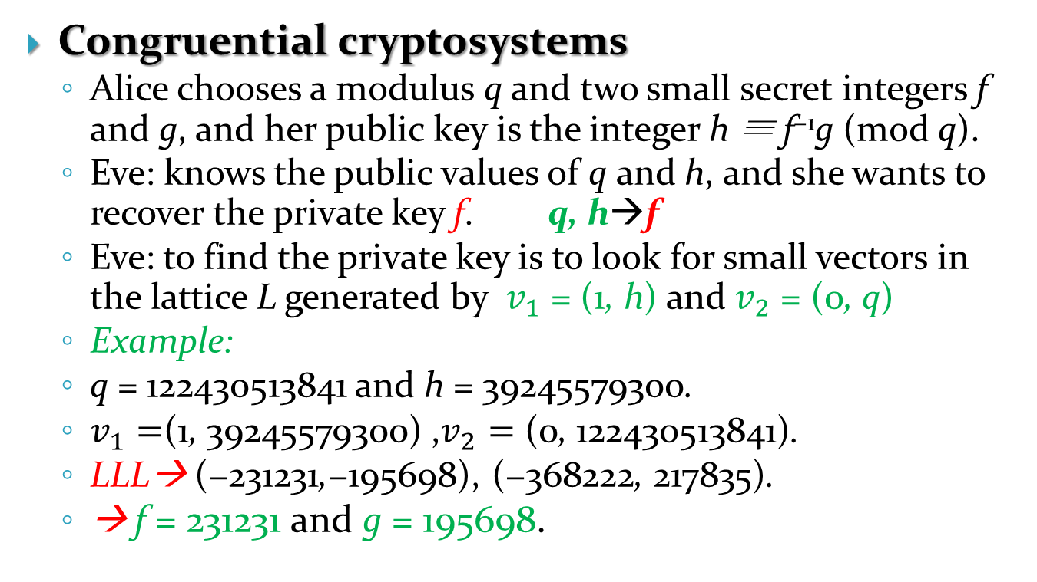
6.13 Applications of LLL to cryptanalysis-1
Congruential cryptosystems
  Alice chooses a modulus q and two small secret integers f and g, and her public key is the integer h ≡ f⁻¹g (mod q).
  Eve: knows the public values of q and h, and she wants to recover the private key f. q, h→f
  Eve: to find the private key is to look for small vectors in the lattice L generated by $v_{1}$ = (1, h) and $v_{2}$ = (0, q)
  Example:
  q = 122430513841 and h = 39245579300.
  $v_{1}=$(1, 39245579300) ,$v_{2}=$ (0, 122430513841).
  LLL→ (−231231,−195698), (−368222, 217835).
  → f = 231231 and g = 195698.

Slide 74
6.13 Applications of LLL to cryptanalysis-2
Applying LLL to knapsacks
Example:
  M = (89, 243, 212, 150, 245) and S = 546
  LLL performs 21 swaps ->the reduced basis
  The short vector: (−1, 1,−1, 1,−1, 0)
  (−1, 1,−1, 1,−1, 0) = (−1, 0,−1, 0,−1, 1)A_{M,S} .
  The solution to the knapsack problem
  −89 − 212 − 245 + 546 = 0.

Slide 75
6.13 Applications of LLL to cryptanalysis-3
Applying LLL to GGH
Example 6.36
  Alice’s public lattice L generated by the rows w₁,w₂,w₃
  Bob’s encrypted message
  e = (−79081427,−35617462, 11035473).
  Eve: to find a vector in L that is close to e: applies LLL to the lattice L and finds the quasi-orthogonal basis

Slide 76
6.13 Applications of LLL to cryptanalysis-3
Eve next applies Babai’s algorithm to find a lattice vector v = (79081423, 35617459,−11035471), very close to e.
v = −86w₁ + 35w₂ + 32w₃
Bob’s plaintext: m = (−86, 35, 32).

Slide 77
Exercises

Slide 78
Exercises

Slide 79
Exercises

Slide 80
Exercises

