Slide 1
Theory and Practice of Modern Cryptography
Chapter 8 Number Theory
Miao Fuyou (苗付友)
mfy@ustc.edu.cn
Oct. 2022

Slide 2
Outline
1. Divisibility and the Division Algorithm
2. The Euclidean Algorithm
3. Modular Arithmetic
4. Prime Numbers
5. Fermat’s and Euler’s Theorems
6. Testing for Primality
7. Finding Multiplicative Inverse
8. The Chinese Remainder Theorem
9. Discrete Logarithms

Slide 3
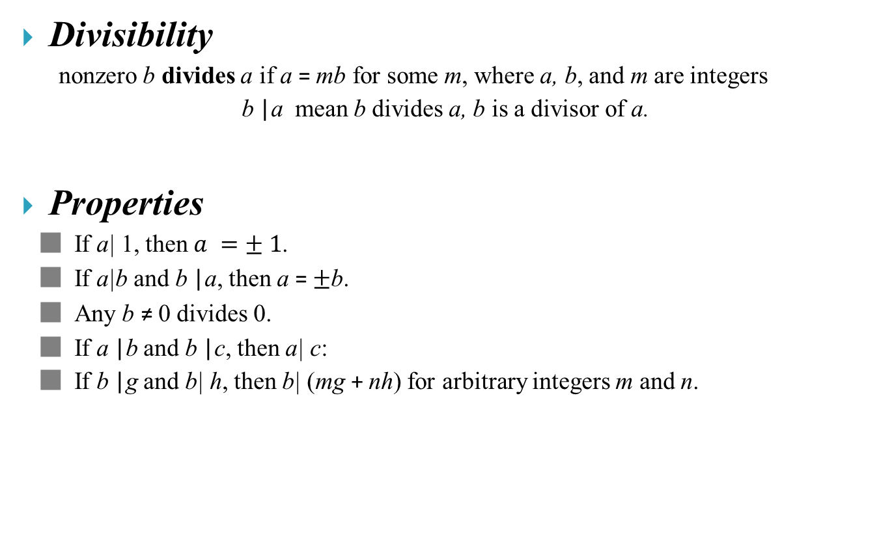
1.Divisibility and the Division Algorithm
Divisibility
nonzero b divides a if a = mb for some m, where a, b, and m are integers
b |a mean b divides a, b is a divisor of a.
Properties
■ If a| 1, then $a =± 1$.
■ If a|b and b |a, then a = $±$b.
■ Any b ≠ 0 divides 0.
■ If a |b and b |c, then a| c:
■ If b |g and b| h, then b| (mg + nh) for arbitrary integers m and n.

Slide 4
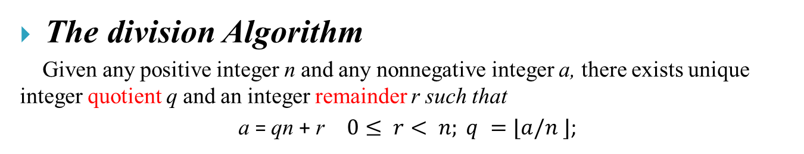
Divisibility and the Division Algorithm
The division Algorithm
Given any positive integer n and any nonnegative integer a, there exists unique integer quotient q and an integer remainder r such that
a = qn + r $0≤ r< n; q =⌊a/n ⌋$;

Slide 5
2.The Euclidean Algorithm
Two integers are relatively prime if and only if their only common positive integer factor is 1.
Greatest Common Divisor
  The greatest common divisor (gcd) of a and b is the largest positive integer that divides both a and b.
  The positive integer c is said to be the greatest common divisor of a and b if
    1. c is a divisor of a and of b.
    2. any divisor of a and b is a divisor of c.
Equivalently, gcd(a, b) = max[k, such that k |a and k |b]

Slide 6

Finding the Greatest Common Divisor
Given integer $a, b$, let $d=gcd⁡(a,b),$to find $d$

Slide 7
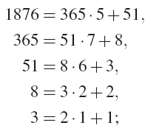
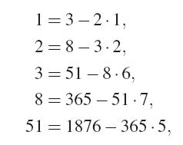
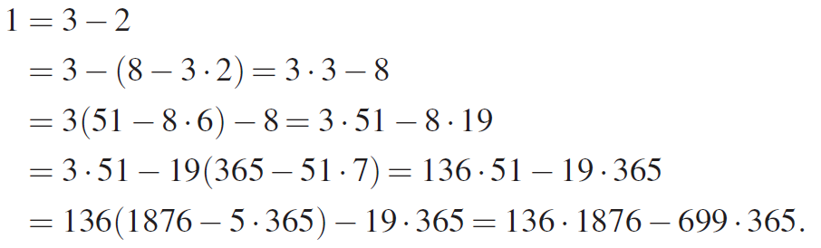
Bezout’s Identity
Replace in the inverse direction
Theorem 4 (Bezout’s Identity). If the greatest common divisor of a and b is d, then
d = ar+bs
holds for some integers r and s.

Slide 8
Finding the Greatest Common Divisor

Slide 9
Extended Euclidean Algorithm matrix
求d = 365x+1876y d=1
d x y
(coeff. of 365 ) (coeff. of
1876)
1876 0 1
365 1 0
365 ·5 5 0
51 = 1876−365 ·5 −5 1
51 ·7 −35 7
8 = 365−51 ·7 36 −7
8 ·6 216 −42
3 = 51−8 · 6 −221 43
3 · 2 −442 86
2 = 8−3 · 2 478 −93
1 = 3−2 −699 136
d x y
(coeff. of 365 ) (coeff. of
1876)
1876 = 0* 365 + 1*1876
365 =1* 365 + 0*1876
365 ·5 =5 * 365 + 0*1876
51 = 1876−365 ·5 = −5 *365 + 1*1876
51 ·7 = −35 *365 + 7*1876
8 = 365−51 ·7 = 36 *365 − 7*1876
8 ·6 = 216 *365 − 42*1876
3 = 51−8 · 6 =−221 *365 +43*1876
3 · 2 = −442 * 365 +86*1876
2 = 8−3 · 2 = 478 * 365 −93*1876
1 = 3−2 =−699 * 365 +136*1876

Slide 10
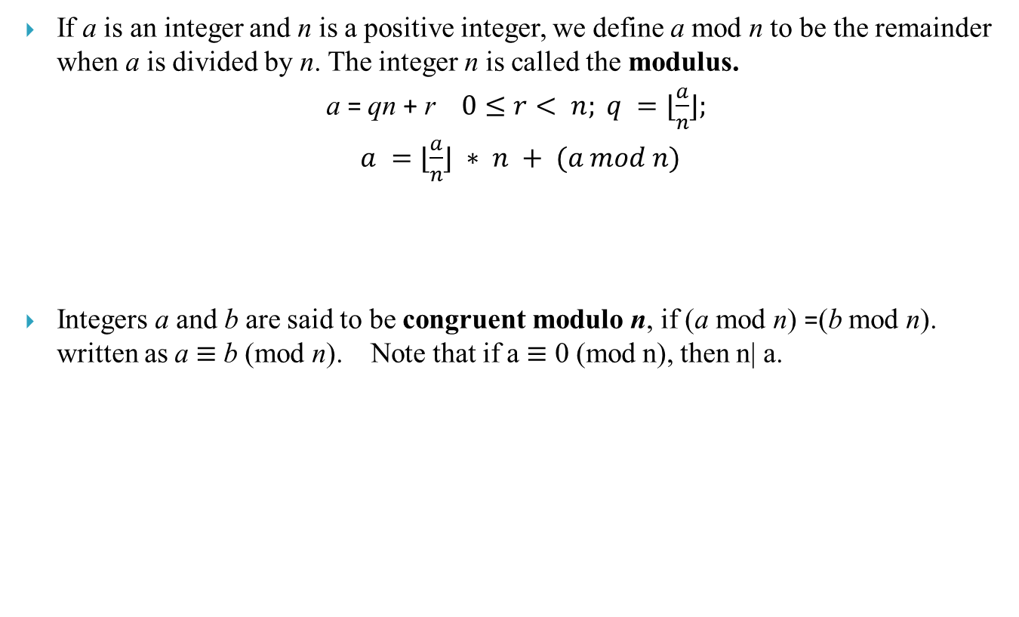
3.Modular Arithmetic
If a is an integer and n is a positive integer, we define a mod n to be the remainder when a is divided by n. The integer n is called the modulus.
a = qn + r $0≤r< n; q =⌊\frac{a}{n}⌋;$
$a =⌊\frac{a}{n}⌋ ∗ n + (a mod n)$
Integers a and b are said to be congruent modulo n, if (a mod n) =(b mod n). written as a $≡$ b (mod n). Note that if a $≡$ 0 (mod n), then n| a.

Slide 11

3.Modular Arithmetic
Properties of Congruences
1. a $≡$ b (mod n) if n |(a - b).
2. a $≡$ b (mod n) implies b $≡$ a (mod n).
3. a $≡$ b (mod n) and b $≡$ c (mod n) imply a $≡$ c (mod n).

Slide 12
3.Modular Arithmetic
Modular Arithmetic Operations
  1. [(a mod n) + (b mod n)] mod n = (a + b) mod n
  2. [(a mod n) - (b mod n)] mod n = (a - b) mod n
  3. [(a mod n) * (b mod n)] mod n = (a * b) mod n

Slide 13
Properties of Modular Arithmetic
Define the set Z_{n} as the set of nonnegative integers less than n:
Z_{n} = {0, 1, … , (n - 1)}

Slide 14

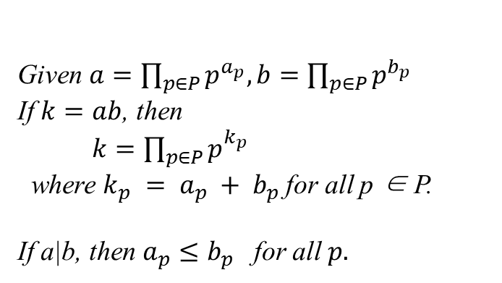
4.Prime Numbers
An integer p >1 is a prime number if and only if its only divisors are $±$1 and$±$p.
Any integer a > 1 can be factored in a unique way as,
$$a=p_{1}^{a_{1}}×p_{2}^{a_{2}}×…×p_{t}^{a_{t}} ,$$
$$p_{a}<p_{2}<…<p_{3},$$
$a_{i}≥0, p_{i} prime , i∈[1,t]$
Given $a=\prod_{p∈P}{p^{a_{p}},b=\prod_{p∈P}{p^{b_{p}} }}$
If $k=ab$, then
$k=\prod_{p∈P}{p^{{k_{p}}_{}} }$
where $k_{p} = a_{p} + b_{p}$for all p ∈ P.
If a|b, then $a_{p}≤b_{p}$ for all $p.$

Slide 15

5. Fermat’s & Euler’s Theorems
Fermat’s Theorem
If p is prime and a is a positive integer not divisible by p, then
$a^{p−1}≡ 1 (mod p)$ (2.10)

Slide 16
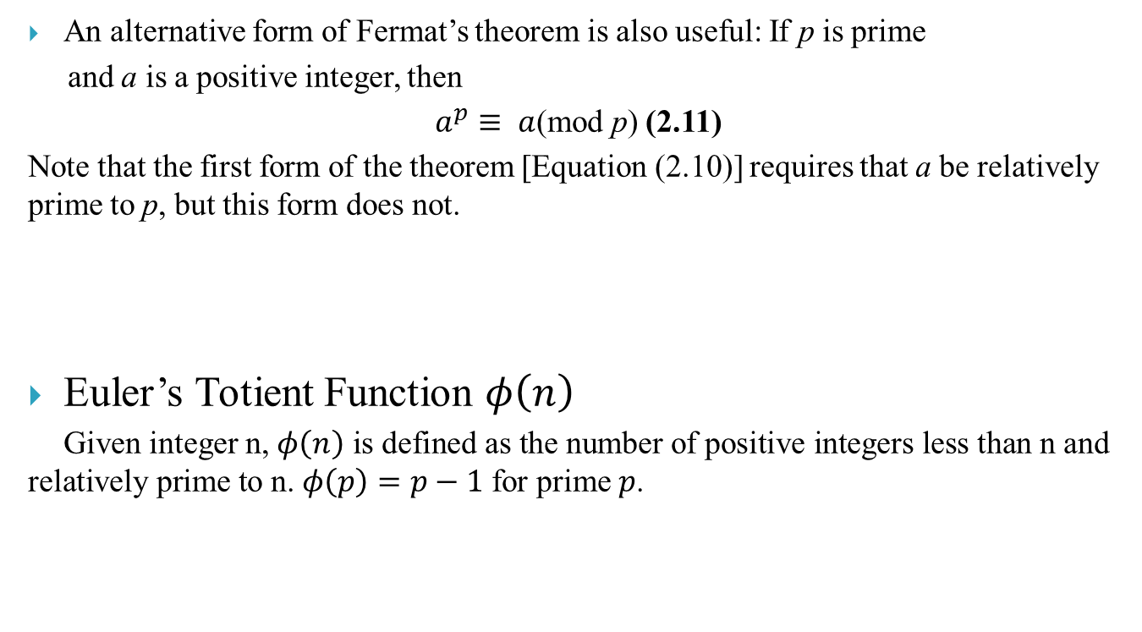
An alternative form of Fermat’s theorem is also useful: If p is prime
and a is a positive integer, then
$a^{p}≡ a$(mod p) (2.11)
Note that the first form of the theorem [Equation (2.10)] requires that a be relatively prime to p, but this form does not.
Euler’s Totient Function $φ\left(n\right)$
Given integer n, $φ\left(n\right) \text{is} \text{defined} \text{as} \text{the} \text{number} \text{of} \text{positive} \text{integers} \text{less} \text{than} \text{n} \text{and} \text{relatively} \text{prime} \text{to} \text{n}\text{.}$ $φ\left(p\right)=p−1$for prime $p$.

Slide 17
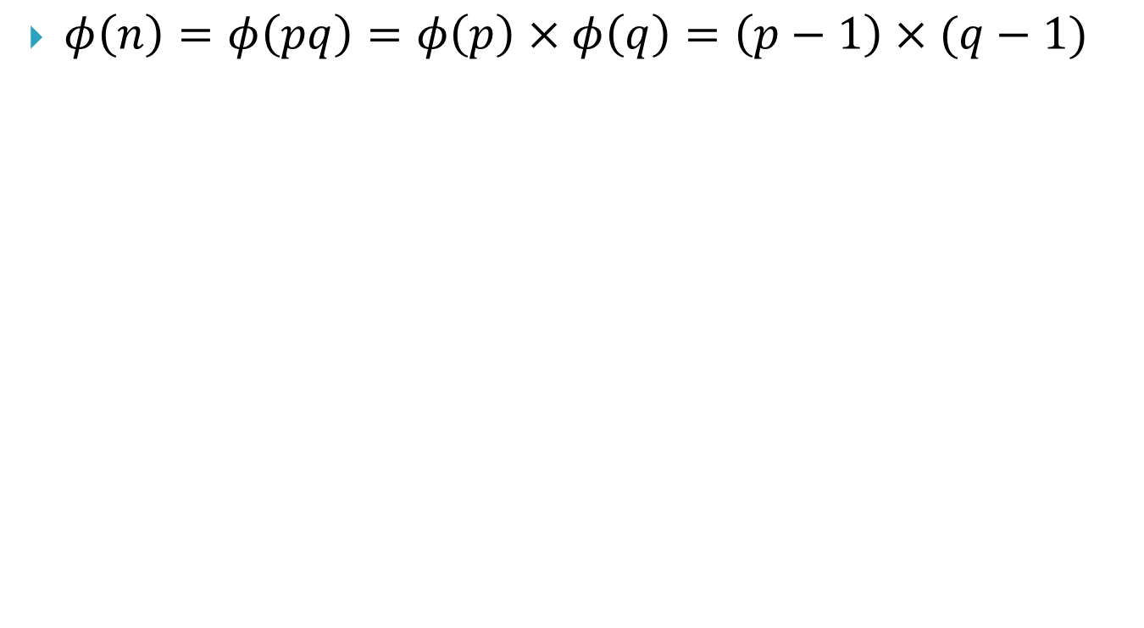
$φ\left(n\right)=φ\left(pq\right)=φ\left(p\right)×φ\left(q\right)=\left(p−1\right)×(q−1)$

Slide 18

Euler’s Theorem
For every a and n that are relatively prime:
$a^{φ\left(n\right)}≡ 1(mod n)$(2.12)
an alternative form $: a^{φ\left(n\right)+1}≡a\left(mod n\right)$(2.13)

Slide 20
Theorem 3.1 (Euler’s Formula for pq). Let p and q be distinct primes and let
g = gcd(p − 1, q − 1).
Then
a^{(p−1)(q−1)/g} ≡ 1 (mod pq)
for all a satisfying gcd(a, pq) = 1.
Proof:
lcm(p-1,q-1)=(p−1)(q−1)/g : divisible by both (p-1) and (q-1).
In particular, if p and q are odd primes, then
a^{(p−1)(q−1)/2} ≡ 1 (mod pq)
for all a satisfying gcd(a, pq) = 1.
Since a^{(p−1)(q−1)/g} = a^{(p−1){ (q−1)/g }}≡ 1^{(q−1)/g} (mod p) ≡ 1 (mod p)
Similarly, a^{(p−1)(q−1)/g} ≡ 1 (mod q)
Therefore, a^{(p−1)(q−1)/g} ≡ 1 (mod pq)

Slide 21
Proposition 3.4 Let p and q be distinct primes and let e ≥ 1 satisfy
gcd(e, (p − 1)(q − 1)) = 1.
e has an inverse modulo (p − 1)(q − 1), say
de ≡ 1 (mod (p − 1)(q − 1)).
Then the congruence x^{e} ≡ c (mod pq) has the unique solution
x ≡ c^{d} (mod pq).
Proof:
Correctness:
(c^{d})^{e} ≡ c^{de} (mod pq)≡ c^{1+k(p−1)(q-1)} (mod pq)
≡ c · (c^{(p−1)(q-1)})^{k} (mod pq) ≡ c · 1^{k} (mod pq)≡ c (mod pq).
Uniqueness:

Slide 22
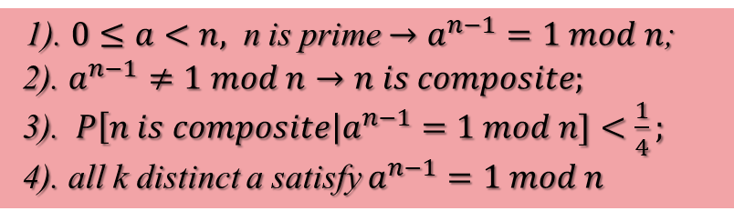
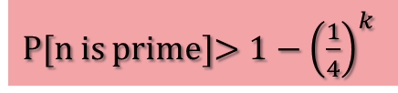
6.Testing for Primality
Miller-Rabin Algorithm
1). $0≤a<n,$ n is prime $→a^{n−1}=1 mod n$;
2). $a^{n−1}≠1 mod n→n is composite;$
3).$P\left[n is composite\right|a^{n−1}=1 mod n]<\frac{1}{4};$
4). all k distinct a satisfy $a^{n−1}=1 mod n$
P[n is prime]$>1−{\left(\frac{1}{4}\right)}^{k}$

Slide 23
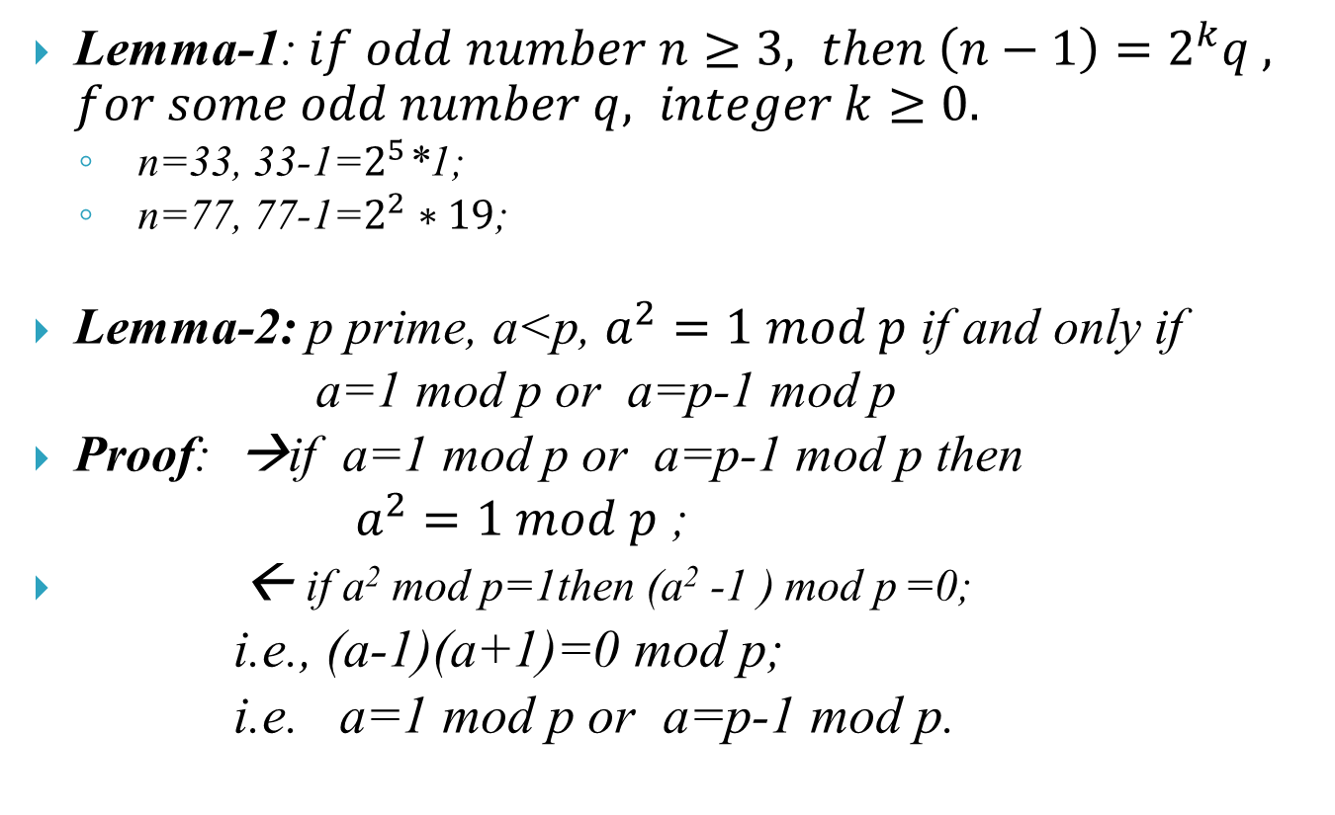
6.Testing for Primality
Lemma-1: $if odd number n≥3, then \left(n−1\right)=2^{k}q , for some odd number q, integer k≥0.$
  n=33, 33-1=$2^{5}$*1;
  n=77, 77-1=$2^{2}∗19$;
Lemma-2: p prime, a<p, $a^{2}=1 mod p$ if and only if
a=1 mod p or a=p-1 mod p
Proof: →if a=1 mod p or a=p-1 mod p then
$a^{2}=1 mod p$ ;
← if a² mod p=1then (a² -1 ) mod p =0;
i.e., (a-1)(a+1)=0 mod p;
i.e. a=1 mod p or a=p-1 mod p.

Slide 24
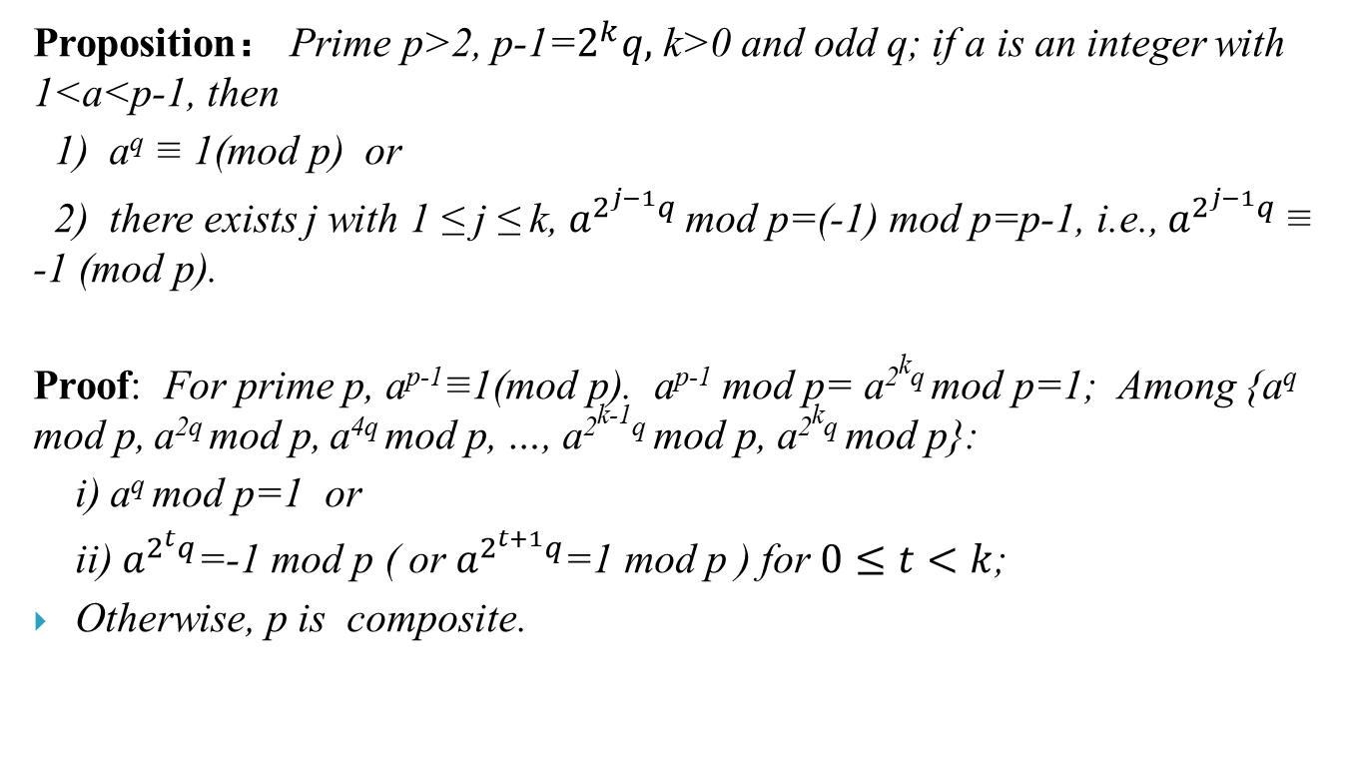
6.Testing for Primality
Proposition： Prime p>2, p-1=$2^{k}q,$ k>0 and odd q; if a is an integer with 1<a<p-1, then
1) a^{q} ≡ 1(mod p) or
2) there exists j with 1 ≤ j ≤ k, $a^{2^{j−1}q}$ mod p=(-1) mod p=p-1, i.e., $a^{2^{j−1}q}$ ≡ -1 (mod p).
Proof: For prime p, a^{p-1}≡1(mod p). a^{p-1} mod p= a^{2kq} mod p=1; Among {a^{q} mod p, a^{2q} mod p, a^{4q} mod p, …, a^{2k-1q} mod p, a^{2kq} mod p}:
i) a^{q} mod p=1 or
ii) $a^{2^{t}q}$=-1 mod p ( or $a^{2^{t+1}q}$=1 mod p ) for $0≤t<k$;
Otherwise, p is composite.

Slide 25
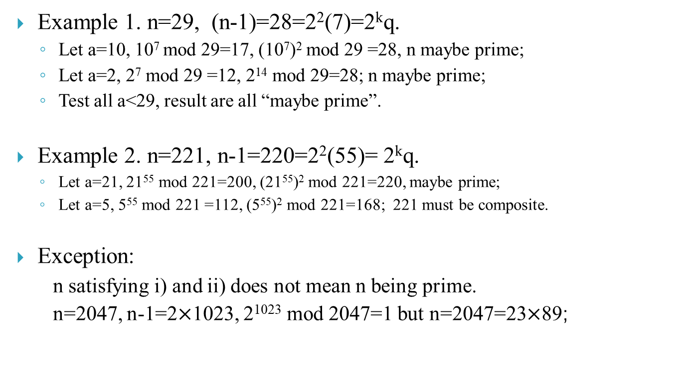
6.Testing for Primality
Example 1. n=29, (n-1)=28=2²(7)=2^{k}q.
  Let a=10, 10⁷ mod 29=17, (10⁷)² mod 29 =28, n maybe prime;
  Let a=2, 2⁷ mod 29 =12, 2¹⁴ mod 29=28; n maybe prime;
  Test all a<29, result are all “maybe prime”.
Example 2. n=221, n-1=220=2²(55)= 2^{k}q.
  Let a=21, 21⁵⁵ mod 221=200, (21⁵⁵)² mod 221=220, maybe prime;
  Let a=5, 5⁵⁵ mod 221 =112, (5⁵⁵)² mod 221=168; 221 must be composite.
Exception:
n satisfying i) and ii) does not mean n being prime.
n=2047, n-1=2$×$1023, 2¹⁰²³ mod 2047=1 but n=2047=23$×$89;

Slide 26
7.Finding multiplicative inverse
ax mod n = 1, x=a⁻¹=?
1) Euler’s Theorem
  aa⁻¹ mod n =1= a^{φ(n)} mod n →a⁻¹ = a^{φ(n)-1} mod n. → if ax mod n =1, then
  x=a^{φ(n)-1} mod n
  2) If φ(n) is unknown, apply Extended Euclidean Algorithm to find x.

Slide 27
ax=b mod n, x=?
Theorem If g=gcd(a, n) and g|b then ax mod n=b has g solutions :
x=[x₁ + t( n/g )] mod n, t = 0,1,…, g-1.
where x₁ is the solution to (a/g)x mod (n/g)=b/g.
Proof: if ax mod n =b, then there exists integer k s.t. ax-kn=b, hence g|a and g|b yields g|b. Due to gcd(a/g,n/g)=1,
(a/g)x mod (n/g)=b/g （1）
has unique solution x₁∈[1,( n/g )-1]. (1) multiplied by g gives
ax mod n=b (2)
Therefore, x₁ is also a solution to (2). Moreover, due to n|(a*t*n/g),
x = x₁ + t( n/g ) mod n, t=0,1, …, g-1 are all solutions to (3).

Slide 28
ax=b mod n, x=?
Example: Find x in 6x=4 mod 10.
Due to g=gcd(6,10)=2 and 2|4, there are g=2 solutions to x. To find solution x₁ to ( a/g)x mod ( n/g)=b/g i.e.，
3x mod 5=2, x₁=4.
According to
x=[x₁ + t( n/g )] mod n, t = 0,1,…, g-1.
we have
x=[4 +0*(10/2)] mod 10 =4, t=0
x=[4 +1*(10/2)] mod 10 =9, t=1

Slide 29
8.Chinese Remainder Theorem
Theorem 8.6
Let d₁,…,d_{t} be pairwise coprime integers, n=d₁d₂…d_{t}, then
f(x) mod n=0
if and only if f(x) mod d_{i}=0, (1≤i≤t).
Proof：
necessity： n|f(x)→ d_{i}|f(x), i=1,…,t.
sufficiency： gcd(d_{i},d_{j})=1→ d_{i}d_{j} |f(x) → n|f(x)
Since all d_{i} are pairwise coprime, then gcd(d_{i},d_{j})=1,
i.e., ad_{i}+bd_{j} =1 (#);
d_{i}|f(x)→ d_{i} k(x)=f(x);
d_{j}|f(x)→ d_{j} t(x)=f(x);
(#)*d_{i} k(x):
ad_{i}d_{i} k(x)+bd_{j} d_{i} k(x)=f(x) (substitution)
→ ad_{i}d_{j} t(x)+bd_{j} d_{i} k(x)=f(x)
d_{i}d_{j} (a*t(x)+b*k(x))=f(x)
→ d_{i}d_{j} |f(x) .
Similarly, gcd(d_{i}d_{j} ,d_{k} )=1→ d_{i}d_{j}d_{k} |f(x)
iterate the above process → n|f(x).

Slide 30
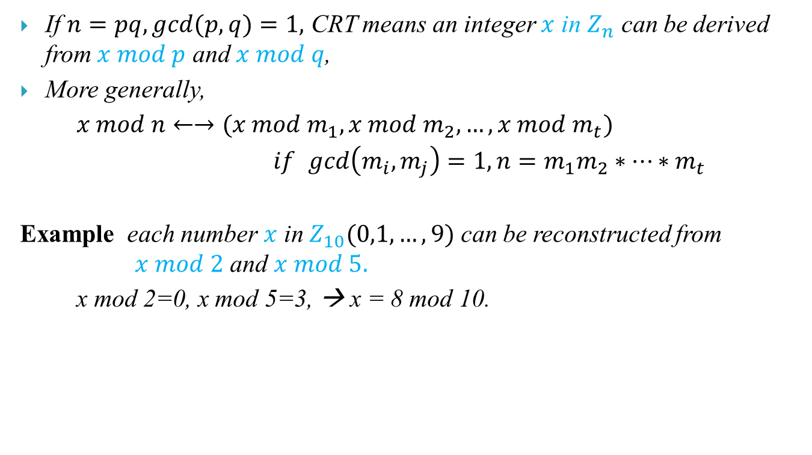
8.Chinese Remainder Theorem
If $n=pq, gcd⁡(p,q)=1,$ CRT means an integer $x$ in $Z_{n}$ can be derived from$x mod p$ and $x mod q$,
More generally,
$x mod n←→(x mod m_{1}, x mod m_{2}, …,x mod m_{t})$
$if$ $\gcd\left(m_{i},m_{j}\right)=1, n=m_{1}m_{2}∗…∗m_{t}$
Example each number $x$ in $Z_{10}(0,1,…,9)$ can be reconstructed from $x mod 2$ and $x mod 5.$
x mod 2=0, x mod 5=3, → x = 8 mod 10.

Slide 31
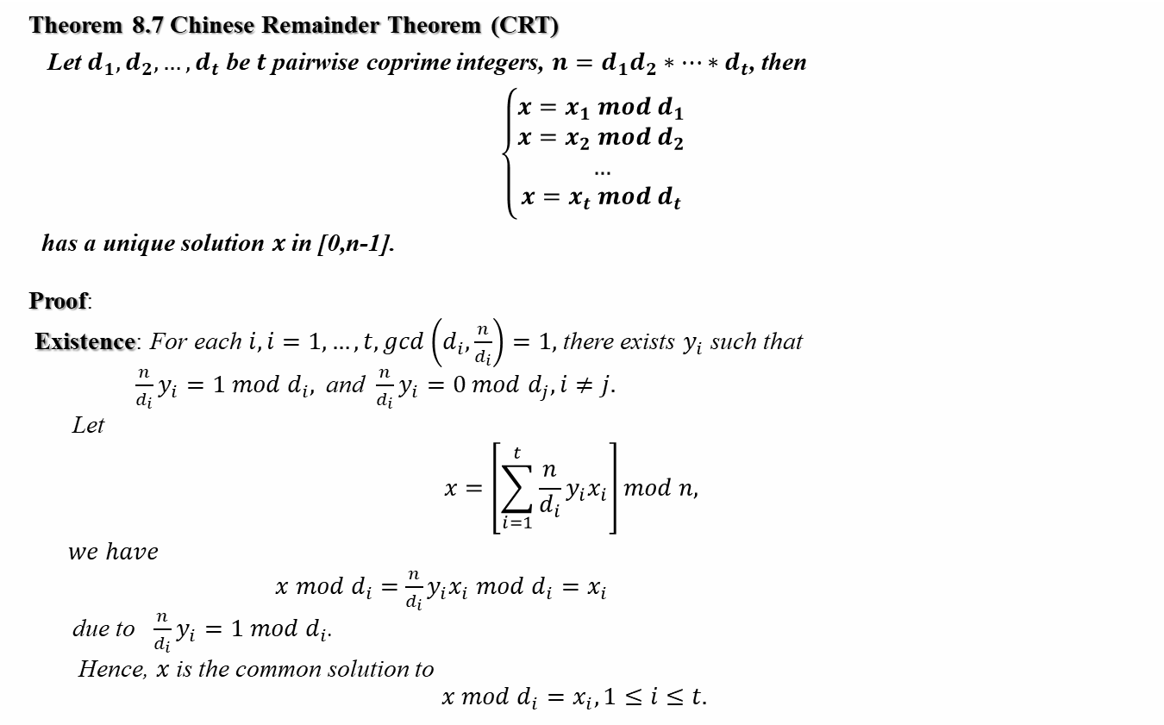
8.Chinese Remainder Theorem
Theorem 8.7 Chinese Remainder Theorem (CRT)
Let $d_{1},d_{2}, …, d_{t}$ be $t$ pairwise coprime integers, $n=d_{1}d_{2}∗…∗d_{t}$, then
$\left\{\begin{aligned}x=x_{1} mod d_{1} \\ x=x_{2} mod d_{2} \\ … \\ x=x_{t} mod d_{t}\end{aligned}\right.$
has a unique solution $x$in [0,n-1].
Proof:
Existence: For each $i, i=1,…,t,\gcd\left(d_{i},\frac{n}{d_{i}}\right)=1,$ there exists $y_{i}$such that
$\frac{n}{d_{i}}y_{i}=1 mod d_{i},$and $\frac{n}{d_{i}}y_{i}=0 mod d_{j}, i≠j.$
Let
$$x=\left[\sum_{i=1}^{t}{\frac{n}{d_{i}}y_{i}x_{i}}\right]mod n,$$
$we have$
$x mod d_{i}=$ $\frac{n}{d_{i}}y_{i}x_{i} mod d_{i}=x_{i}$
due to $\frac{n}{d_{i}}y_{i}=1 mod d_{i}$.
Hence, $x$is the common solution to
$$x mod d_{i}=x_{i}, 1≤i≤t.$$

Slide 32

Uniqueness:
If $x,x’∈Z_{n}$ are both solutions to
$x mod d_{i}=x_{i}, i=1,2,…,t$
then $\left(x−x’\right)mod d_{i}=0, i=1,2,…,t.$
Due to $d_{i}$being coprime to each other,
$$\left(x−x’\right) mod n=0$$
follows, i.e., $x=x^{′} mod n$or $x=x′$ in $Z_{n}.$

Slide 33

Algorithm of CRT
Algorithm CRT (n, d₁,…, d_{t}, x₁,…, x_{t})
begin “return x∈[0, n-1] such that x mod d_{i}=x_{i}，(1≤i≤t)”
for i:=1 to t do
y_{i}:= ($\frac{n}{d_{i}}$)⁻¹ mod d_{i};
x:=0;
for i:=1 to t do
x:=[x + ($\frac{n}{d_{i}}$)y_{i} x_{i}] mod n;
return x;
end

Slide 34
Page 73

Slide 35
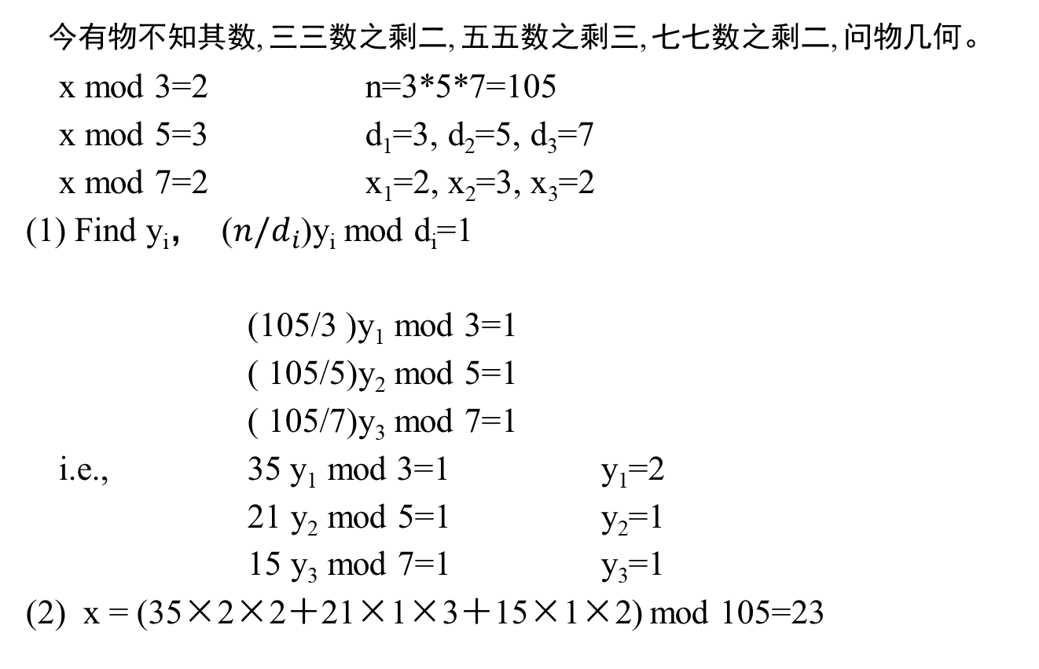
孙子定理(孙子算经, 3-5世纪)
今有物不知其数, 三三数之剩二, 五五数之剩三, 七七数之剩二, 问物几何。
x mod 3=2 n=3*5*7=105
x mod 5=3 d₁=3, d₂=5, d₃=7
x mod 7=2 x₁=2, x₂=3, x₃=2
(1) Find y_{i}， ($n/d_{i}$)y_{i} mod d_{i}=1
(105/3 )y₁ mod 3=1
( 105/5)y₂ mod 5=1
( 105/7)y₃ mod 7=1
i.e., 35 y₁ mod 3=1 y₁=2
21 y₂ mod 5=1 y₂=1
15 y₃ mod 7=1 y₃=1
(2) x = (35×2×2＋21×1×3＋15×1×2) mod 105=23

Slide 36
Solve ax =b mod n by Theorem 8.6
To solve ax =b mod n, n=d₁d₂…d_{t} , d₁,…,d_{t} be pairwise coprime integers,
find a common solution to
ax=b mod d_{i} (1≤i≤t),
we can construct the solution x from {x₁,x₂,…, x_{t}}, x_{i} is the solution to
ax=b mod d_{i.}
i.e., ax_{i}=b mod d_{i} i=1,2,…,t.
Example.
  If n=p*q, prime p,g,
  ax mod n =b←→ax mod p=b, ax mod q=b←→
  x mod p=x₁, x mod q= x₂ (Extended Euclid)←→
  CRT: (x₁,x₂)→x.
  5x mod 21=4 ; 21=p*q=3*7
  ←→ 5x mod 3=4 mod 3=1; 5x mod 7=4
  ←→ x₁=2 mod 3; x₂=5 mod 7
  ←→ x=CRT(x₁, x₂)=5

Slide 37
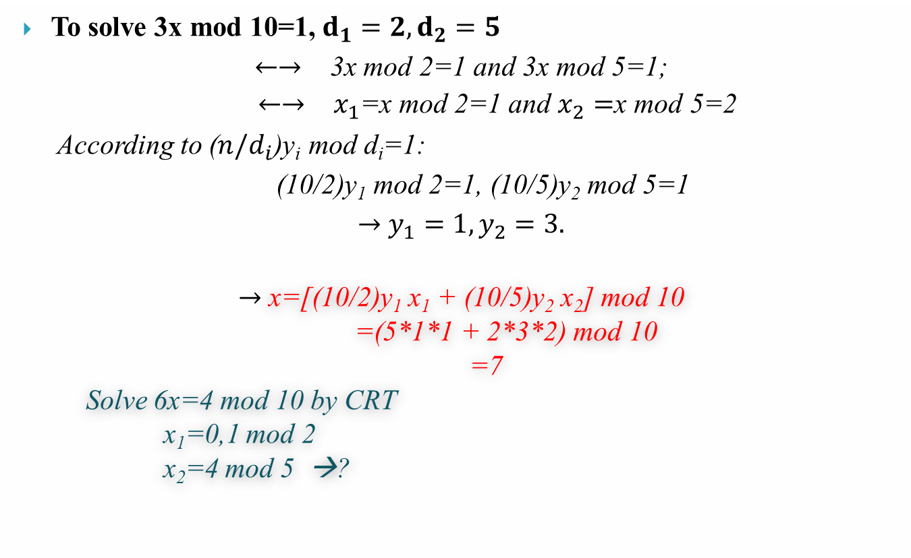
Find 3x =1 mod 10 by CRT
To solve 3x mod 10=1, $d_{1}=2, d_{2}=5$
$←→$ 3x mod 2=1 and 3x mod 5=1;
$←→$ $x_{1}$=x mod 2=1 and $x_{2}=$x mod 5=2
According to ($n/d_{i}$)y_{i} mod d_{i}=1:
(10/2)y₁ mod 2=1, (10/5)y₂ mod 5=1
$→$ $y_{1}=1, y_{2}=3.$
$→$ x=[(10/2)y₁ x₁ + (10/5)y₂ x₂] mod 10
=(5*1*1 + 2*3*2) mod 10
=7
Solve 6x=4 mod 10 by CRT
x₁=0,1 mod 2
x₂=4 mod 5 →?

Slide 38
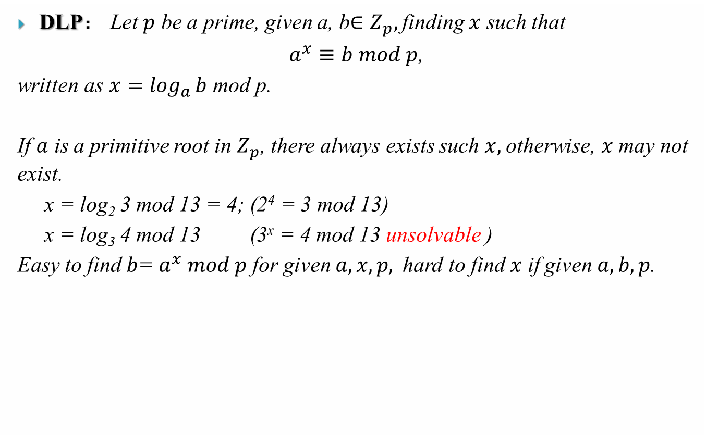
9.Discrete Logarithm Problem-DLP
DLP： Let $p$ be a prime, given a, b$∈Z_{p},$finding $x$ such that
$a^{x}≡b mod p$,
written as $x=\log_{a}{b}$ mod p.
If $a$ is a primitive root in $Z_{p}$, there always exists such $x,$otherwise, $x$may not exist.
x = log₂ 3 mod 13 = 4; (2⁴ = 3 mod 13)
x = log₃ 4 mod 13 (3^{x} = 4 mod 13 unsolvable )
Easy to find $b$= $a^{x} mod p$ for given $a,x,p,$hard to find $x$ if given $a, b, p$.

Slide 39
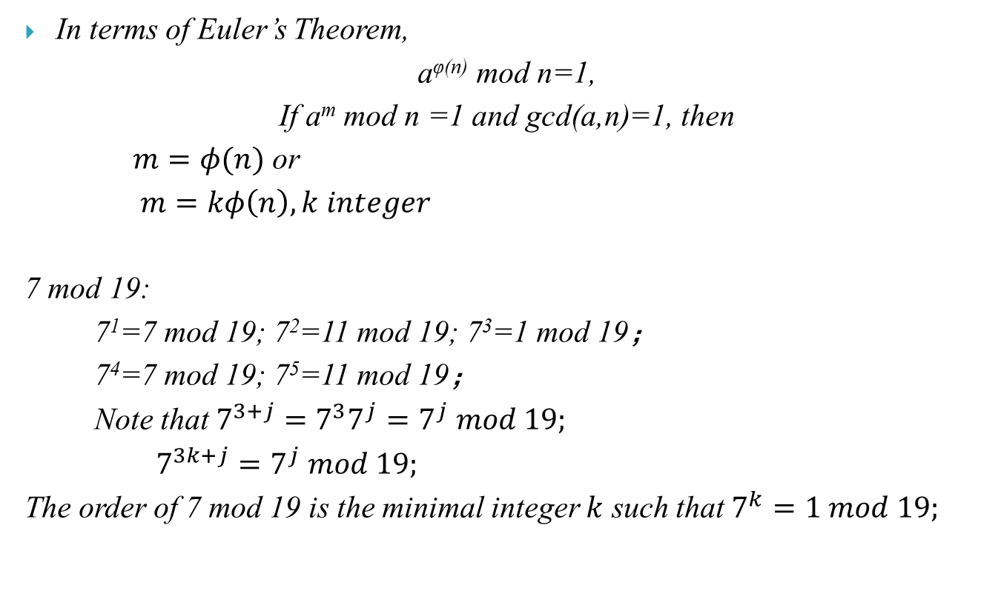
9.Discrete Logarithm Problem-DLP
In terms of Euler’s Theorem,
a^{φ(n)} mod n=1,
If a^{m} mod n =1 and gcd(a,n)=1, then
$m=φ(n)$ or
$m=kφ\left(n\right), k integer$
7 mod 19:
7¹=7 mod 19; 7²=11 mod 19; 7³=1 mod 19；
7⁴=7 mod 19; 7⁵=11 mod 19；
Note that $7^{3+j}=7^{3}7^{j}=7^{j} mod 19;$
$7^{3k+j}=7^{j} mod 19;$
The order of 7 mod 19 is the minimal integer $k$ such that $7^{k}=1 mod 19;$

Slide 40
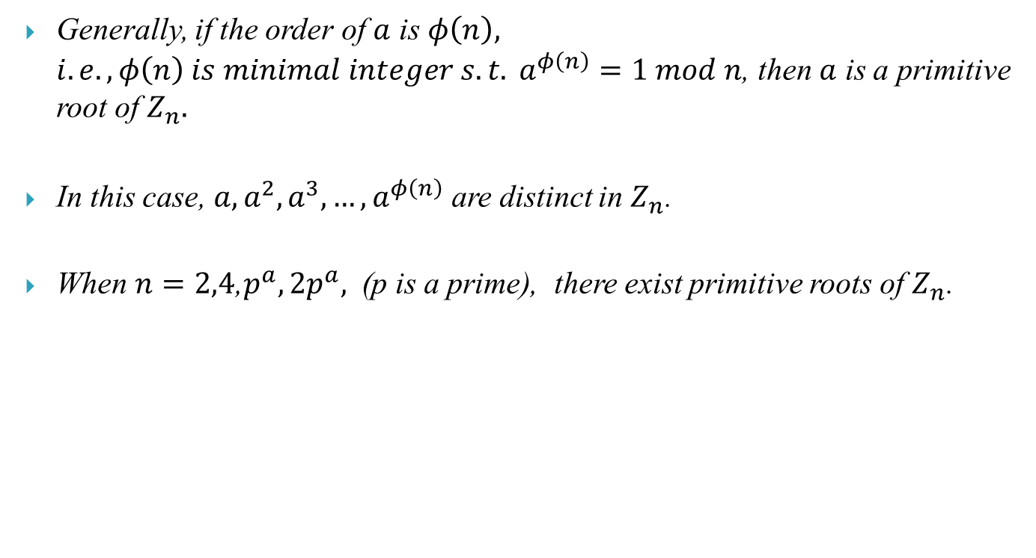
9.Discrete Logarithm Problem-DLP
Generally, if the order of $a$ is $φ\left(n\right), i.e., {φ\left(n\right) is minimal integer s.t. a}^{φ\left(n\right)}=1 mod n$, then $a$ is a primitive root of $Z_{n}.$
In this case, $a, a^{2},a^{3},…, a^{φ\left(n\right)}$ are distinct in $Z_{n}$.
When $n=2,4$,$p^{a}, 2p^{a},$ (p is a prime), there exist primitive roots of $Z_{n}$.

Slide 41
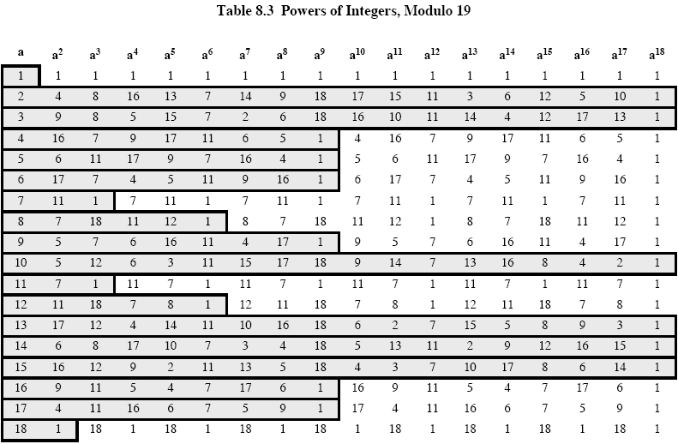
9.Discrete Logarithm Problem-DLP

Slide 42
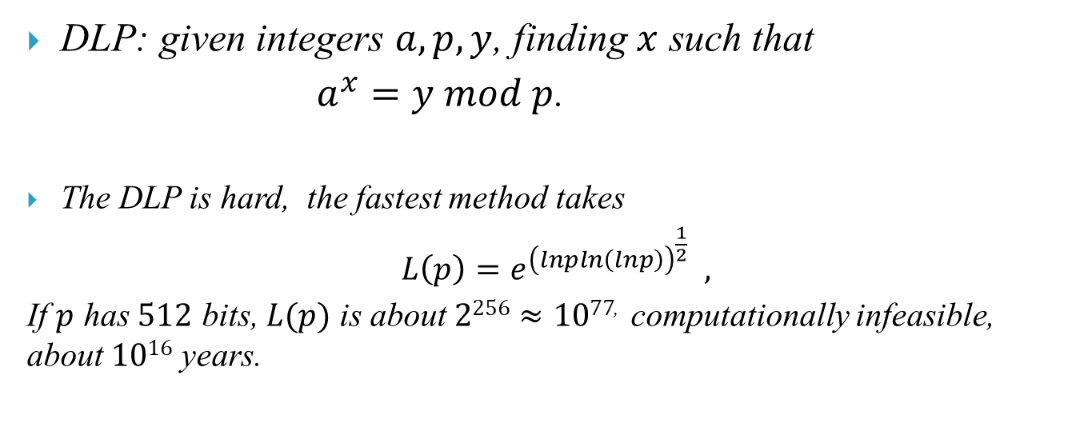
DLP: given integers $a,p,y$, finding $x$ such that
$a^{x}=y mod p$.
The DLP is hard, the fastest method takes
$L\left(p\right)=e^{{\left(lnpln\left(lnp\right)\right)}^{\frac{1}{2}}} ,$
If $p$ has $512$ bits, $L(p)$ is about $2256≈1077$, computationally infeasible, about $1016$ years.

Slide 44
Assignments
Complements:
  Let p=17，g=3，
    Find the order of g in Z_{p}？
    Find all primitive roots of Z_{p .}
  Find x in 22x mod 37=1respectively by Fermat’s Theorem and Euclidean algorithm.
  Find out all solutions for 6x mod 21 = 9.
4. Consider the equations
x mod p = x₁ or p – x₁
x mod q = x₂ or q – x₂
where n = pq for primes p and q.
There are four common solutions, given by
z₁ = crt (n, p, q, x₁, x₂) z₂ = crt (n, p, q, x₁, q-x₂)
z₃ = crt (n, p, q, p-x₁, x₂) z₄ = crt (n, p, q, p-x₁, q-x₂)
show that z₄ = n –z₁ and z₃ = n –z₂
5. Using the result of the preceding problem, find the 4 solutions to the
equation x² mod 77 = 4 by first finding solutions to x² mod 7 = 4 and
x² mod 11 = 4.

Slide 45
Assignments
1, 2, 3, 4, 6, 8, 9, 12, 19, 20,

Slide 46
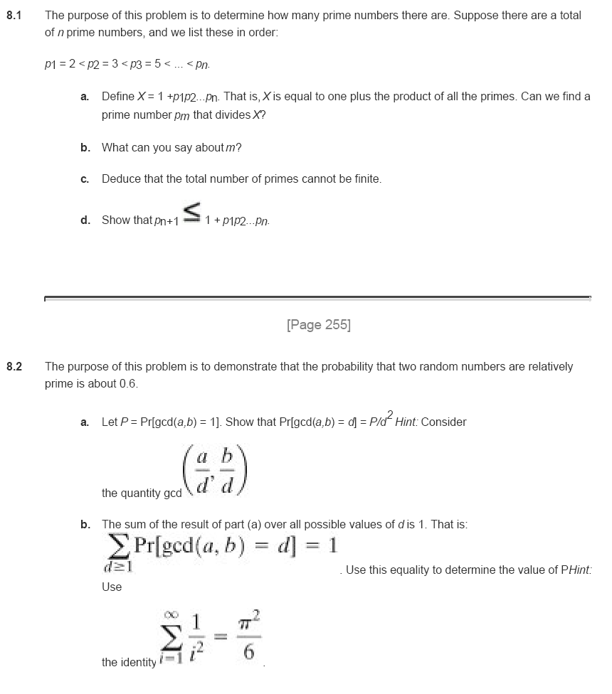

Slide 47
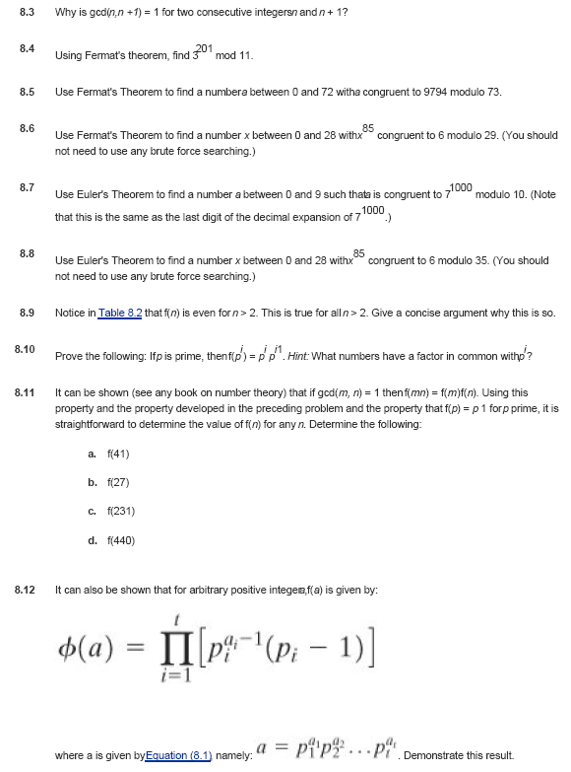

Slide 48
