Slide 1
What’s wrong with these PowerPoint slides?

Slide 2
This is a PowerPomt slide
Slides can have bad features
Some of these are text problems.
Some are not
Do you see any probblems on this slide?

Slide 3
Is there a problem with this slide?
What is wrong?
Is this slide OK?

Slide 4
Is it OK to have dark backgrounds?
Are there problems on this slide?
What would you change to make this slide better?

Slide 5
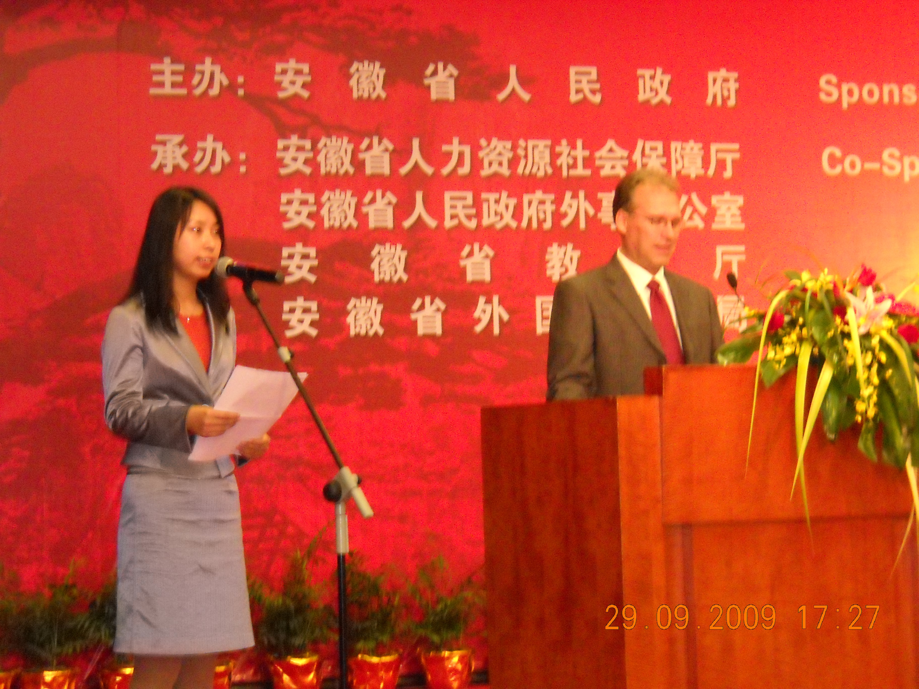
Here’s another slide that has some problems
Many slides has a problem.
Do you see two problem on this slide?
maybe There aRe more Than two Problems.
Are there much than?

Slide 6
What other problems?
This is, a bullet point that; is beside a picture (of a computer]
Here, is the. second point, in this list. [Do you, think this is a good idea?) Are; there any problems on this slide? Maybe there

