Slide 1
Publishing English
Lesson 1
USTC School of Management
Spring 2019
Teacher: Dr. Murray Sherk

Slide 2
Lesson 1 Outline
Course introduction and syllabus
Our profession as writers
The research and publishing game
Logical arguments and argument strategies
Mind Mapping / Concept Mapping

Slide 3
Activity 1: Course Introduction and Syllabus
Course Website; access via:
http://staff.ustc.edu.cn/~msherk
Syllabus Sheet:
  Download from website
  Highlights are on the following slides

Slide 4
About your teacher Murray
Please call me “Murray”
From Canada
PhD in theoretical Computer Science from U. Toronto in 1989
Taught CS in Canada 4 years
19th year teaching at USTC
Involved in publishing >250 papers since Jan 1, 2016 through editing and polishing

Slide 5
About your teacher Murray
Please call me “Murray”
http://staff.ustc.edu.cn/~msherk
msherk@ustc.edu.cn

Slide 6
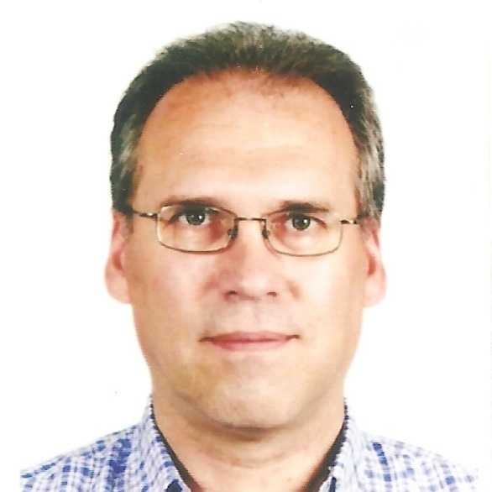
 | Murray Sherk Murray BZ13027783 msherk@ustc.edu .cn
←Front
Write the corresponding information for you on your card in the appropriate places.
Intelligence Test:
Leave room for your photo.
Computer-aided language learning, data structures and algorithms Toronto, Canada An interesting thing about me is that I program computers for fun – I love the creativity involved in it.
←Back

Slide 7
Writing project
During this semester, you will be working on one of your research results, turning it into a paper fully edited and polished, ready to submit to a top-ranked journal.
Currently working on one? Good!
  whether just starting, midway, or almost done
Just finished one? Start a new one
This is your “writing project” for this course.

Slide 8
Schedule: Classes
Monday mornings:
  March 11, 18, 25; April 1, 8, 15, 22, 29
    9:00AM to 12:15PM
Final Exam:
  Time & Date to be determined

Slide 9
Use of Computers
You must have some device in class that will let you run a web browser.
  E.g. read articles from the Internet
The device should also let you write/create documents in the workshop
Best option: portable Windows computer
You will need MS Word or another editor
You will need to install some free programs and/or sign up for some free web services.

Slide 10
How you get your Grade
20% Attendance and participation
  Attend eight classroom lessons
  Participate in class/workshop activities
30% Homework
  Writing project & reports
  Individual assignments
50% Final exam

Slide 11
Final Exam
(worth 50%)
Covers
Knowledge of class material
Practical editing/proof-reading
Short writing task (<250 words)
During the exam…
You may use computer, books, notes, all tools you want, except…
…You may not communicate with other people nor copy their writing

Slide 12
Activity 2: Our profession
What is your professional goal?
University professor? Researcher? Scholar? Academic?

Slide 13
Complete this sentence:
“The most important tool for success as a researcher is _____________________.”
How about “writing”?

Slide 14
Our profession
What is your professional goal?
University professor? Researcher? Scholar?
Fully participating internationally requires publishing

Slide 15
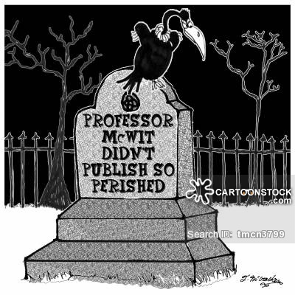

Slide 16
Our identity as writers
We’re not just scholars who sometimes write
Writing is part of being a scholar
Writing must be part of our identity
You are a professional writer.

Slide 17
Wise words from Greek philosopher Aristotle
(384-322 BCE)
“We are what we repeatedly do.
Excellence, then, is not an act, but a habit.”

Slide 18
Wise words from U.K.
Prof. C. S. Lewis (1898-1963)
“What you want is practice, practice, practice. It doesn’t matter what we write … so long as we write continually as well as we can. I feel that every time I write a page either of prose or of verse, with real effort, even if it’s thrown in the fire the next minute, I am so much further on.”

Slide 19
Deep practice and myelin
Physiological basis for “practice makes perfect”
Every movement, thought, feeling is electrical signal in brain along a neuron pathway = circuit of nerve fibers
Myelin = insulation wrapping fibers. More myelin brings more signal strength, speed, accuracy.
The more a circuit fires, the more myelin develops.

Slide 20
What is “deep” practice?
Deliberate
Targeted, focussed repetition
Persistent correcting of mistakes
Goal in mind: Improve performance!
Think!

Slide 21
“Becoming an Academic Writer: 50 Exercises for Paced, Productive, and Powerful Writing” by Patricia Goodson
“Research examining productive faculty’s habits consistently point to scheduled and protected writing time as a key element for success.”

Slide 22
Study participant Karen Harris, quoted by Patricia Goodson
“The trick is that research and writing time belong on your calendar… An author must write in the calendar time to write and do research… you must protect this time just as if it were a meeting that you could not reschedule.”

Slide 23
Practical Application:
Your Course Project
Choose 1 hour in your weekly schedule to reserve for working on your course project.
Same time, each week
  You cannot change this appointment!
  You MUST write then, each week!
  At least 30 minutes must be spent actually generating, editing, or polishing your text, but related tasks (e.g. trying out a new writing tool) can also be done.
Send a report by email to me each week after you do your scheduled hour.
  Reports are worth 12% of your final grade!

Slide 24
Practical Application:
Your Course Project
8 Homework Assignments each worth 1.5%
Each week, starting before next class, report to me what you did in your scheduled writing time
  100-word report by email (80-120 words)
  a description of what you did.
    Do not send the manuscript text!
  Use full sentences in your report. Try to write clearly, concisely, and well.

Slide 25
Example Report 1
Report #1: Thursday, March 14, 1:45-2:45
This week I tried out EndNote for 20 minutes to see if it would help me organize my way of handling citations and references. I ended up concluding it would work but I need to learn more about it.
I generated text for my writing project about the effect of family incivility on voter turnout in elections in South Africa. I worked mostly on the Conclusion section, summarizing the contributions of my paper but I took a lot of time to think through and list the limitations of my work.

Slide 26
Example Report 2
Report #2: Thursday, March 21, 1:45-2:45
My project paper combines results from a survey I do and some government reports on voter turnout at elections. Today I worked for about 20 minutes on the introduction but then I got frustrated so I switched to working on the literature review.
I tried using cMapTools to design the literature review using a concept map. It felt a bit like I was wasting time but I guess it helped me get started and avoid writer’s block.

Slide 27
Example Report 3
Report #3: Thursday, March 28, 1:45-2:45
I worked the entire time on editing and polishing my Introduction section. Grammarly helped me find some grammar mistakes and some spelling problems.
Also, it turns out that I mix British and American English spelling so I need to choose one or the other. I prefer British style but I tend to use American quotation mark style; I must be more careful about that.
I also found places where I could make my meaning more specific and clear by rewriting, so I changed those. I found 15 places where I used “it” but it was not clear what “it” referred to. I’m adding this to my checklist of things I need to check in my writing.

Slide 28
Email the Weekly Reports
to msherk@ustc.edu.cn with Subject line: “Project report #x” (x = 1, 2, 3, …)
I need a report from you each week.
Email it soon (<12 hours) after you do your scheduled project session.
  (If you wish, you may spend 10 minutes of your project hour writing the report, but not more than that.)

Slide 29
Activity 3: The research and publishing game
This is now a part of your life.
Get used to it!

Slide 30
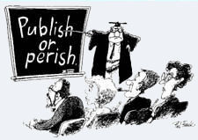
What every grad student and professor has to deal with:

Slide 31
Maybe some who publish actually deserve to die for how they write?
“The third major component of modeling phenomena involves the utilization of symbolic representations of modeled patterns in the form of imaginal and verbal contents to guide overt performances. It is assumed that reinstatement of representational schemes provides a basis for self-instructions on how component responses must be combined and sequenced to produce new patterns of behavior.”

Slide 32
The Trick: Sound scholarly but not pretentious
Use good vocabulary, but don’t sound like you’re showing off
Use precise terminology of your research area, but avoid overuse of jargon.
How?

Slide 33
How? Know, Use, Check
Know what you’re aiming for and what mistakes to avoid
Use tools that will help
Check and edit your writing
  (with a skeptical eye!)

Slide 34
Know: How do we get started writing? Avoid Writer’s Block?
Three separate tasks are involved in writing
Generation of text
Editing of generated text
Proof-reading
Often some of 3 is done during 2, but 2 focuses on English correctness and 3 focuses on style and logic.

Slide 35
Generating text using a Computer
Open a text editor on your computer
On the topic of interest, just start typing your ideas in sentences.
Do not correct spelling, grammar, logic, ideas, …
  Try making the edit window small so you cannot see what you’re typing.
Goal = produce lots of text with many ideas. (Ideas generate more ideas)

Slide 36
“What this course should be”
For this new course I want to teach students how to be professional. Also, they need more nuts and bolts. The textbook (should I use it as a textbook?) says we are professional writers. I emphasize professional. Sutdents need to be more careful with scholarship. Sometimes they use words for words sake. Good vocabularly is important but should be a tool that is no overused.

Slide 37
“What this course should be”
For this new course I want to teach students how to be professional. Also, they need more nuts and bolts. The textbook (should I use it as a textbook?) says we are professional writers. I emphasize professional. Sutdents need to be more careful with scholarship. Sometimes they use words for words sake. Good vocabularly is important but should be a tool that is no overused.

Slide 38
Generating Text using Paper
Start with a blank piece of paper.
On the topic of interest, just start writing your ideas, using sentences
Do not correct spelling, grammar, logic, ideas, spacing, …
Messy writing is OK if it is readable
Goal = produce lots of text with many ideas. (Ideas generate more ideas)

Slide 39
Topic: Advice for newly arriving USTC grad students from my country
Using paper, generate text for a short article about this topic for 5 minutes
Just start writing your ideas in sentences.
Do not correct spelling, grammar, logic, ideas, spacing, …
Messy writing is OK if it is readable
Goal = produce lots of text with many ideas. (Ideas generate more ideas)

Slide 40
Topic: Advice for newly arriving USTC grad students from my country
Using a new sheet of paper, write an edited version of the first sheet.
Take 10 minutes.
Fix any problems you see: spelling, grammar, logic, ideas, spacing, …
Add / change / delete material
Check / fix the logic
Look up vocabulary words if necessary

Slide 41
Topic: Advice for newly arriving USTC grad students from my country
Label the 2 sheets as Versions 1 and 2
Write your name at the top of both.
Hand these both in now.
(This is diagnostic – it will not count in your grade.)

Slide 42
Activity 4: Logical arguments and argument strategies
All published articles are arguments.
Successful scholarly writers make convincing arguments.

Slide 43
Strategies for Arguments
“Argument” = “claim” + “reasons and evidence”
(“Argument” = “conclusion” + “premises”)
Is the claim clear?
Are these good reasons to accept the claim?
Is there enough evidence to accept the claim (without exceeding the time/space you have)?

Slide 44
Strategies for Arguments
Logic & Reason
  objective facts plus logical thinking
Character & Credentials
  “I’m honest – I’m telling the truth”
  “I know what I’m talking about”
  “They are honest and can speak with authority, and they believe this”
  Partly subjective, but “expert opinion”
Emotion
  fear, love, respect, loyalty, patriotism…

Slide 45
Claim: “You should schedule a time to write each workday.”
Emotion
  “Do it or you will fail as a scholar!”
  “Do it and Murray will give you a high mark in this course, which will make your mother proud of you.”

Slide 46
Claim: “You should schedule a time to write each workday.”
Emotion
  “Do it or you will fail!”
Character & Credentials
  “Accomplished scholar Patricia Goodson of Texas A&M university strongly recommends this in her book Becoming an Academic Writer.”
  “Many successful academic writers say the key to success is to write extensively, and that a large amount of writing time is needed to become an expert.”

Slide 47
Claim: “You should schedule a time to write each workday.”
Emotion
  “Do it or you will fail!”
Character & Credentials
  “Successful academic writers say…”
Logic & Reason
  “In many areas of life, practice makes perfect so you need to practice a lot. Research on myelin confirms this.”
  “In the busy life of a scholar, things that are not scheduled get put aside easily, so you should give your writing time the priority of a meeting with a person.”

Slide 48
Scholarly Arguments
Use L&R for 90% or more of evidence
C&C is used some for motivation in the literature review part of the paper
  Particularly if the paper responds to a specific challenge: “Pioneer researchers Jones and Finn stated that understanding this factor is crucial.”
Emotion can be used to motivate, but is considered very weak
  Often because it is just your subjective opinion that “this research is vital!” (so you get your PhD?)

Slide 49
Argument Strategy Exercise
Working with your partner(s), figure out how to use all 3 strategies to argue that the following claim is true:
Claim: “Intelligent beings from outer space have visited Earth.”

Slide 51
Some Possible L&R Arguments
“Mysteries like how ancient people build huge things like Egyptian pyramids – easy to solve if helped by advanced aliens.”
“So many planets in Universe implies so many aliens that it’s likely one visited.”
  Bad math actually
  “It’s easy for a male student to get a girlfriend at USTC because there are 3,000 female students.”
  Ignores issues of personality, culture, religion, and numbers! (12,000 males competing for the 3000)

Slide 52
Some Possible C&C Arguments
“Governments of many major nations have seriously investigated UFO sightings and cannot explain them all as false.”
“In the past 100 years, thousands of people around the world have reported seeing UFOs or aliens.”

Slide 53
Some Possible Emotion Arguments
“Aliens advanced enough for space flight must be scientifically ahead of us. We must prepare to defend ourselves! (i.e. at least behave like we believe they exist)”
  (“It’s dangerous to behave like the claim is false.”)
“If they’ve visited, then they’re technologically superior and have not destroyed us. Maybe they’re helping us develop like parents guiding children.”
  (“It’s comforting to believe the claim is true.”)

Slide 54
Break Time
5-minute break.
  Please be back promptly.
Workshop starts after the break.
(Workshop ends at 12:15)

Slide 55
Workshop 1:
March 11
Concept Maps intro
Concept map for homework

Slide 56
Mind Mapping
“Mind mapping is a fabulous instrument for generating new writing ideas, for structuring various writing pieces, as well as for capturing all the associations one makes while thinking through a writing project… It is especially useful for writing introductions, or for thinking through the structure of an entire paper.”
  (p.151, “Becoming an Academic Writer”, Patricia Goodson)

Slide 57
Concept Maps
A version of mind mapping.
Concepts and Relationships
Google “cMapTools” and go to
https://cmap.ihmc.us/
Can use this tool online or install it on Windows, OS X, iPad, Linux

Slide 58
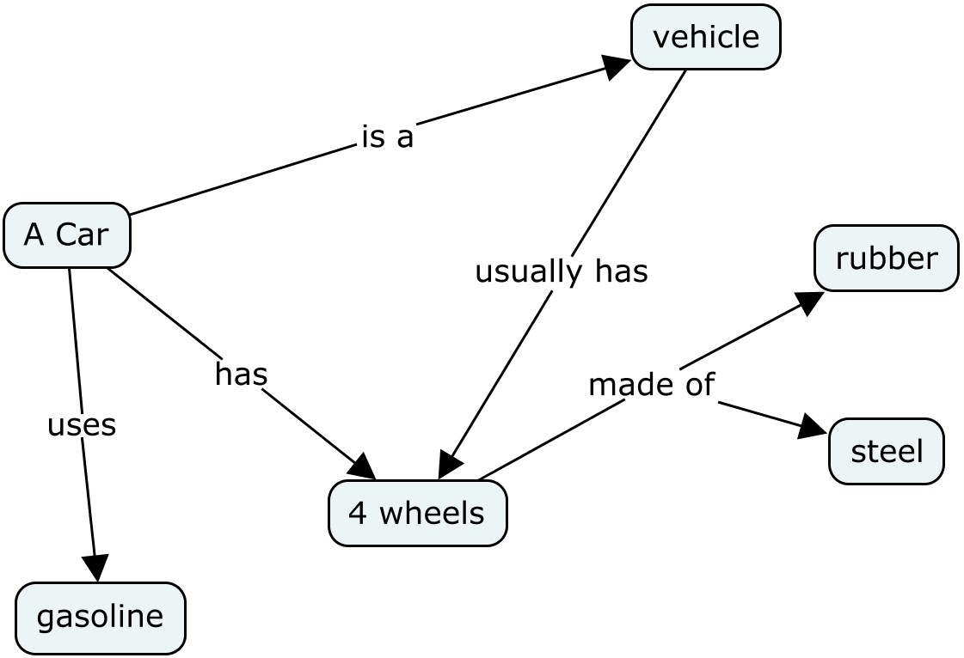

Slide 59
Concept Maps
A version of mind mapping.
Concepts:
  Things, ideas, …
Relationships
  Tells how concepts are related
A concept is related to one or more other concepts
A concept may have many relationships

Slide 61
Concept Map of Yourself
Root concept is your name.
Add some relationships to other concepts.
  “is from”, “likes”, “is good at”, “was born in”, “is a”, …
Add a “fork” = add an arrow from an existing relationship to a new concept
Add a “join” = add a relationship or arrow so two concepts are both related to the same third concept

Slide 62
Join
Fork

Slide 63
Concept Map of Yourself
Root concept is your name.
Add some relationships to other concepts.
  “is from”, “likes”, “is good at”, “was born in”, “is a”, …
Add a “fork” = add an arrow from an existing relationship to a new concept
Add a “join” = add a relationship or arrow so two concepts are both related to the same third concept

Slide 64
Team Concept Maps
Use paper or computer
Each choose a different topic from:
  “Graduate Student”, “Movie Star”, “Computer”
Write your topic as a concept.
Add a relationship to one other concept. E.g. [Car] is a [Vehicle]
Add another relationship to another concept. E.g. [Car] has [4 wheels]
Add a fork (and concept) from one of the two relationships. E.g. <x> has [seats]

Slide 65
Team Concept Maps
Move to your partner’s concept map (on paper or computer)
Add 2 or 3 things to the map you now are looking at:
  Concepts
  Relationships
  Forks
  Joins
Switch again and repeat

Slide 66
Team Concept Maps
With your partner(s), go to look at the concept maps of another group.
How do your concept maps compare with the other group’s maps?
Discuss this with your partner.
What ideas were generated by making cmaps?

Slide 67
Team Concept Maps
With your partner(s), look at the concept maps you drew.
How did the one you started evolve?
Did this give you new ideas about your original concept?
Discuss this with your partner(s).

Slide 68
Mind Mapping
“Mind mapping is a fabulous instrument for generating new writing ideas, for structuring various writing pieces, as well as for capturing all the associations one makes while thinking through a writing project… It is especially useful for writing introductions, or for thinking through the structure of an entire paper.”
  (p.151, “Becoming an Academic Writer”, Patricia Goodson)

Slide 69
Homework Concept Map
Write a concept map for a start-up guide for new grad students about what the best journals are in your research area and how to access those journals here at USTC.
Compare your concept map with your partner.
  Feel free to share ideas but do not copy exactly.

Slide 70
Homework:
Write an email to me before next class Report#1 for your writing project. (Subject: “Report #1” Be sure to state the time when you will work on your project each week.
Email me a selfie (photo of you – head/shoulders) for your card.
Write a 200-word start-up guide for new grad students about what the best journals are in your research area and how to access those journals here at USTC. Use your best English!
  Submit this by email to msherk@ustc.edu.cn before next class. This guide is worth 2% of your final grade.
  Use cMapTools to make a concept map for your guide and bring this concept map (on paper) to our next class. (worth 1%)
Bring a computer or tablet device to our next class. Internet access is a minimum requirement but a computer on which you can run Word and other tools is best.

