Slide 1
How to Develop a Winning Research Proposal
G. Wayne Brodland
Civil and Environmental Engineering
University of Waterloo
[with comments by Murray]
Research Methods Course
November 12, 2015
Notes:
I used to hate writing!

Slide 2
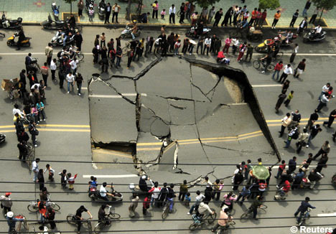
What effect does this photo have on you?
http://english.sina.com/china/p/1/2007/0426/110686.html
Notes:
Hole
Could go around, but will cause traffic jam – impedes flow

Slide 3
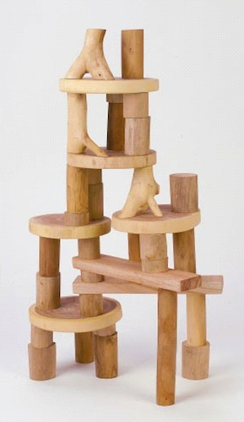
What do you think Science “Looks” like?
Where are the gaps?
“Paint a hole”
http://www.rosiehippo.com/c-151-building-and-stacking.aspx
http://buildingblocksblog.com/

Slide 4
Degree Requirements
The PhD degree is awarded for the accomplishment of independent and original research and reporting thereon in a dissertation. The normal requirements for the PhD degree are as follows:
Satisfactory completion of three one-term (0.5 unit weight) (600 or 700 series) graduate level courses acceptable for graduate credit by the Department with an overall average of 70%.
Satisfactory performance in a Comprehensive examination. The examination consists of the following two parts:
an examination of the research proposal that the candidate intends to develop into a successful PhD research thesis
an examination of the breadth of the candidate's knowledge in the field of research.
Submission and oral defense of a thesis, embodying the results of original research.
Required to attend 20 Seminars within your program time limit. (Master’s Seminar, PhD Comprehensive or Defense or External Seminar).
Notes:
First of many

Slide 5
What is a Proposal?
A proposal is “an act of putting forward or stating something for consideration”
Merriam online dictionary
Notes:
ESL

Slide 6
Two Proposals: [with Murray’s added comments]
Data on Ontario Bridges
I plan to visit all of the bridges in Ontario and collect information about bridge size and span, structural materials used and the condition of each bridge. I will use total station survey equipment and ultrasonic transducers to collect this data. I would like to make this data available to all interested parties. The data I collect will be helpful to the government. It will also be of great interest to other researchers.
Problems:
Overuse of “I”
Oxford comma (serial comma)
Is caught by Grammarly
Beholder word
Simplistic sentence structure
Short sentences at end are “choppy”, not fluent and smooth
More about this in Lesson 7
Notes:
Read just left one, and score out of 10
Then read right one and score both

Slide 7
Two Proposals:
Data on Ontario Bridges
I plan to visit all of the bridges in Ontario and collect information about bridge size and span, structural materials used and the condition of each bridge. I will use total station survey equipment and ultrasonic transducers to collect this data. I would like to make this data available to all interested parties. The data I collect will be helpful to the government. It will also be of great interest to other researchers.
Ontario Bridge Survey
For the Government of Ontario to make informed decisions regarding infrastructure planning, it needs a comprehensive survey of all public bridges in the province. My goal is to build this urgently-needed database by visiting all such bridges and collecting geometric, structural, and surface-condition data using state-of-the-art equipment. The data will be made available through a public website.
Notes:
Read just left one, and score out of 10
Then read right one and score both

Slide 8
Who cares?
What have others done?
Significance
State-of-the-art
The IDEA
How much will it cost?
How will you carry out your idea?
Resources
Methodology
Evaluation
Is the idea worth pursuing?
Safety / collaborators / equipment / data availability

Slide 9
The Document
Abstract [for research proposal]
(Acknowledgements)
Introduction
Literature Review
Methodology
Preliminary Results
Conclusions
Future Work
Reference List
[Although this PowerPoint file is about Research Proposals rather than Journal Papers, much of the information applies to both.]
Notes:
Write a word or two beside each describing its FUNCTION

Slide 10
The Key Ingredients
Generate an IDEA
Convey it
Convince the reader
Get audience buy-in
Novelty, meaning
Clarity, precision
Value
Would make the world a better place
Personal engagement
Desire
We need to do this
Notes:
Emphasize what buy-in looks like. If they don’t do this project, I want to have my students or someone do it.
Save $10 per month/ build rocket and go to the moon/ buy a certain used vehicle.

Slide 11
Abstract (2 pages) [Not a research paper abstract]
A brief, (generally) semi-technical overview of your IDEA
“Explain your IDEA to a family member” - i.e., to a non-techie
Always “paint a hole” [= bring attention to a missing piece of knowledge]
Make sure all relevant keywords appear in the abstract
Use one or more sentences to summarize the highlight(s) of each chapter:
Set scene – relate your IDEA to the real world
Identify the “hole”
Address “who cares?” Give numbers, if possible
Present your goal(s)
Outline your plan and methods
Explain your expected (and/or achieved) results
What do the findings mean? What is their significance?
How will your efforts make the world a better place?
Does the reader know what you plan to do, why you will do it, how you will do it, and whether your success will make any real difference in the world?

Slide 12
Introduction (3-5 pages)
A more detailed and technical overview than the abstract.
Write this for someone with some knowledge in the field
Use one or more paragraphs to summarize each chapter:
Set scene – relate your idea to the real world
– address big picture and small picture issues
More clearly identify the “hole”
Address “who cares?” Give numbers, if possible
Present your goal(s) – be specific
Outline your plan and methods – give key details
Explain your expected (and/or achieved) results
What do the findings mean? What is their significance?
How will your efforts make the world a better place?
What is your project about?
Who cares?

Slide 13
Literature Review (7-20 pages)
Explains the current state-of-the-art
Makes the reader an “expert” on the background relevant to your project
Relates your project to what is known
Describes the hole with precision
Makes it clear why your goals address the hole
Might discuss philosophy – i.e., big picture
Explain why your proposed work is important
Describe the exact boundaries of current relevant knowledge
Discuss the strengths and limitations of proposed methods
What have other people done in this area?
Why is it important for you to do what you propose?

Slide 14
Methodology (11-20 pages)
Explain what you are going to do and how you will do it.
Outline the steps
Show data flow
Explain analysis methods
Discuss reliability and accuracy if appropriate
Explain what new knowledge is expected
Remind the reader about the significance of what you are doing
Provide enough detail that someone versed in the art could do the work themselves (but keep a few secrets to yourself)
Provide timelines and budgets. Relate to the plan
What will you do?
How will you do it?
Does your plan achieve your stated goals?
Is your plan feasible?

Slide 15
(Preliminary) Results (7-15 pages)
Show that you will be able to do what you propose
Demonstrate the key steps in your plan by example
Use synthetic data if appropriate
Are your results generally what you expected?
If not, why?
Does your plan have a high probability of success?

Slide 16
Discussion and Conclusions (3-5 pages)
Identify successes to date
Identify potential problem areas
Explain what you will do if your “Plan A” does not work
Show me how your efforts are likely to make the world a better place
Is there value in the results?
How will your findings make the world a better place?

Slide 17
Future Work (2-3 pages)
For a Proposal (additional steps that you must complete in order to succeed):
How will you complete the plan?
Do you have the needed resources?
Is the necessary expertise available?
Can the work be completed in the stated period of time?
For a Thesis (steps that someone might do in the future) :
Does the work open new avenues of endeavour?
Can the proposed plan be completed using the allotted/available resources?

Slide 18
References (Usually 30-50 Entries)
These entries define the state-of-the-art
Each entry must be complete and properly formatted
Usually, most should be journal papers
Limit the number of web references
Consider using RefWorks [a reference-keeping system*]
* Dr. Brodland’s university had a RefWorks site license at the original time of this presentation. Not long after, RefWorks servers migrated to the USA and many Canadian universities looked for an alternative.
Is the project academically credible?

Slide 19
Technical Writing
Start with a plan
Know the function of each section and subsection
Use a flow chart, figure, or other tool if appropriate [e.g. cMapTools]
The first sentence of each paragraph tells you what it is about
Identify the function of each paragraph
Good resources:
1) http://engineering.missouri.edu/civil/files/science-of-writing.pdf
or Google “The Science of Scientific Writing”
2) http://www.meaning.ca/archives/archive/art_how_to_write_P_Wong.htm
Have you communicated a compelling message?

Slide 20
Assignment
1. Write a 300 to 500-word abstract on an imaginary topic of your choice. Ensure that all of the key points related to abstract writing are covered. Use paragraphs.
2. Write a 300 to 500-word abstract on a proposed project of your choice, preferably related to your research area. Ensure that all of the key points related to abstract writing are covered. Use paragraphs. Remember, a non-expert should be able to read your abstract and to get a sense of the value, significance and probability of success of the proposed work.
Do you know how to write a winning abstract?

