Slide 1
计算机体系结构
周学海
xhzhou@ustc.edu.cn
0551-63606864
中国科学技术大学

Slide 2
05/13-Review
向量机的存储器访问
存储器组织：独立存储体、多体交叉方式
Stride : 固定步长（1 or 常数）, 非固定步长（index）
基于向量机模型的优化
链接技术
有条件执行
稀疏矩阵的操作
多媒体扩展指令
扩展的指令类型较少
向量寄存器长度较短
GPU

Slide 3
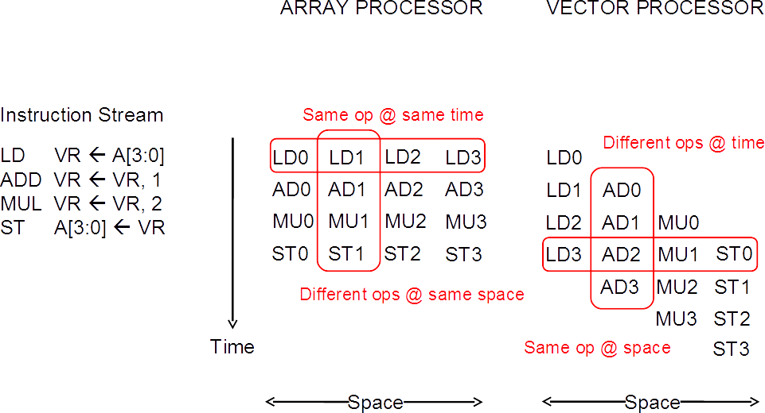
Array vs. Vector Processors
Array processor：又称为并行处理机、SIMD处理器。其核心是一个由多个处理单元构成的阵列，用单一的控制部件来控制多个处理单元对各自的数据进行相同的运算和操作。

Slide 4
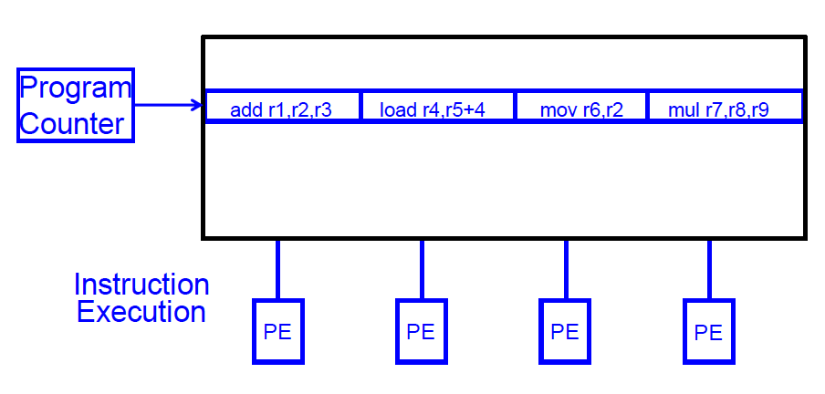
SIMD Array Processing vs. VLIW
VLIW: 多个独立的操作由编译器封装在一起

Slide 5
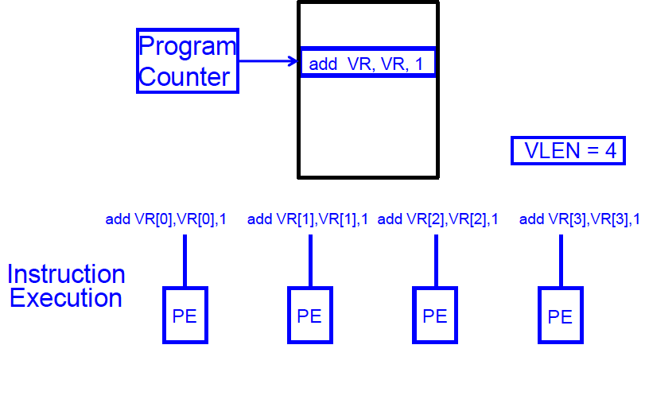
SIMD Array Processing vs. VLIW
Array processor: 单个操作作用在多个不同的数据元素上

Slide 6
Vector/SIMD Processing Summary
Vector/SIMD 机器适合挖掘数据级并行
同样的操作作用于不同的数据元素
向量内的元素操作独立，可有效提高性能，简化设计
性能的提升受限于代码的向量化
标量操作限制了向量机的性能
Amdahl’s Law
很多ISA包含SIMD操作指令
Intel MMX/SSEn/AVX, PowerPC AltiVec, ARM Advanced SIMD

Slide 7
Multimedia Extensions (aka SIMD extensions)
在已有的ISA中添加一些向量长度很短的向量操作指令
将已有的 64-bit 寄存器拆分为 2x32b or 4x16b or 8x8b
1957年，Lincoln Labs TX-2 将36bit datapath 拆分为2x18b or 4x9b
新的设计具有较宽的寄存器
128b for PowerPC Altivec, Intel SSE2/3/4 (Sreaming SIMD Extensions)
256b for Intel AVX (Advanced Vector Extensions)
单条指令可实现寄存器中所有向量元素的操作

Slide 8
Multimedia Extensions (aka SIMD extensions)
64b
32b
32b
16b
16b
16b
16b
8b
8b
8b
8b
8b
8b
8b
8b
16b
16b
16b
16b
16b
16b
16b
16b
4x16b adds
+
+
+
+
16b
16b
16b
16b

Slide 9
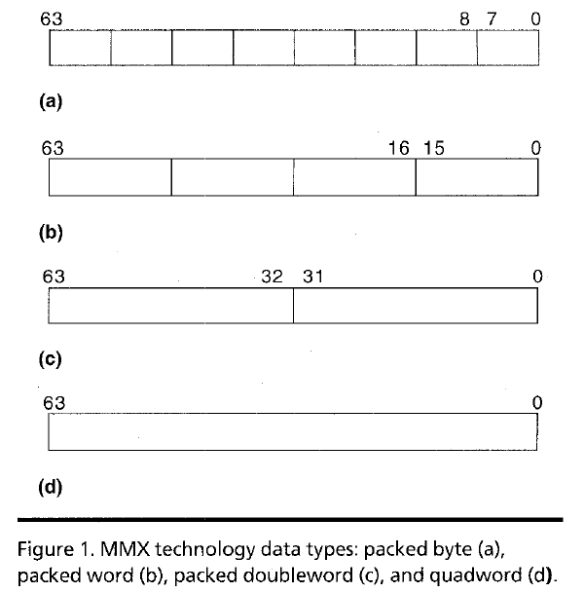
Intel Pentium MMX Operations
idea: 一条指令操作同时作用于不同的数据元
全阵列处理
用于多媒体操作
No VLEN register
Opcode determines data type:
8 8-bit bytes
4 16-bit words
2 32-bit doublewords
1 64-bit quadword
Stride always equal to 1.

Slide 10
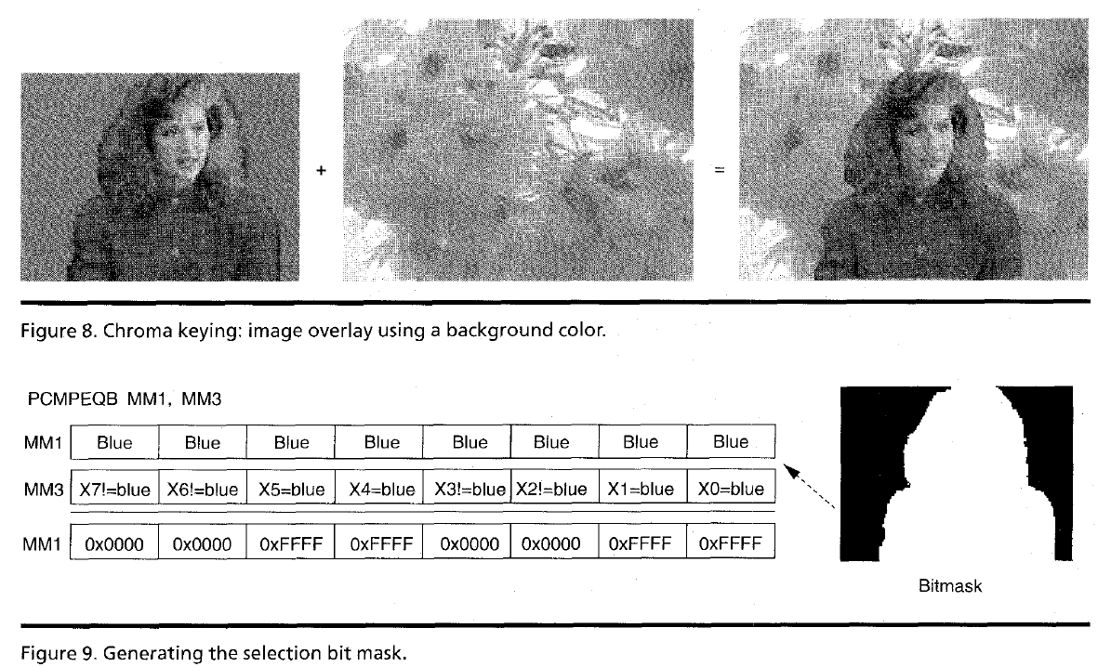
MMX Example: Image Overlaying (I)

Slide 11
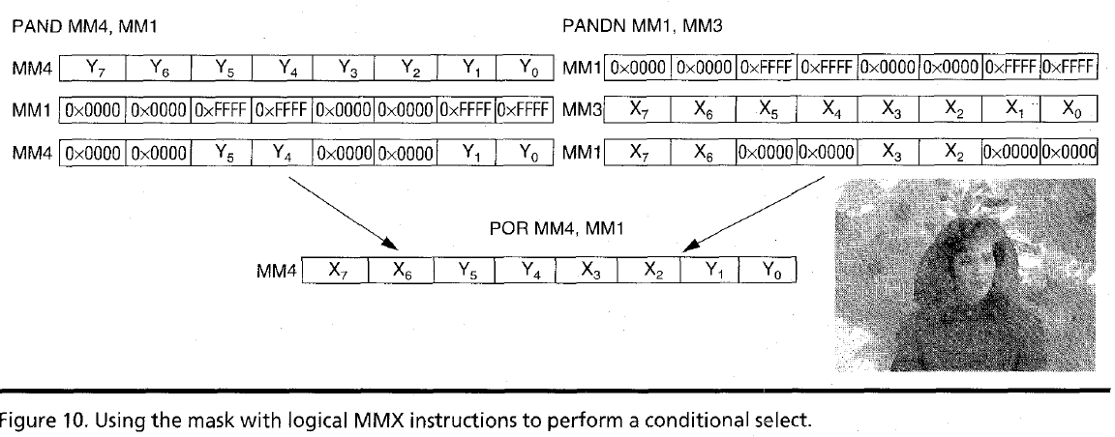
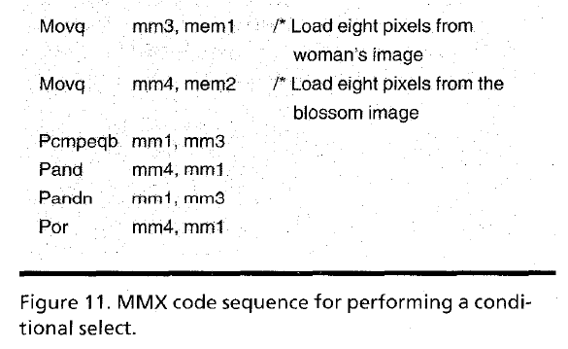
MMX Example: Image Overlaying (II)

Slide 12
Multimedia Extensions versus Vectors
受限的指令集:
无向量长度控制
Load/store操作无 常数步长寻址和 scatter/gather操作
loads 操作必须64/128-bit 边界对齐
受限的向量寄存器长度:
需要超标量发射以保持multiply/add/load 部件忙
通过循环展开隐藏延迟增加了寄存器读写压力
在微处理器设计中向全向量化发展
更好地支持非对齐存储器访问
支持双精度浮点数操作 (64-bit floating-point)
Intel AVX spec (announced April 2008), 256b vector registers (expandable up to 1024b)

Slide 13
GPU
GPU的起源
GPU基本的硬件结构
GPU编程模型
GPU的存储层次
GPU分支处理（发散与汇聚）

Slide 14
Graphics Processing Units (GPUs)
早期的GPU是指带有高性能浮点运算部件、可高效生成3D图形的具有固定功能的专用设备 (mid-late 1990s)
让PC机具有类似工作站的图形功能
用户可以配置图形处理流水线，但不是真正的对其编程
2001-2005，GPU加入了越来越多的可编程性
例如新的语言 Cg可用来编写一些小的程序处理图形的顶点或像素，是Windows DirectX的变体
大规模并行（针对每帧上百万顶点或像素）但非常受限于编程模型
有些用户注意到通过将输入和输出数据映射为图像，并对顶点或像素渲染计算 可进行通用计算
因为不得不使用图形流水线模型，这对完成通用计算来说是个非常难用的编程模型

Slide 15
General-Purpose GPUs (GP-GPUs)
2006年, Nvidia 的 GeForce 8800 GPU 支持一种新的编程语言: CUDA
“Compute Unified Device Architecture”
随后工业界推出OpenCL，与CUDA具有相同的ideas, 但独立于供应商
Idea: 针对通用计算，发挥GPU计算的高性能和存储器的高带宽来加速一些通用计算中的核心（Kernels）
一种协处理器模型（GPU作为附加设备）：Host CPU发射数据并行的kernels 到GP-GPU上运行
我们仅讨论Nvidia CUDA样式的简化版本，仅考虑GPU的计算核部分，不涉及图形加速部分

Slide 16
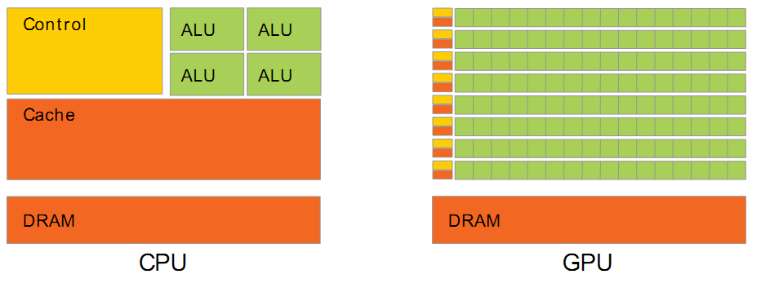
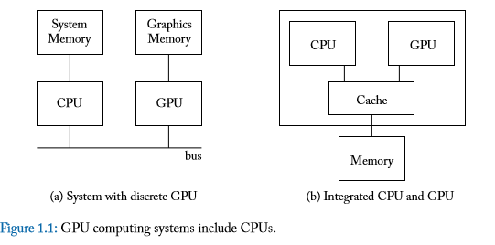
Using CPU+GPU Architecture
CPU+GPU异构多核系统
针对每个任务选择合适的处理器和存储器
通用CPU 适合执行一些串行的线程
串行执行快
带有cache，访问存储器延时低
GPU 适合执行大量并行线程
可扩放的并行执行
高带宽的并行存取
强控制、弱计算
弱控制、强计算
GPU
CPU
SMem
SMem
SMem
Cache
Cache
Host Memory
Bridge
Device Memory
PCIe

Slide 17
GPU: a multithreaded coprocessor
SM
SP: scalar processor
‘CUDA core’
Executes one thread
SP
SP
SP
SP
SP
SP
SP
SP
SP
SP
SP
SP
SP
SP
SP
SP
SM
streaming multiprocessor
32xSP (or 16, 48 or more)
Fast local ‘shared memory’
(shared between SPs)
16 KiB (or 64 KiB)
SHARED MEMORY
GLOBAL MEMORY
(ON DEVICE)

Slide 18
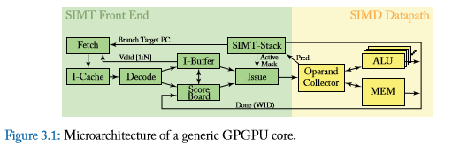
GPUs are SIMD Engines Underneath
指令流水线类似于SIMD的流水线。
不是用SIMD指令编程
基于一般的指令，应用由一组线程构成。
两个概念
Programming Model (Software) vs Execution Model (Hardware)
编程模型指程序员如何描述应用（从程序员角度看到的机器模型）
例如, 顺序模型 (von Neumann), 数据并行(SIMD), 数据流模型、多线程模型 (MIMD, SPMD), …
执行模型指硬件底层如何执行代码
例如, 乱序执行、向量机、数据流处理机、多处理机、多线程处理机等
执行模型与编程模型可以差别很大
例如., 顺序模型可以在乱序执行的处理器上执行。
SPMD 模型可以用SIMD处理器实现 (a GPU)

Slide 19
How Can You Exploit Parallelism Here?
for (i=0; i < N; i++)
C[i] = A[i] + B[i];
Scalar Sequential Code
load
Let’s examine three programming options to exploit instruction-level parallelism present in this sequential code:
1. Sequential (SISD)
2. Data-Parallel (SIMD)
3. Multithreaded (MIMD/SPMD)
Iter. 1
load
add
store
load
Iter. 2
load
add
store

Slide 20
Prog. Model 1: Sequential (SISD)
Scalar Sequential Code
Can be executed on a:
Pipelined processor
Out-of-order execution processor
Independent instructions executed when ready
Different iterations are present in the instruction window and can execute in parallel in multiple functional units
In other words, the loop is dynamically unrolled by the hardware
Superscalar or VLIW processor
Can fetch and execute multiple instructions per cycle
load
Iter. 1
load
add
store
load
Iter. 2
load
add
store
for (i=0; i < N; i++)
C[i] = A[i] + B[i];

Slide 21
Prog. Model 2: Data Parallel (SIMD)
Scalar Sequential Code
Vector Instruction
Vectorized Code
load
load
VLD A → V1
load
load
Iter. 1
load
load
VLD B → V2
add
VADD V1 + V2 → V3
add
add
store
store
store
VST V3 → C
load
Iter. 1
Iter. 2
Realization: Each iteration is independent
Idea: Programmer or compiler generates a SIMD instruction to execute the same instruction from all iterations across different data
Best executed by a SIMD processor (vector, array)
Iter. 2
load
add
store
for (i=0; i < N; i++)
C[i] = A[i] + B[i];

Slide 22
Prog. Model 3: Multithreaded
Scalar Sequential Code
load
load
for (i=0; i < N; i++)
C[i] = A[i] + B[i];
load
load
Iter. 1
load
load
add
add
add
store
store
store
load
Iter. 1
Iter. 2
load
Realization: Each iteration is independent
Idea: Programmer or compiler generates a thread to execute each iteration. Each thread does the same thing (but on different data)
Can be executed on a MIMD machine
Iter. 2
add
store

Slide 23
Prog. Model 3: Multithreaded
for (i=0; i < N; i++)
C[i] = A[i] + B[i];
load
load
load
load
add
add
store
store
Iter. 1
Iter. 2
Realization: Each iteration is independent
Idea: Programmer or compiler generates a thread to execute each iteration. Each thread does the same thing (but on different data)
Can be executed on a MIMD machine
This particular model is also called:
SPMD: Single Program Multiple Data
Can be executed on a SIMT machine
Single Instruction Multiple Thread
Can be executed on a SIMD machine

Slide 24
SPMD
Single procedure/program, multiple data
它是一种编程模型而不是计算机组织
每个处理单元执行同样的过程，处理不同的数据
这些过程可以在程序中的某个点上同步，例如 barriers
多条指令流执行相同的程序
每个程序/过程
操作不同的数据
运行时可以执行不同的控制流路径
许多科学计算应用以这种方式编程，运行在MIMD硬件结构上 (multiprocessors)
现代 GPUs 以这种类似的方式编程，运行在SIMD硬件上

Slide 25
A GPU is a SIMD (SIMT) Machine
GPU不是用SIMD指令编程
使用线程 (SPMD 编程模型)
每个线程执行同样的代码，但操作不同的数据元素
每个线程有自己的上下文(即可以独立地启动/执行等）
一组执行相同指令的线程由硬件动态组织成warp
一个warp是由硬件形成的SIMD操作

Slide 26
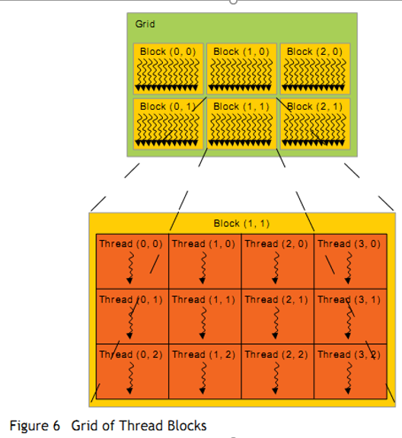
Threads and Blocks
一个线程对应一个数据元素
大量的线程组织成很多线程块
许多线程块组成一个网格
GPU 由硬件对线程进行管理
Thread Block Scheduler
SIMD Thread Scheduler

Slide 27
Programmer’s View of Execution
blockIdx 0
threadId 0
blockDim = 256 (programmer can choose)
threadId 1
创建足够的线程块以适应输入向量
(Nvidia 中将由多个线程块构成的、在GPU上运行的代码 称为Grid，Grid可以是2维的)
threadId 255
blockIdx 1
threadId 0
threadId 1
threadId 255
blockIdx
(n+255)/256)
threadId 0
Conditional (i<n) turns off unused threads in last block
threadId 1
threadId 255

Slide 28
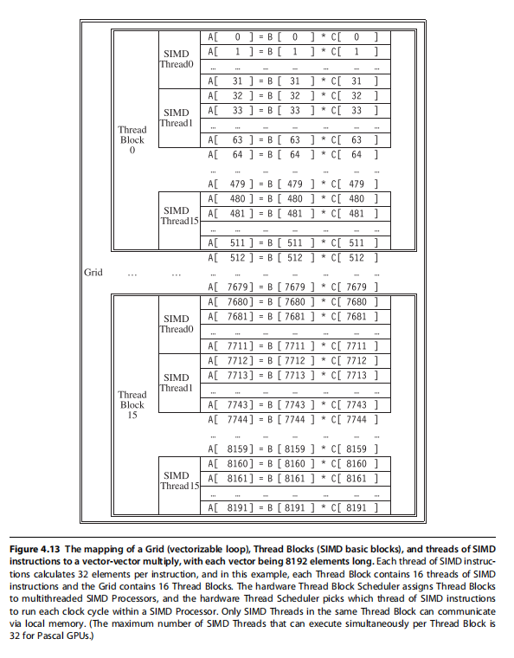
处理向量长度为8192的程序组织：
Grid 包含16个线程块（512个元素/Block）
Block包含16个SIMD 线程
32个CUDA 线程/SIMD线程
处理一个元素/CUDA线程

Slide 29
Hardware Execution Model
GPU
CPU
Core 0
Core 1
Core 15
Lane 0
Lane 0
Lane 0
Lane 1
Lane 1
Lane 1
Lane 15
Lane 15
Lane 15
CPU Memory
GPU Memory
GPU 由多个并行核构成，每个核是一个多线程SIMD处理器（包含多个车道（Lanes）)
CPU 发送整个 “grid”到GPU，由GPU将这些线程块分发到多个核上（每个线程块在一个核上运行）
GPU上核的数量对程序员而言是透明的

Slide 30
Simplified CUDA Programming Model
计算由大量的相互独立的线程(CUDA threads or microthreads) 完成，这些线程组合成线程块（thread blocks）
// C version of DAXPY loop.
void daxpy(int n, double a, double*x, double*y)
{ for (int i=0; i<n; i++)
y[i] = a*x[i] + y[i]; }
// CUDA version.
__host__ // Piece run on host processor.
int nblocks = (n+255)/256; // 256 CUDA threads/block
daxpy<<<nblocks,256>>>(n,2.0,x,y);
__device__ // Piece run on GP-GPU.
void daxpy(int n, double a, double*x, double*y)
{ int i = blockIdx.x*blockDim.x + threadId.x;
if (i<n) y[i]=a*x[i]+y[i]; }

Slide 31
NVIDIA Instruction Set Arch.
ISA 是硬件指令集的抽象
“Parallel Thread Execution (PTX)”
使用虚拟寄存器
用软件将其翻译成机器码
Example:
shl.s32 R8, blockIdx, 9 ; Thread Block ID * Block size (512 or 2⁹)
add.s32 R8, R8, threadIdx ; R8 = i = my CUDA thread ID
ld.global.f64 RD0, [X+R8] ; RD0 = X[i]
ld.global.f64 RD2, [Y+R8] ; RD2 = Y[i]
mul.f64 RD0, RD0, RD4 ; Product in RD0 = RD0 * RD4 (scalar a)
add.f64 RD0, RD0, RD2 ; Sum in RD0 = RD0 + RD2 (Y[i])
st.global.f64 [Y+R8], RD0 ; Y[i] = sum (X[i]*a + Y[i])

Slide 32
CUDA kernel maps to Grid of Blocks
kernel_func<<<nblk, nthread>>>(param, … );
Host Thread
Grid of Thread Blocks
. . .
GPU
SMs:
CPU
SMem
SMem
SMem
Cache
Cache
Host Memory
Bridge
Device Memory
PCIe

Slide 33
Thread blocks execute on an SM Thread instructions execute on a core
float myVar;
__shared__ float shVar;
__device__ float glVar;
Thread
Block
Registers
Per-block Shared
Memory
Per-app
Device Global
Memory
Per-thread
Local Memory
GPU
SMs:
CPU
SMem
SMem
SMem
Cache
Cache
Host Memory
Bridge
Device Memory
PCIe
Notes:
SM: Streaming Multiprocessor
PTX: Parallel Thread Execution

Slide 34
CUDA：“Single Instruction, Multiple Thread”
GPUs 使用 SIMT模型, 每个CUDA线程的标量指令流汇聚在一起在硬件上以SIMD方式执行 (Nvidia groups 32 CUDA threads into a warp)
µT0
µT1
µT2
µT3
µT4
µT5
µT6
µT7
ld x
Scalar instruction stream
mul a
ld y
add
st y
SIMD execution across warp

Slide 35
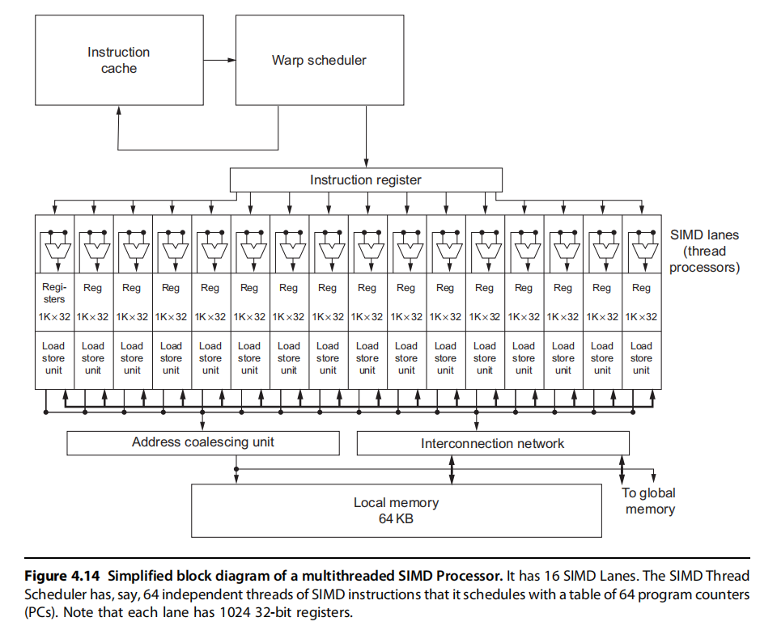

Slide 36
SPMD on SIMT Machine
load
load
Warp 0 at PC X
load
load
Warp 0 at PC X+1
add
add
Warp 0 at PC X+2
store
store
Warp 0 at PC X+3
Iter. 1
Iter. 2
Warp: A set of threads that execute
the same instruction (i.e., at the same PC)
Realization: Each iteration is independent
Idea: Programmer or compiler generates a thread to execute each iteration. Each thread does the same thing (but on different data)
Can be executed on a MIMD machine
for (i=0; i < N; i++)
C[i] = A[i] + B[i];
This particular model is also called:
SPMD: Single Program Multiple Data
A GPU executes it using the SIMT model:
Single Instruction Multiple Thread
Can be executed on a SIMD machine

Slide 37
SIMD vs. SIMT Execution Model
SIMD: 一条指令流（一串顺序的SIMD指令），每条指令对应多个数据输入（向量指令）
SIMT: 多个指令流（标量指令）构成线程， 这些线程动态构成warp。一个Warp处理多个数据元素
SIMT 主要优点：
可以独立地处理线程,即每个线程可以在任何标量流水线上单独执行（ MIMD 处理模式）
可以将线程组织成warp，即可以将执行相同指令流的线程构成warp，形成SIMD 处理模式, 以充分发挥SIMD处理的优势

Slide 38
Multithreading of Warps
设一个warp由 32 threads构成
如果有32K次循环 → 1K 个warps
这些Warps可以在同一条流水线上交替执行
Fine grained multithreading of warps
for (i=0; i < N; i++)
C[i] = A[i] + B[i];
load
load
Warp 0 at PC X
Warp 1 at PC X
load
load
add
add
Warp 20 at PC X+2
store
store
Iter. 1
Iter. 2
Iter. 32+1
Iter. 32+2
Iter. 20*32 + 1
Iter. 20*32 + 2

Slide 39
Warps and Warp-Level FGMT
Warp: 执行相同指令（操作不同的数据元素）的一组线程
同一Warp中的所有线程执行相同代码
Warp: The threads that run lengthwise in a woven fabric …
Thread Warp 3
Thread Warp 8
Thread Warp
Common PC
Scalar
Scalar
Scalar
Scalar
Thread Warp 7
Thread
Thread
Thread
Thread
W
X
Y
Z
SIMD Pipeline
Notes:
In SIMD, you need to specify the data array + an instruction (on which to operate the data on) + THE INSTRUCTION WIDTH. Eg: You might want to add 2 integer arrays of length 16, then a SIMD instruction would look like (the instruction has been cooked-up by me for demo) add.16 arr1 arr2 However, SIMT doesn't bother about the instruction width. So, essentially, you could write the above example as: arr1[i] + arr2[i] and then launch as many threads as the length of the array, as you want. Note that, if the array size was, let us say, 32, then SIMD EXPECTS you to explicitly call two such 'add.16' instructions! Whereas, this is not the case with SIMT.

Slide 40
Warp Instruction Level Parallelism
Can overlap execution of multiple instructions
Example machine has 32 threads per warp and 8 lanes
Completes 24 operations/cycle while issuing 1 warp/cycle
Load Unit
Multiply Unit
Add Unit
W0
W1
W2
time
W3
W4
W5
Warp issue
Slide credit: Krste Asanovic

Slide 41
Latency Hiding via Warp-Level FGMT
Warp: 一组执行相同指令的线程（作用于不同的数据元素）
Fine-grained multithreading
流水线上每次执行每个线程的一条指令 (No interlocking)
通过warp的交叉执行来隐藏延时
所有线程的寄存器值保存在寄存器文件中
FGMT 可以容忍长延时
Millions of pixels
Thread Warp 3
Warps available
Thread Warp 8
for scheduling
Thread Warp 7
SIMD Pipeline
I-Fetch
Decode
R
R
R
F
F
F
Warps accessing
A
A
A
memory hierarchy
L
L
L
U
U
U
Miss?
D-Cache
Thread Warp 1
All Hit?
Data
Thread Warp 2
Writeback
Thread Warp 6
Slide credit: Tor Aamodt
Notes:
With a large number of shader threads multiplexed on the same execution re- sources, our architecture employs fine-grained multithreading where individual threads are interleaved by the fetch unit to proactively hide the potential latency of stalls before they occur. As illustrated by Figure, warps are issued fairly in a round-robin queue. When a thread is blocked by a memory request, shader core simply removes that thread’s warp from the pool of “ready” warps and thereby allows other threads to proceed while the memory system processes its request.
With a large number of threads (1024 per shader core) interleaved on the same pipeline, FGMT effectively hides the latency of most memory operations since the pipeline is occupied with instructions from other threads while memory operations complete. also hides the pipeline latency so that data bypassing logic can potentially be omitted to save area with minimal impact on performance. simplify the dependency check logic design by restricting each thread to have at most one instruction running in the pipeline at any time.

Slide 42
Warp-based SIMD vs. Traditional SIMD
传统的SIMD仅包含一个线程
Lock step: 一条向量指令执行完，然后启动下一条向量指令
编程模型为SIMD (no extra threads) → SW 需要知道向量长度
ISA 包含vector/SIMD指令
Warp-based SIMD 由多个标量线程构成，以SIMD方式执行 (即所有的线程执行相同的指令)
不需要lock step
每个线程可以单独对待(即可以映射到不同的warp中），编程模型不是SIMD
SW 不必知道向量长度
多个线程可以动态构成warp
ISA是标量ISA → 可以动态形成逻辑上的向量指令
是一种在SIMD硬件上实现的SPMD编程模型

Slide 43
Warp Execution (Recall the Slide)
32-thread warp executing ADD A[tid],B[tid] → C[tid]
Execution using one pipelined functional unit
Execution using four pipelined functional units
A[6]
B[6]
A[24]
B[24]
A[25]
B[25]
A[26]
B[26]
A[27]
B[27]
A[5]
B[5]
A[20]
B[20]
A[21]
B[21]
A[22]
B[22]
A[23]
B[23]
A[4]
B[4]
A[16]
B[16]
A[17]
B[17]
A[18]
B[18]
A[19]
B[19]
A[3]
B[3]
A[12]
B[12]
A[13]
B[13]
A[14]
B[14]
A[15]
B[15]
C[2]
C[8]
C[9]
C[10]
C[11]
C[1]
C[4]
C[5]
C[6]
C[7]
C[0]
C[0]
C[1]
C[2]
C[3]
Slide credit: Krste Asanovic

Slide 44
SIMD Execution Unit Structure
Functional Unit
Registers
for each
Thread
Registers for thread IDs
0, 4, 8, …
Registers for thread IDs
1, 5, 9, …
Registers for thread IDs
2, 6, 10, …
Registers for thread IDs
3, 7, 11, …
Lane
Memory Subsystem
Slide credit: Krste Asanovic

Slide 45
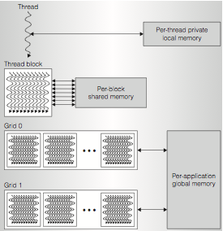
GPU Memory Hierarchy
[ Nvidia, 2010]

Slide 46
SIMT Memory Access
不同线程的相同指令使用线程id来存取不同的数据元素
Let’s assume N=16, 4 threads per warp → 4 warps
0
1
2
3
4
5
6
7
8
9
10
11
12
13
14
15
Threads
+
0
1
2
3
4
5
6
7
8
9
10
11
12
13
14
15
Data elements
+
+
+
+
Warp 0
Warp 1
Warp 2
Warp 3
Slide credit: Hyesoon Kim

Slide 47
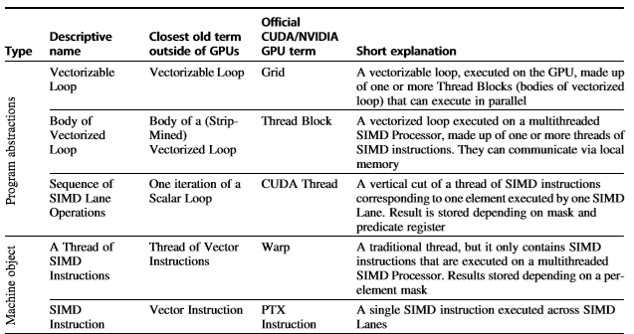
Summary- 向量处理机 vs. GPU
不同层次相近的术语比较

Slide 48
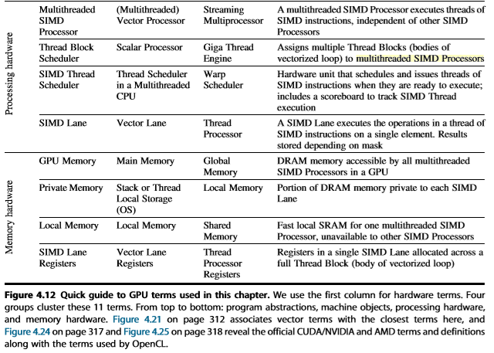
Summary-向量处理机 vs. GPU

Slide 49
Acknowledgements
These slides contain material developed and copyright by:
John Kubiatowicz (UCB)
Krste Asanovic (UCB)
John Hennessy (Standford)and David Patterson (UCB)
Chenxi Zhang (Tongji)
Muhamed Mudawar (KFUPM)
UCB material derived from course CS152、CS252、CS61C
KFUPM material derived from course COE501、COE502
CMU Introduction to Computer Architecture
http://www.ece.cmu.edu/~ece447/

