Slide 1
Recent Results from ATLAS
Zhengguo ZHAO
University of Science and Technology of China

Slide 2
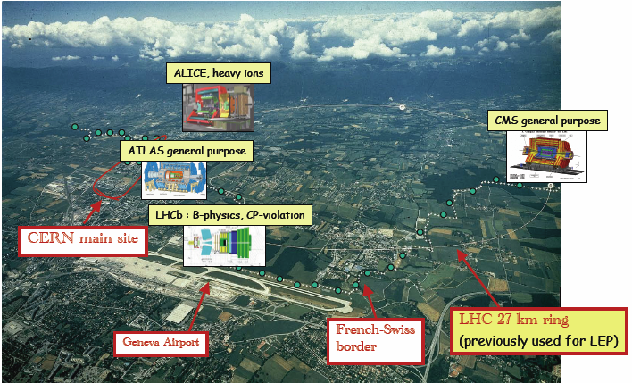
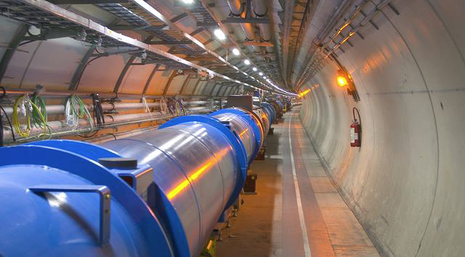
Experiments at LHC
Tunnel circumference: 27 km; diameter: 3.8 m
Depth: 70 – 140 m, inclined by ~1.4%

Slide 3
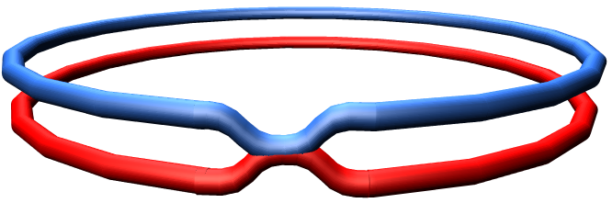
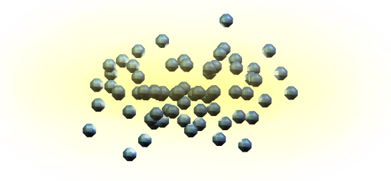


Collisions at the LHC
Final object to be identified
leptons (e, μ, τ)
γ
jets
Missing E_{T}
Bunch
N = L × σ(pp→x) = 10⁹ collision/s
Mostly low p_{t} events (soft) events.
20 inelastic (low-p_{T}) events
(“minimum bias”) produced
simultaneously in the detectors at
each bunch crossing → pile-up
Interesting high p_{t} events are rare
New physics rate ~ 10⁻⁽³⁻⁵⁾ Hz
→ event selection 1 in 10¹²⁻¹⁴
Proton
Parton
(quark, gluon)
e
l
Higgs
+
l
e
Z
-
e
o
Particle
+
Z
o
e
SUSY.....
jet
jet
-

Slide 4

~3200 authors (~1100 students), 38 Countries,174 Institutions

Slide 5
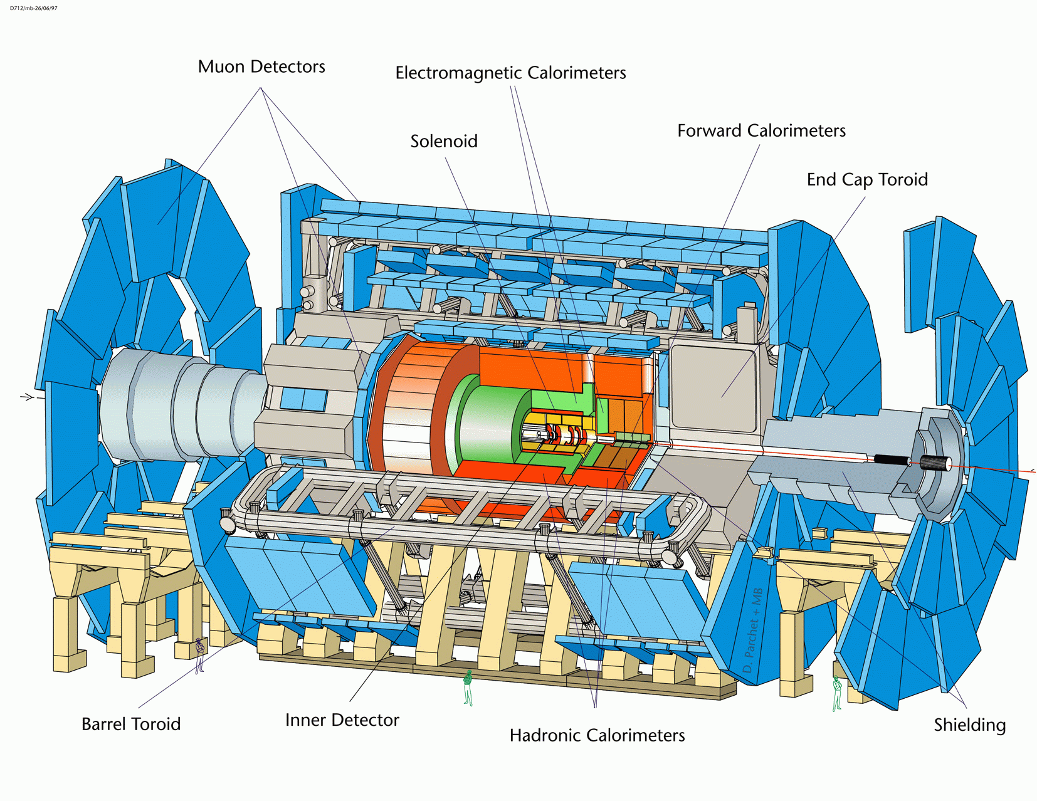
Muon spectrometer (|η| < 2.7)
Trigger & meas. of muon
CSC+TGC+RPC+MDT
σ/p_{T} <10 % up to 1 TeV
EM Calorimeter (|η|<3.2)
e/γ trigger, i.d. & measurement
Pb-Lar accordion
σ/E ~ 10%/√E(GeV)⊕1%
4 Superconducting magnets:
Central Solenoid (B= 2T)
3 Air core Toroids(B=3-8 T)
44 m
24 m
Inner detector (|η|< 2.5, B=2T)
Tracking, vertexing,
dE/dx, e/π i.d.
Si pixels, Si strips, TRD
σ/p_{T} ~3.8x10⁻⁴p_{T}(GeV)⊕0.15%;
Hadron Calorimeter (|η|<3)
Trigger and meas. of jet/E_{miss}
Fe/scintillator (central),
Cu/W-LAr (fwd)
σ/E ~ 50%/√E(GeV)⊕3%
Weight : ~ 7000 tons
Channels: ~ 10⁸
Cost: 550 MCHF

Slide 6
ATLAS Hardware Status
Subdetector | N Channels | Operational Fraction
Pixels | 80 M | 96.9%
SCT Silicon Strips | 6.3 M | 99.1%
TRT Transition Radiation Tracker | 350 k | 97.5%
LAr EM Calorimeter | 170 k | 99.5%
Tile Calorimeter | 9.8 k | 97.9%
Hadronic Endcap LAr Calorimeter | 5.6 k | 99,6%
Forward LAr Calorimeter | 3.5 k | 99.8%
MDT Muon Drift Tubes | 350 k | 99.8%
CSC Cathode Strip Chambers | 31 k | 98.5%
RPC Barrel Muon Chambers | 370 k | 97.0%
TGC Encap Muon Chambers | 320 k | 98.4%
LVL1 Calo Trigger | 7160 | 99.9%
LVL1 Muon RPC Trigger | 370 k | 99.5%
LVL1 Muon TGC Trigger | 320 k | 100%
>96%

Slide 7
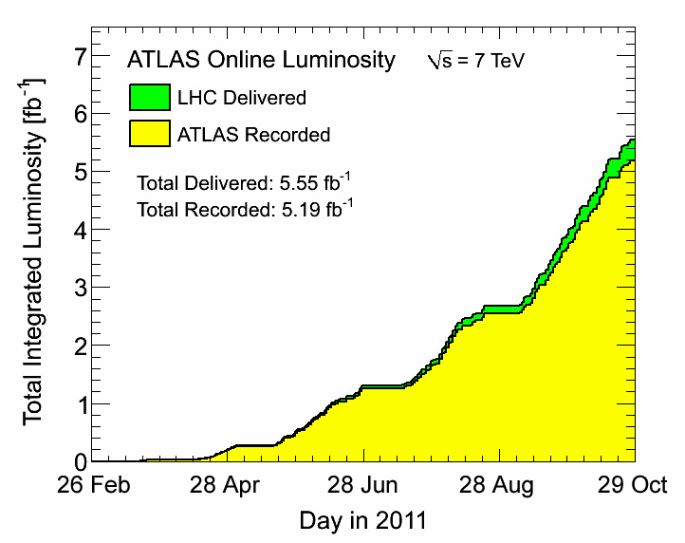
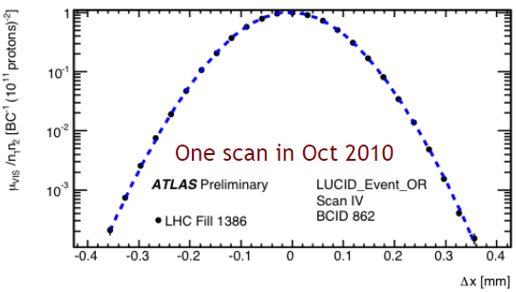
Luminosities
Absolute luminosity calibration by van der
Meer scans
ΔL/L = ±3.7%
The maximum peak luminosity: 3.3x10³³ cm⁻² s⁻¹
Data taking efficiency: 94%

Slide 8
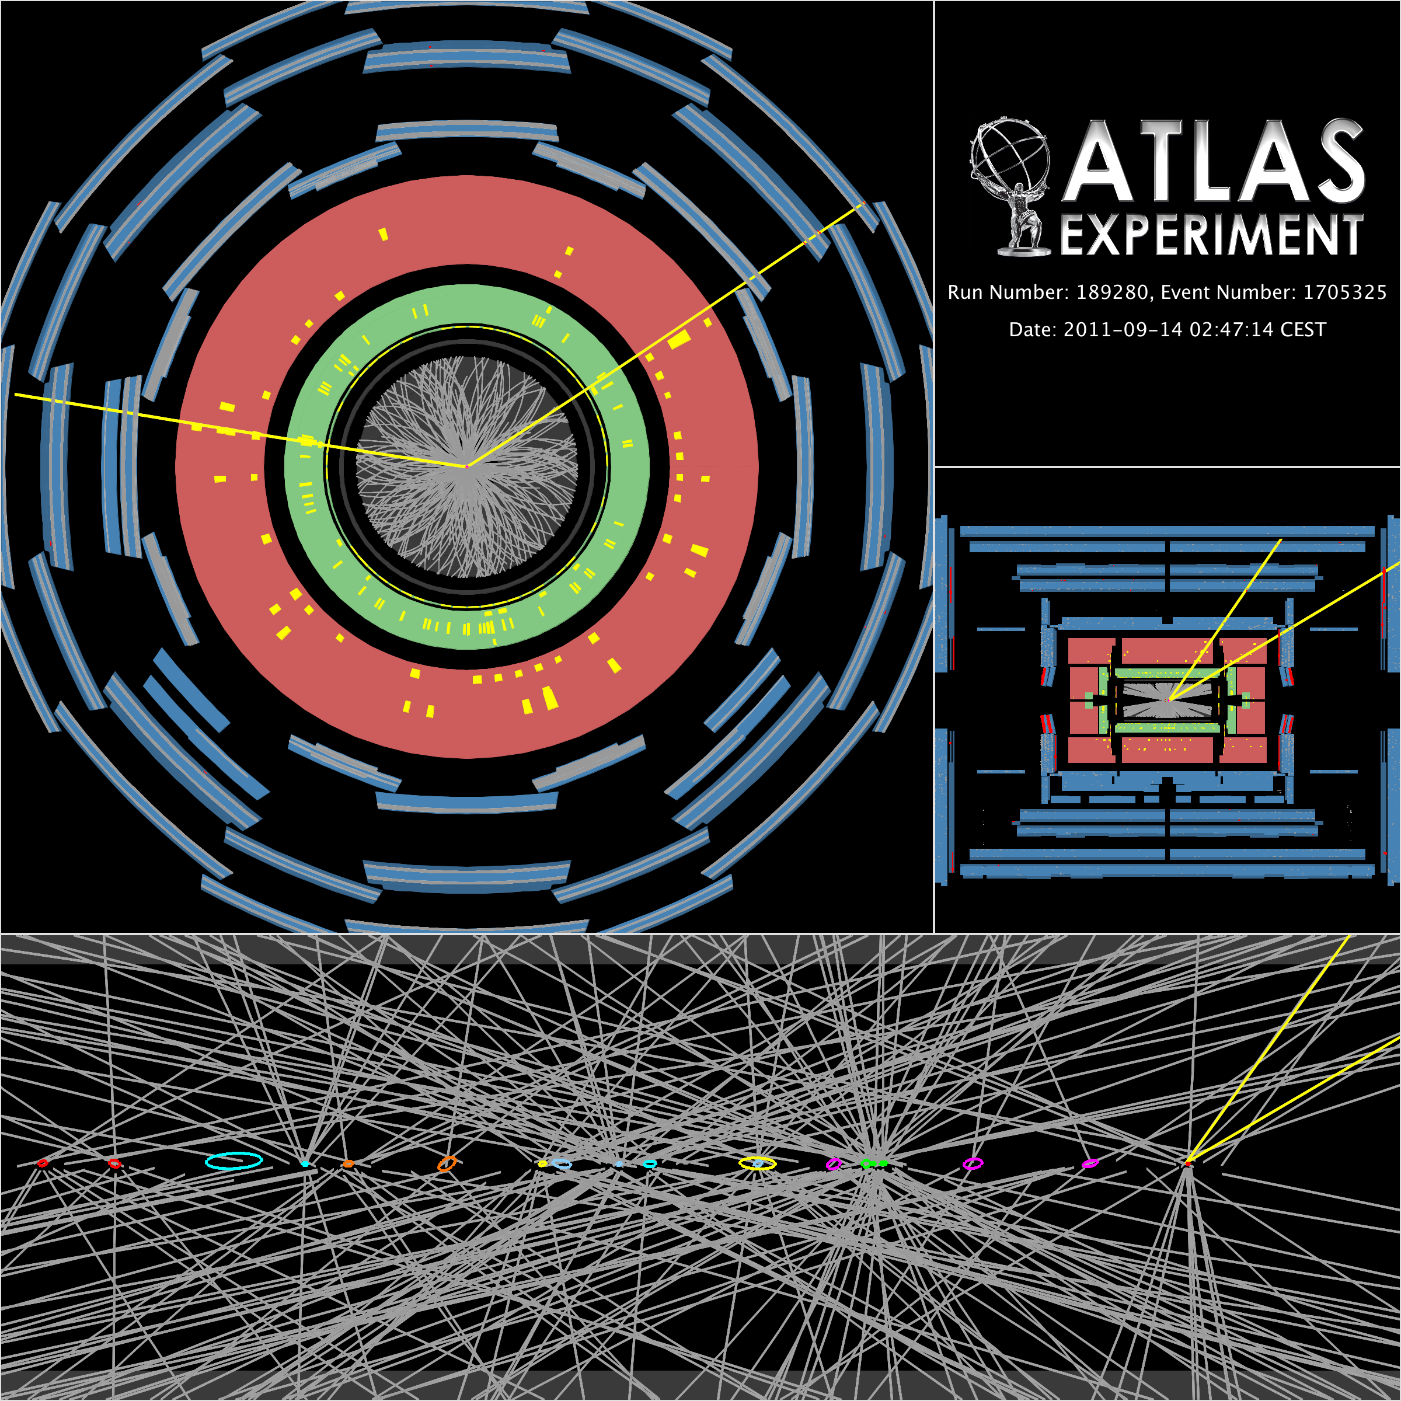
Pile-up
Example of Z → μμ decay
with 20 reconstructed vertices
Total scale along z is ~ ± 15 cm,
p_{T} threshold for track reco is
0.4 GeV (ellipses have size of
20σ for visibility)
Now have <pile-up> ~ 14
per bunch crossing.
a challenge for tracking
and for low-p_{T} jets!

Slide 9
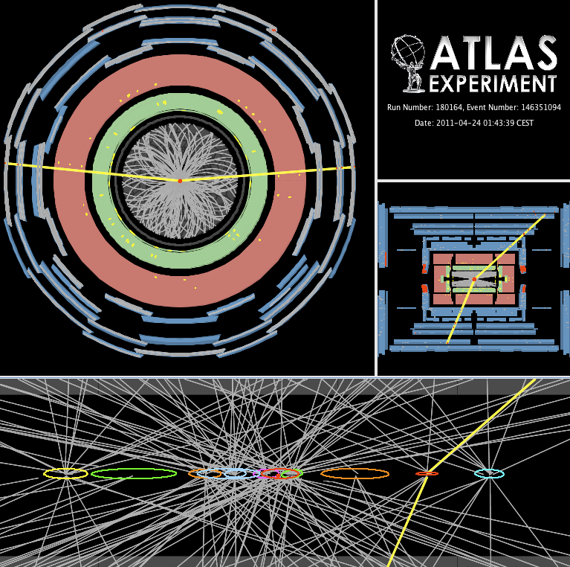
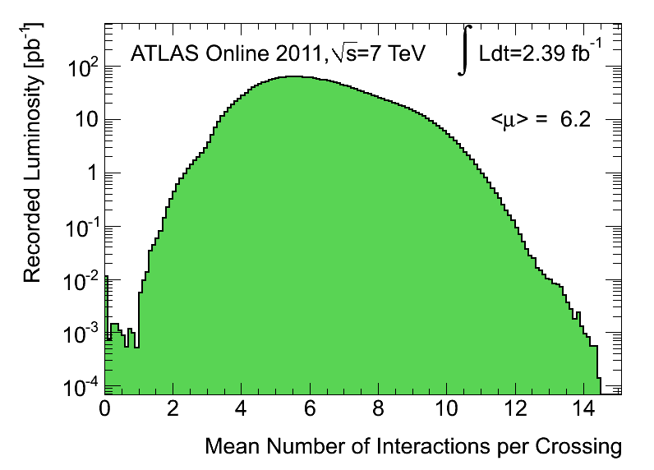
Pile-up
50 ns bunch trains for ~all 2011 data
Substantial in- and out-of-time pileup
Much progress understanding impact on performance, with data & simulation
Z→μμ event with 11 primary vertices

Slide 10
ATLAS trigger: preserve perf. and physics!
Difficult e.g. to keep inclusive single lepton trigger at ~ 20 GeV!
Trigger objects | Offline Selection (p_{T} thresholds) | Trigger Selection |  | L1 Rate (kHz) at 3 10³³ | EF Rate (Hz) at 3 10³³
 |  | L1 | EF
Single leptons | Single muon > 20 GeV | 11 GeV | 18 GeV | 8 | 100
 | Single electron > 25 GeV | 16 GeV | 22 GeV | 9 | 55
Two leptons | 2 muons > 4 GeV | 11 GeV | 15,10 GeV | 6 | 5
 | 2 electrons, > 15 GeV | 2x10 GeV | 2x12 GeV | 2 | 1.3
 | 2 τ → h > 45, 30 GeV | 15,11 GeV | 29,20 GeV | 7.5 | 15
Two photons | 2 photons, > 25 GeV | 2x12 GeV | 2x20 GeV | 3.5 | 5
E_{T}^{miss} | E_{T}^{miss} > 170 GeV | 50 GeV | 70 GeV | 0.6 | 5
Multi-jets | 5 jets, > 55 GeV | 5x10 GeV | 5x30 GeV | 0.2 | 9
Single jet plus E_{T}^{miss} | Jet p_{T} > 130 GeV & E_{T}^{miss} > 140 GeV | 50 GeV & 35 GeV | 75 GeV & 55 GeV | 0.8 | 18
Total rate (peak) |  |  |  | 55 kHz | 550 Hz

Slide 11
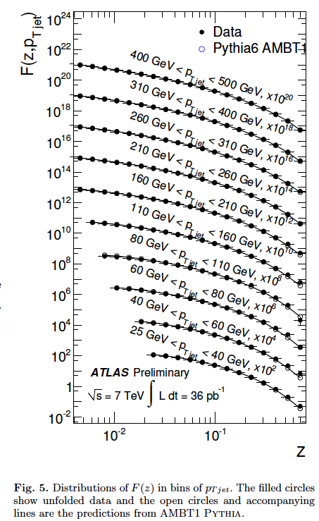
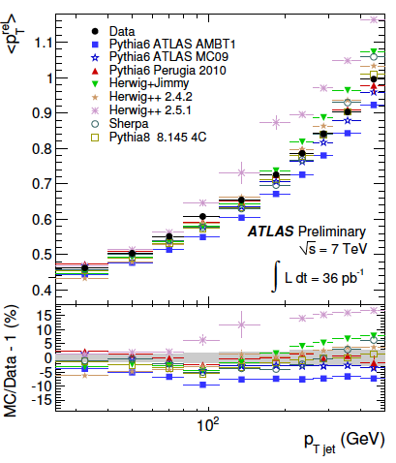

Jet fragmentation measurements: a step towards improved JES?
Precise fragmentation function measurements now available and in good agreement with eg Pythia6 for 25 < p_{T}^{jet} < 500 GeV.
None of the current generators nor tunes agree well with all the transverse measurements (p_{T}^{rel}, wrt to jet axis, is shown below on the right) within their uncertainties.
Large difference between HERWIG++ and Pythia dominates JES uncertainty at high E_{T}

Slide 12
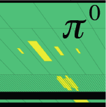
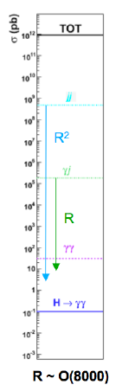
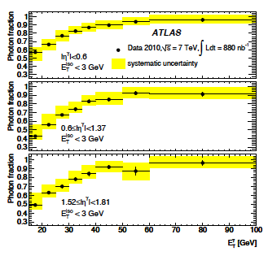
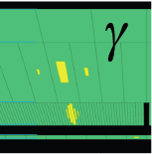
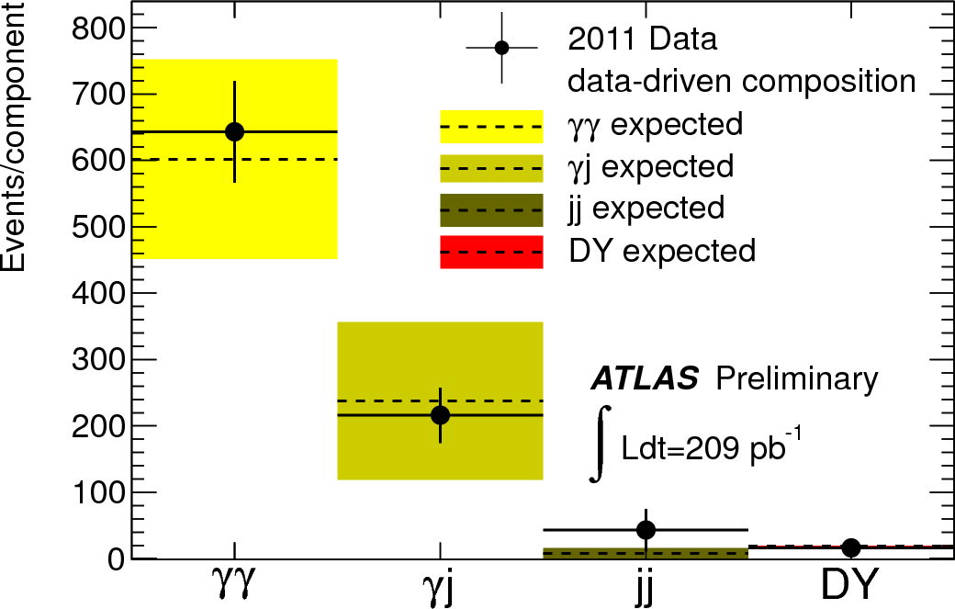
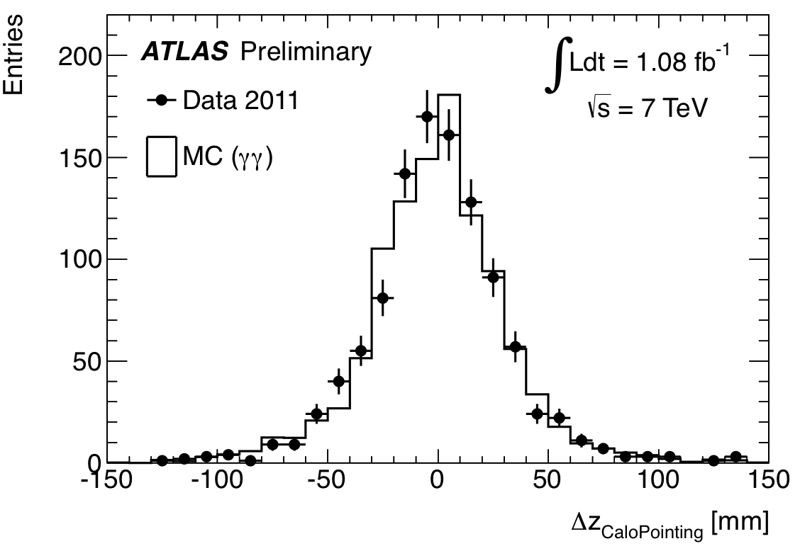
Photon measurements: physics and commissioning of H to γγ search
Data
Determined choice of
fine lateral segmentation
(4mm strips) of the first
compartment of ATLAS
EM calorimeter
Potentially huge background
from jets fragmenting into
a single hard π⁰
→ π⁰ fakes single photon
Photon purity versus ET:
around 70-80% in H to γγ range (25-40 GeV)
above 90% at high E_{T}
γγ, γj, jj backgrounds estimated from data
using control samples → γj + jj << γγ irreducible
jj
~ 500 μb
z-vertex measurement from calorimeter “pointing”
using Z → ee decays: very robust against pile-up
γj
~ 200 nb
η-strips
σ (z) ~ 1.5 cm
σ (γj, jj): huge
uncertainties !!
Not clear γj, jj
could be suppressed
until measured
with data.
~ 30 pb
H → γγ
~ 40 fb
z (“γ₁”) – z (”γ₂”)

Slide 13
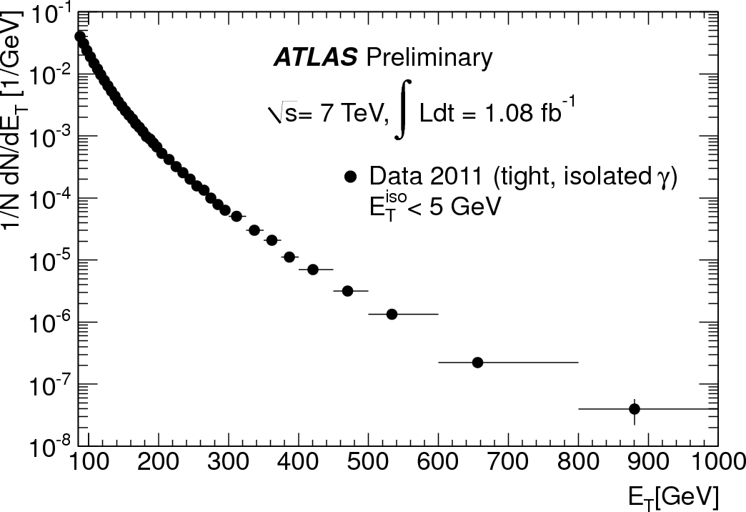
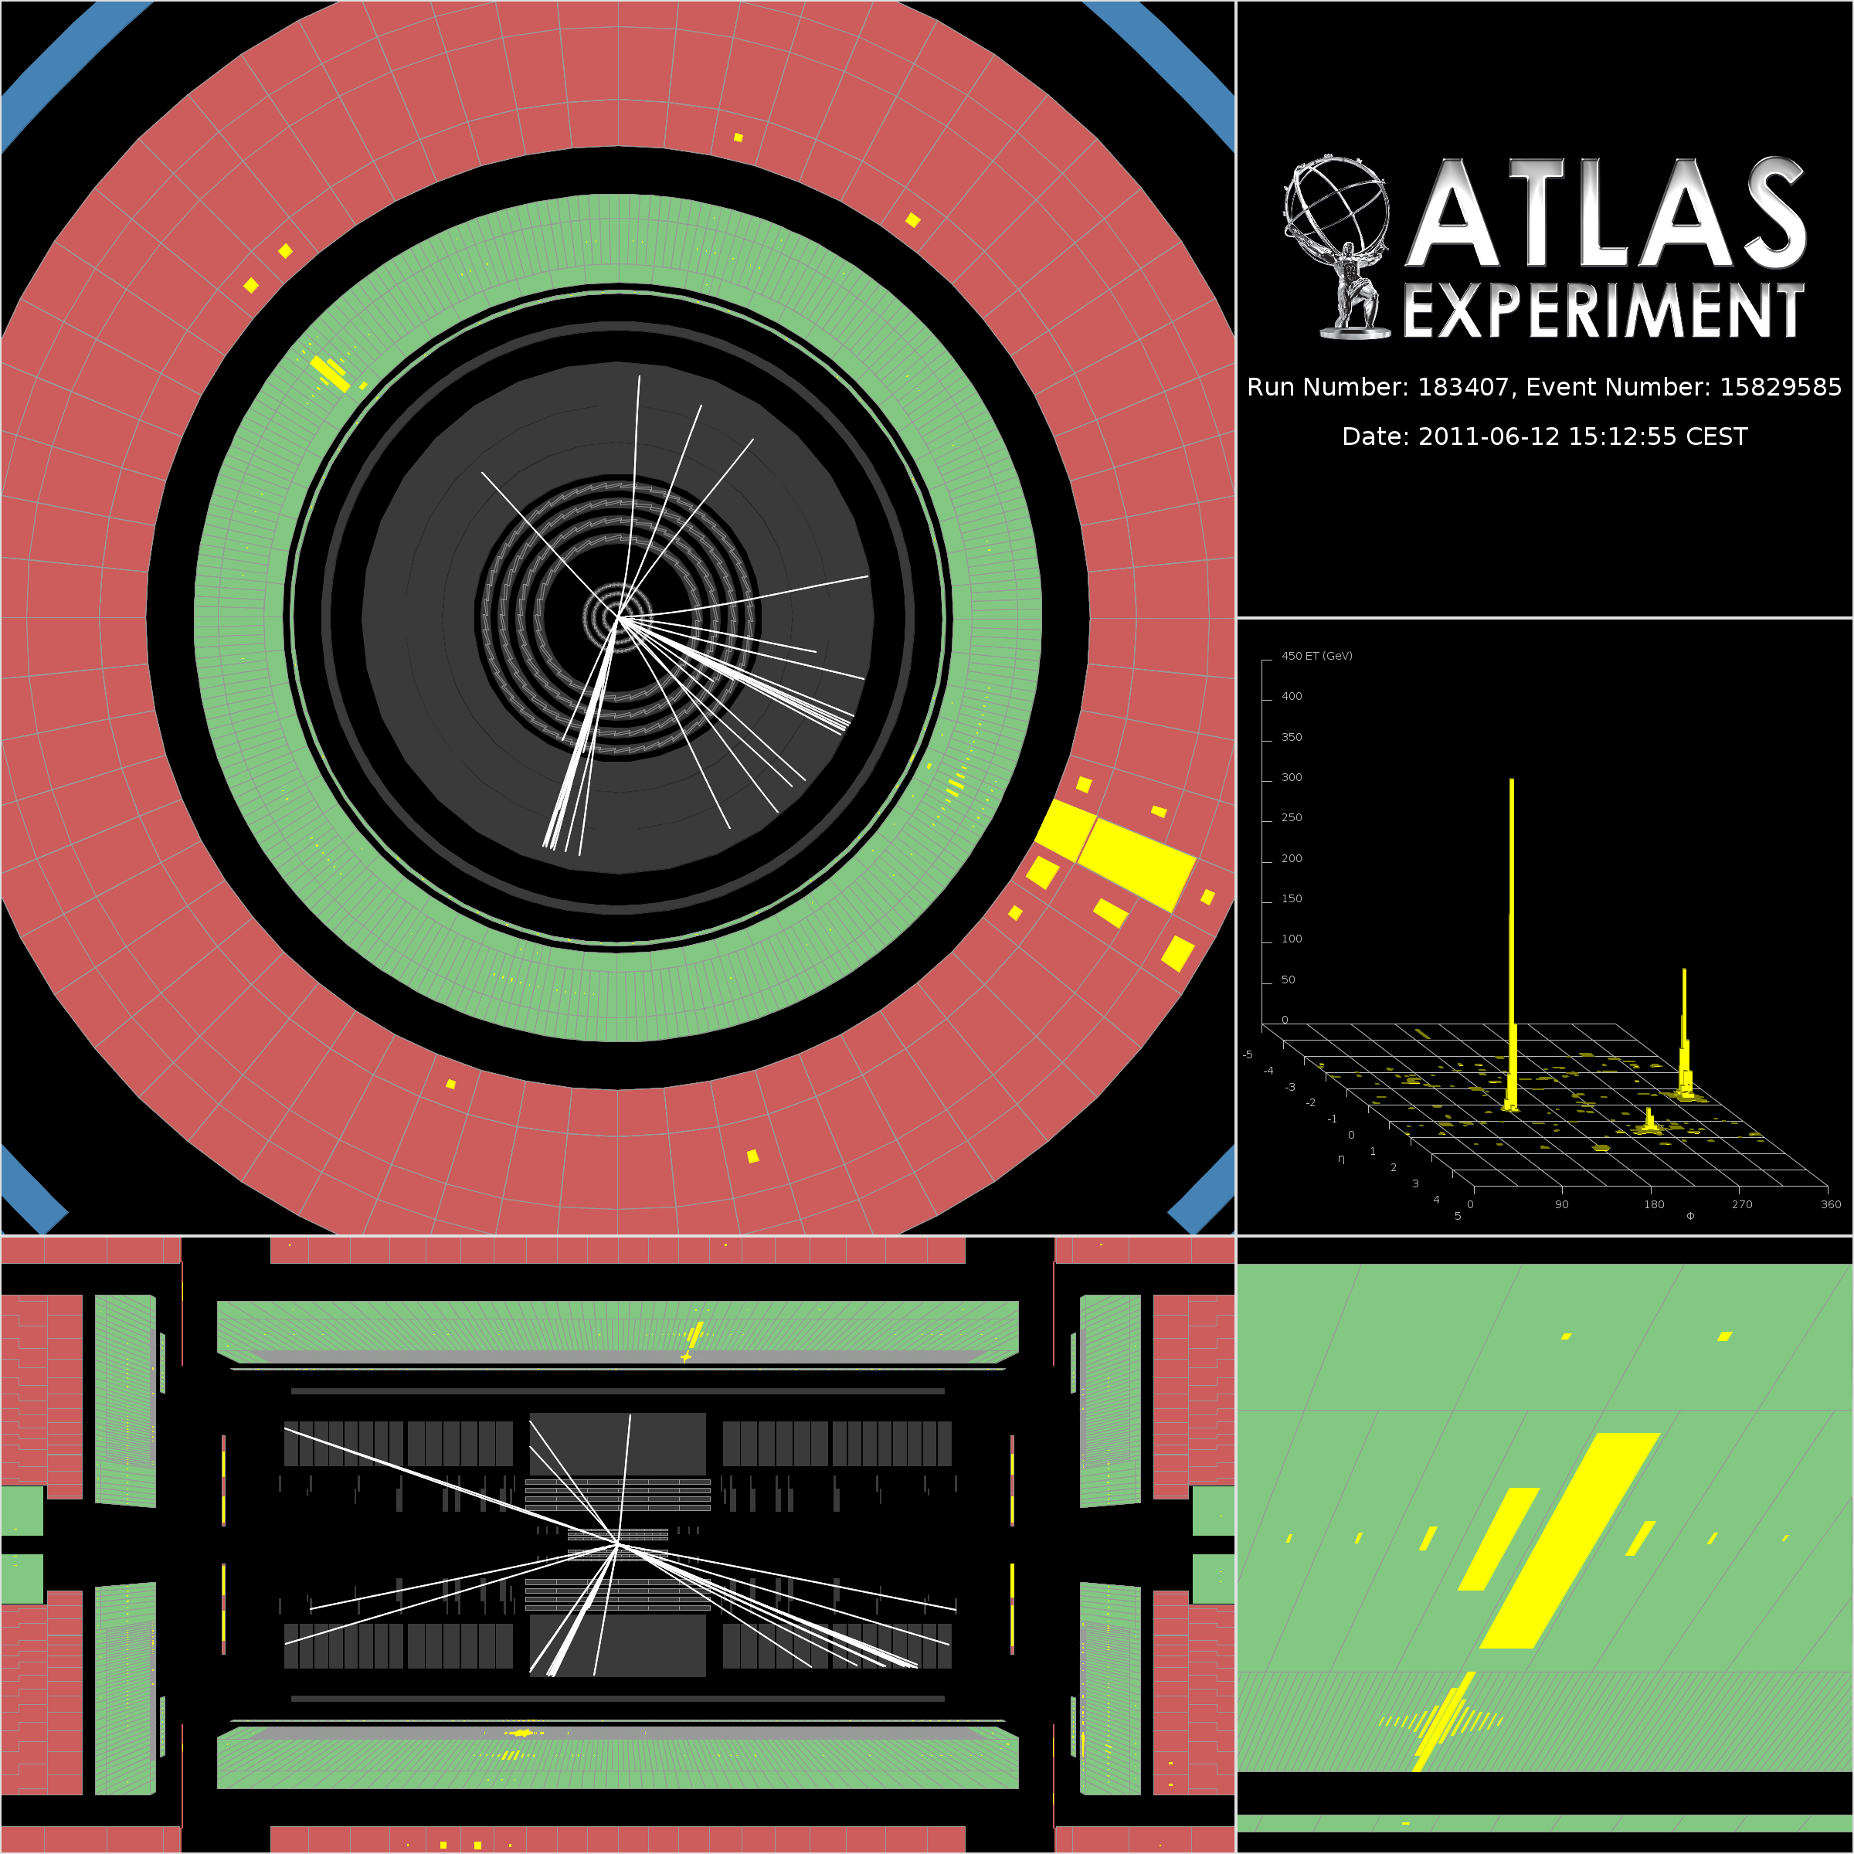
Photon measurements: reach also TeV scale by now!
Highest E_{T} (960 GeV) unconverted photon observed to-date

Slide 14
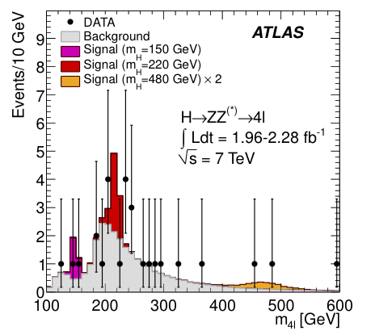
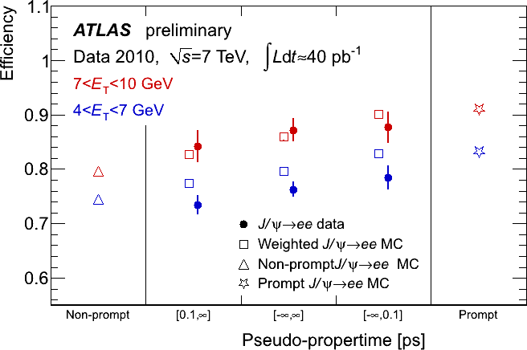
Electrons from J/ψ decay
and H to ZZ decays
Data: 27 events
Expected B : 24±4
Crucial experimental aspects:
High lepton acceptance, reconstruction and identification efficiency down to lowest p_{T}
Present analysis: p_{T}^{1,2,3,4} > 20,20,7,7 GeV
Need also good mass resolution
(presently 1.9 GeV for H→ 4μ for m_{H}=130 GeV)
Lepton efficiency from J/ψ → ll,
W →lν, Z→ ll data samples
J/ψ sample contains both prompt and non-prompt
J/ψ → ee decays
Difficult analysis requiring very performant trigger and good control of backgrounds

Slide 15
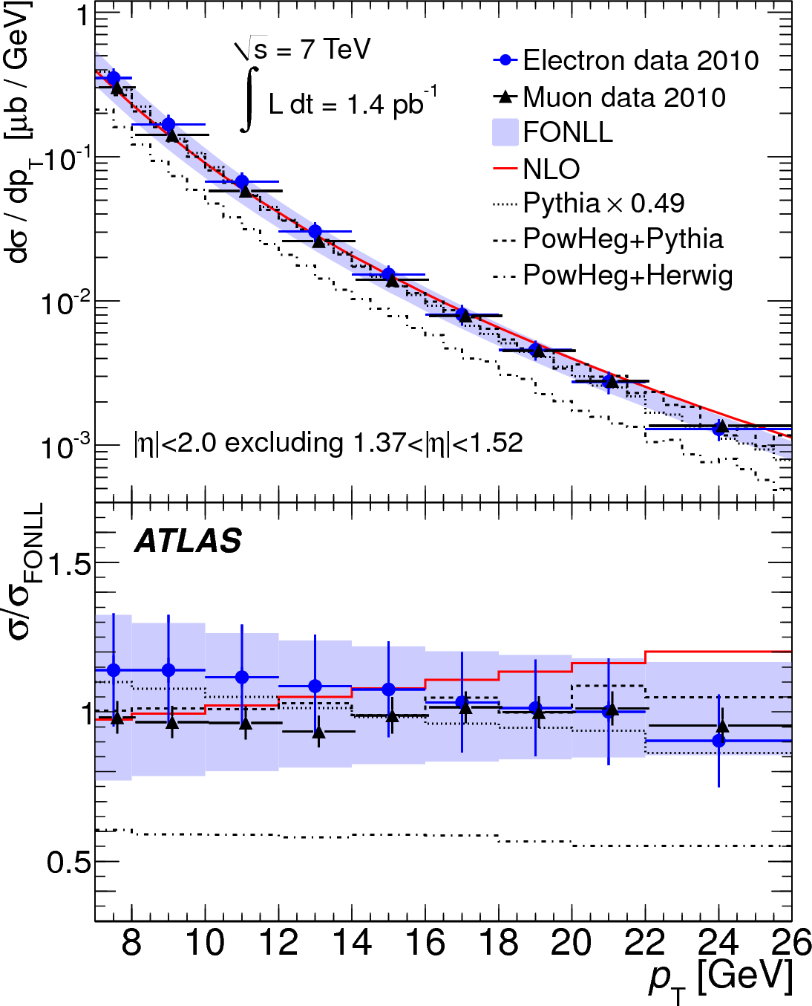
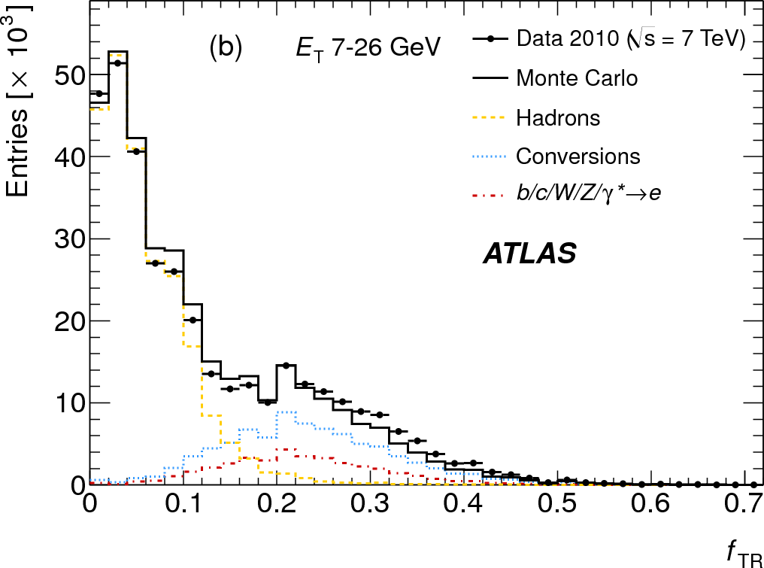
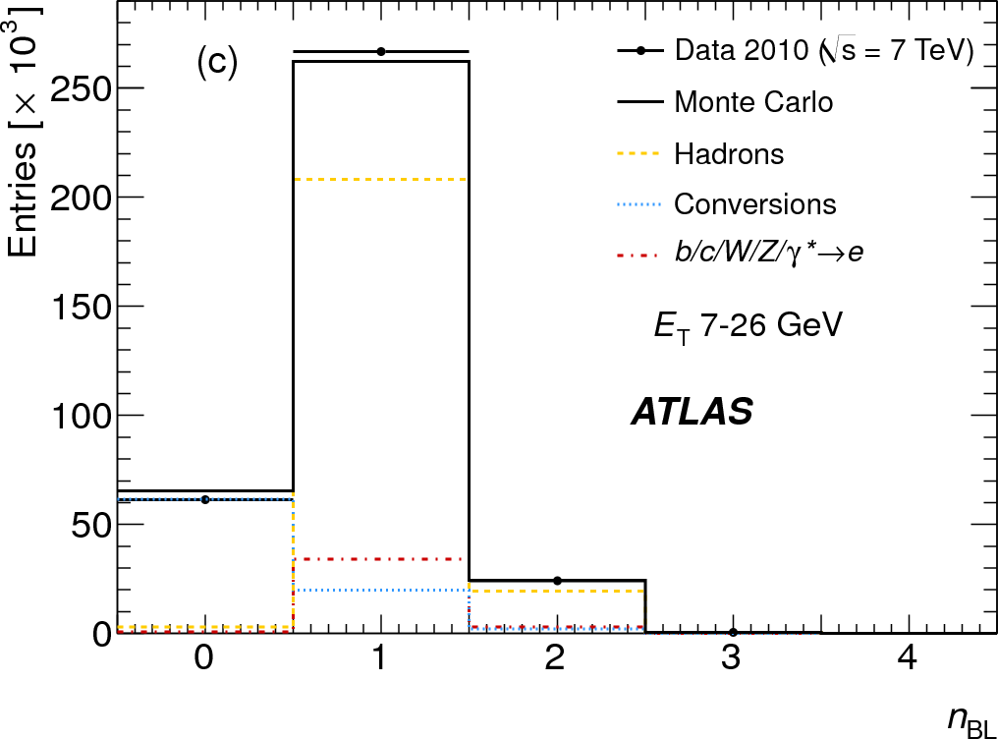
Inclusive electrons at the LHC: a real challenge!
TR ratio provides excellent discrimination between hadrons and electrons of any type. But it varies depending on how much jet activity is around.
Presence of hit in B-layer provides excellent discrimination between electrons from conversions and any other charged particle track
For the first time in a hadron collider, fiducial heavy-flavour cross-sections for inclusive electrons and muons are produced and compared to each other and to theory!

Slide 16
Inclusive electrons at the LHC: a real challenge!
TR ratio provides excellent discrimination between hadrons and electrons of any type. But it varies depending on how much jet activity is around.
Presence of hit in B-layer provides excellent discrimination between electrons from conversions and any other charged particle track
For the first time in a hadron collider, fiducial heavy-flavour cross-sections for inclusive electrons and muons are produced and compared to each other and to theory!

Slide 17
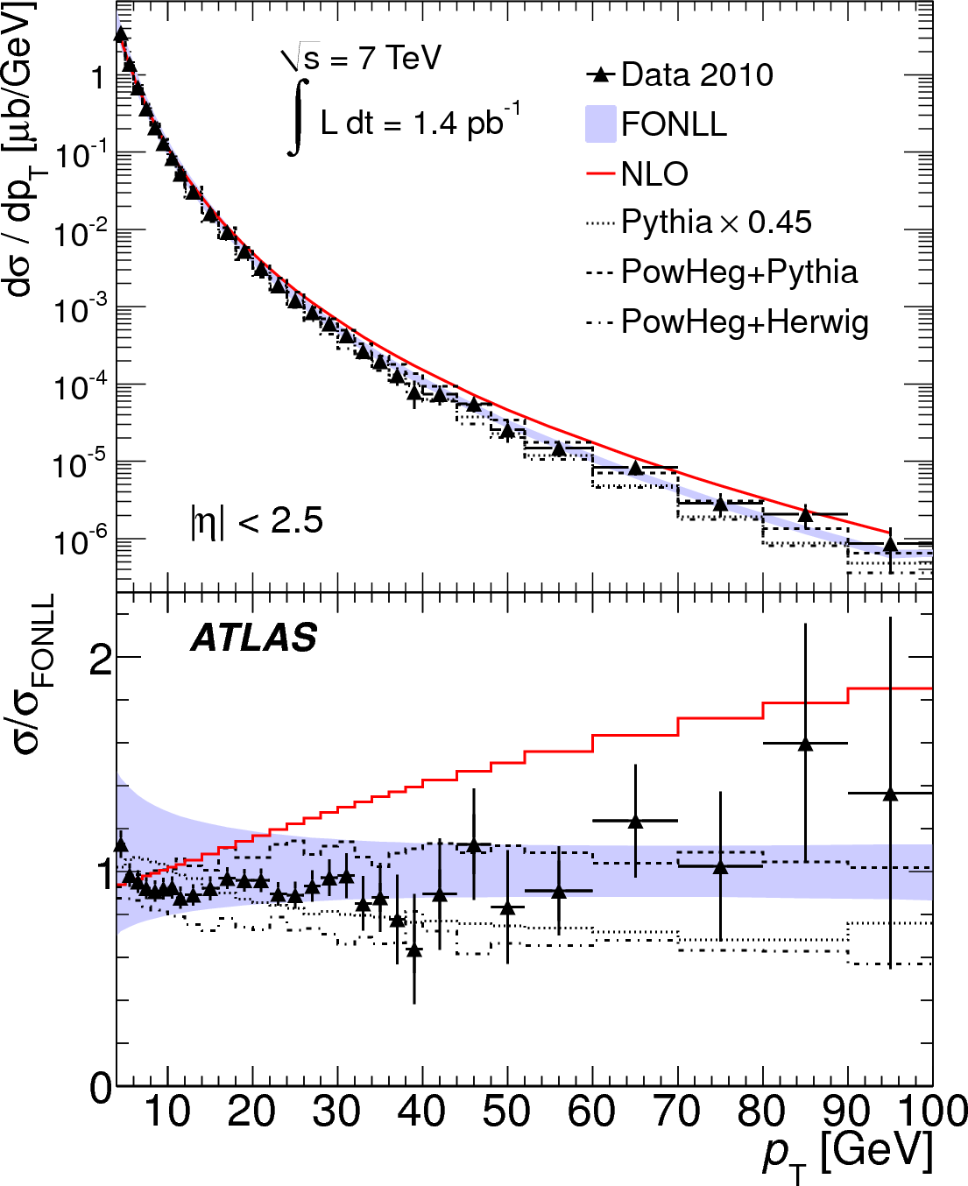
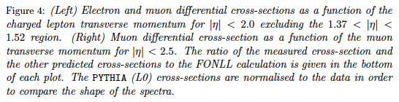
Inclusive leptons at the LHC: final result

Slide 18
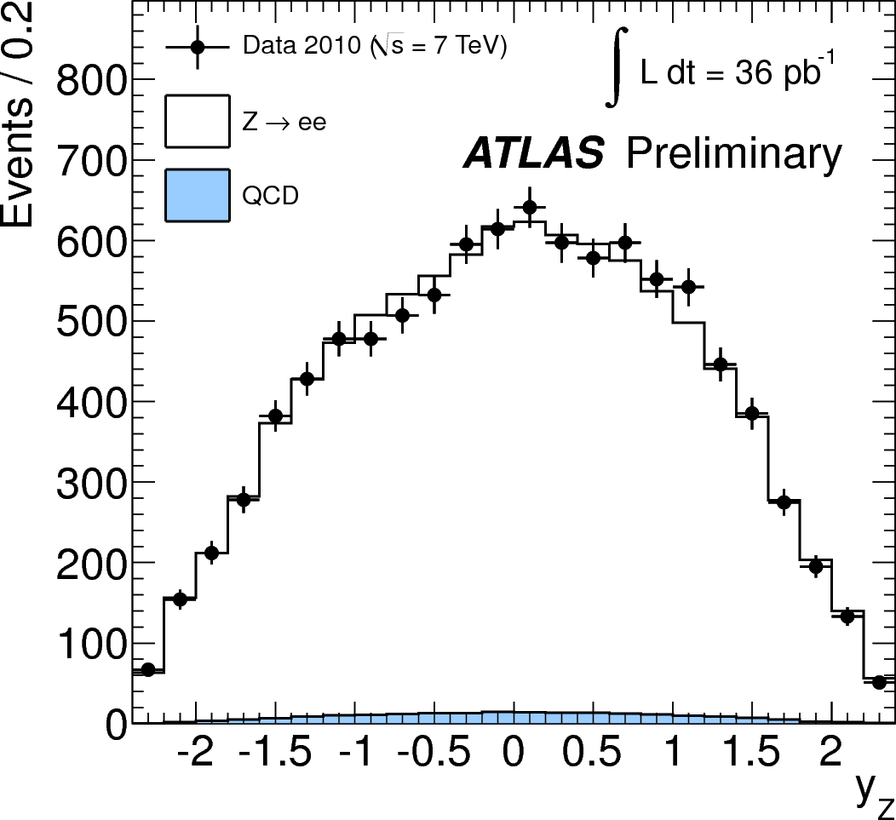
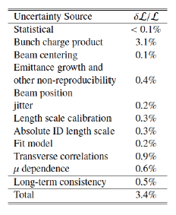
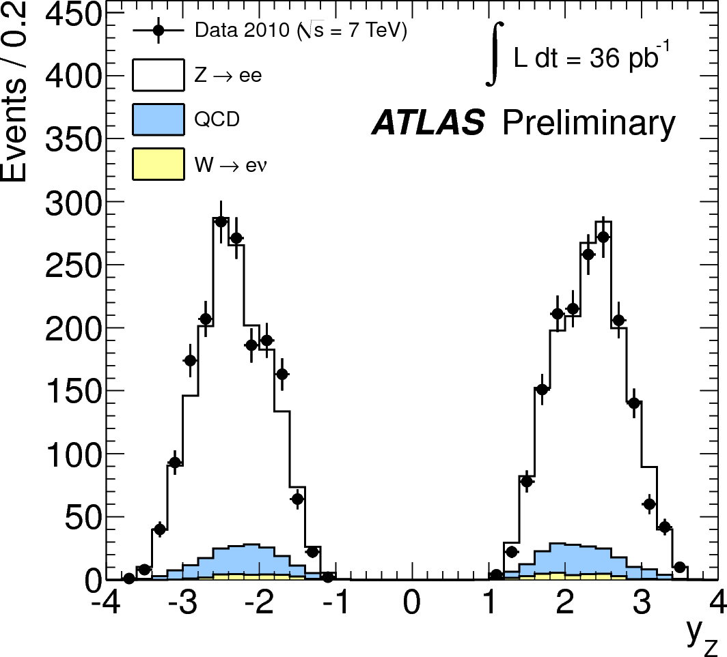
SM physics: W/Z differential measurements
Submitted for publication for 2010 data: excellent training for 2011 analysis which will be a precision test of theoretical predictions.
For 3 fb⁻¹, expect ~ 20M W to lν decays, 1.7M Z to ll decays, and 0.5M Z to ee decays with one forward electron (2.5 < |η| < 4.9)
A certain number of interesting lessons learned already:
  NNLO tools to predict fiducial cross-sections (FEWZ, DYNNLO) are extremely powerful and provide the means for more precise comparisons
  Full set of differential distributions for W⁺, W⁻, and Z will provide strong constraints on theoretical predictions and in particular on pdfs
  Very promising for future, but measurements would benefit from decrease of experimental systematic uncertainties on efficiencies and E_{T}^{miss} for ratios and also of luminosity for absolute measurements
9725 Z to ee
with two central electrons
3376 Z to ee
with one forward electron

Slide 19
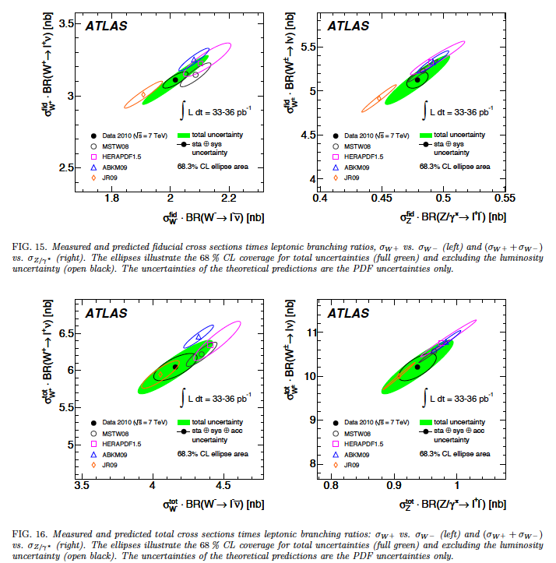
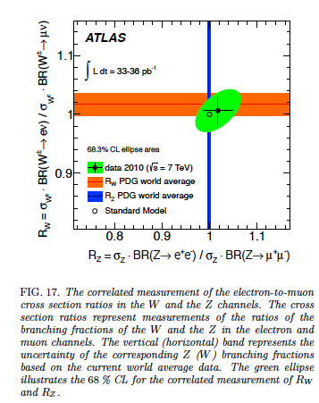
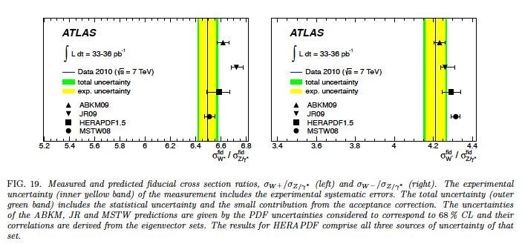
SM physics: W/Z differential measurements
Already now, probe lepton universality with high accuracy compared to the PDG world average from LEP and TeVatron for W boson!
Fiducial measurements provide already now a more precise test of QCD predictions, at least in terms of pdfs, than when they are corrected back to the total cross-sections
Reducing the size of the error bars on the major axes of these ellipses will be a challenge for the next phase!
Note that the green one is dominated by the uncertainty on the luminosity measurement.
Preliminary
Preliminary
Finally, the ratios of W to Z fiducial cross-sections have perhaps the highest potential for precision measurements in the future
Preliminary
Preliminary
Preliminary
Preliminary
Preliminary

Slide 20
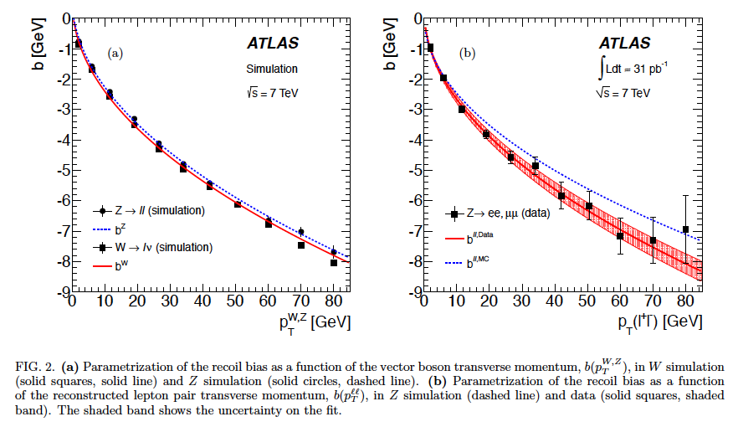
SM physics: measurement of p_{T}^{Z} and p_{T}^{W}
Already a quite precise measurement for p_{T}^{W}, with the hadronic recoil calibrated in terms of data to MC differences using the Z → ll decays
Longer-term goal is a high-precision measurement of m_{W}

Slide 21
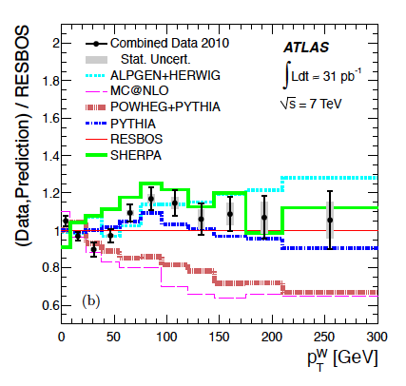
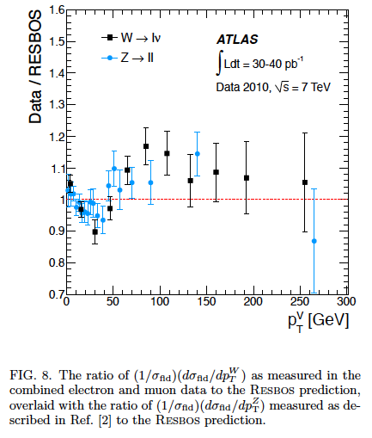
SM physics: measurement of p_{T}^{Z} and p_{T}^{W}
Already a quite precise measurement for p_{T}^{W}, with the unfolded fiducial distribution showing shape differences wrt certain models
As shown bottom right, the Z → ll and W → lν shapes agree perhaps better with each other than with any model
Ratio of the combined measurement and various predictions to the RESBOS prediction for the normalized differential cross section, using the O(alpha_s) and O(alpha_s^2) predictions from ALPGEN+HERWIG, MC@NLO, POWHEG+PYTHIA, PYTHIA, and SHERPA. The statistical uncertainties on the predicted distributions are negligible compared to the uncertainty on the measurement and are not shown.

Slide 22
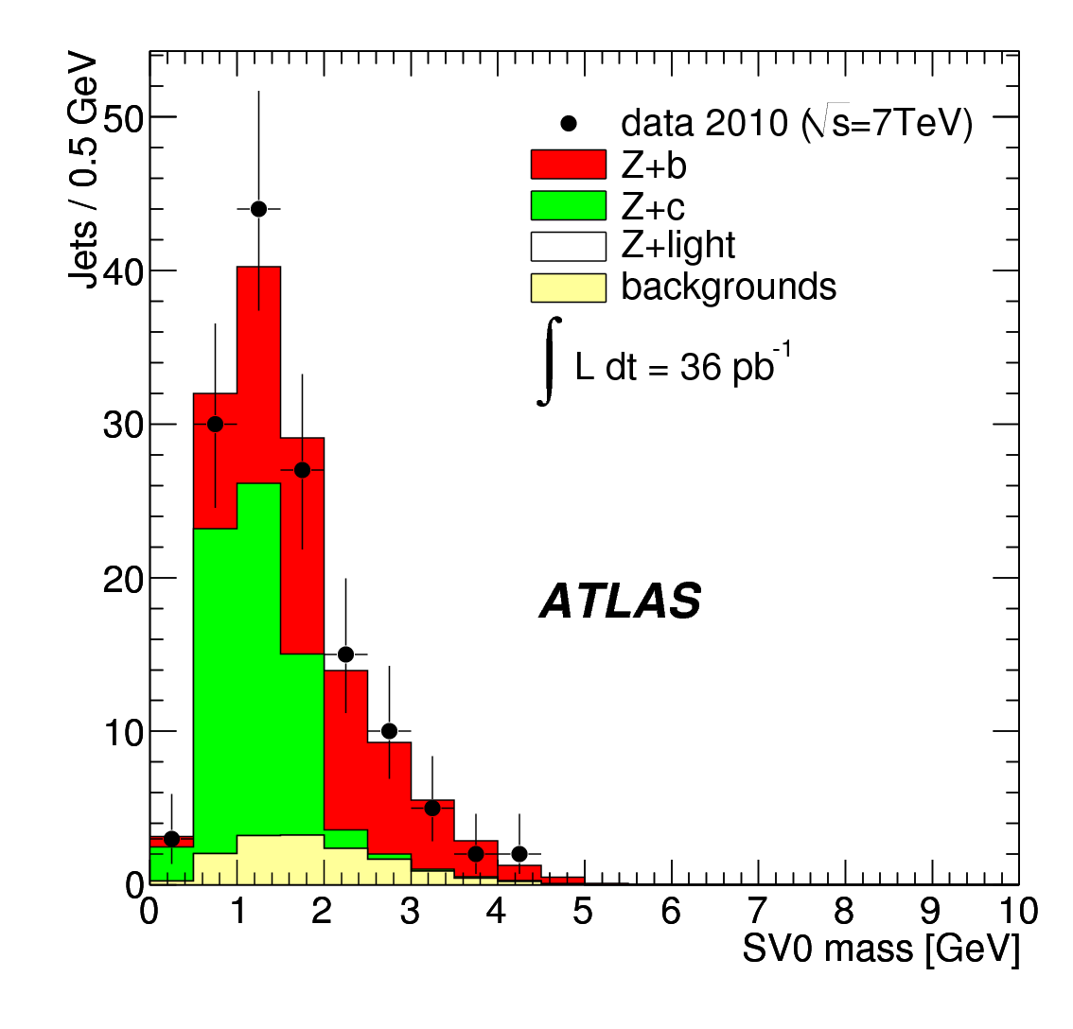
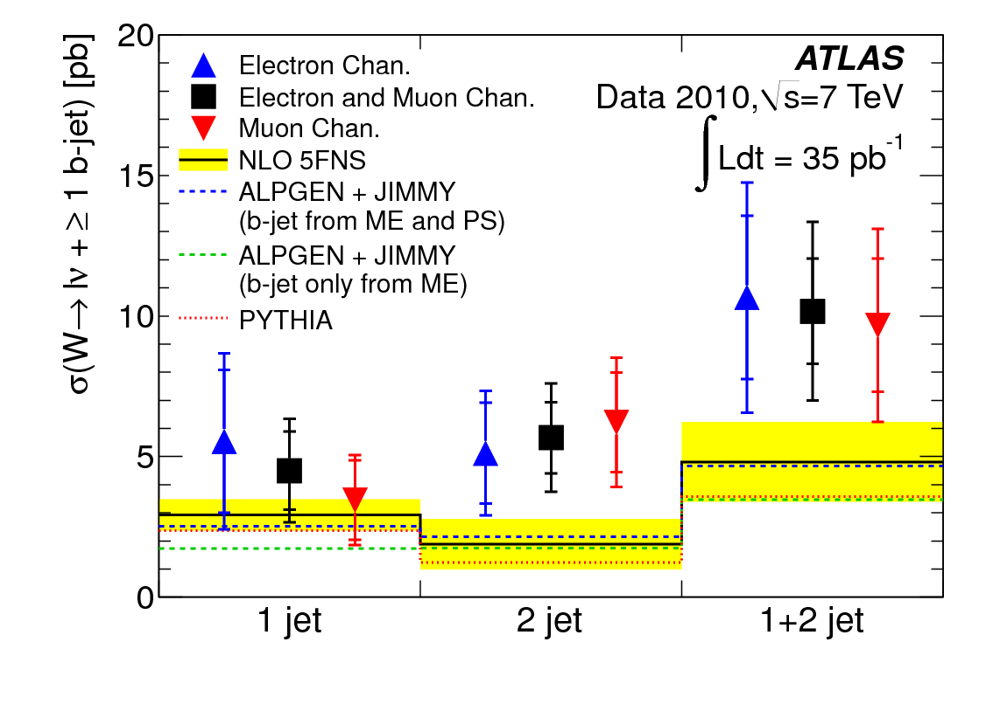
SM physics: measurement of W/Z+b-jets
A measurement known to be a severe test of QCD predictions of W/Z+jets at hadron colliders (first quantitative results from TeVatron rather recent and higher than expectations)
A prelude to the really interesting measurement of W/Z + 2 b-jets in view of Higgs-boson searches in the bb channel. Note that the QCD background at the LHC is much higher than at TeVatron, thereby posing severe problems to inclusive searches for the most sensitive TeVatron channels for a low-mass Higgs boson
Measured fiducial cross-section
for W → lν + ≥ 1 b-jet
Distribution of invariant mass of secondary vertex for Z → ll + ≥ 1 b-jet

Slide 23
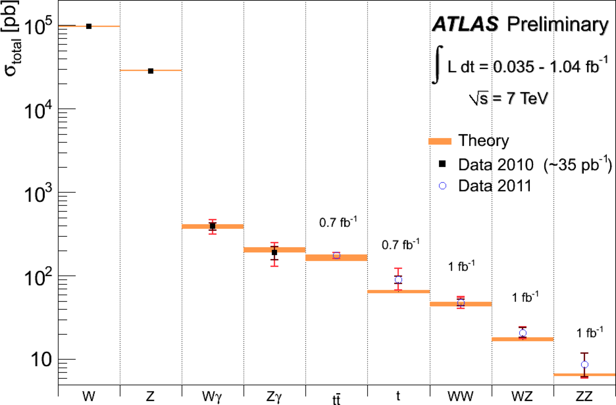
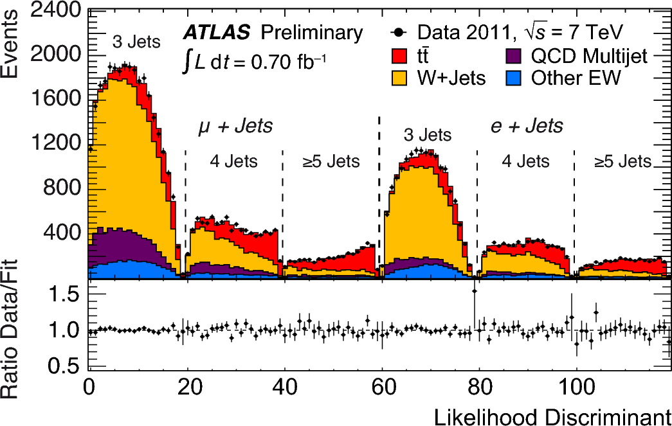
Summary of main SM EW and top cross-section measurement
Challenge theory now also with top measurements:
  theory at near NNLO: σ_{tt} = 165 (+11,-16) pb for m_{top} = 172.5 GeV
  combined ATLAS measurements with 0.7 fb⁻¹:
  σ_{tt} = 179.0 ± 9.8 (stat+syst) ± 6.6 (lumi) pb
~ 7%

Slide 24
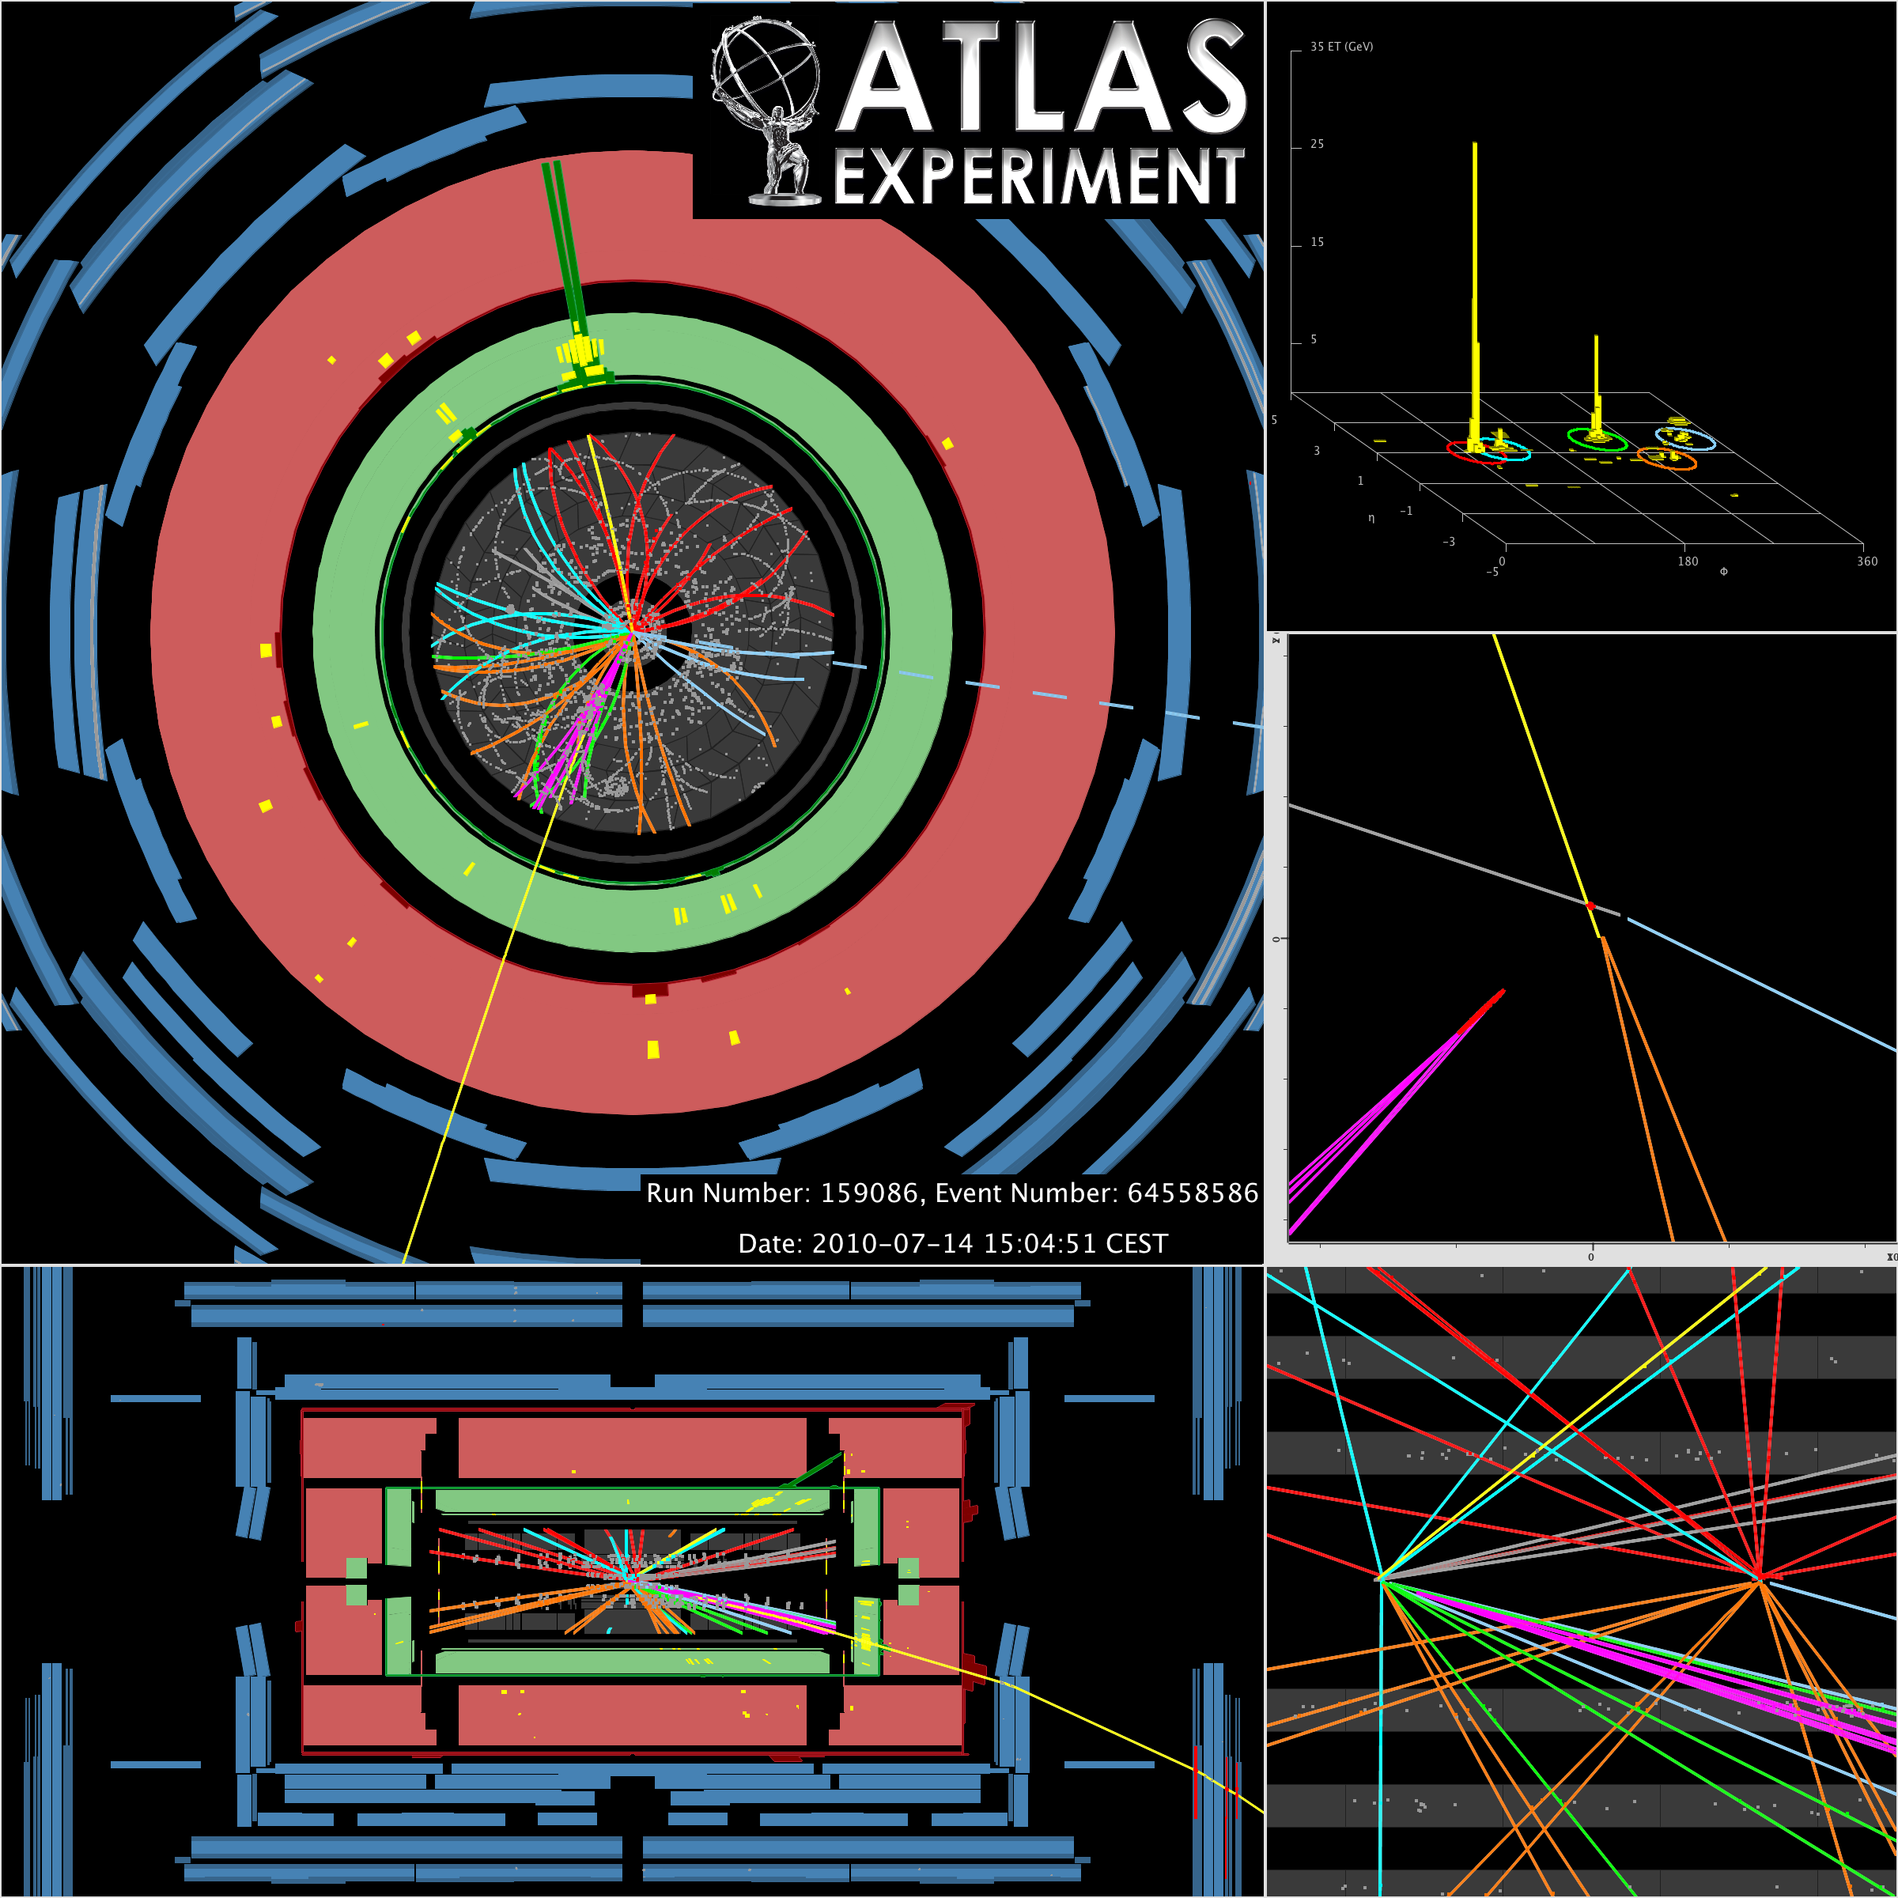
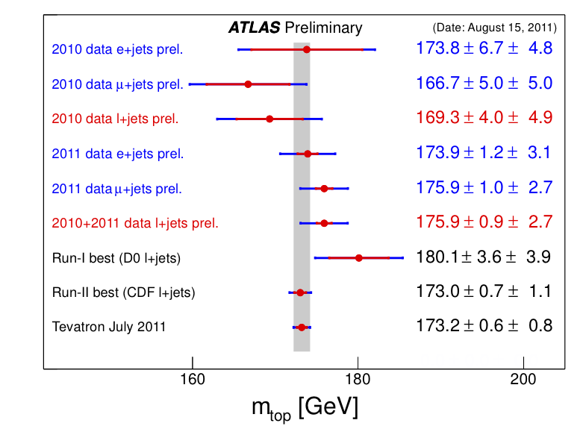
Top-quark physics: precision measurements on their way!
Measurement of the top-quark mass now accurate to ~ 1.6%,
demonstrating the quality of the data and the maturity of the analysis
e-
E_{T}^{miss}
43 GeV
μ inside jet
b-jet
primary
vertex
pile-up
vertex

Slide 25
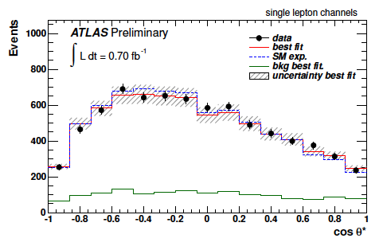
Top-quark physics: precision measurements on their way!
Measurement of the W-boson polarisation in top quark decays:
use ~ 7000 semi-leptonic and ~ 900 dilepton events (0.7 fb⁻¹ dataset)
measure helicity fractions depending on W polarisation, extracted from cosθ* distribution between lepton and reversed b-quark in W-boson rest frame
NNLO QCD predictions are quite precise, e.g. F₀ = 0.687 ± 0.005 (longitudinal)
Measurement: F₀ = 0.75 ± 0.08 (stat+syst)

Slide 26
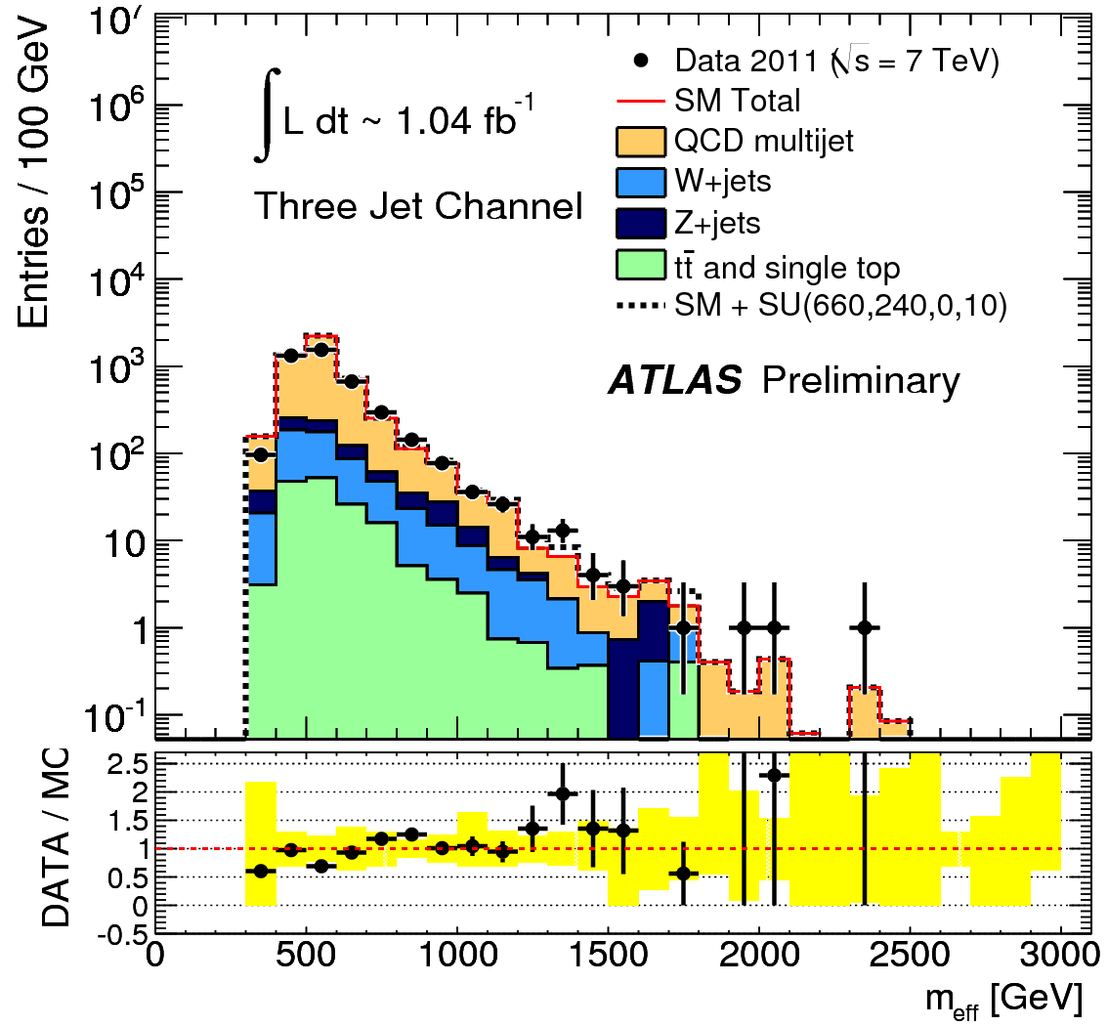
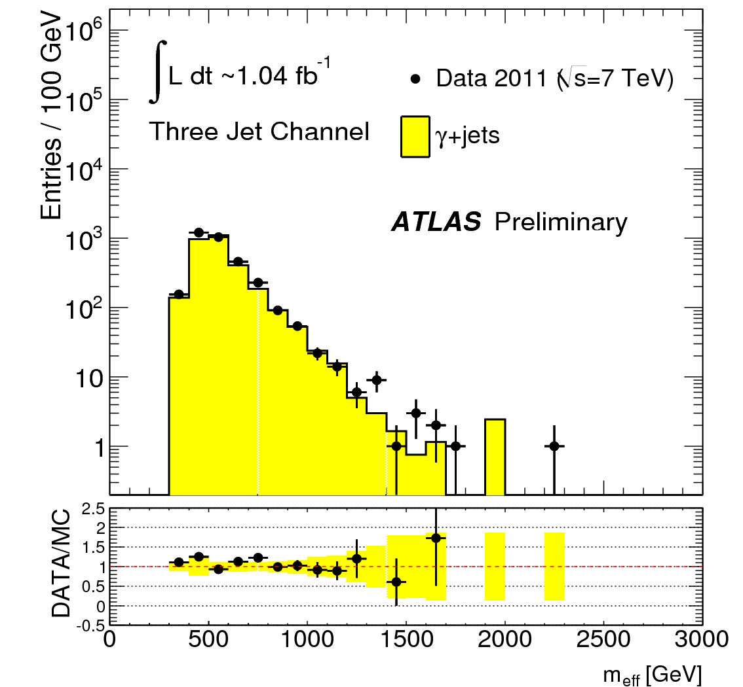
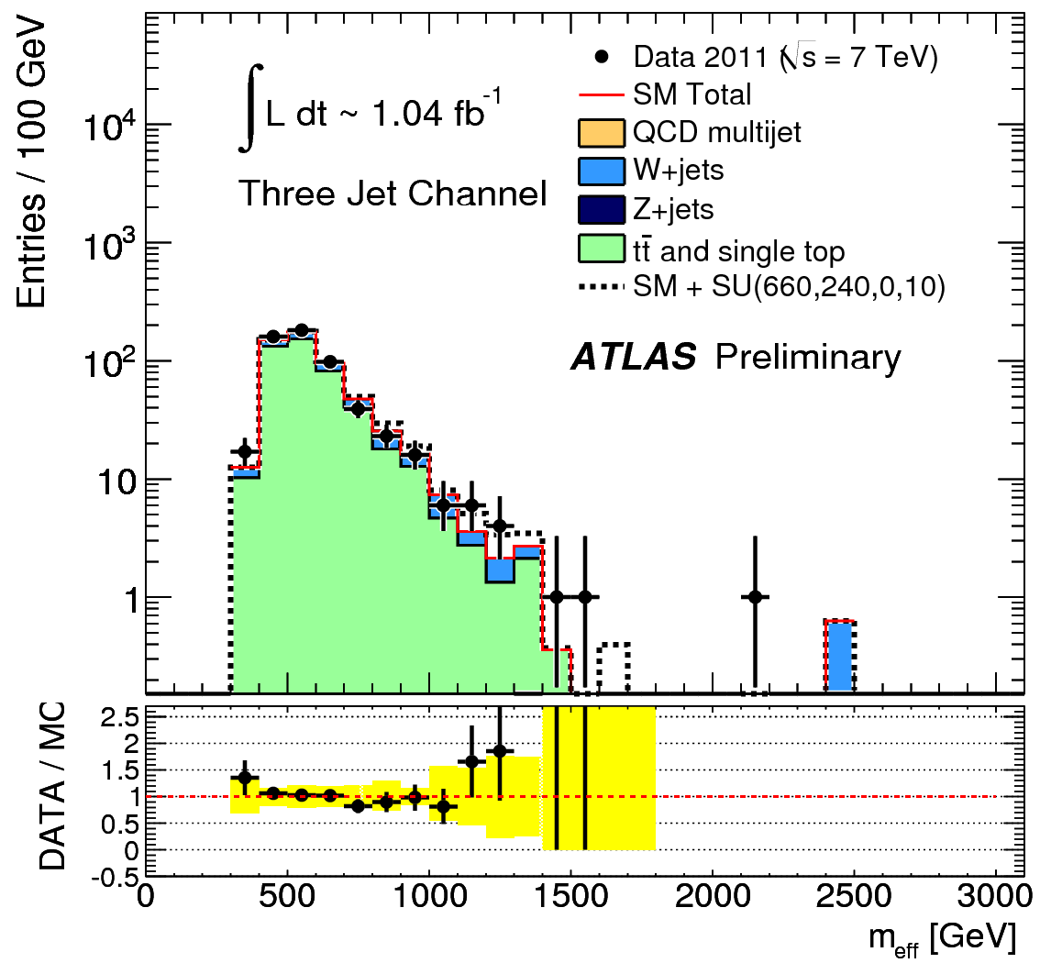
SUSY searches:
progress on understanding of SM background
Example: 0 lepton+ jets + ETmiss analysis, using m_{eff} = ETmiss + H_{T}
QCD background
≥ 3-jet events with
E_{T}^{miss} > 130 GeV, p_{T}^{j1} > 130 GeV, p_{T}^{j} > 40 GeV and with
min[Δφ(p_{T}^{j},ETmiss)] < 0.2
Top-pair background
≥ 3-jet events as on left, but with one b-jet and one lepton with
30 < m_{T}^{lν} < 100 GeV
Z(->vv) background Mimic by replacing
Z → νν by high-p_{T} photon or Z → ll
m_{eff} (GeV)
m_{eff} (GeV)
m_{eff} (GeV)
Yellow band in ratio plots shows that agreement is good between data and MC
Notes:
26

Slide 27
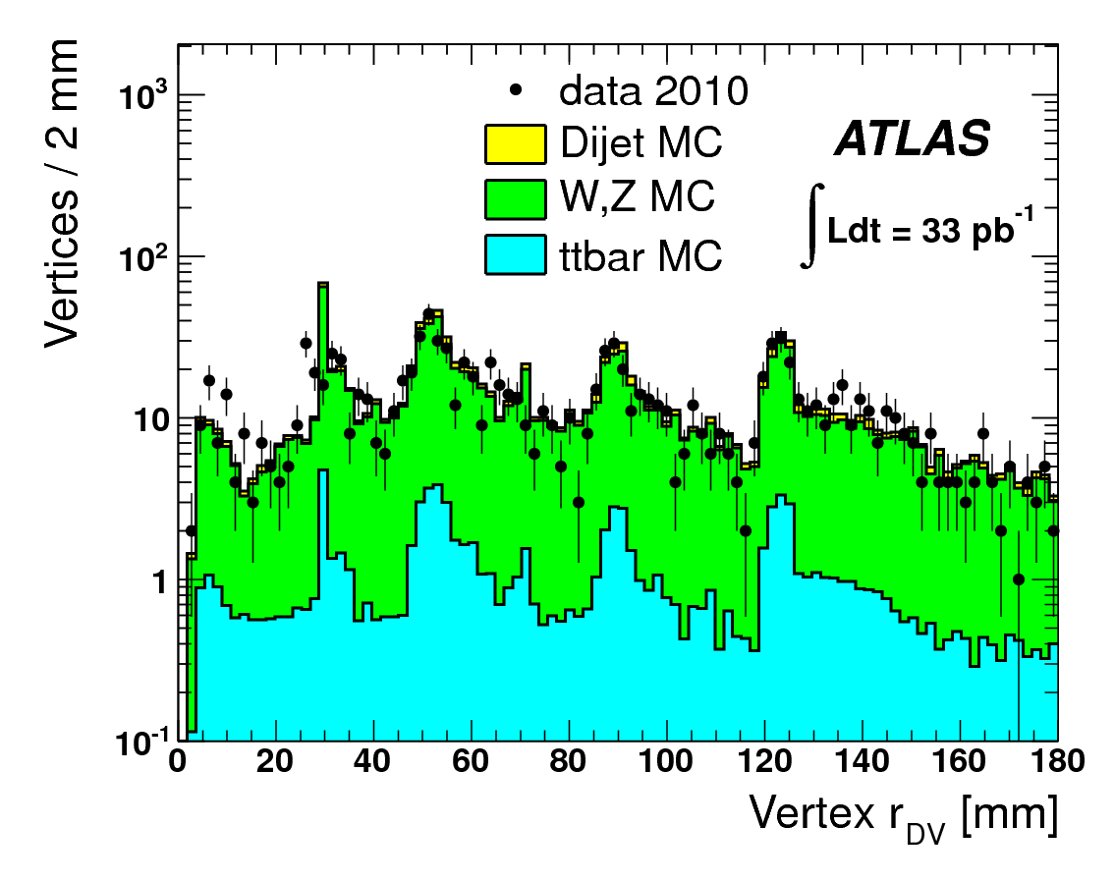
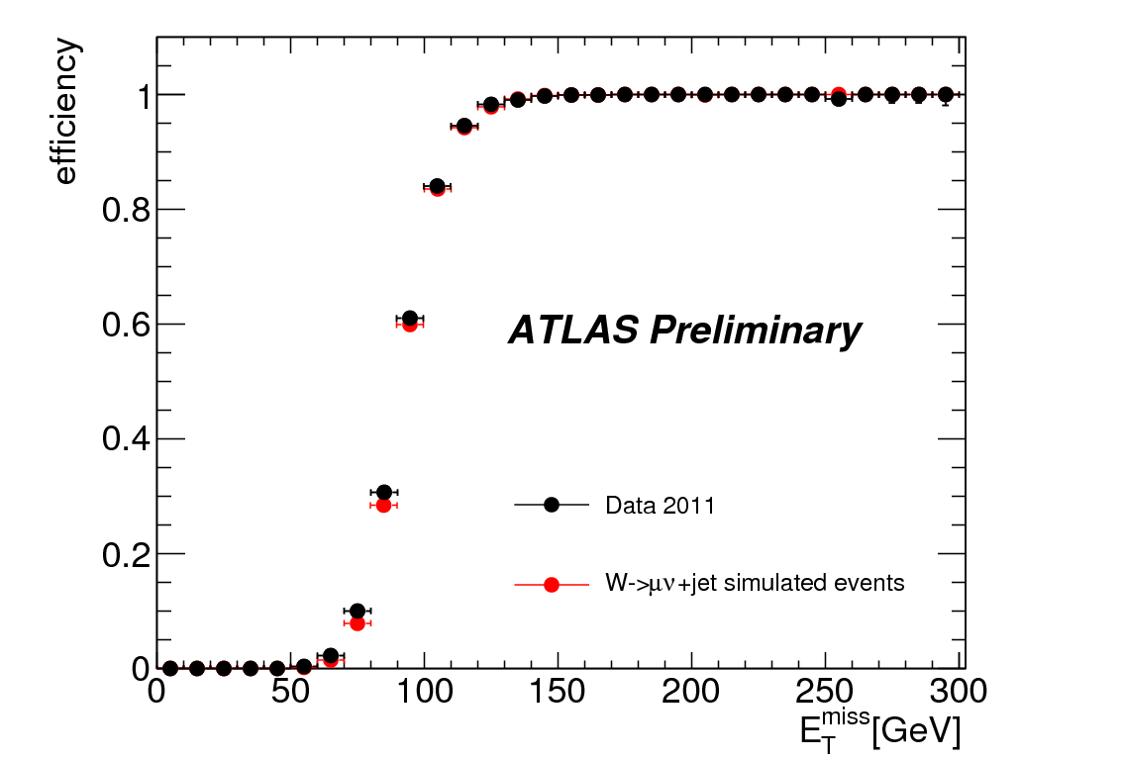
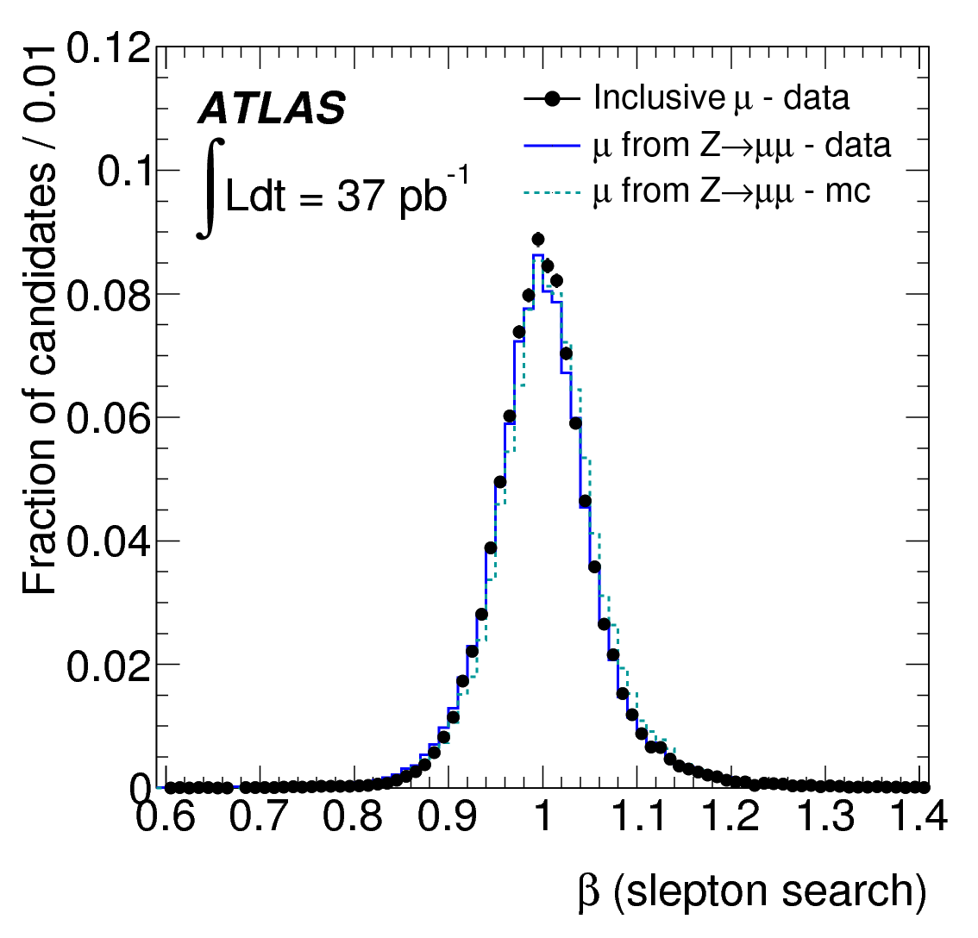
SUSY searches:
progress on understanding of SM background
Other examples: stranger SUSY partners!
Depend on good understanding of detector performance
Long-lived neutralino:
decay to two jets, displaced vertex with high track multiplicity
(tracking, vertex reco.)
Monojets:
efficiency of E_{T}^{miss} turn-on curve for trigger
Long-lived isolated slepton: timing of muon spectrometer
Radius of displaced vertex (mm)
E_{T}^{miss} (GeV)
Measured β
Notes:
27

Slide 28
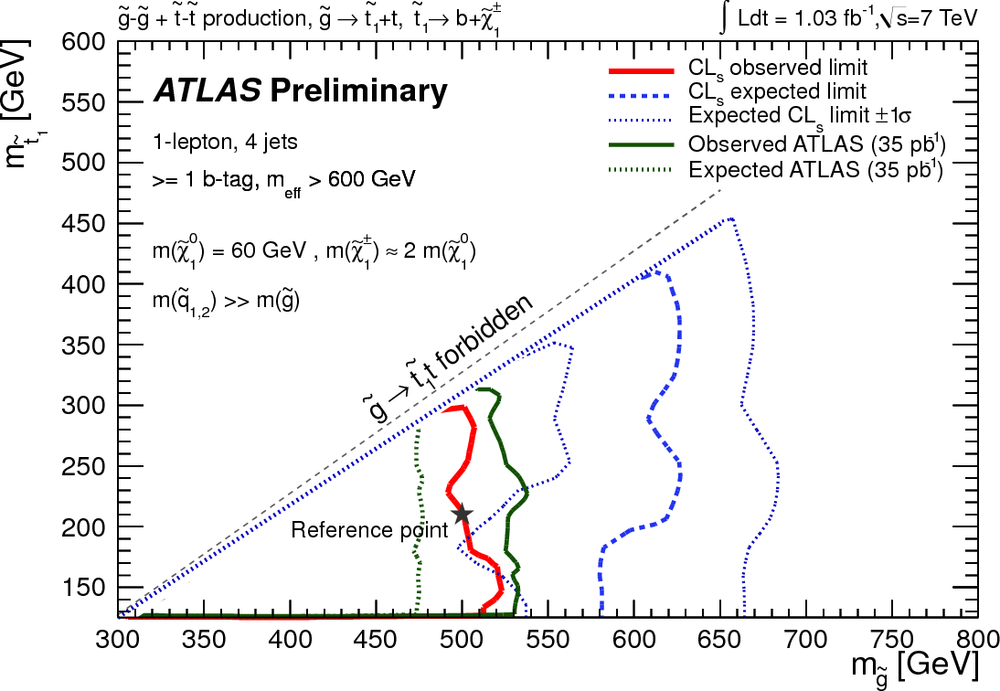

SUSY searches: quick overview of results
Excellent performance of E_{T}^{miss} measurements even with high pile-up
Most sensitive channel: jets + E_{T}^{miss} (no leptons)
Some have been heard to say: SUSY will be dead if m_{stop} > 1 TeV:
a real challenge for the LHC and its experiments!
E_{T}^{miss} spectrum in data for events with
a lepton pair with m_{ll} ~ m _{Z} well described
(over 5 orders of magnitude !) by various
background components.
Note: dominated by real E_{T}^{miss} from ν’s
already for E_{T}^{miss} ~ 50 GeV
→ little tails from detector effects !
Simplified SUSY model
Z+jets
(E_{T}^{miss} mainly
from fakes)
top (E_{T}^{miss}
from ν‘s)
Notes:
28

Slide 29

Summary of BSM searches: look for your favourite signature!
Notes:
29

Slide 30
ATLAS status report: a snapshot after reaching L = 3.3 10³³ cm⁻²s⁻¹ (18 months and 3 fb⁻¹ after first collisions at 7 TeV).
ATLAS is an experiment happily learning about proton-proton physics at 7 TeV. The accelerator and detector are continuously delivering beautiful data. This together with the emerging state-of-the-art MC tools opens the possibility of doing precision measurements in both the EW and QCD sectors of the SM.
Amazing how much could be done with only 36 pb⁻¹ of data accumulated in 2010: a number of results are still in the pipeline, but already theory is being tested quantitatively … and is still holding its own (unfortunately!)
With 3-5 fb⁻¹ in 2011 (deep thanks to the LHC accelerator crew!) and with the modern theoretical predictions and tools available to test the SM and search for physics beyond what we know today (deep thanks also to our theory colleagues with whom it is great fun to discuss physics based on new data again after so long!), we are all experiencing a hugely exciting period of data analysis. It will surely keep us busy even during the long shutdown in 2013-14.
For what concerns discoveries, no promises can be made. During the long design and construction phase, many of us suspected it would be difficult to probe successfully beyond the SM and even to find the Higgs boson (if it exists). But this past year has shown that the potential is undoubtedly there.

Slide 31



ATLAS status report: what about the hunt for the Higgs boson?
Search for charged Higgs boson in top decays:
require one high-p_{T} τ-lepton hadronic decay + 4 jets (with one b-tag)
Search for charged Higgs boson: improve on previous TeVatron limits

Slide 32

ATLAS status report: what about the hunt for the Higgs boson?
Search for the Higgs boson: many channels commissioned!
See seminar yesterday 20/09 by J. Guimaraes Da Costa

Slide 33

ATLAS status report: what about the hunt for the Higgs boson?
Search for the Higgs boson: huge progress over 2011. More to come.

Slide 34
Back-up slides

Slide 35



ATLAS reconstruction: impact of pile-up
Effective noise per cell/tower increases as pile-up increases (many towers in a jet!)
Optimal performance will require correction per cell type in η-bins and as a function of luminosity to set average measured E_{T} to ~ 0
At the moment, introduce increased jet energy scale uncertainty for low-p_{T} jets
(at maximum 7% for jets in forward calo)

Slide 36

Electrons from photon conversions
TRT very powerful to track secondaries and then identify which ones are conversions. A few beautiful examples shown here for the pleasure of the eye.

Slide 37


SM physics: W/Z differential measurements
Differential distributions indicate that probing pdfs will perhaps be best achieved by using separately measurements for W⁺, W⁻ and Z as inputs to the fits

Slide 38

Inclusive electrons at the LHC: a real challenge!
The biggest challenge for the electrons has been to measure the efficiency for non-isolated electrons from data: use tag-and-probe technique where the tag is a tight electron candidate, which enriches the QCD dijet background in heavy-flavour dijets with one jet producing a real electron. The probe is then selected with minimal cuts and the fraction of signal is large enough to apply the same method as in the normal analysis to measure the signal component before and after cuts.

Slide 39


H → γγ
114 < m_{H} ≤ 150 GeV
Signature is two high-p_{T} photons
(E_{T} (γ₁, γ₂) > 40, 25 GeV)
σ ~ 40 fb
15 signal events expected in 1 fb⁻¹
after all selections
Main background: γγ continuum; S/B ~ 0.02
Crucial experimental aspects:
excellent γγ mass resolution to
observe narrow signal peak above
irreducible γγ background
(σ_{γγ} ~ 1.7 GeV m_{H}=120 GeV)
powerful γ/jet separation to suppress γj and jj background with
jet → π⁰ faking single γ

Slide 40



SUSY searches:
progress on understanding of SM background
Other examples: focus on tt background for other SUSY analyses
0 lepton + b-jets + E_{T}^{miss}
≥ 3-jet events ~ as on left and at least one tagged b-jet and E_{T}^{miss} > 130 GeV, but with
one lepton, m_{eff} > 600 GeV and 40 < m_{T}^{lν} < 100 GeV
1 lepton + b-jets + E_{T}^{miss} ≥ 4-jet events with at least one tagged b-jet,
E_{T}^{miss} > 80 GeV,
m_{eff} > 600 GeV, but with 40 < m_{T}^{eν} < 100 GeV
1 lepton + jets + E_{T}^{miss}
≥ 3-jet events with
p_{T}^{j1} > 130 GeV, p_{T}^{j} > 40 GeV
after preselection
m_{eff} (GeV)
m_{eff} (GeV)
E_{T}^{miss} (GeV)
Yellow band in ratio plots also show here that agreement is good between data and MC
Notes:
40

Slide 41

Exotic searches

Slide 42

SUSY searches

Slide 43
Prospects for Higgs-boson searches
More data:
  ~ 4-5 fb⁻¹ by end of 2011 and > 10 fb⁻¹ by end of 2012
Refine understanding of detector performance:
  Alignment, calibration, comparison with simulation
  Better performance, smaller systematic uncertainties and higher efficiency for rare channels
More precise measurements of SM processes
  Additional constraints on MC generators
More sophisticated analyses:
  Multivariate techniques and additional discriminating variables (pT, angular distributions)
  Exclusive channels (e.g. VBF channels)
  Higher statistics leading to sharper observables (e.g. H to tt mass reconstruction for non back-to-back t-pairs)

Slide 44
ATLAS status report
Now have covered a lot of phase space for many signatures

Slide 45



Slide 46


Slide 47


ATLAS status report
Now have covered a lot of phase space for many signatures
http://arxiv.org/abs/arXiv:1108.1582

