Slide 1
Super Charm-tau Factory
Zhengguo Zhao
University of Science and Technology of China

Slide 2
Hunting Ground with SM Picture
Factory of meson, φ, Tau-charm, B factory
Factory of Z, W, t
e dipole moment muon rare decays g-2…
ν: accelerator, reactor, atmospheric, sun and cosmos

Slide 3
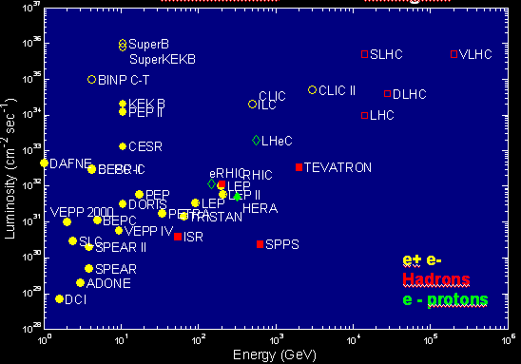
From J.P.Delahaye
Luminosity Frontier
Courtesy of
M.Biscari
EPS-HEP09
Toward
Energy frontier

Slide 4
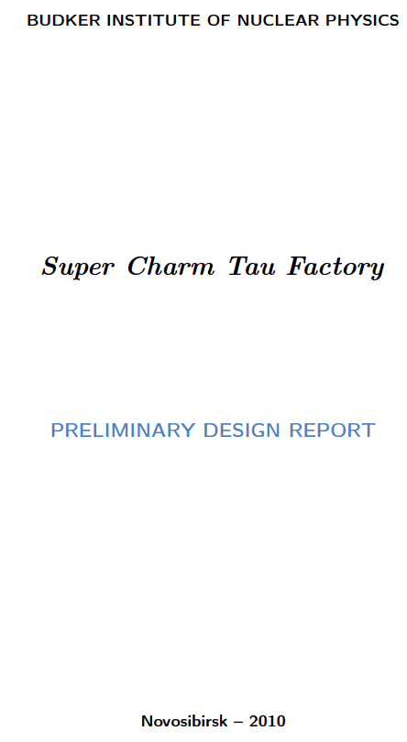
Definition of SCTF
E_{cm}: 2-5/6 GeV
L: 10³⁵ cm⁻²s⁻¹
Endorsed by EHEP
SCTF
Physical program for SCTF
Conceptual design of the
detector for the SCTF
CT factory collider
4. Injection system of the SCTF
176 pages

Slide 5
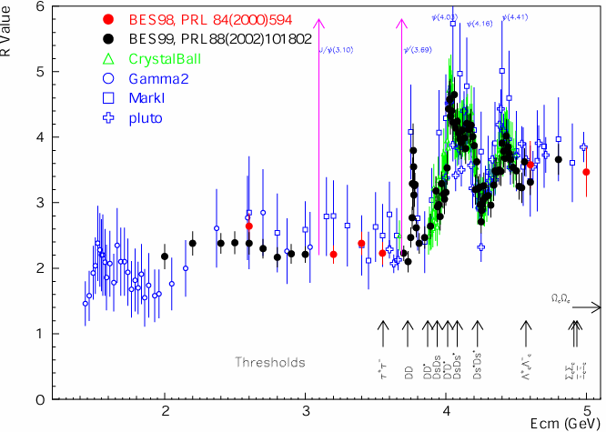
Features of the Charm tau Energy Region
Rich of resonances, charmonium and charmed mesons.
Threshold characteristics (pairs of τ, D, D_{s}, charmed baryons…).
Transition between smooth and resonances, perturbative and non-perturbative QCD.
Energy location of the gluonic matter and glueball, exotic states and hybrid

Slide 6
Physics Program at SCTF
Charmonium
Spectroscopy of states of light quarks
Physics of D mesons
Physics of charmed baryons
Lepton physics
Measurement of the cross section of e⁺e⁻ →hadrons
Two-photon physics.

Slide 7
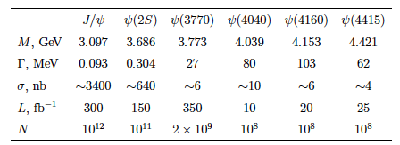
Data Sample at Resonances for 1 ab⁻¹
BESIII current 10⁸ 10⁸ 10⁷ 10⁵⁻⁶ 0 0
BESIII future 10⁹ 10⁹ 10⁷ ? 10⁶ 10⁶
?

Slide 8
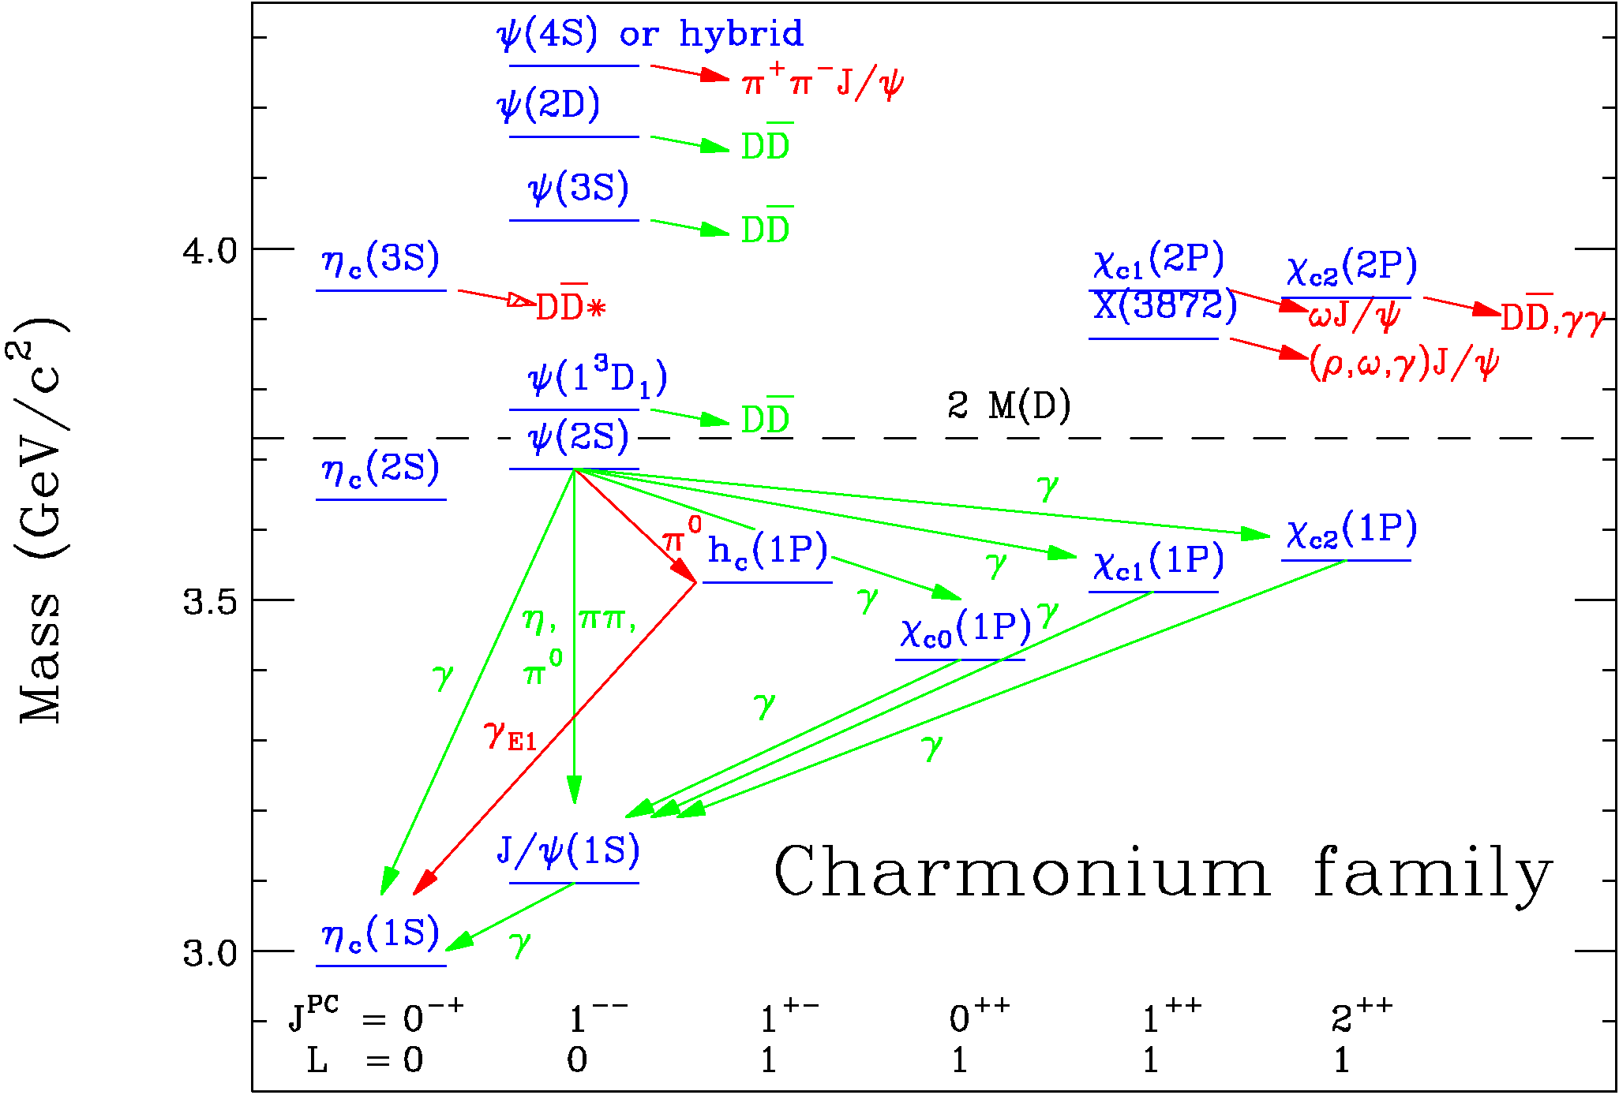
Charmonium
Reasonably well understood below open charm. However, information about decays of low-lying states is very incomplete (e.g. only 40% of hadronic decays of J/ψ is known).
Many unknown above the open charm.
Not well understood
Reasonably well
understood

Slide 9
Precision Measurement
Precision measurement of probabilities for transition between low-lying levels of charmonium, their masses, total and leptonic or two-photon widths→Compare with the predictions from potential quark models, LQCD
Measure probabilities of rare, not yet discovered transitions
Electric
− η_{c}(2S)→γh_{c} 2.5x10⁻³
− ψ(3770)→γχ_{c0} 2x10⁻⁴
Magnetic
− ψ(2S)→γη_{c}(2S) 5x10⁻⁴
− η_{c}(2S)→γJ/ψ 3x10⁻⁵
− h_{c}→γχ_{c0} 10⁻⁶

Slide 10
XYZ-like Particles
High statistics data at ψ(4040), ψ(4160) ψ(4200?) ψ(4400) →γχ_{cJ}(2P)
Direct production of Y(4260), Y(4360), Y(4660)
-scan from 3.8 to 5.0 GeV 100 fb⁻¹

Slide 11
Search for Weak Charmonium Decays
c→sW⁺ ~10⁻⁸
Semileptonic: J/ψ→D_{s}(D*_{s}) lν
Hadronic decay: J/ψ→D_{s}⁺ρ⁻, D_{s}^{*+}π⁻
ΔS=0 process (SM suppressed) - 10⁻¹¹
J/ψ→D⁰π⁰, D⁰ρ⁰
cc→φφ 10⁻⁸
10⁻⁹

Slide 12
Search for CPV, LFV Processes
One of physical effects BSM is the existence of the non-zero electric dipole moment (EDM) of quarks or leptons leading to CPV
J/ψ→γφφ c quark EDM at 10⁻¹⁵ e-cm level
J/ψ→ΛΛ set limit ~10⁻¹⁹ e-cm for EDM of Λ
(two order of magnitude more stringent)
Lepton flavor violation
J/ψ→ll’ (l,l’=e, μ, τ) < 10⁻⁹

Slide 13
Light Hadron Spectroscopy
Systematically study spectroscopy of states of light quarks.
Search for bound states of two gluons, glueballs, and hybrid states, qqg, multi-quark states.
Glueball: J/ψ radiotive decay, two-photon meson production
Hybrid: π₁(1400), π₁(1600)
- Exotic(J^{PC}= 1⁻⁺): search for S-wave decay χ_{c1}→ππ₁, P-wave
decay J/ψ→ρπ₁
- Noe-exotic(J^{PC}= 0⁻⁺): χ_{c1}→ππ₁, ψ decays

Slide 14
Physics with D Mesons
SCTF
10⁹ pairs of charge and neutral D mesons
10⁷ pairs of D_{s} mesons
Advantage as compared to SBF
Low multiplicity—low background
Threshold effect
Produce in a quantum-coherent state, with
- J^{PC}=1⁻⁻ for e⁺e⁻→DD
- J^{PC}=0⁺⁺ for e⁺e⁻→γDD

Slide 15
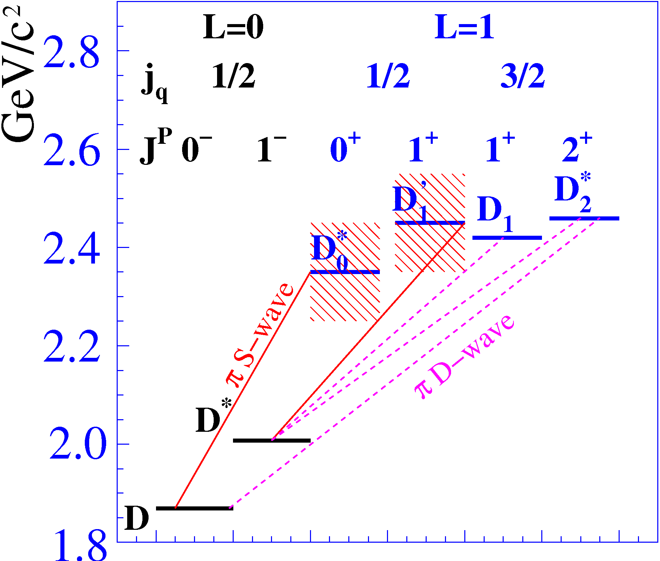
The D-meson States and Their Transition
Production
4.3-5 GeV:
5-6 GeV
- D_{sJ}(2632), D_{sJ}(2708), D_{sJ}(2860)
- New states
Experimental information is incomplete.
The quantum numbers for most of them are not established.
Almost no information about their decay modes.
The masses of the D_{sJ} mesons lie well below the predictions
of the quark model → hypotheses for six-quark or molecular
D_{sJ} structure.

Slide 16
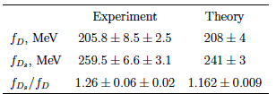
Charmed Meson Decays
CLEOC
SM gives:
Precision measur. of leptonic, semi-leptonic decays of D and Ds
Measure f_{D}, f_{Ds} to better than 0.5%
The difference between the experiment and the SM calculation may indicate physics BSM.

Slide 17
D⁰-D⁰ Mixing
Eigenstates of the mass matrix:
Two non-dimensional parameters:
Results from BF
With 10 ab⁻¹ data at SCTF, a precision of measuring mixing parameters can compete with that from SBF.

Slide 18
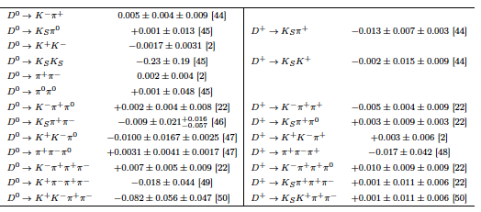
Search for CPV
Search for CPV in D decay—one of the most interesting project at SCTF
SM predict a very small CP asymmetry in charm sector—10⁻³ is expected in the Cabibbo-suppressed (CS) D decays.
Observation of a CP asymmetry in CF and DCS decays at any level or an asymmetry higher than 10⁻³ in CS decays will clearly indicate the presence of new physics BSM.
Current values of CP asymmetry measured in D decays

Slide 19
D Meson Rare Decays
Rare decays of D mesons are a tool for a search for new physics BSM.
Most suitable for:
- flavor-changing neutral current (FCNC) decays
via the weak neutral current, providing the
transition between c and u quarks;
- lepton-flavor-violating (LFV) decays;
- lepton-number-violating (LV) decays.

Slide 20
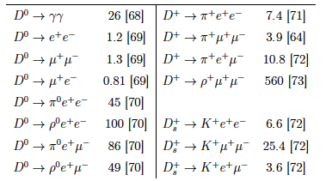
Rare Decays of D
10⁻⁸ for transition of c→ul⁺l⁻ and c→uγ. Increased to 10⁻⁵ considering large distance dynamics.
Experimental upper limit on rare D and Ds decays in unite of 10⁻⁶

Slide 21
Charmed Baryons
First observed in 1970s
Observed mass range: 2.3-2.7 GeV
Evidence of doubly charmed meson Ξ_{cc} at 3.52 GeV from SELEX
Predicted triply charmed baryon Ω_{ccc}, but not yet observed.
There is practically no experimental information about the quantum numbers of baryons and absolute branching fractions of their decays.

Slide 22
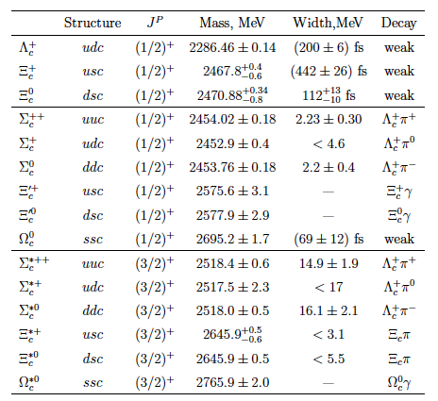
Parameters of the S-wave Charmed Baryons
Mainly from BF, 10⁷ Λ_{c}Λ_{c}

Slide 23
Physics with τ Leptons
e⁺e⁻→τ⁺τ⁻ near threshold -- low and controlled background
Precision measurements of α_{s}, m_{s}, V_{us}
Lepton universality: m_{τ}, τ→π⁺ν_{τ} and τ→Κ⁺ν_{τ}
Lorentz structure of the amplitude for τ→lν_{l}ν_{τ}
Search for LFV processes: τ→lγ, lll’, lh – sensitive to new physics
(10⁻⁷−10⁻⁸ from BF)
Search for CPV: A_{CP} = (Γ(τ→f+) - Γ(τ→f-)) / (Γ(τ→f+) + Γ(τ→f-))
Most promising processes τ→Kπ⁰ν_{τ}, ρπν_{τ}, ωπν_{τ}, a₁πν_{τ}
Observation of CP asymmetry would be an explicit indication of
physics BSM.
Competition from SBF, but threshold effect is important for controlling and understanding background
Longitudinal polarization of the initial beams will significantly increase sensitivity in searches for CPV in lepton decays.

Slide 24
R-values and QCD
R (1%), α_{s} and m_{c}
Quark and glue fragmentation functions
Form factors: p, π……
Important test of QCD: Modified Leading Log Approximation/Local parton-hadron duality (MLLA/LPHD)
- ξ distribution (ξ=-ln(2p/√s), parameter Λ &
KLPHD
- Multiplicity, 2nd binomial moment R₂

Slide 25
Toru Lijima
ICFA 2011

Slide 26
Toru Lijima
ICFA 2011

Slide 27
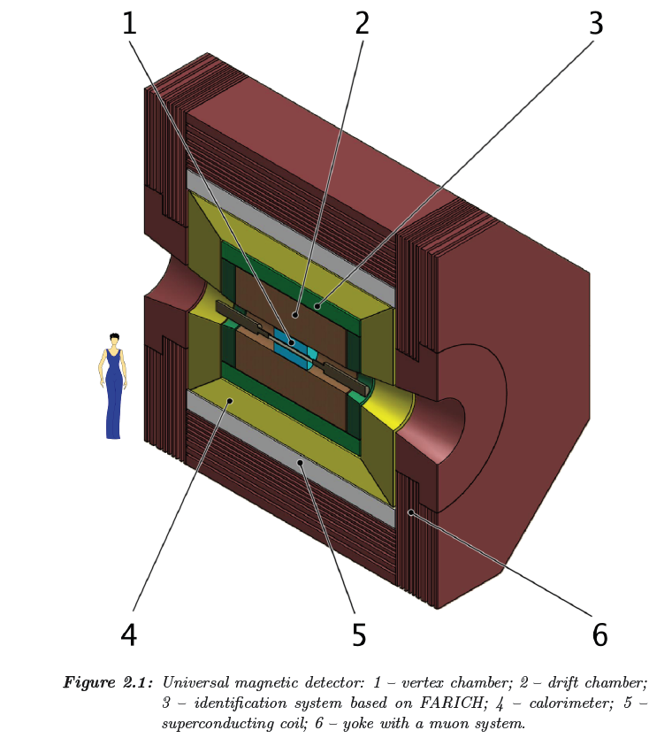
Vertex detector
TPC (spacial res. 50-100 μm
Silicon strips (10-20 μm)
Drift chamber
Spacial res. 100-120 μm
σ(dE=dx) <= 7. 5% for RBB
FARICH
high μ/π below and above 1GeV/c
K/π/p PID not covered by dE/dx
EMCAL-CsI(Tl)
Muon system
Streamer tubes
9 layers in barrel+8 layers at endcap
Technology that we don’t have, or
not yet utilized to construction :
TPC, MPGD
Silicon strip/pixel,
RICH, ASIC, optical link

Slide 28
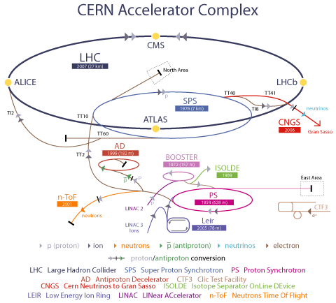
LEP: 1988-2000
E_{cm}(e⁺e⁻) = 200-209 GeV
LHC: Construction 1998-2007
Commission 2007
E(p+p) = 14 TeV
2007
Discover W, Z
450 GeV
ν_{τ}–ν_{μ}
Produce >1000 different
isotopes
1969
25 GeV
1959, 678 m
Over 50 years!

Slide 29
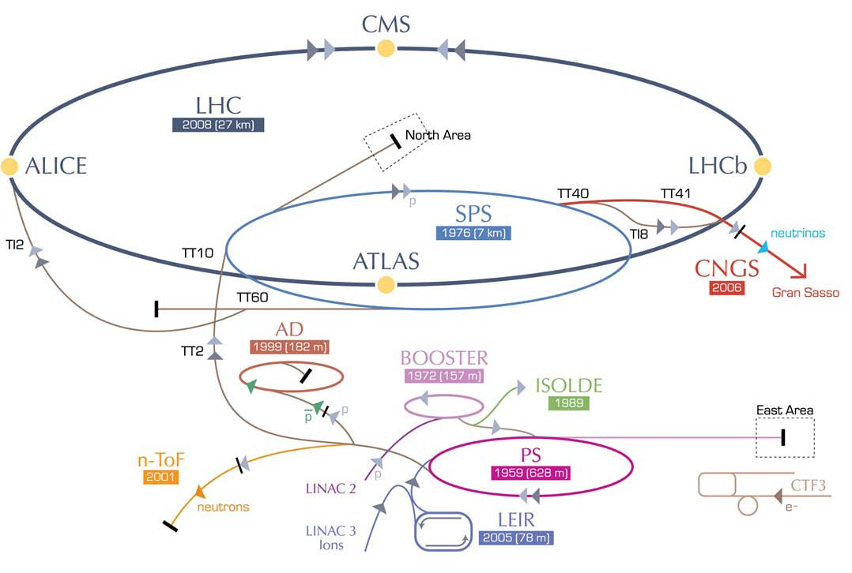
HE-LHC – LHC modifications
HE-LHC
2030-33
SPS+,
1.3 TeV, 2030-33
2-GeV Booster
Linac4
Courtesy of
F.Zimmermann

Slide 30
What Can Be Learnt From CERN?
Successful for over 50 years. Leads the HEP since SPS
Site that can accommodate continuous development and expansion—Sustainable development
Multiformity
p, p n, e⁺⁻ , ion, ν, >1000 isotopes, nuclear
physics, high energy physics, neutrino physics,
anti-matter, application…..

Slide 31
Features of Accelerator Based Experiment
Frontier of high energy, precision and intensity
Condition controlled experiment
Rich physics topics with broad spectrum
Cutting edge technologies, driven force for high tech.
Unique base for training experts and work force for industry, college of modern society
High cost, large international collaboration

Slide 32
Remarks
Infrastructures based in China is crucial – We should have our own facilities
Frontiers based abroad and in China are complementary
HEP has been going global, international collaborations is not spending money for others, but spending money affordable to have the opportunity for standing at the frontier with discovery potential(LHC, AMS is a typical example), train world first class scientists, master cutting edge technology……
Our community is too small, it needs to be significantly expanded with projects and recruiting/cultivate experts Except for IHEP+IMP, dream for having ~30 groups from universities, each has faculties, PD and graduate students
Theorists+Experimentalists+Smart strategy = Fun and success

Slide 33
Summary
Rich of physics with broad spectrum for SCTF (→SFC). Cost
affordable, key technology feasible – good for developing
countries
SCTF has been proposed by BINP and endorsed by HEP community. Turkish is proposing building accelerator complex with CTF included.
China has been leading physics on tau-charm sector for two decades, we have experts (Machine, detector and physics) – SCTF may still be one of the possible choice for HEP in China.

Slide 34
Extra Slides

Slide 35
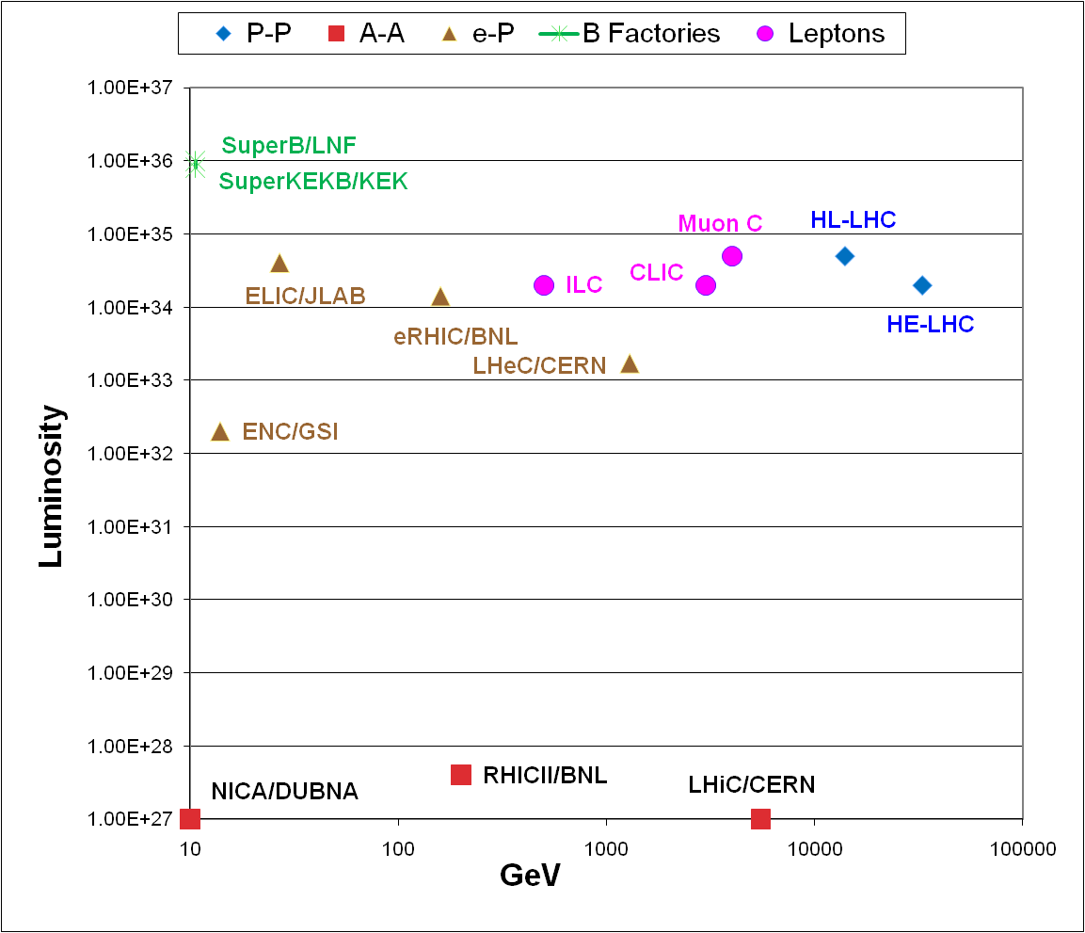
Possible Future HEP Facilities
B Factories
Protons
Leptons
E-/Hadrons
From J.P.Delahaye
Ions

Slide 36
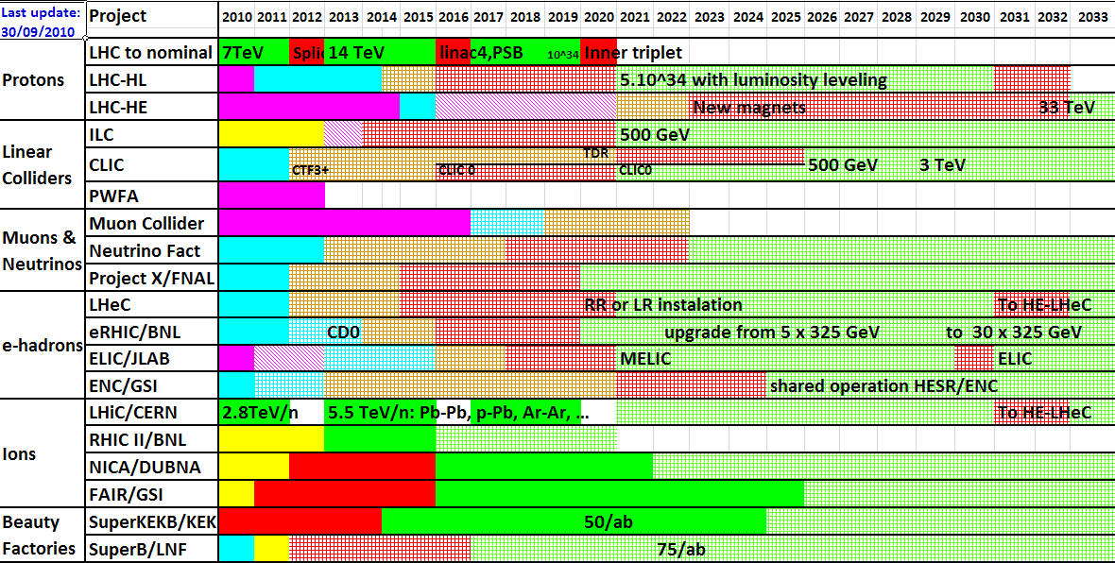
Tentative schedule new projects
European Strategy
For Particle Physics
Future facility specif. from LHC Physics?
Today
SCTF?
LHC = 1 fb⁻¹
66 fb⁻¹
336 fb⁻¹
3070 fb⁻¹

Slide 37
Conceptual Design of the Detector
The detector should feature:
Extremely high p_{t} and energy resolution for charged particles and photons;
Very good PID system. K/π separation higher than 3σ (for D);
Robust μ/π separation up to 1.2 GeV/c (for τ→μγ)
DAQ 300-400 kHz, 30kB/event
Unique trigger
10 Gbit optical links will be used to transmit the data

Slide 38
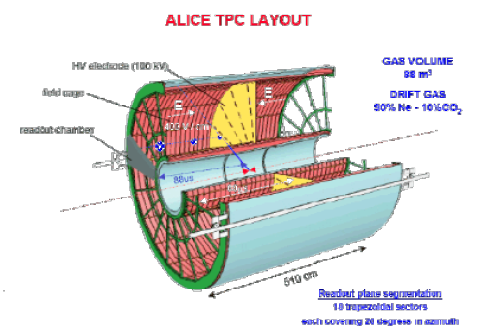
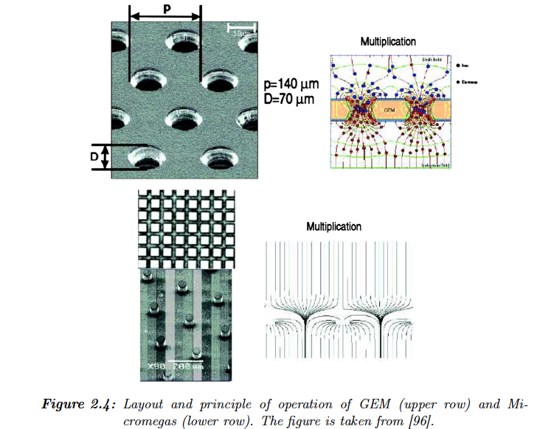
TPC+MPGD(GEM,Micomegas as readout)
Position measurement--p_{t}
dE/dx--PID
Handle High rates to about
200 MHz/cm²

Slide 39
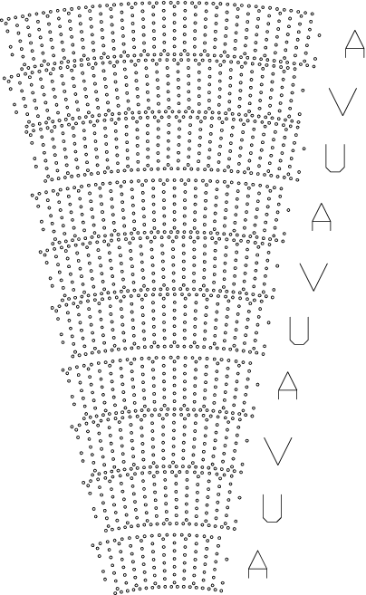
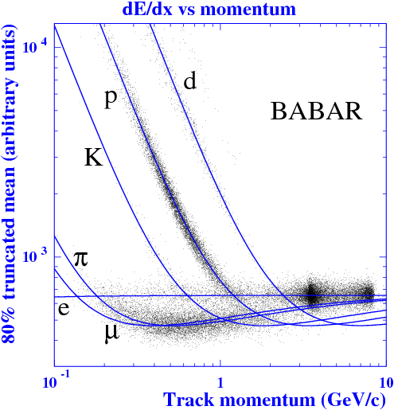
Drift Chamber
Based on the BABAR drift chamber
Arrangement of drift chamber wires. One sixteenth sector of the full chamber is shown, with axial (A) and small-angle stereo (U and V) superlayers indicated.

Slide 41
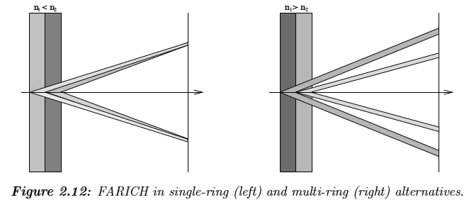
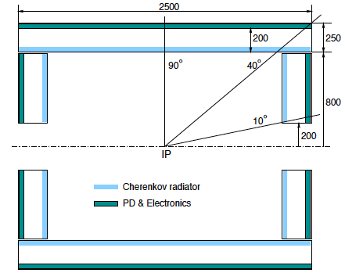
Focusing Aerogel Imaging Cherenkov Counter
4 π solid angle and identify
muons and hadrons with
momenta up to ~2 GeV/c.
Large number of channels and their high density will require a development of dedicated
front-end electronics based on ASICs

Slide 42
Electromagnetic calorimeter
Detection of e/γ
Measure of E and position in the energy range from 1 MeV to 2 GeV
Separation of electrons and hadrons
Neutral trigger
Scintillation crystals CsI(Tl)
Best reached: σ_{E}/E ~ 1.8% at 1 GeV and about 3% at 100 MeV.

Slide 43
Muon System
Nine layers of coordinate detectors in the barrel and eight layers at the endcap.
Streamer tube, or RPC?

Slide 44
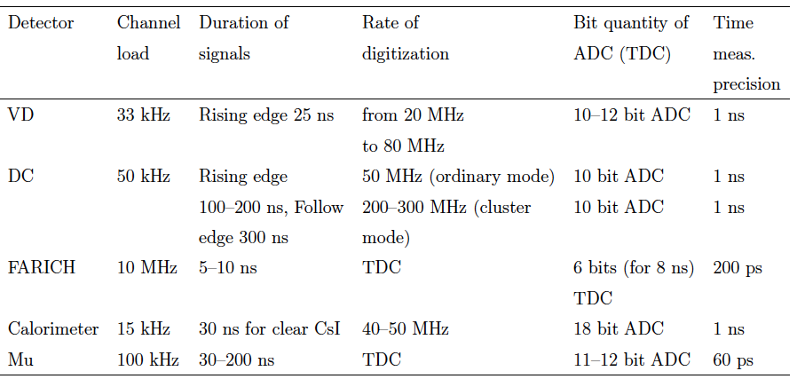
Sub-system Electronics

Slide 45
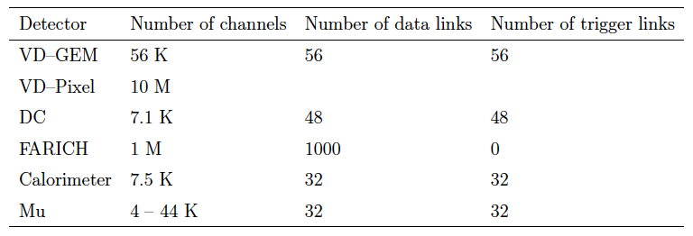
Number of Read Out Channels
10⁷

Slide 46
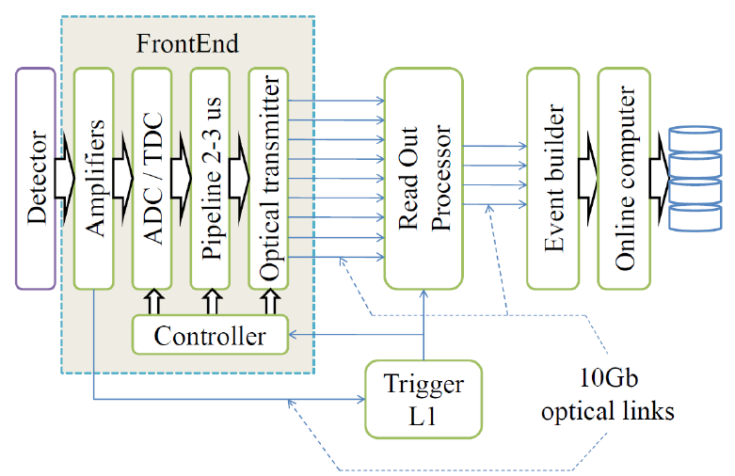
Block Diagram of Electronics

Slide 47
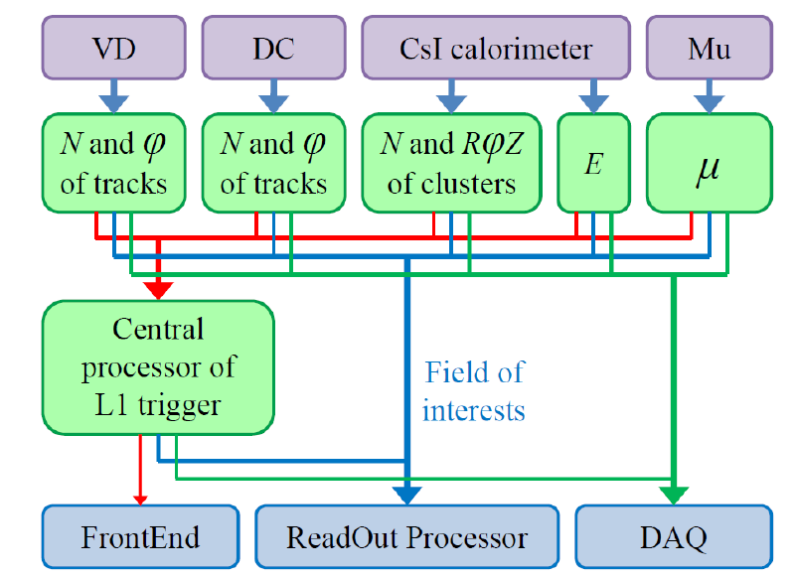
Level One Trigger

Slide 48
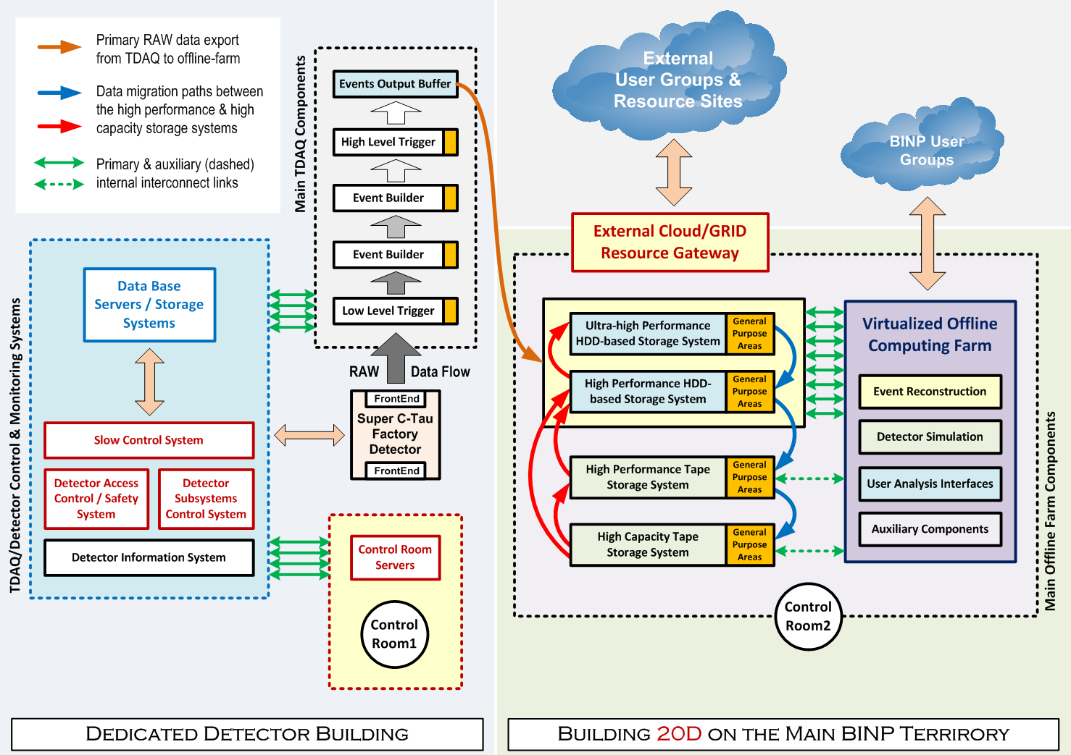
TDAQ and offline data processing systems

Slide 49
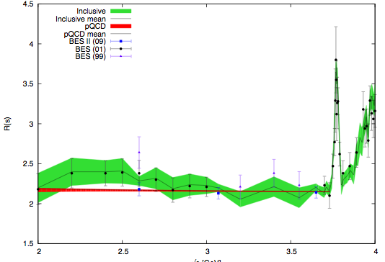
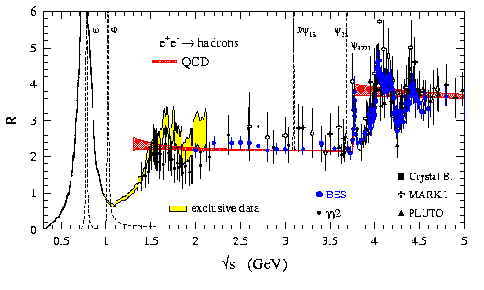
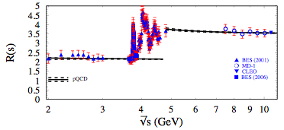
R(pQCD) and R(BES)
D. Michel
Thomas Teubner, 2009
pQCD calculation agree
well with BES data
Slight deviate in 2.2-2.5
GeV
H. Kuhn, 2009

Slide 50
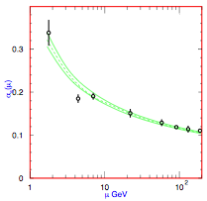
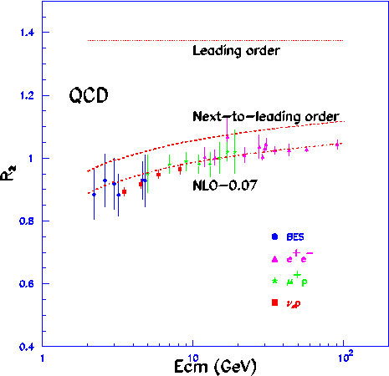
α_{s} and R₂
BEPC
Blue:BES Preliminary
PDG08: α_{s}(M_{Z})=0.1170±0.0012
BESII √s=2.60,3.07, 3.65GeV
α_{s}(M_{Z})=0.117^{+0.012} ₋₀₀₁₇

Slide 51
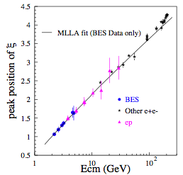
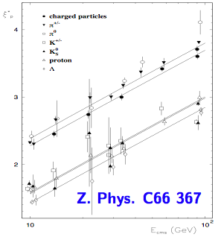
MLLA/LPHD Predictions
BEPCII
BESII R scan data: PRD69 (2004) 072001 for inclusive charged particle.
Consistant with high energy ep data at 5% level
Pretty large uncertainty
No exclusive data yet
BESIII can contribute

Slide 52
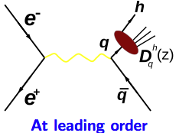
Fragmentation Function
Fragmentation function D^{h}_{q}(z): probability that hadron h is found in the debris of a parton (quark/gluon) carrying a fraction z = 2E_{h}/√s of parton’s energy.
LO: dσ(e⁺e⁻ → h+X)/dz=∑_{q} σ(e + e− → qq)(D^{h}_{q}(z) + D^{h}_{q}(z))
No Good data at √s < 10 GeV
DASP: π± at 3.6GeV; average stat. uncertainty 18%
DASP: k± at 3.6GeV; average stat. uncertainty 55%

Slide 53
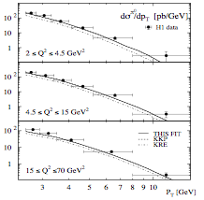
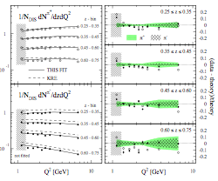
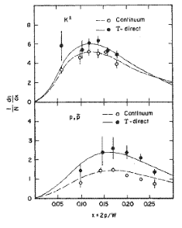
Frangmenation Function
ep collision, H1 data
Fix target experiment
HEMERS
CLEO
BEPCII region
BESIII can privide e⁺e⁻ data in 2-5 GeV

Slide 54
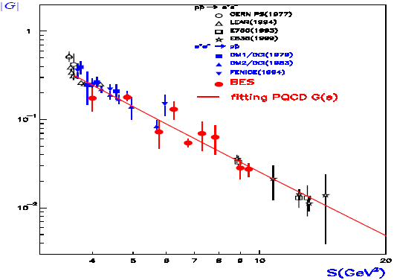
Form Factor: pp
QCD predict

Slide 58
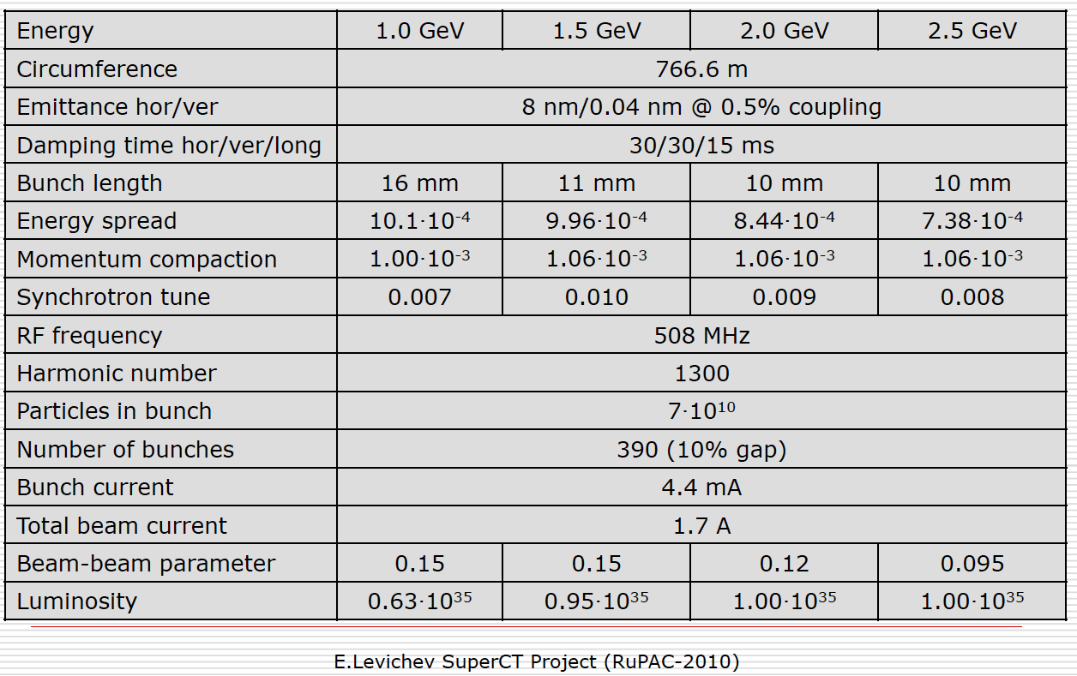
Parameters

Slide 59
R and QCD
Almost asymptotic for u-, d-, and s quarks in 3-6 GeV . No resonances made of light quarks here. But for the c quark the resonance region starts just in this energy range. Only after 5 GeV the cross section of the process e⁺e⁻ → cc starts reaching asymptotics.
A energy region that bridges pQCD and non-pQCD

